Slide 1



KS3 Mathematics
S8 Volume
Notes:
The aim of this unit is to teach pupils to:
Deduce and use formulae to calculate lengths, perimeters, areas and volumes in 2-D and 3-D shapes
Material in this unit is linked to the Key Stage 3 Framework supplement of examples pp 234-241.

Slide 2
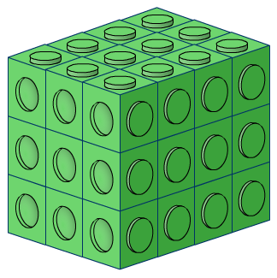


Making cuboids
The following cuboid is made out of interlocking cubes.
How many cubes does it contain?

Slide 3
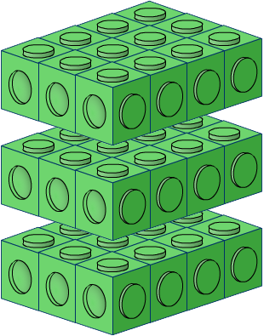
Making cuboids
We can work this out by dividing the cuboid into layers.
The number of cubes in each layer can be found by multiplying the number of cubes along the length by the number of cubes along the width.
3 × 4 = 12 cubes in each layer
There are three layers altogether so the total number of cubes in the cuboid = 3 × 12 = 36 cubes

Slide 4
Making cuboids
The amount of space that a three-dimensional object takes up is called its volume.
Volume is measured in cubic units.
For example, we can use mm³, cm³, m³ or km³.
The ³ tells us that there are three dimensions, length, width and height.
Liquid volume or capacity is measured in ml, l, pints or gallons.
Notes:
Link:
S7 Measures – units of volume and capacity.

Slide 5
Volume of a cuboid
We can find the volume of a cuboid by multiplying the area of the base by the height.
The area of the base
= length × width
So,
height, h
Volume of a cuboid
= length × width × height
= lwh
length, l
width, w

Slide 6
Volume of a cuboid
What is the volume of this cuboid?
Volume of cuboid
= length × width × height
5 cm
= 13 × 8 × 5
8 cm
13 cm
= 520 cm³

Slide 7
Volume and displacement
By dropping cubes and cuboids into a measuring cylinder half filled with water we can see the connection between the volume of the shape and the volume of the water displaced.
1 ml of water has a volume of 1 cm³
For example, if an object is dropped into a measuring cylinder and displaces 5 ml of water then the volume of the object is 5 cm³.
What is the volume of 1 litre of water?
1 litre of water has a volume of 1000 cm³.
Notes:
Ask pupils to give the dimensions of a cube that would hold 1 litre of water. This would be a 10 cm by 10 cm by 10 cm cube.
Ask pupils how many litres of water we could fit into a metre cube. (1000 litres.)
A litre of water has a weight of 1 kg. A metre cube would therefore hold 1 tonne of water!
Link:
S7 Measures – units of volume and capacity.

Slide 8
Volume of a prism made from cuboids
What is the volume of this L-shaped prism?
3 cm
We can think of the shape as two cuboids joined together.
3 cm
4 cm
Volume of the green cuboid
= 6 × 3 × 3 = 54 cm³
6 cm
Volume of the blue cuboid
= 3 × 2 × 2 = 12 cm³
Total volume
5 cm
= 54 + 12 = 66 cm³
Notes:
Compare this with slide 50, which finds the surface area of the same shape.

Slide 9
Volume of a prism
Remember, a prism is a 3-D shape with the same cross-section throughout its length.
3 cm
We can think of this prism as lots of L-shaped surfaces running along the length of the shape.
Volume of a prism
= area of cross-section × length
If the cross-section has an area of 22 cm² and the length is 3 cm,
Volume of L-shaped prism =
22 × 3 =
66 cm³

Slide 10
Volume of a prism
What is the volume of this triangular prism?
7.2 cm
4 cm
5 cm
Area of cross-section = ½ × 5 × 4 =
10 cm²
Volume of prism = 10 × 7.2 =
72 cm³

Slide 11
Volume of a prism
What is the volume of this prism?
12 m
4 m
7 m
3 m
5 m
Area of cross-section = 7 × 12 – 4 × 3 =
84 – 12 =
72 m²
Volume of prism = 5 × 72 =
360 m³

