Slide 1

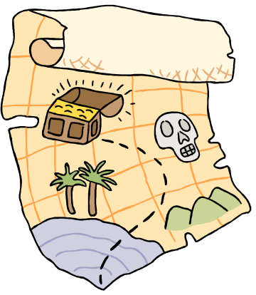
Treasure Hunt

Slide 2
Instructions
Start at (0,0)
Translate by 1 in the X Direction and –3 in the Y direction
Reflect in the line y=x
Rotate by 90º clockwise about the point (-1,1)
What point is the treasure buried at?

Slide 3
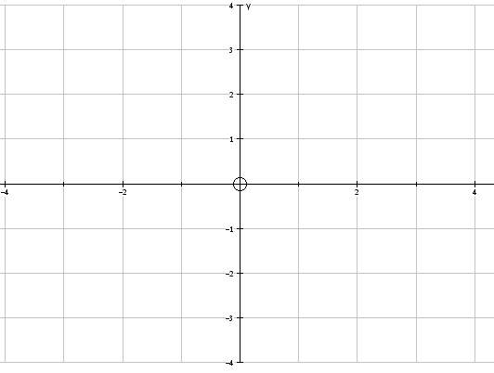
1) Start at (0,0)

Slide 4
2) Translate by 1 in the X Direction and –3 in the Y direction

Slide 5
3) Reflect in the line y=x

Slide 6
4) Rotate by 90º clockwise about the point (-1,1)

Slide 7

5) The treasure is buried at ( -1,3)

