Slide 1



KS3 Mathematics
S5 Enlargement
Notes:
The aim of this unit is to teach pupils to:
Understand and use the language and notation associated with translations
Recognise and visualise transformations of 2-D shapes
Use and interpret maps and scale drawings
Material in this unit is linked to the Key Stage 3 Framework supplement of examples pp 203, 205, 212-217.

Slide 2
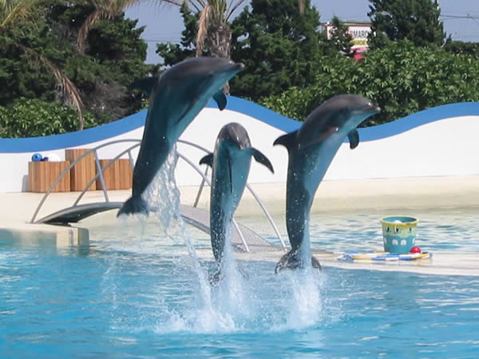


Find the missing lengths
The second photograph is an enlargement of the first.
What is the length of the missing side?
10 cm
4 cm
?
3 cm
3 cm
7.5 cm
Notes:
Before attempting the missing lengths exercise, it may be useful to revise work on fractions, decimals, ratio and proportion.
Establish that for the second picture to be an enlargement of the first, the ratio of length to width must be the same in both photos.
Ask pupils to suggest methods for finding the missing length, and discuss their suggestions.
For example, we can scale from the length of the first picture to the length of the second picture by multiplying by 2.5. Using this scale factor to multiply the width of the first picture gives the width of the enlarged picture: 2.5 × 3 cm = 7.5 cm.
Alternatively, to scale from the length to the width in the first picture we multiply by ¾. Therefore, using the same scale factor the enlarged picture has a width of 10 cm × 0.75 = 7.5 cm.
Click to reveal the answer.
Link:
N8 Ratio and proportion – scale factors.

Slide 3
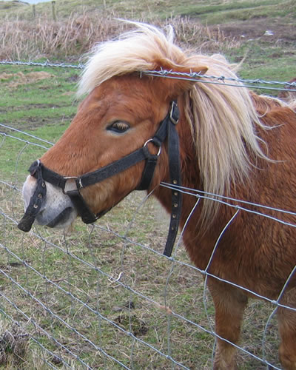
Find the missing lengths
The second photograph is an enlargement of the first.
What is the length of the missing side?
10 cm
4 cm
?
5 cm
12.5 cm
Notes:
Discuss methods of finding the missing length. To scale from 5 to 12.5 we multiply by 2.5. To find the missing length we can therefore divide 10 cm by 2.5 to get 4 cm.
Discuss alternative reasoning and methods. For example, we could also argue that in the enlargement the width is ¹/₅ (or 20%) less then the height. ¹/₅ less than 5 cm is 4 cm. Pupils need to be careful here: ¹/₅ less than the height is not the same as ¹/₅ of the height.
Click to reveal the answer.
Link:
N8 Ratio and proportion – scale factors.

Slide 4

Find the missing lengths
The second picture is an enlargement of the first picture.
What are the missing lengths?
11.2 cm
5.6 cm
6.7 cm
?
6.7 cm
13.4 cm
2.9 cm
5.8 cm
?
5.8 cm
Notes:
Pupils should notice that the second picture is twice the size of the first picture (because 11.2 cm is double 5.6 cm) and use this to find the missing lengths.
Link:
N8 Ratio and proportion – scale factors.

Slide 5
Find the missing lengths
The second shape is an enlargement of the first shape.
What are the missing lengths?
6 cm
4 cm
?
4 cm
4.5 cm
4.5 cm
?
3 cm
6 cm
9 cm
5 cm
?
5 cm
7.5 cm
Notes:
The second shape is 1¹/₂ times bigger than the first shape (because 9 cm is 1¹/₂ × 6 cm).
Multiplying the lengths in the first shape by 1¹/₂ will give the lengths in the second shape, whereas dividing the lengths in the second shape by 1¹/₂ (or multiplying by ²/₃) will give the lengths in the first shape.
Link:
N8 Ratio and proportion – scale factors.

Slide 6
Find the missing lengths
The second cuboid is an enlargement of the first.
What are the missing lengths?
10.5 cm
3.5 cm
?
3.5
1.2 cm
1.8 cm
3.6
3.6 cm
?
5.4 cm
Notes:
Pupils should notice that the lengths in the second cuboid are three times the lengths in the first cuboid (5.4 cm is 3 × 1.8 cm) and use this to find the missing lengths.
Ask pupils if the volume of the second cuboid is three times the volume of the first cuboid. (No, the volume of the first cuboid is 7.56 cm³ and the volume of the second cuboid is 204.12 cm³.) Allow pupils to use calculators to verify that the volume is, in fact, 27 times more (which is 3³ times more).
If there is time, pupils could investigate the relationship between the enlargement of the lengths and the enlargement of the volume for other cuboids or, in two dimensions, the relationship between the enlargement of the lengths and the enlargement of the area for rectangles.
Link:
N8 Ratio and proportion – scale factors.
S8 Perimeter, area and volume – area and volume.

Slide 7
Enlargement
A’
A
Shape A’ is an enlargement of shape A.
The length of each side in shape A’ is 2 × the length of each side in shape A.
We say that shape A has been enlarged by scale factor 2.
Notes:
Stress the every side in the shape has to be two times bigger to enlarge the shape by a scale factor of 2.
Ask pupils to tell you the difference between the angles in the first shape (the object) and the angles in the second (the image).
Tell pupils that when we enlarge a shape the lengths change but the angles do not.
The original shape and its image are not congruent but they are similar (they are different sizes but are the same shape).

Slide 8
Enlargement
When a shape is enlarged the ratios of any of the lengths in the image to the corresponding lengths in the original shape (the object) are equal to the scale factor.
A’
A
4 cm
6 cm
6 cm
9 cm
B
B’
C
8 cm
12 cm
C’
A’B’
B’C’
A’C’
=
=
= the scale factor
AB
BC
AC
6
12
9
=
=
= 1.5
4
8
6
Notes:
Remind pupils that we can write ratios as fractions as well as using the ratio notation. The notation that we use depends on the context of the problem. AC : A’C’ is the same ratio as AC/A’C’, written in a different way.
The result means that the ratio of any two corresponding lengths in the object and the image can be used to find the scale factor.
Click through to show how to find the scale factor using the lengths in the diagram.

Slide 9
Congruence and similarity
Is the image of an object that has been enlarged congruent to the object?
Remember, if two shapes are congruent they are the same shape and size. Corresponding lengths and angles are equal.
In an enlarged shape the corresponding angles are the same but the lengths are different.
The image of an object that has been enlarged is not congruent to the object, but it is similar.
In maths, two shapes are called similar if their corresponding angles are equal. Corresponding sides are different lengths, but the ratio in lengths is the same for all the sides.
Notes:
Review the meaning of the term congruent and introduce the term similar.
Two shapes are called similar if they are the same shape but a different size.
Link:
S2 2-D shapes – congruence.

Slide 10
Find the scale factor
What is the scale factor for the following enlargements?
B’
B
Scale factor 3
Notes:
Count squares to deduce that the scale factor for the enlargement is 3.
Show that that the ratios of any of the corresponding lengths on the image and in the object are equal to the scale factor.

Slide 11
Find the scale factor
What is the scale factor for the following enlargements?
C’
C
Scale factor 2
Notes:
By counting squares deduce that the scale factor for the enlargement is 2.

Slide 12
Find the scale factor
What is the scale factor for the following enlargements?
D’
D
Scale factor 3.5
Notes:
Deduce that the scale factor for the enlargement is 3.5 by counting squares. Point out that it doesn’t matter which lengths we compare. They are all enlarged by the same scale factor.
For example, in the second shape it is difficult to determine the length of the sides. Instead we can compare the diagonals of the shapes. The size of the diagonal of the first shape is 2 units and the size of the diagonal of the second shape is 7 units. 7 ÷ 2 gives us the scale factor 3.5.

Slide 13
Find the scale factor
What is the scale factor for the following enlargements?
E
E’
Scale factor 0.5
Notes:
The lengths in the second shape are half the size of the lengths in the first shape and so the scale factor is 0.5 or ½. Point out that technically this is still called an enlargement even though the shape has been made smaller. Scale factor 1 doesn’t change the size; factors greater than 1 increase the size; and factors less than 1 make the shape smaller.

Slide 14
Using a centre of enlargement
To define an enlargement we must be given a scale factor and a centre of enlargement.
For example, enlarge triangle ABC by scale factor 2 from the centre of enlargement O:
A’
A
B’
B
C’
O
C
OA’
OB’
OC’
=
=
= 2
OA
OB
OC
Notes:
The scale factor tells us the size of the enlargement and the centre of enlargement tells us the position of the enlargement.
Here the scale factor is 2, so:
The distance from O to A’ is twice the distance from O to A.
The distance from O to B’ is twice the distance from O to B.
The distance from O to C’ is twice the distance from O to C.

Slide 15
Using a centre of enlargement
Enlarge parallelogram ABCD by a scale factor of 3 from the centre of enlargement O.
A’
D’
A
D
O
B
C
B’
C’
OA’
OB’
OC’
OD’
=
=
=
= 3
OA
OB
OC
OE
Notes:
The distance from O to A’ is three times the distance from O to A.
The distance from O to B’ is three times the distance from O to B.
The distance from O to C’ is three times the distance from O to C.
The distance from O to D’ is three times the distance from O to D.

Slide 16
Enlargement on a coordinate grid
y
The vertices of a triangle lie on the points A(2, 4), B(3, 1) and C(4, 3).
10
9
A’(4, 8)
8
7
C’(8, 6)
6
The triangle is enlarged by a scale factor of 2 with a centre of enlargement at the origin (0, 0).
5
A(2, 4)
4
C(4, 3)
3
2
B’(6, 2)
1
B(3, 1)
What do you notice about each point and its image?
0
1
2
3
4
5
6
7
8
9
10
x
Notes:
When the centre of enlargement is at the origin, the coordinates of each point in the image can be found by multiplying the coordinates of each point on the original shape by the scale factor.

Slide 17
Enlargement on a coordinate grid
y
The vertices of a triangle lie on the points A(2, 3), B(2, 1) and C(3, 3).
10
A(6, 9)
C’(9, 9)
9
8
7
6
The triangle is enlarged by a scale factor of 3 with a centre of enlargement at the origin (0, 0).
5
4
A(2, 3)
3
C(3, 3)
B’(6, 3)
2
1
B(2, 1)
What do you notice about each point and its image?
0
1
2
3
4
5
6
7
8
9
10
x
Notes:
Using the rule from the previous slide, ask pupils to predict the coordinates of the image before revealing them.

