Slide 1




KS4 Mathematics
S6 Symmetry

Slide 2

Reflection symmetry
If you can draw a line through a shape so that one half is the mirror image of the other then the shape has reflection or line symmetry.
The mirror line is called a line of symmetry.
one line of symmetry
four lines of symmetry
no lines of symmetry
Notes:
Some pupils may find it easier to visualize a line of symmetry if they visualize it as a fold line rather than a mirror line. Explain that if you fold along a line of symmetry the two sides should match up exactly.
The last example has rotational symmetry but not line symmetry.

Slide 3

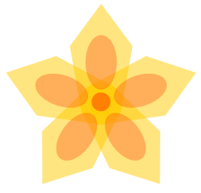

Reflection symmetry
How many lines of symmetry do the following designs have?
one line of symmetry
five lines of symmetry
three lines of symmetry

Slide 4
Rotational symmetry
An object has rotational symmetry if it fits exactly onto itself when it is turned about a point at its centre.
The order of rotational symmetry is the number of times the object fits onto itself during a 360° turn.
If the order of rotational symmetry is one, then the object has to be rotated through 360° before it fits onto itself again.
Only objects that have rotational symmetry of two or more are said to have rotational symmetry.
We can find the order of rotational symmetry using tracing paper.
Notes:
Discuss what it means for a shape to have rotational symmetry.

Slide 5

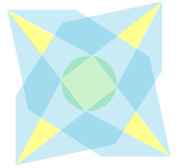
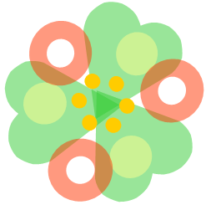
Rotational symmetry
What is the order of rotational symmetry for the following designs?
Rotational symmetry order 4
Rotational symmetry order 3
Rotational symmetry order 5
Notes:
Decide on the order of rotational symmetry before revealing the answer.

Slide 6
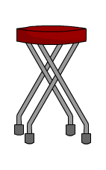
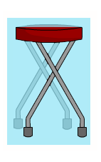
Reflection symmetry in 3-D shapes
Sometimes a 3-D shape can be divided into two symmetrical parts.
What is the shaded area called?
This shaded area is called a plane of symmetry.

Slide 7
Reflection symmetry in 3-D shapes
How many planes of symmetry does a cube have?
We can divide the cube into two symmetrical parts here.
Notes:
Challenge pupils to draw all the planes of symmetry for a cube on isometric paper. There are nine altogether.

Slide 8
Reflection symmetry in 3-D shapes
We can draw the other eight planes of symmetry for a cube, as follows:
Notes:
Reveal the images on this slide to compare with the pupils solutions.
Point out that these images are shown from a different angle to the ones drawn on an isometric grid. The last plane of symmetry on the slide can only be shown as a line because of the angle chosen.

Slide 9
Reflection symmetry in 3-D shapes
How many planes of symmetry does a cuboid have?
A cuboid has three planes of symmetry.
Notes:
Ask pupils to draw the three planes of symmetry of a cuboid on squared or isometric paper.
Point out that each corner of the plane of symmetry will touch half-way along the corresponding edge of the cuboid.

Slide 10

Reflection symmetry in 3-D shapes
How many planes of symmetry do the following solids have?
A regular octahedron
A regular pentagonal prism
A sphere
Explain why any right prism will always have at least one plane of symmetry.
Notes:
Establish that a regular octahedron has 5 planes of symmetry, a regular pentagonal prism has 6 planes of symmetry and a sphere has an infinite number. Ask pupils to describe the position of each plane of symmetry.
A right prism is a prism whose opposite faces are parallel.

Slide 11
Rotational symmetry in 3-D shapes
Does a cube have rotational symmetry?
We can draw a line through the centre of the cube, here.
This line is called an axis of symmetry.
What is the order of rotational symmetry about this axis?
How many axes of symmetry does a cube have?
Notes:
Ask pupils to imagine turning the cube about the axis of symmetry. Ask them how many times the cube can be turned to fit the original shape before getting back to the starting position.
A cube has 13 axes of symmetry. These are demonstrated on the next slide.
There are 3 axes of symmetry that pass through the centre of two opposite faces. The order of rotational symmetry for these axes is 4.
There are 6 axes of symmetry that pass through the centre of two opposite edges. The order of rotational symmetry for these axes is 2.
There are 4 axes of symmetry that pass through two opposite vertices. The order of rotational symmetry for these axes is 3.

Slide 12
Rotational symmetry in 3-D shapes
How many axes of symmetry do each of the following shapes have?
An octahedron
A cuboid
A tetrahedron
What is the order of rotational symmetry about each axis?
Notes:
A cuboid has 3 axes of rotational symmetry. The order of rotational symmetry about each of these is 4.
A tetrahedron has 4 axes of rotational symmetry through each vertex and the opposite face. The order of rotational symmetry about each of these is 3. It also has 3 axes of rotational symmetry through each edge and the opposite edge. The order of rotational symmetry about each of these is 2.
If we imagine the octahedron as two square-based pyramids joined together at the base, the octahedron has 1 axis of rotational symmetry through the apex of the square-based pyramids. The order of rotational symmetry about this axis is 4.
Where the bases of the two square-based pyramids join together, it has 2 axes of rotational symmetry through each vertex and the opposite vertex and 2 axes of rotational symmetry through each edge and the opposite edge. The order of rotational symmetry about each of these is 2.

