Slide 1









Whiteboardmaths.com
7
2
1
5
© 2004 All rights reserved

Slide 2



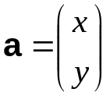



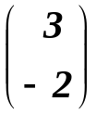
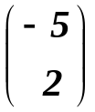

Introduction
Vectors
A vector quantity has both magnitude and direction.
Vectors can be used to represent physical quantities such as force, velocity and acceleration.
i = a and j = d
f
A displacement vector can be displayed on a co-ordinate grid as a directed line segment. Vectors are denoted by a bold letter and a column pair
a
i
b
c
d
3
e
The x and y components give the displacement as measured from tail to nose in the direction of the arrow - head.
1
g
h
j
Two vectors are equal if they have the same magnitude and direction.

Slide 3
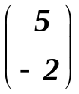
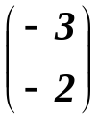

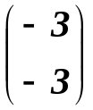
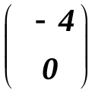
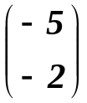

Vectors
A vector quantity has both magnitude and direction.
Vectors can be used to represent physical quantities such as force, velocity and acceleration.
f
Determine the column pair for each of the vectors shown on the grid.
a
b
c
d
e
h
g

Slide 4



Magnitude
Vectors
A vector quantity has both magnitude and direction.
Vectors can be used to represent physical quantities such as force, velocity and acceleration.
The magnitude (size) of a vector can be found using Pythagoras’ Theorem.
5
a
2
The negative sign in front of any component can be ignored when applying Pythagoras as (- x)² = x²

Slide 5







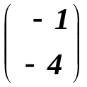
Vectors
A vector quantity has both magnitude and direction.
Vectors can be used to represent physical quantities such as force, velocity and acceleration.
Find the magnitude of vectors a and b
a
b

Slide 6
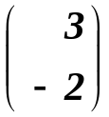
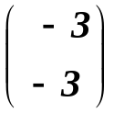






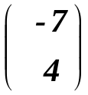
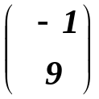






Vectors
The magnitude of a vector can be calculated without it being displayed on a grid.
Example: Calculate the magnitude of the vectors a = and b =
Questions: Calculate the magnitude of the vectors a = and b =

Slide 7



Adding
Vectors
Vectors that are represented by line segments can be added using the “nose - to - tail” method. Their column vectors can also be added to obtain this resultant vector.
a
b
b
To obtain the resultant vector a + b, the tail of b is joined to the nose of a.
a
a + b
a + b = + =
b + a
a
To obtain the resultant vector b + a, the tail of a is joined to the nose of b.
b
So adding “nose to tail” or “tail to nose” gives the same resultant vector.
b + a = + =

Slide 8


Vectors
Draw the resultant vector a + b
b
a + b = + =
a
b
a + b

Slide 9
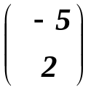
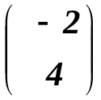
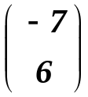
Vectors
Draw the resultant vector c + d
c + d = + =
d
c + d
c
d

Slide 10
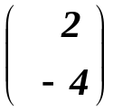
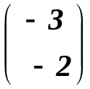
Vectors
Draw the resultant vector p + q
p
p + q = + =
q
p + q
q

Slide 11
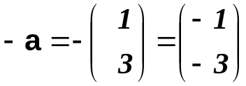
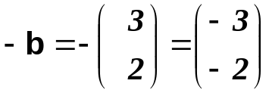
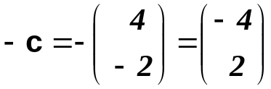
Negative sign
Vectors
A negative sign in front of a vector reverses its direction in the plane and changes the signs of the x and y components
a
b
-b
-a
-c
c

Slide 12
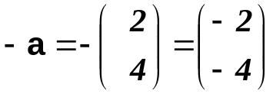
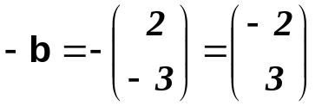
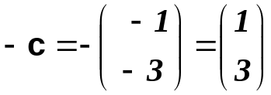
Vectors
Draw the negative vector for those shown on the grid and write down their new column pair.
-b
a
b
-c
-a
c

Slide 13

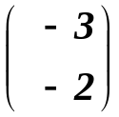
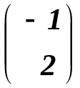
Vectors
Vectors can also be subtracted. The resultant vector p - q is obtained by drawing p + (-q)
- q
p
p - q
q
p - q = + =

Slide 14
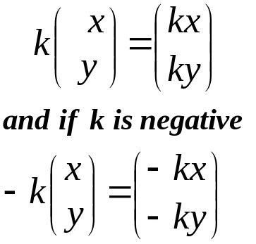





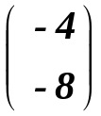
Scalar
Vectors
A scalar quantity has magnitude but not direction. Examples include volume, mass and temperature. Ordinary numbers are scalars.
If a vector p is represented by a line segment then multiplication by a scalar k, results in the vector kp. This new vector changes the magnitude of the original line segment by a factor k.
a
2a
b
3b
c
2a = 2 =
3b = 3 =
-4c
-4c = -4 =

Slide 15
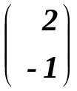
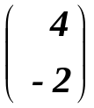

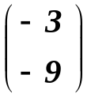
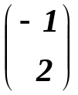
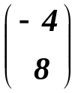
Vectors
A scalar quantity has magnitude but not direction. Examples include volume, mass and temperature. Ordinary numbers are scalars.
Draw the vectors:
2a, -3b and 4c anywhere on the grid and determine their new column form.
a
2a
b
2a = 2 =
4c
-3b
-3b = -3 =
4c = 4 =
c

Slide 16
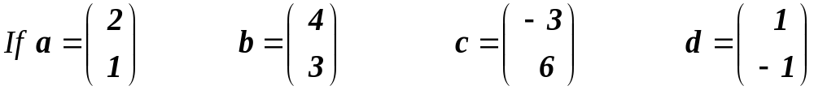
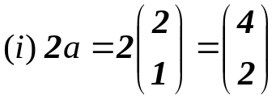
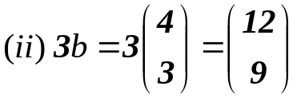
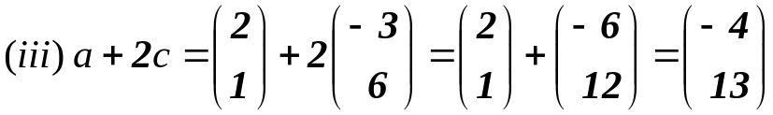
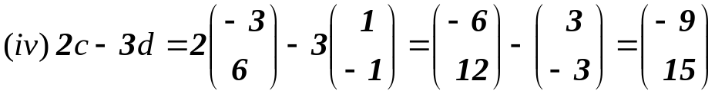
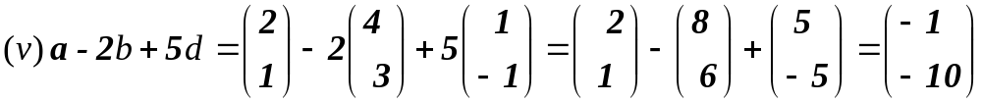
Linear Combinations
Linear Combinations of Vectors
Column vectors can be combined using the usual arithmetical operations to form new vectors. We will calculate some combinations below.
(i) 2a (ii) 3b (iii) a + 2c (iv) 2c - 3d (v) a - 2b + 5d

Slide 17
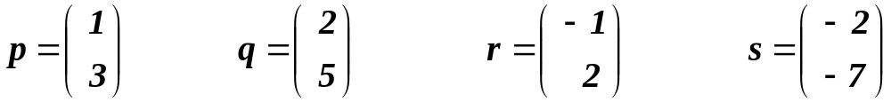
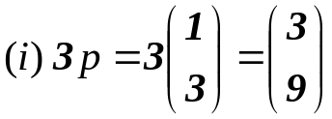
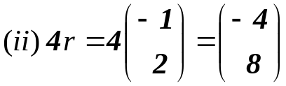
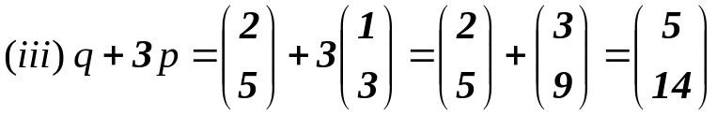
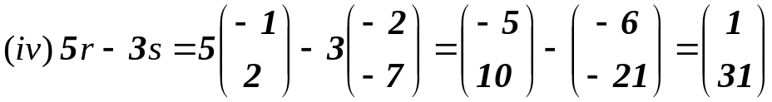
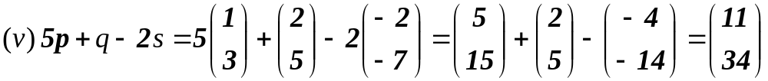
Linear Combinations of Vectors
If p, q, r and s are the column vectors shown below, then calculate the following:
(i) 3p (ii) 4r (iii) q + 3p (iv) 5r - 3s (v) 5p + q - 2s

Slide 18
Geometry
Vectors in Geometry
In geometry problems involving vectors, the vectors can be written using a pair of capital letters with an arrow above them.
For example in the diagram below:
→ → →
RS = a PQ = 2a SQ = b
→ → →
SR = - a QP = -2a QS = - b
Diagrams not accurately drawn
Going anti-clockwise around the diagram gives:
RP = a + b - 2a = b - a
P
2a
Q
→
b
R
S
a
→
→
→
→
This means that PQ = 2RS and similarly, RS = ½ PQ.
→
Also, the vector RP can be written in terms of a and b, by taking a route of known vectors from R to arrive at P.

Slide 19
The diagram below is a parallelogram ABCD. Write the following vectors in terms of p and q.
→
→
→
→
→
(i) DA (ii) CD (iii) DB (iv) AC (v) CA
A
p
B
Remember
Go via a route of known vectors
q
D
C
→
(i)
DA = q (opposite sides parallel and equal in length)
→
(ii)
CD = - p (opposite sides parallel/equal in length/opposite in direction)
→
(iii)
DB = q + p (going via A) or equivalently p + q (going via C)
→
(iv)
AC = p - q (going via B) or equivalently - q + p (going via D)
→
→
(v)
CA = - AC = - (p - q) = q - p
Diagrams not accurately drawn

Slide 20
The diagram below is a hexagon ABCDEF. Write the following vectors in terms of a and b.
→
→
→
→
→
(i) AC (ii) FA (iii) FD (iv) DC (v) AE
Remember
Go via a route of known vectors
→
(i) AC = a + b
a
B
A
→
(ii) FA =4a - b - a = 3a - b
b
→
4a
(iii) FD = b + 3a
F
C
→
(iv) DC = - 3a - b + 4a = a - b
→
→
→
(v) AE = AF + b = - FA + b
b
= - (3a - b) + b
= - 3a + b + b = 2b - 3a
E
D
Diagrams not accurately drawn
3a

Slide 21
The diagram below is a regular hexagon ABCDEF. Write the following vectors in terms of a and b.
→
→
→
→
→
(i) FC (ii) DA (iii) EB (iv) EA (v) FD
Remember
Go via a route of known vectors
→
Remember: Opposite sides of a regular hexagon are parallel
a
(i) FC = 2a
A
B
→
(ii) DA = - 2b
b
→
→
→
→
→
(iii) EB = EF + FO + OA + AB
F
O
= - b + a - b + a
C
= 2a - 2b = 2(a - b)
→
→
(iv) EA = EB - a
= 2(a - b) - a = a - 2b
E
D
→
(v) FD = b + a
Diagrams not accurately drawn

Slide 22
The diagram below shows a trapezium ABCD, with M as the mid-point of AB. Write the following vectors in terms of p and q.
→
→
→
→
→
(i) AD (ii) CA (iii) DB (iv) CM (v) MD
→
4p
M
B
(i) AD = 4p - q - p = 3p - q
A
→
(ii) CA = q - 4p
→
q
(iii) DB = p + q
→
(iv) CM = q - 2p
D
→
→
p
C
(v) MD = - 2p + AD
Remember
Go via a route of known vectors
= - 2p + 3p - q = p - q
Diagrams not accurately drawn

Slide 23
Vectors Showing Relationships
In triangle ABC, P is a point on AC such that CP:PA = 3:1.
Find BP in terms of m and n.
→
A
Remember
Go via a route of known vectors
→
CA = n + m
P
→
→
CP = ¾ CA = ¾ (n + m)
m
→
BP = - n + ¾ (n + m)
= -¼ n + ¾ m
B
= or ¼ (3m - n)
C
n
Diagrams not accurately drawn

Slide 24
Vectors Showing Relationships
In triangle ABC, P is a point on AC such that CP:PA = 2:1.
Show that BP = 2/3 m - 1/3 n
→
A
Remember
Go via a route of known vectors
→
CA = n + m
P
→
→
CP = 2/3 CA = 2/3 (n + m)
m
→
BP = - n + 2/3 (n + m)
= 2/3 m - 1/3 n
n
B
C
Diagrams not accurately drawn

Slide 25
Vectors Showing Relationships
In triangle XYZ, S is point on XZ such that XS = 2SZ and T is a point on ZY
such that YT = 2 TZ. Prove that ST is parallel to XY and 1/3 the length of XY.
→
→
→
→
→
→
X
→
XZ = a + b
→
→
→
a
XS = 2/3 (a + b)
(since XS = 2SZ)
S
Going clockwise from S to T
→
⇒ ST = -2/3 (a + b) + a + 2/3 b
→
→
(since YT = 2TZ)
→
Z
T
b
Y
⇒ ST = -2/3 a - 2/3 b + a + 2/3 b
→
⇒ ST = 1/3 a
→
→
Remember
Go via a route of known vectors
∴ ST is parallel to XY and 1/3 the length
Diagrams not accurately drawn

Slide 26
Vectors Showing Relationships
In triangle XYZ, S is point on XZ such that XS = 3SZ and T is a point on ZY
such that YT = 3 TZ. Prove that ST is parallel to XY and 1/4 the length of XY.
→
→
→
→
→
→
X
→
XZ = a + b
→
→
→
a
XS = 3/4 (a + b)
(since XS = 3SZ)
Going clockwise from S to T
→
S
⇒ ST = -3/4 (a + b) + a + 3/4 b
→
→
Y
(since YT = 3TZ)
→
Z
T
b
⇒ ST = -3/4 a - 3/4 b + a + 3/4 b
→
⇒ ST = 1/4 a
→
→
Remember
Go via a route of known vectors
∴ ST is parallel to XY and 1/4 the length
Diagrams not accurately drawn

Slide 27
Vectors Showing Relationships
The Mid-Point Theorem:
This well known theorem states that if a straight line is drawn between the mid-points of any two sides of a triangle, this line is parallel to the third side and ½ its length.
If S and T are the midpoints of XZ and XY respectively, prove the mid-point theorem.
X
→
Diagrams not accurately drawn
ST = ½ a + ½ b = ½ (a + b)
→
S
ZY = a + b
T
a
→
→
b
⇒ ST = ½ ZY QED
Z
Y
Remember
Go via a route of known vectors

Slide 28
Worksheets
b
a
c
d
p
q

Slide 29
a
b
a
b
c
c
a
a
b
b
c
c

Slide 30
The diagram below is a parallelogram ABCD. Write the following vectors in terms of p and q.
→
→
→
→
→
(i) DA (ii) CD (iii) DB (iv) AC (v) CA
A
p
B
Diagrams not accurately drawn
q
D
C

Slide 31
The diagram below is a hexagon ABCDEF. Write the following vectors in terms of a and b.
→
→
→
→
→
(i) AC (ii) FA (iii) FD (iv) DC (v) AE
a
B
Diagrams not accurately drawn
A
b
4a
F
C
b
E
D
3a

Slide 32
The diagram below is a regular hexagon ABCDEF. Write the following vectors in terms of a and b.
→
→
→
→
→
(i) FC (ii) DA (iii) EB (iv) EA (v) FD
Diagrams not accurately drawn
a
A
B
b
F
O
C
E
D

Slide 33
The diagram below shows a trapezium ABCD, with M as the mid-point of AB. Write the following vectors in terms of p and q.
→
→
→
→
→
(i) AD (ii) CA (iii) DB (iv) CM (v) MD
Diagrams not accurately drawn
4p
M
B
A
q
D
p
C

Slide 34
Vectors Showing Relationships
In triangle ABC, P is a point on AC such that CP:PA = 3:1.
Find BP in terms of m and n.
→
A
Diagrams not accurately drawn
P
m
n
B
C

Slide 35
Vectors Showing Relationships
In triangle ABC, P is a point on AC such that CP:PA = 2:1.
Show that BP = 2/3 m - 1/3 n
→
A
Diagrams not accurately drawn
P
m
n
B
C

Slide 36
Vectors Showing Relationships
In triangle XYZ, S is point on XZ such that XS = 2SZ and T is a point on ZY
such that YT = 2 TZ. Prove that ST is parallel to XY and 1/3 the length of XY.
→
→
→
→
→
→
X
Diagrams not accurately drawn
a
S
Z
T
b
Y

Slide 37
Vectors Showing Relationships
In triangle XYZ, S is point on XZ such that XS = 3SZ and T is a point on ZY
such that YT = 3 TZ. Prove that ST is parallel to XY and 1/4 the length of XY.
→
→
→
→
→
→
X
Diagrams not accurately drawn
a
S
Z
T
b
Y

Slide 38
Vectors Showing Relationships
The Mid-Point Theorem:
This well known theorem states that if a straight line is drawn between the mid-points of any two sides of a triangle, this line is parallel to the third side and ½ its length.
If S and T are the midpoints of XZ and XY respectively, prove the mid-point theorem.
X
Diagrams not accurately drawn
S
T
a
b
Z
Y

