Slide 1
Exploring and understanding React with Redux
BALAKRISHNA RAGALA

Slide 2
*** basic ***
Notes:
This meetup focused on educating the participants on the basics of ReactJS.

Slide 3
My impression
Though simple libs –
steep learning curve
too many things in eco system
Not clear and concise docs – mostly ends like a Inception movie ☺

Slide 4
Our Views/Routes
/What/is/React
/Why/React
/JSX
/Redux
/React/Redux
/NO/REACT/ROUTER
/NO/VIRTUALDOM

Slide 5
What is React
Just a view library (MVC)
One-way data flow
Component based
Reusable, Encapsulation
Virtual DOM

Slide 6
Why React
Components
Extremely efficient
Makes writing Javascript easier
Server side and client side rendering capabilities
https://www.syncano.io/blog/reactjs-reasons-why-part-1/

Slide 7
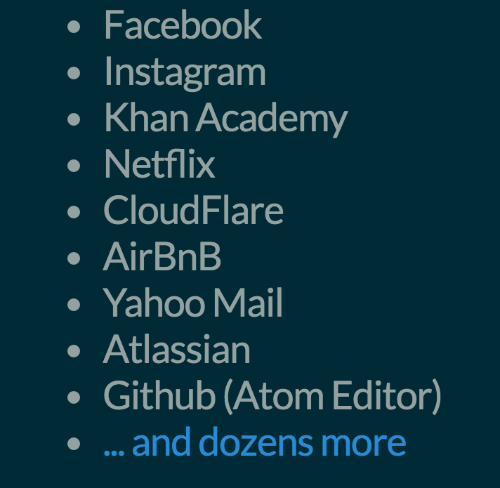
Who uses React

Slide 8
JSX
JSX is a JavaScript syntax extension that looks similar to XML.
It's more familiar for casual developers such as designers.
React JSX transforms from an XML-like syntax into native JavaScript
JSX lets you create JavaScript objects using HTML syntax
JS :
React.createElement('a', {href: 'https://facebook.github.io/react/'}, 'Hello!')
JSX :
<a href="https://facebook.github.io/react/">Hello!</a>
JSX is not required to use React
Notes:
React's JSX uses the upper vs. lower case convention to distinguish between local component classes and HTML tags.

Slide 9
Core Concepts
state
props
refs
propTypes

Slide 10
Thinking in react
https://facebook.github.io/react/docs/thinking-in-react.html
Notes:
SRP - a component should ideally only do one thing. If it ends up growing, it should be decomposed into smaller subcomponents.
displaying a JSON data model to a user, you'll find that if your model was built correctly, your UI (and therefore your component structure) will map nicely

Slide 11
Redux
Redux is a predictable state container for JavaScript apps
Redux is an architecture pattern and a library

Slide 12
redux
Redux is a framework that controls states in a JavaScript app

Slide 13
Redux dissection
Store - manages the states
Action - command to change a state
Reducer - returns a new state

Slide 14
Store
A store is simply a state container.
A place where your state lives and where actions are dispatched and handled.
Redux recommends to only have one store

Slide 15
Action
Actions are objects that describe how we want to mutate our state
{
type : ADD_USER,
payload : {
email : bar@foo.com,
password : xxxxxx,
username : foobar
}
}

Slide 16
Reducer
Reducers are action handlers that act upon dispatched actions in your store and reduce these actions into state changes.

Slide 17
React redux app
To-do application – apologize if this seems to very basic app but the right example that helps in understanding react redux integration

Slide 18
There are many steps for a simple Todo App. The theory is that, earlier frameworks made building Todo apps simple but real apps hard. But React Redux make building Todo apps hard but real productions apps simple.
https://medium.com/@rajaraodv/step-by-step-guide-to-building-react-redux-apps-using-mocks-48ca0f47f9a#.j6u8zw53m

Slide 19
The plan
State
{
todo: {
items: [
{
message: "Finish Redux blog post...",
completed: false
}
]
}
}

Slide 20
The plan
action
function addTodo(message) {
return {
type: 'ADD_TODO',
message: message,
completed: false
};
}
Notes:
Type should be unique
Convention is to format the type in uppercase and with underscore the as a word separator

Slide 21
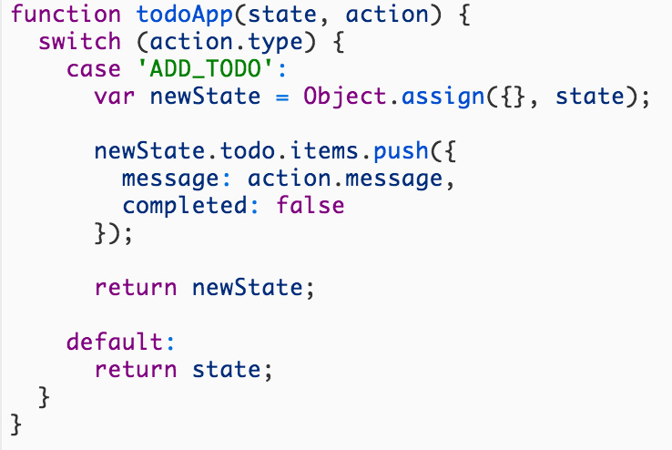
The plan
reducer

Slide 22
Talk on connect (redux – react)
Connects a React component to a Redux store.
It does not modify the component class passed to it. Instead, it returns a new, connected component class, for you to use.

Slide 23
Some useful links
https://github.com/facebookincubator/create-react-app
https://github.com/reactjs/react-redux/tree/master/docs
https://quickleft.com/blog/redux-plain-english-workflow/
https://stormpath.com/blog/build-a-redux-powered-react-application
https://github.com/reactjs/redux/tree/master/examples/todomvc

