Slide 1

DEBUGGING
B.JAIPAL
CSE-III YEAR
21SS1A0506

Slide 2

What is DEBUGGING ?
Process of finding and resolving of defects.
Prevent correct operation of a system.
Bugs are found in testing phase.

Slide 3

Opps !!
Mistakes made by programmer’s.
Also called ( better way):
1.Error
2.Defects.
3.Faults.
GDB- running programs.
GDB will be show:
The line the programming has stopped.
Short description about cause of error.

Slide 4

Basic steps:
Recognize that a bug exist.
Isolate the source of bug.
Identify the cause of the bug.
Determine of fix for the bug.
Apply the fix and test it.

Slide 5
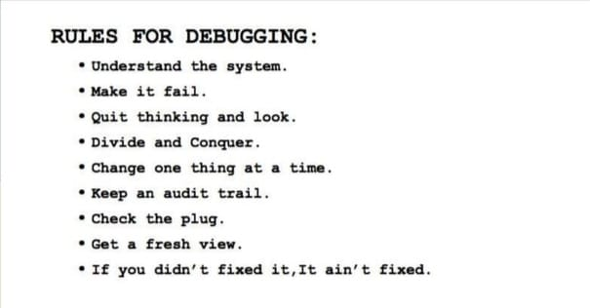
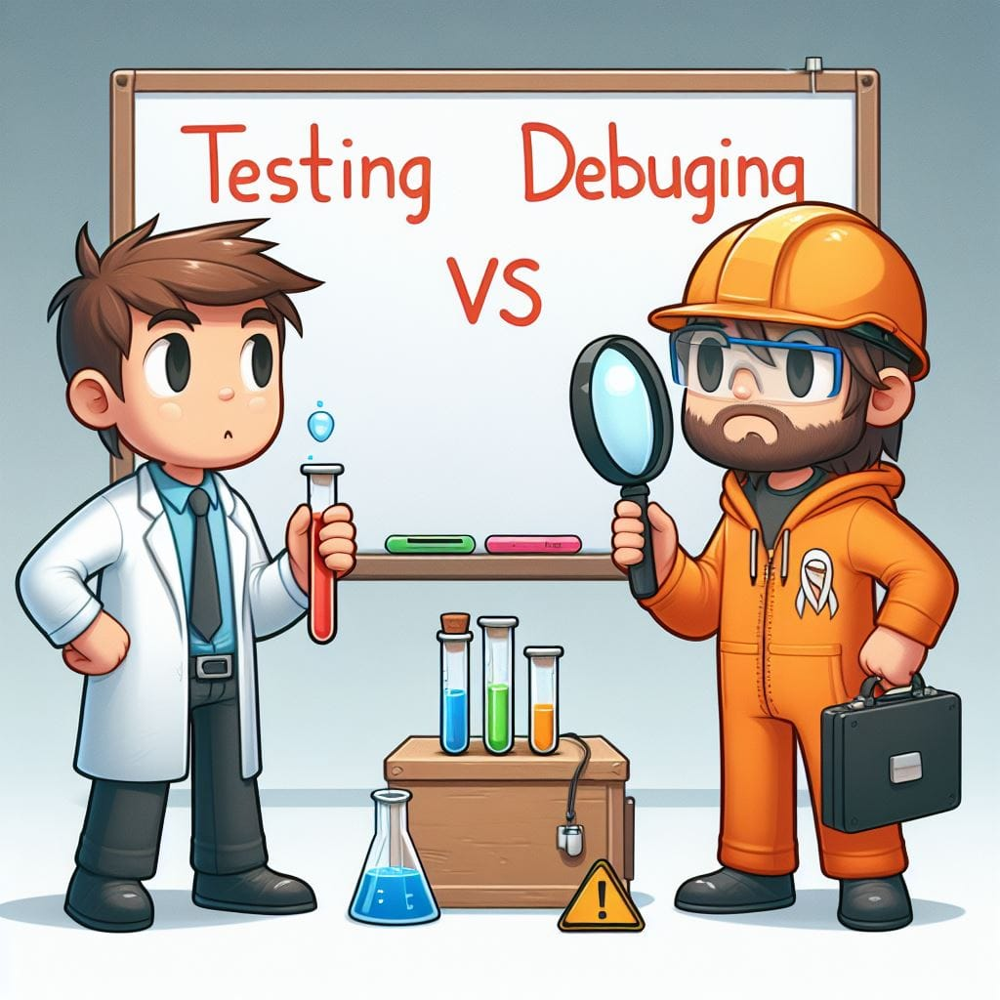
TESTINGS V/S DEBUGGING

Slide 6


