Slide 1


DATA DRIVEN. SAFER TOMORROW.
ROAD SAFETY ANALYSIS
DASHBOARD — PROJECT DATASET OVERVIEW
Analysis of the Indian Road Accidents dataset used to build a six-page Power BI dashboard. This presentation walks through the dataset, cleaning steps, dashboard pages, chart choices, and the insights each page reveals.
Dataset: indian_road_accidents_dataset.csv
Prepared by Sourav | B.Tech CSE, Data Analytics Portfolio

Slide 2




PROJECT OVERVIEW
Executive Summary
What this project set out to do, and the scale of data behind it.
2,000
18
32
2023-24
6
Accident Records
Data Columns
States Covered
Years Spanned
Dashboard Pages
Project Objective
Built as a teacher-assigned road-safety analytics project, this dashboard turns raw accident records into a decision-ready tool: identifying where accidents cluster, what causes them, who is most affected, and when they spike — so road-safety measures can be targeted rather than generic.
Tool
Power BI Desktop + Power Query
Modeling
Custom DAX measures across 14 sections
Structure
6 report pages, drill-through detail view
Interactivity
Synced slicers on every page
Indian Road Accidents Dataset
2

Slide 3





DESIGN PRINCIPLES
Choosing the Right Chart
Every chart in this dashboard was picked to answer one kind of question well.
Trend over time
Compare categories
LINE / AREA CHART
BAR / COLUMN CHART
Connects points across months so rising or falling accident counts are visible at a glance.
Puts values side by side so causes, states, or vehicle types can be ranked and compared.
Part-to-whole split
Relationship between measures
PIE / DONUT CHART
SCATTER CHART
Shows how total accidents break into shares — severity, weather, or alcohol involvement.
Plots speed limit against accident count to reveal correlation and outlier zones.
Geographic pattern
Exact values / record detail
FILLED MAP / TOP-N BARS
TABLE / DRILL-THROUGH
Anchors accident volume to states and districts so hotspots are immediately clear.
Delivers precise, row-level figures when an exact record matters more than a shape.
Indian Road Accidents Dataset
3

Slide 4






THE DATA
Understanding the Dataset
2,000 accident records across 18 columns describe crashes on Indian roads — enough breadth to support every chart in this dashboard.
Record identity
Geography
Accident_ID, Date, Year, Quarter, Month, Day
State, District, Highway_Type
A unique ID plus a full calendar breakdown makes every trend, seasonal, and weekday view possible.
32 states and 218 districts give the dataset enough spatial detail to rank hotspots and map demand.
Conditions
Driver profile
Weather, Visibility, Road_Condition, Rainfall_mm, Temperature
Driver_Age, Driver_Gender, Driver_Experience_Years
Continuous and categorical environment fields describe the setting of each crash — clear vs. foggy, dry vs. wet.
Demographic fields describe who was behind the wheel, from teen learners to decades-experienced drivers.
Safety equipment
Outcome & cause
Helmet_Used, Seatbelt_Used, Alcohol_Involvement
Severity, Accident_Cause, Vehicle_Type, Casualties
Compliance fields capture whether basic safety measures were in place at the time of the crash.
The dependent variables — what happened, why, in what vehicle, and how serious the result was.
Indian Road Accidents Dataset
4

Slide 5
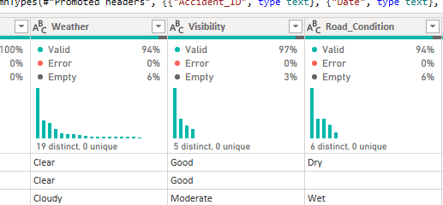
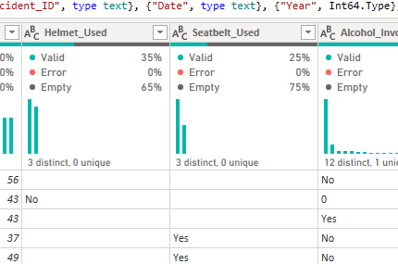
POWER QUERY
Data Cleaning & Preparation — Part 1
Column quality checks on conditions and safety-equipment fields, before any chart was built.
Weather, Visibility & Road_Condition
Helmet_Used, Seatbelt_Used & Alcohol_Involvement
Weather (94% valid, 19 distinct values) and Road_Condition (94% valid, 6 distinct) each carry a small ~6% empty share — flagged for imputation, not deletion.
Visibility is the cleanest of the three at 97% valid across just 5 distinct categories (Good, Moderate, Poor, etc.).
Helmet_Used and Seatbelt_Used are mostly empty (65% and 75% empty) — likely “not applicable” for non-two-wheeler / non-front-seat records rather than true missing data.
Alcohol_Involvement shows 12 distinct values for what should be a Yes/No field, including a stray “0” entry — standardized during cleaning.
Indian Road Accidents Dataset
5

Slide 6
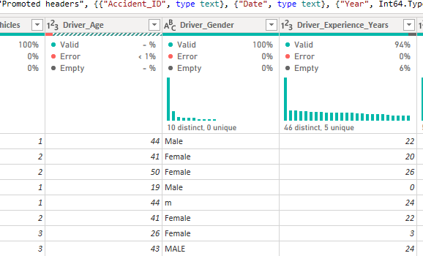
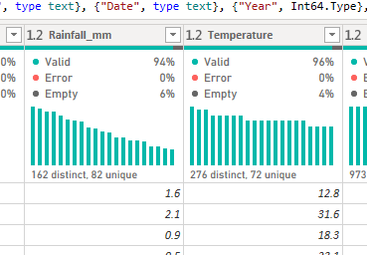
POWER QUERY
Data Cleaning & Preparation — Part 2
Column quality checks on driver demographics and continuous weather measures.
Driver_Age, Driver_Gender & Driver_Experience_Years
Rainfall_mm & Temperature
Driver_Age is 100% valid, but Driver_Gender shows 10 distinct values for a 3-category field — casing inconsistencies like “Male”, “MALE” and “m” all needed standardizing to one label.
Driver_Experience_Years is 94% valid with 46 distinct values across a 6% empty share — cleaned with median imputation via List.Median() rather than dropping rows.
Rainfall_mm (94% valid, 162 distinct) and Temperature (96% valid, 276 distinct) are both continuous fields with a small empty share, imputed the same way to preserve distribution shape.
Indian Road Accidents Dataset
6

Slide 7



WORKFLOW
Working in Power BI Desktop
From raw CSV to a published dashboard — the workflow behind every page in this report.
Get Data
Power Query
Data Modeling
IMPORT THE CSV
TRANSFORM & SHAPE
CALCULATED COLUMNS & DAX MEASURES
Connected directly to indian_road_accidents_dataset.csv and loaded it into Power BI Desktop as the source table.
Checked data types, standardized categories, and imputed missing values (e.g. List.Median() for numeric gaps).
Built a 14-section DAX measures file — totals, rates, and KPIs layered on top of the flat table.
Visuals
Slicers & interactivity
Publish & share
BAR, LINE, DONUT, SCATTER, TABLE
YEAR, STATE, WEATHER, CAUSE, ROAD TYPE
POWER BI SERVICE
Placed one chart type per guiding question across six report pages, plus a drill-through detail view.
Added synced slicers so every visual on a page filters together the moment a user picks one value.
Published the report so the dashboard can be viewed, refreshed, and shared online.
Indian Road Accidents Dataset
7

Slide 8
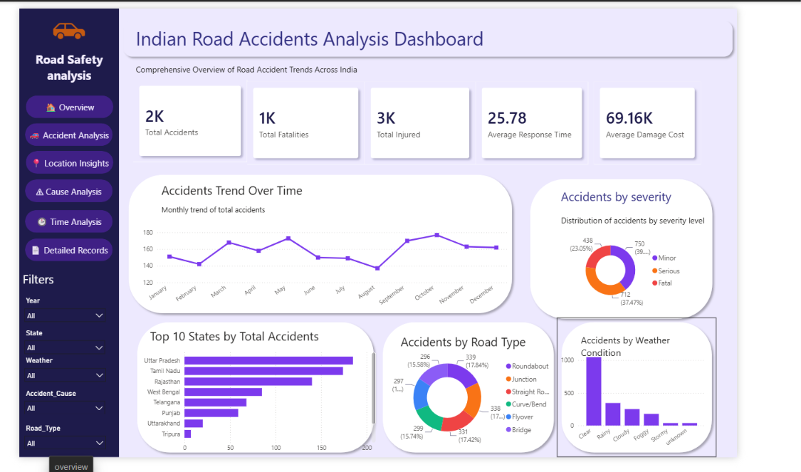
1
Overview
What is the overall scale and severity picture of road accidents across India?
KEY INSIGHTS
2,000 total accidents on record, with roughly 1,000 fatalities and 3,000 injured — an average response time of 25.78 minutes.
Average damage cost per incident runs about ₹69.16K, underlining the economic weight of road accidents.
Severity splits fairly evenly across Minor, Serious and Fatal, with Serious the single largest share at roughly 37%.
Uttar Pradesh and Tamil Nadu lead the Top 10 states; Clear weather accounts for the large majority of recorded accidents — a function of exposure, not necessarily risk.
Live view: Page 1 of 6 — Overview
8

Slide 9

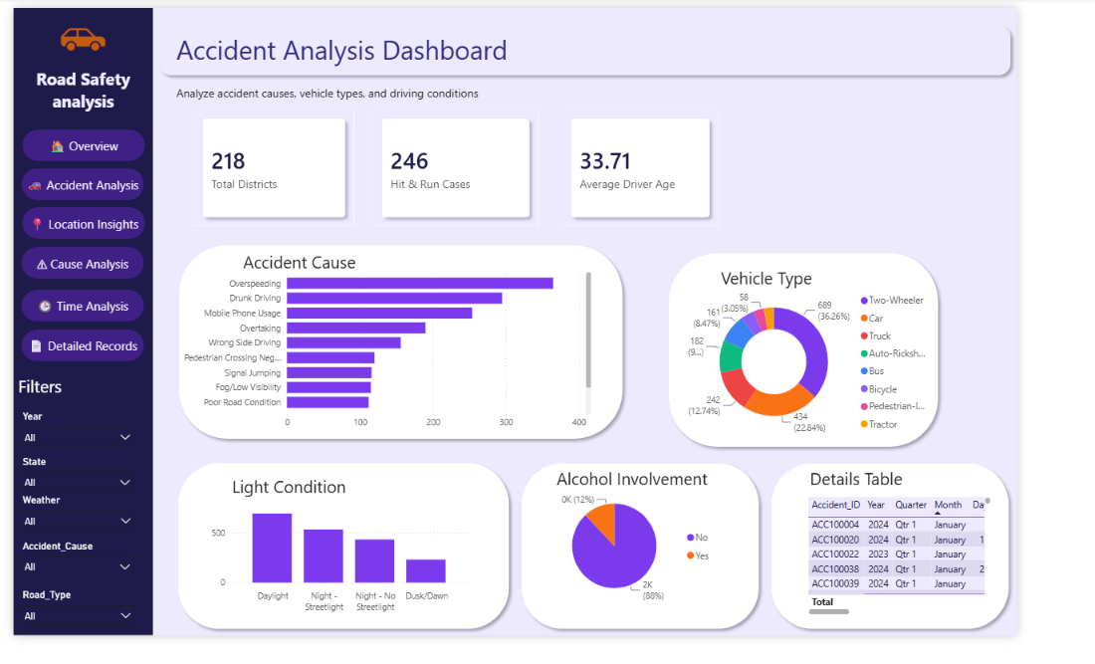
2
Accident Analysis
What causes accidents, which vehicles are involved, and under what conditions?
KEY INSIGHTS
Overspeeding is the leading recorded cause, followed by Drunk Driving and Mobile Phone Usage — all three squarely behaviour-driven.
Two-Wheelers are involved in 36% of accidents, more than double any other vehicle type; Pedestrian-involved cases follow at 23%.
Daylight sees the highest accident count of any light condition, ahead of both streetlit and unlit night conditions.
Alcohol was recorded as a factor in about 12% of accidents; 246 cases were hit-and-run, and average driver age is 33.7 years.
Live view: Page 2 of 6 — Accident Analysis
9

Slide 10
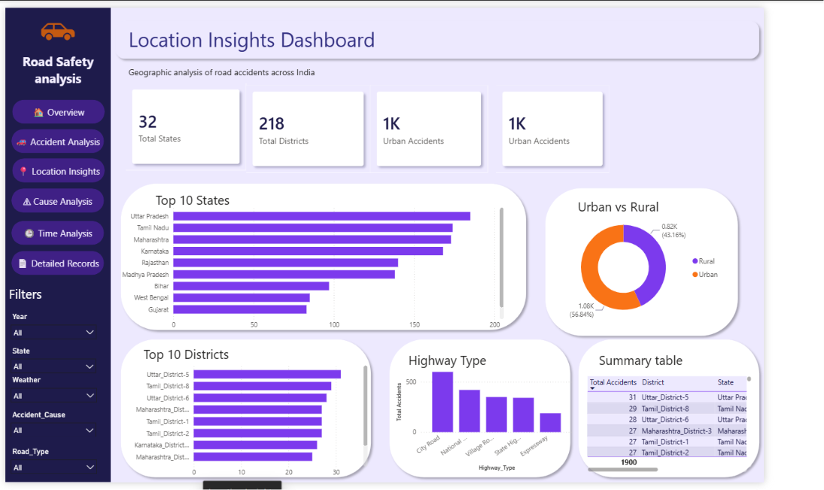
3
Location Insights
Where do accidents cluster, and how does urban demand compare to rural?
KEY INSIGHTS
Accidents span 32 states and 218 districts, with Uttar Pradesh, Tamil Nadu and Maharashtra topping the state ranking.
Urban roads account for roughly 57% of accidents versus 43% rural — consistent with higher urban traffic density.
City Roads see the most accidents of any highway type, well ahead of National Highways and Village Roads.
Uttar_District-5 tops the district-level table at 31 recorded accidents, narrowly ahead of Tamil_District-8 at 29.
Live view: Page 3 of 6 — Location Insights
10

Slide 11
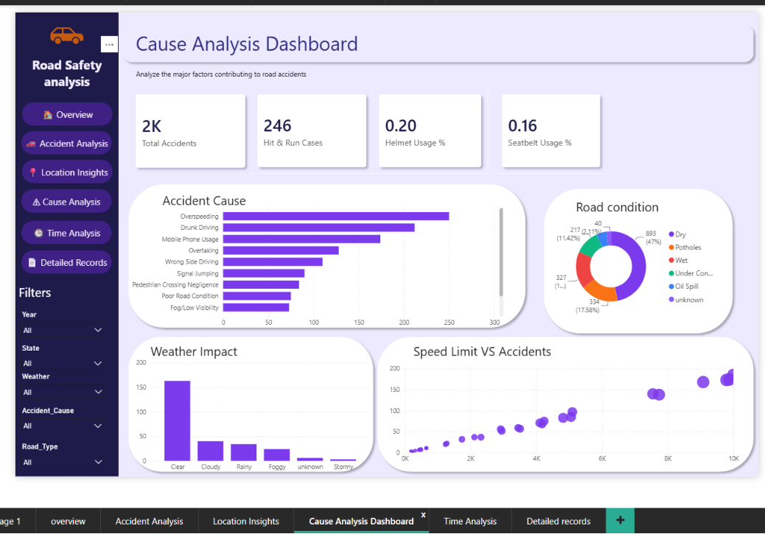
4
Cause Analysis
How do safety-equipment compliance and road conditions relate to accident causes?
KEY INSIGHTS
Helmet usage sits at just 20% and seatbelt usage at 16% among recorded accidents — a significant compliance gap worth flagging.
Dry road conditions account for 47% of accidents by volume, simply because most driving happens on dry roads, not because dry roads are riskier.
The Speed Limit vs. Accidents scatter shows a clear positive trend — higher posted speed limits associate with more accidents.
Clear weather again shows the highest raw accident count, reinforcing that exposure (more driving in clear weather) drives volume more than hazard alone.
Live view: Page 4 of 6 — Cause Analysis
11

Slide 12

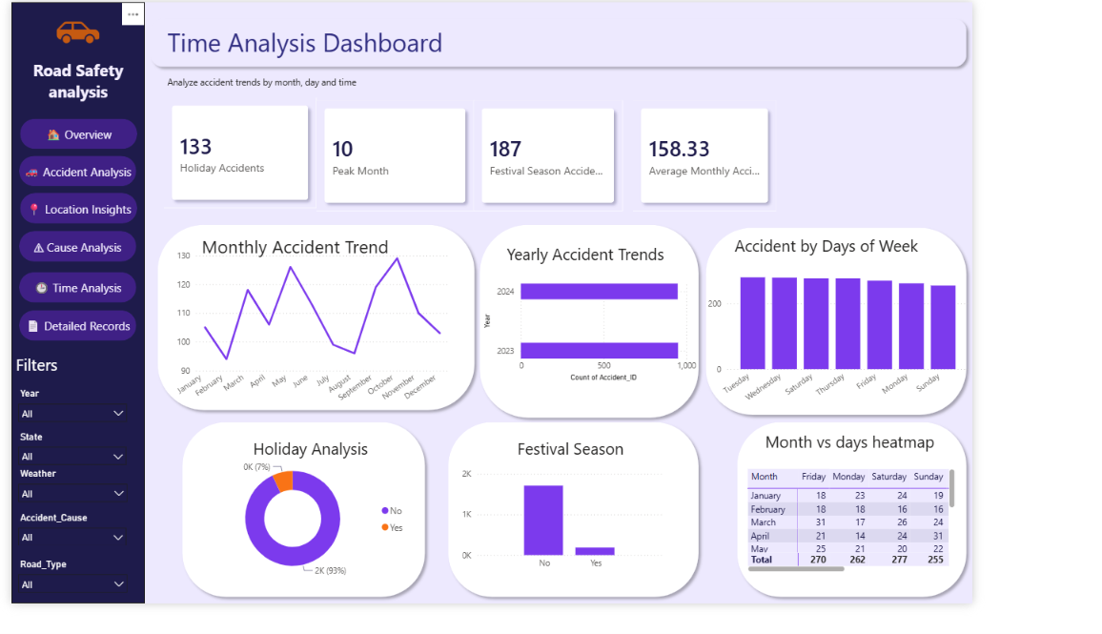
5
Time Analysis
When do accidents spike — by month, weekday, holiday or festival season?
KEY INSIGHTS
October stands out as the peak month for accidents, with the monthly trend fluctuating between roughly 90 and 130 across the year.
Festival-season records add 187 accidents on top of the baseline, while holidays alone account for 133 — about 7% of the yearly total.
Accidents are fairly evenly spread across the week, with Saturday and Tuesday running marginally ahead of the other days.
Average monthly accident count sits at 158.33, giving a steady baseline against which spikes like October and festival season stand out.
Live view: Page 5 of 6 — Time Analysis
12

Slide 13
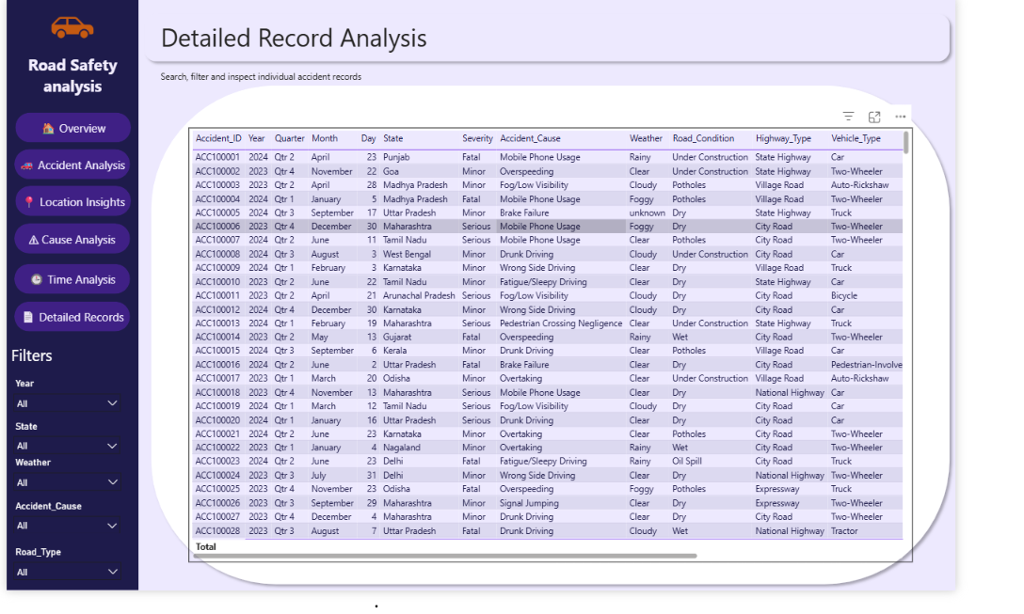
6
Detailed Records
How can an analyst search, filter and inspect individual accident records?
KEY INSIGHTS
A row-level drill-through table exposes all 12 core fields per accident — ID, date, location, severity, cause, weather, road and vehicle type.
The same Year / State / Weather / Accident_Cause / Road_Type filters used on other pages apply here, keeping investigation consistent with the summary views.
This page exists for precision: when a stakeholder needs the exact record behind a chart bar, this table is the source of truth.
Complements the five aggregate pages by supporting audit-style, case-by-case review rather than pattern-level analysis.
Live view: Page 6 of 6 — Detailed Records
13

Slide 14


DATA MODELING
DAX Measures & KPI Framework
Every KPI card on the dashboard is backed by a purpose-built DAX measure, organized into 14 logical sections.
Core Totals
Rate & Ratio KPIs
Total Accidents, Total Fatalities, Total Injured, Total Districts/States
Helmet Usage %, Seatbelt Usage %, Alcohol Involvement %, Hit & Run Cases
Averages
Time Intelligence
Average Response Time, Average Damage Cost, Average Driver Age, Average Monthly Accidents
Yearly Trend, Peak Month, Holiday Accidents, Festival Season Accidents
Location Measures
Severity & Safety
Urban vs. Rural Split, Top-N States/Districts, Highway Type Totals
Severity Distribution, Road Condition Share, Weather Impact
Indian Road Accidents Dataset
14

Slide 15

DATA QUALITY
Problems & Questions We Found
Building the dashboard surfaced a few patterns worth a second look before trusting every number at face value.
Helmet / Seatbelt mostly empty
Is the missing 65%/75% genuinely unrecorded, or structurally not applicable (e.g. car occupants for Helmet_Used)? Needs a data-dictionary check.
35% / 25% valid
Driver_Gender casing
“Male”, “MALE” and “m” all needed standardizing — worth pushing the fix upstream into data collection.
10 distinct values, 3 real categories
Duplicate Urban Accidents card
Both the Urban and a neighboring KPI card display “1K” — likely a copy-paste measure binding that needs correcting.
Location Insights page
Peak Month shows a raw number
The KPI displays ‘10’ instead of ‘October’ — a formatting fix so the card reads correctly at a glance.
Time Analysis page
Alcohol_Involvement stray value
A “0” entry sits alongside Yes/No — cleaned in this build, but flags a validation rule worth adding at entry.
12 distinct for a Yes/No field
Indian Road Accidents Dataset
15

Slide 16

The Takeaway
Nothing on this dashboard is decorative. Each chart type was chosen because it was the clearest way to answer that page’s guiding question.
Trend
Ranking
Proportion
Line, Area
Bar, Column
Pie, Donut
Relationship
Geography
Precision
Scatter
Top-N, Map-style bars
Table, Drill-through
Thank You
Indian Road Accidents Dataset

