Slide 1




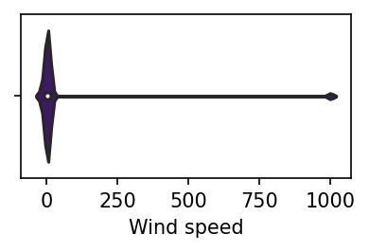
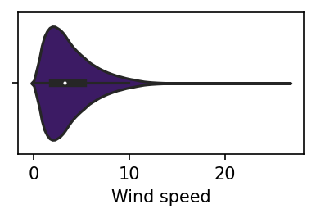
Data preprocessing
11GB, ~1800 files, different structure. Old format
1.5GB, 1 file, union structure. New fast format .parquet.
Data cleaning based on Z-values, quantiles and based on expert judgement.
Fig 1. Example of outliers. Wind speed at 1000 m/s
Fig 2. Data without outliers.

Slide 2
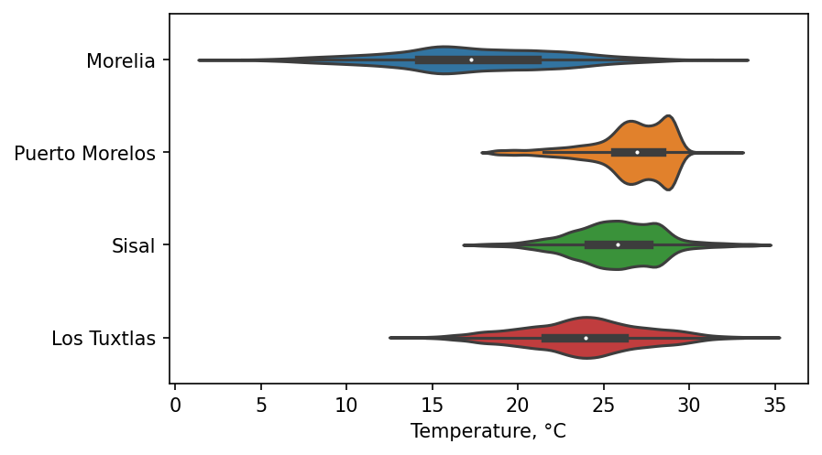
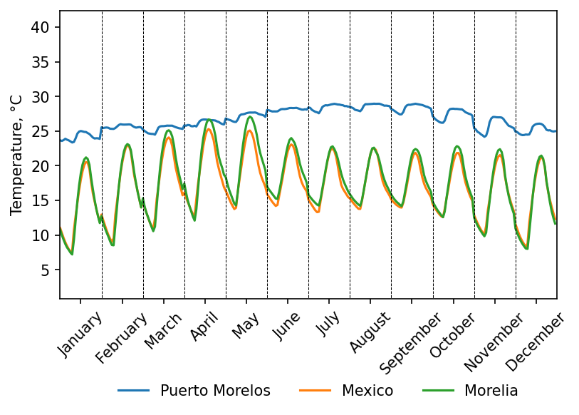
Data analysis
Fig. 1 Distribution of Temperature in different Cities
Fig. 2 Daily changing of Temperature during a year. Averaged in a month.

Slide 3
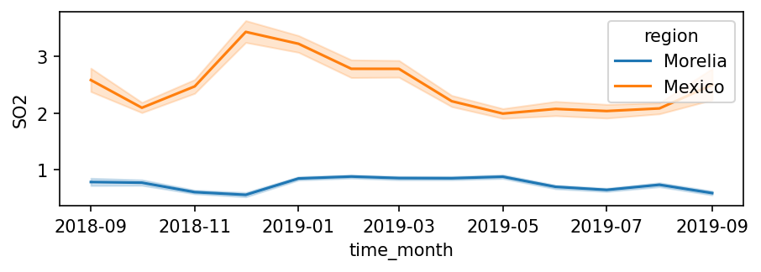
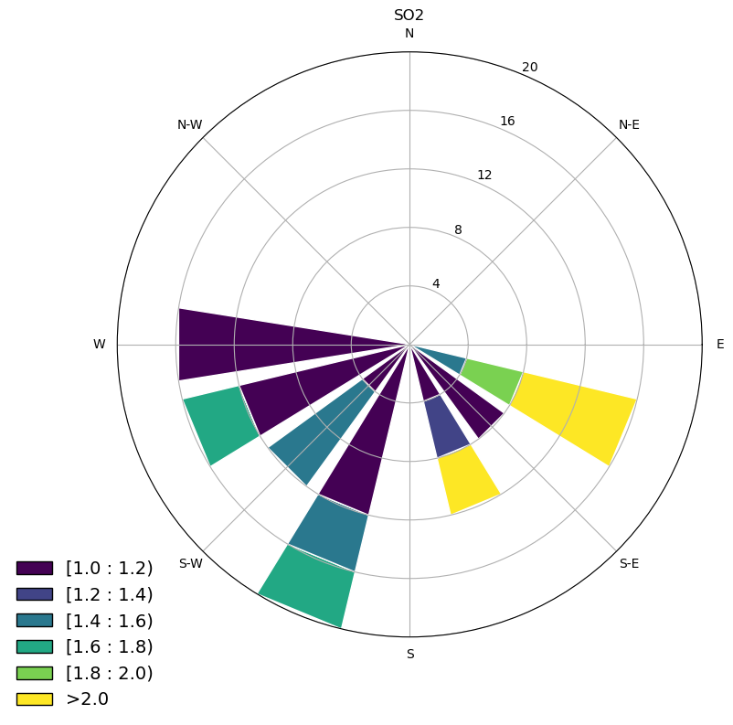
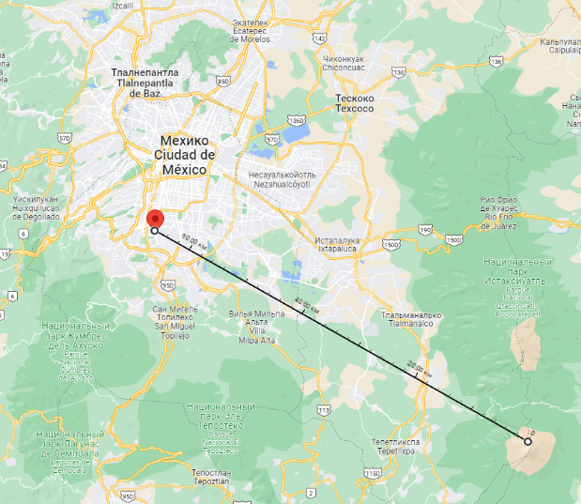
Pollution analysis
Fig. 1 Concentration of SO2 during the time.
Concentration of SO2 is connected with Volcano activities. There is an active volcano 65 km from the station. Peak corresponds with eruption:
15 December 2018 at 18.57 local time, spewing lava, ash and rocks.
Fig. 3 Wind Rose of pollution of SO2.
Fig. 2 Location of station and volcano.

