Slide 1
WORKSHOP Overview Modflow 6 LAB: Customizing for Flow, Transport and Geothermal Modeling
Dr. Mike Müller
Lúcia Pedrosa

Slide 2
Workshop Overview
Extend the capabilities of MODFLOW 6 for advanced groundwater, solute transport, and geothermal modeling
Learn how to use Python and the pymf6 library to implement custom boundary conditions
Focus is on practical, flexible tools to solve complex subsurface problems with minimal code and maximum adaptability

Slide 3

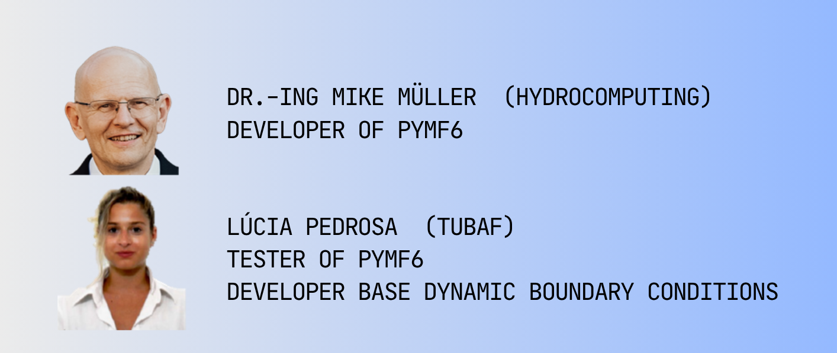
Introduction Round

Slide 4



Program
Thursday:
9:30 – 9:45 Welcome & Introduction
9:45 -10:30 Technical set-up
10:30 -10:45 Break
10:45 – 12:00 pymf6 Principles
12:00 – 13:00 Lunch
13:00 – 15:00 Flow Model: Controlling the well withdraw based on a target groundwater level
15:00 – 15:30 Break
15:30 – 17:00 Flow Model: Dynamic river bed conductance for gaining and loosing river sections

Slide 5
Program
Friday:
Friday 9:30 – 10:00 Recap & Discussion
10:00 – 11:00 Scenario transport
11:00 – 11:15 Break
11.15 – 13:00 Heat model:
13:00 – 14:00 Lunch
14:00 – 15:30 Outlook: Coupling analytic solutions and reactive transport modeling with pymf6
15:30 – 15:45 Break
15:45 – 16:30 Q&A: Ask questions about your model customization needs and get answers from author of pymf6

Slide 6

Workshop Goals
Understand and extend the modular design of MODFLOW 6
Use Python + PyMF6 to automate modeling workflows and customize boundary conditions.
Implement direction-dependent and dynamic boundary conditions programmatically.
Flow, Transport and Heat Models
Understand how to couple MODFLOW 6 with external analytical or numerical models.

