Slide 1
Modflow 6 LAB: Customizing for Flow, Transport and Geothermal Modeling
Introduction to pymf6
Dr. Mike Müller
Lúcia Pedrosa

Slide 2

What is pymf6?
pymf6 is a Python library that enables real-time programmatic control of MODFLOW 6 simulations.
It acts as a bridge between Python and MODFLOW 6, allowing dynamic interaction during model execution.

Slide 3

Why use pymf6?
To overcome Traditional Limitations:
Static parameters: All conditions fixed before simulation
No adaptation: Cannot respond to simulated results
Manual iteration: Repeated runs for scenario testing
Limited coupling: Difficult integration with external models

Slide 4

Why use pymf6?
PyMF6 Advantages
Dynamic control: Adjust parameters during simulation
Adaptive management: Respond to model results in real-time
Automated optimization: Built-in parameter estimation
Coupling: Seamless integration with other models
Complex boundary conditions: Implement conditions impossible in standard MF6

Slide 5
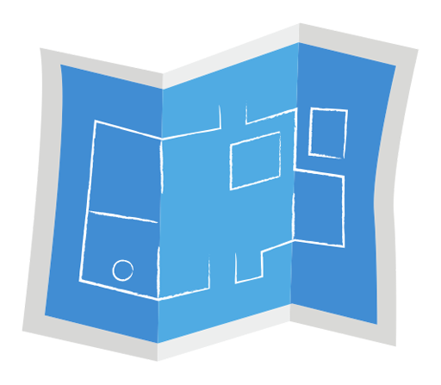
Architecture overview
PyMF6 Python Library: User interface and control logic
Modified MODFLOW 6: Special version with callback hooks
Shared Memory: Real-time data exchange
Configuration System: YAML-based setup

Slide 6
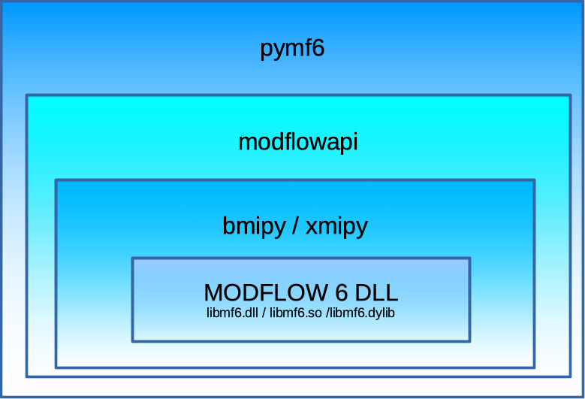
Technology Stack
Basic Model Interface (BMI) - API for simulation models
bmi-python - Python specification of BMI
xmipy extension to bmi-python accessing the MODFLOW 6 DLL with ctypes
modflowapi - High level API for MODFLOW 6
pymf6 is based on xmipy and modflowapi

Slide 7

Usage requirements
Understand the MODFLOW 6 variables as defined in the input files
Have a working knowledge of Python programming

