Slide 1


NTU DSAI Course Module 2 Project 13 Sep 2025
Team
Chris Fong
Lawrence Tay
Joey Ng
Jhin Hin

Slide 2
Project Overview
This project involves building an end-to-end data pipeline and analytics workflow for Brazilian e-commerce data from Olist. The pipeline will extract raw CSV data, load it into BigQuery, transform it into a star schema optimized for analytics, implement data quality validation, orchestrate all processes, and provide interactive dashboards for business insights.
Data Source: Brazilian e-commerce dataset (Olist) between 2016 – 2018 from Kaggle. (https://www.kaggle.com/datasets/olistbr/brazilian-ecommerce)

Slide 3
Business Context
The data pipeline and analytics solution must be capable of answering the following eight critical business questions:
Monthly Sales Trends: How do sales revenue, order volume, and average order values trend over time by month and year?
Top Products and Categories: Which product categories and individual products generate the highest revenue and sales volume?
Geographic Sales Distribution: How do sales vary across Brazilian regions, states, and cities for both customers and sellers?
Seller Performance Analysis: Which sellers and regions perform best in terms of revenue generation, order fulfillment, and product diversity across economic zones?
Customer Purchase Behavior: What are the patterns in customer purchasing frequency, order values, and lifetime value across different customer segments and economic zones?
Payment Method Impact: How do different payment methods (credit card, boleto, voucher, debit card) correlate with sales volumes and order values, including installment patterns?
Delivery Time Patterns: What are the delivery performance metrics across regions, including on-time delivery rates and average delivery times?
Product Reviews and Sales Correlation: How do customer review scores and review availability impact sales performance and customer behavior?
Product & Sales
Performance
Customer
Behavior
Customer
Satisfaction

Slide 4
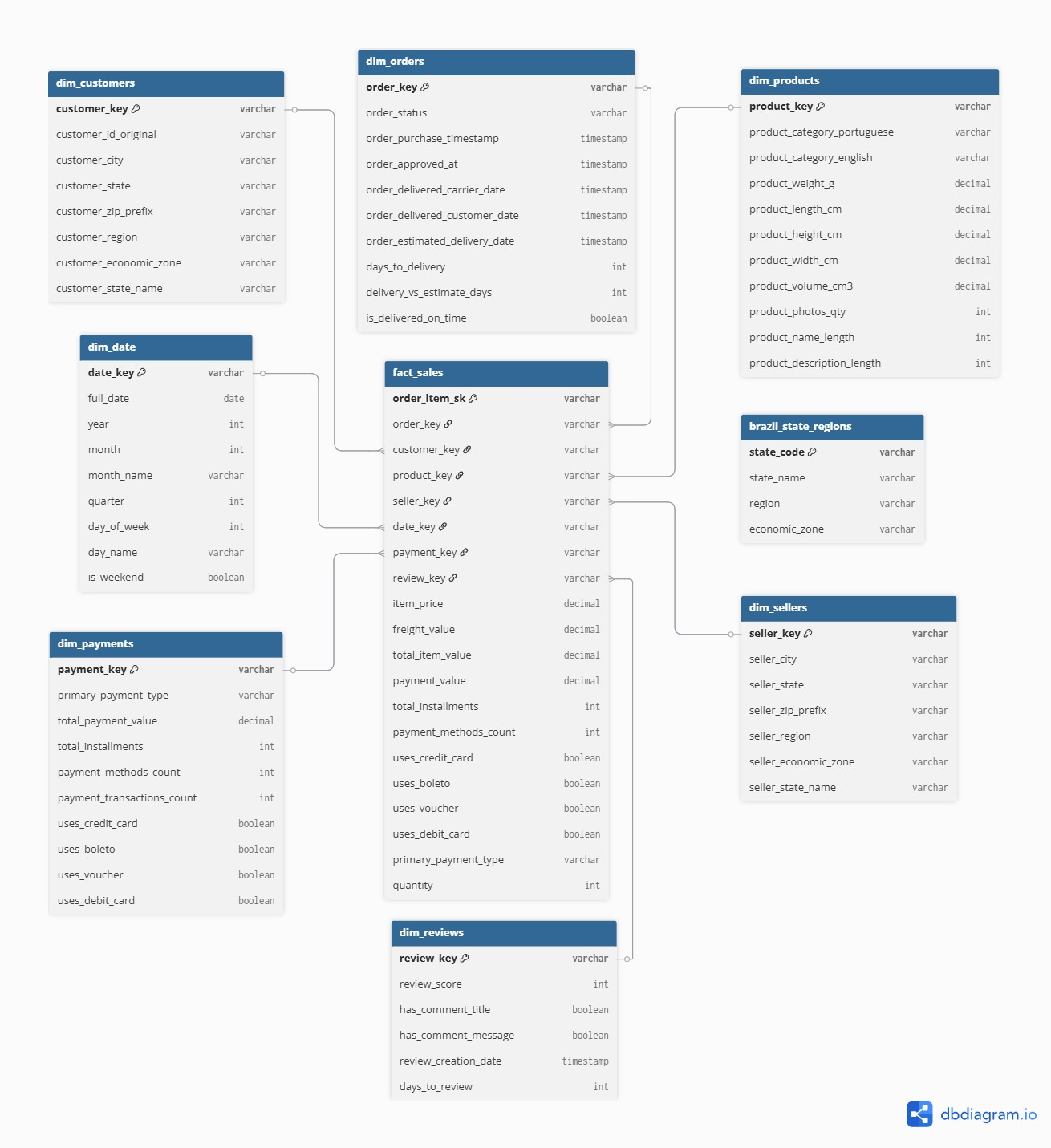
STAR Schema Design
Note: The brazil_state_regions seed table appears disconnected in the diagram because it doesn't have direct foreign key relationships defined in the schema. Instead, it's used through JOIN operations during the data transformation process in dbt.

Slide 5
Using Schema to address business questions
Monthly Sales Trends: dim_date (year, month, month_name) + fact_sales measures (total_item_value as sales) with optional regional filter via dim_customers.customer_region.
Top Products/Categories: dim_products.product_category_english joined to fact_sales to aggregate items, revenue, avg item value, and freight.
Geographic Sales Distribution: dim_customers.customer_region + dim_sellers.seller_region with fact_sales measures; state-level views via dim_customers.customer_state.
Customer Purchase Behavior: fact_sales aggregated to order and customer levels + dim_customers.customer_region for segmentation (order_count, LTV, repeat rate).
Payment Method Impact: dim_payments (primary_payment_type, boolean flags, total_installments) joined to fact_sales to analyze orders, sales, Average Order Value (AOV), and installment patterns.
Seller Performance: dim_sellers.seller_region + fact_sales aggregations (revenue, orders, unique products), including top sellers and product diversity.
Reviews Correlation: dim_reviews LEFT joined to fact_sales (NULL treated as "No Review"); analyses by review category/score and timing using dim_reviews.days_to_review and order dates.
Delivery Patterns: dim_orders delivery metrics (days_to_delivery, delivery_vs_estimate_days, is_delivered_on_time) + dim_customers.customer_region and dim_date for filters and trends; includes same vs cross-region efficiency using customer vs seller regions.

Slide 6
Data Model / Architecture (1/2)
Data Extraction is done in 4-tiered approach with DBT Snapshots for Slow Changing Dimension:
- Raw Layer: Reliable, auditable copy of source data in cloud data warehouse
Unchanged data from source CSV files
All columns stored as STRING data type
Includes Meltano metadata columns (_sdc_extracted_at, _sdc_table_version)
Preserves original data quality issues for auditing
No business logic applied
- Snapshots Layer: Historical change tracking
Implemented using dbt’s built-in SCD Type 2 pattern.
Track historical changes in customers, sellers, and orders.
Preserves point-in-time accuracy and audit trails without overwriting history,
Limit scope to balance cost and performance efficiency.

Slide 7
Data Model / Architecture (2/2)
- Marts Layer: Business-ready analytical data warehouse
Implement star schema dimensional model
Create calculated fields and derived metrics
Join tables to enrich data with business context
Apply complex business rules and logic
Aggregate data where appropriate (payment methods per order)
Implement proper foreign key relationships
- Staging Layer: Type-safe, clean data ready for dimensional modeling
Convert data types from STRING to appropriate types (INTEGER, NUMERIC, TIMESTAMP, BOOLEAN)
Standardize text fields (trim whitespace, normalize case)
Parse and validate timestamp formats
Remove Meltano metadata columns not needed for analysis
Apply basic data quality filters (remove records with null primary keys)
Rename columns to follow consistent naming conventions

Slide 8
Tools Overview
Tools:
- GitHub (Version Control)
- Jupyter (Preliminary Data Analysis)
- Meltano (Extraction/Loading)
-DBT (Transformation/Testing)
- DBT Elementary (Data Quality Monitoring)
- Dagster (Orchestration)
- Google BigQuery (Data Warehouse)
- Streamlit (Analytics/Dashboards)

Slide 9








ELT Process
Extraction: Meltano from csv
Loading: Google BigQuery (raw, snapshots, staging, marts)
Post Ingestion/Transformation validation: DBT Expectations
Transformation: DBT
Orchestration: Dagster
Analytics/Visualisation: Streamlit
Test & Monitoring: DBT Elementary
Orchestration
Data
Analytics/
Visualisation
Prelim Analysis
Transform/ DBT Expectation/ Snapshots
Data Warehouse
Extract/Load
Data Quality

Slide 10
Dagster Orchestration
Dependency Management:
Ensure raw data validation completes before starting dbt staging transformations
Prevent marts transformation until all staging models complete successfully
Block dashboard refresh until all marts validations pass
Error Handling and Alerting:
Stop pipeline execution if critical validations fail
Send notifications for data quality issues requiring attention
Implement retry logic for transient failures
Provide detailed failure context and debugging information
Monitoring and Observability:
Track execution time for each pipeline step
Monitor resource utilization (BigQuery slots, compute usage)
Maintain historical run logs and performance metrics
Provide data lineage visualization
Scheduling and Triggering:
Schedule daily pipeline execution
Support manual pipeline triggers for ad-hoc runs
Enable partial pipeline re-runs from specific points

Slide 11
DBT-Expectation - Post Ingestion validation
Structural Validations:
Verify all expected tables were created
Validate correct number of columns per table
Confirm critical columns are present
Check row counts within expected ranges
Data Quality Validations:
Validate primary keys (customer_id, order_id, product_id, seller_id) are populated
Ensure primary key uniqueness
Validate Brazilian state codes against known values
Validate ID formats and zip code patterns
Check numeric fields for reasonable ranges (prices > 0)
Business Logic Validations:
Order dates should be within expected business operation timeframe
Product weights and dimensions should be positive values
Review scores should be between 1 and 5
Payment values should be positive

Slide 12
DBT-Expectation - Post Transformation validation
Data Completeness Validations:
All order items should have corresponding payment records
Customer and seller regional assignments should be complete (including economic zones)
Product category translations should be available for all products
Customer unique ID assignments should be complete and consistent
Payment method flags should be properly populated for all orders
Analytical Consistency Validations:
Monthly sales totals should show reasonable business patterns
Regional distributions should align with Brazilian geography
Economic zone assignments should be consistent with state codes
Delivery time calculations should be logical (positive days, reasonable ranges)
Payment method combinations should be logical (e.g., installment counts match payment types)

Slide 13
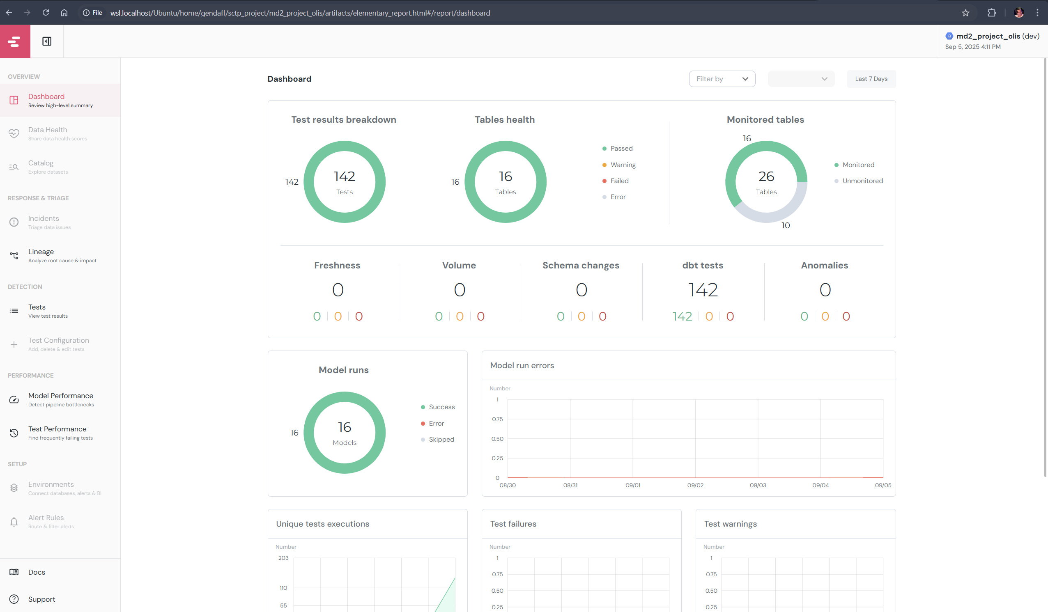
DBT Elementary
Data anomaly detection
Dashboard, alerts and alerts

Slide 14
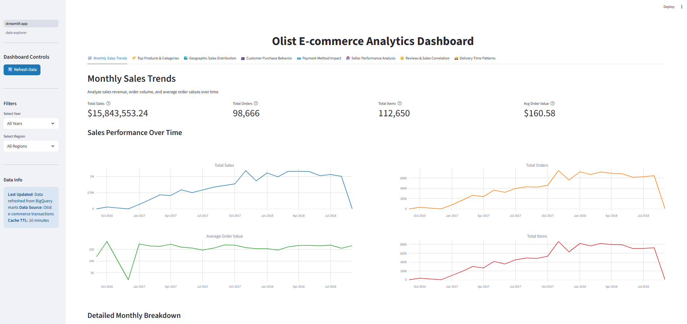
Analytics & Insights (Streamlit)
Dashboards built with Streamlit (http://localhost:8501/):

Slide 15
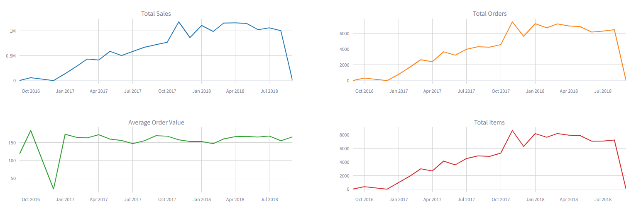
Key Findings
Sales trends:
Healthy growth in Total Sales, Total Orders and Total Items (Sep’16-Sep’17 vs Sep’17-Sep’18)
Total Sales (~$5.2m->~$8.6m, 64.5%)
Total Orders (~32k_>~54K, 71%)
Total Items (~36k-62k, 70.2%)
Average order stable within a range (~$160.58)

Slide 16
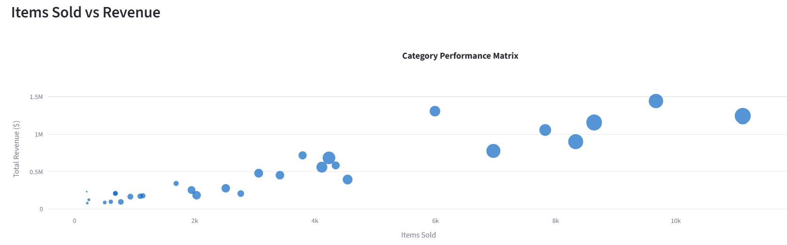

Key Findings
Product trends:
Top 7 categories clearly carry the most revenue accounting for almost 50% of the total revenue for the 3 years.
Rank | Category | unique_products | items_sold | Total_revenue
1 | health_beauty | 2444 | 9670 | $1,441,248.07
2 | watches_gifts | 1329 | 5991 | $1,305,541.61
3 | bed_bath_table | 3029 | 11115 | $1,241,681.72
4 | sports_leisure | 2867 | 8641 | $1,156,656.48
5 | computers_accessories | 1639 | 7827 | $1,059,272.40
6 | furniture_decor | 2657 | 8334 | $902,511.79
7 | housewares | 2335 | 6964 | $778,397.77
Total Revenue from top 7 categories |  |  |  | $7,885,309.84
(~50%)
$7,885,309.84 vs

Slide 17
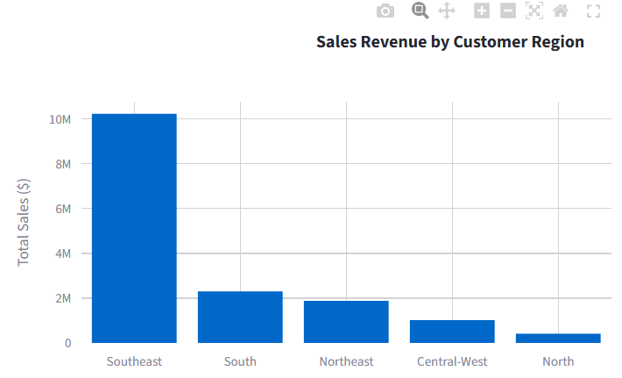
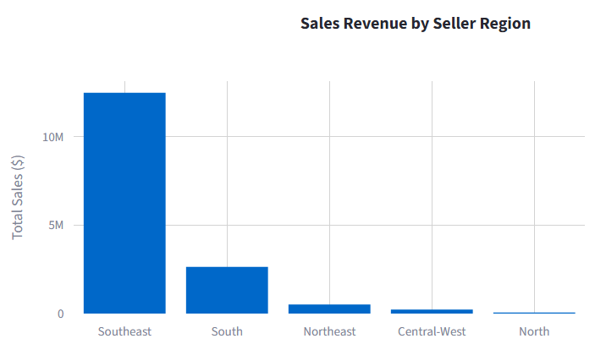
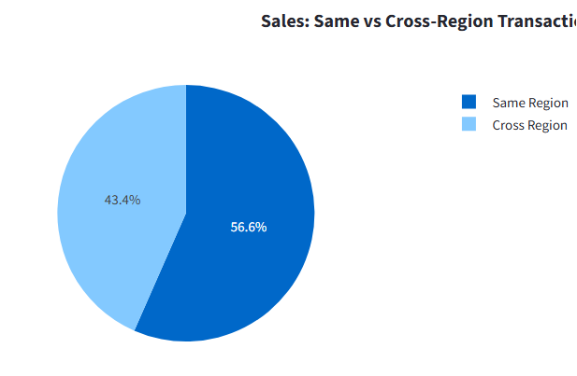
Key Findings
Geographic Sales Distribution:
Southeast region dominates in sales (by customer and by seller)
Same region transactions slightly more

Slide 18
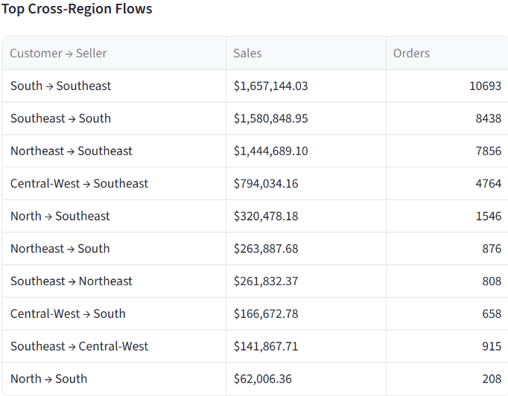
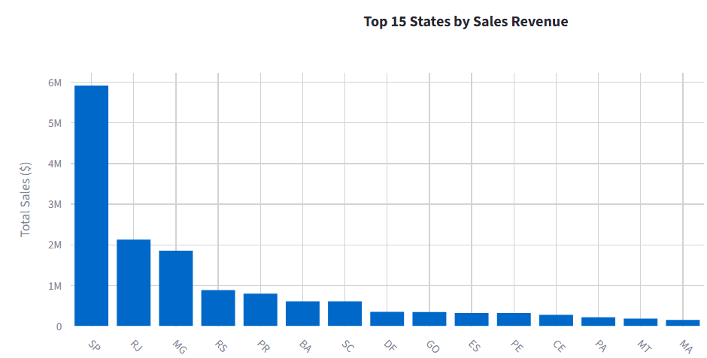
Key Findings
Geographic Sales Distribution:
Top 3 cross region flows by Sales:
South -> Southeast, $1.66M
Southeast -> South, $1.58M
Northeast -> Southeast, $1.44M
SP (Sao Paulo) top state by far with $5.9M total Sales

Slide 19
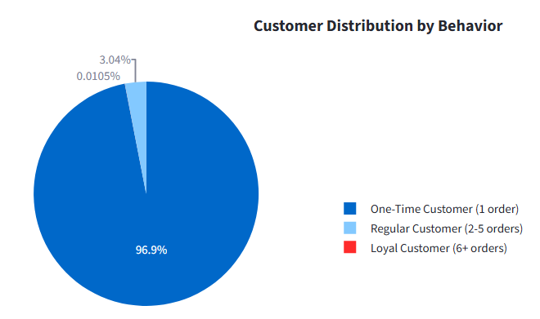
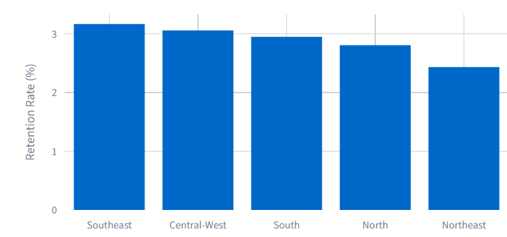
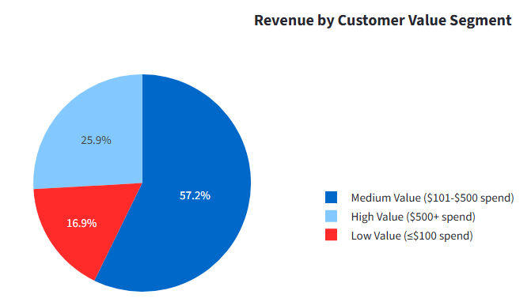
Key Findings
Customer Purchase Behavior:
Extremely low repeat customers (3.1%)
Very low average lifetime value (<$200)
Medium value segment biggest (57.2%),
significant high value segment (25.9%)

Slide 20
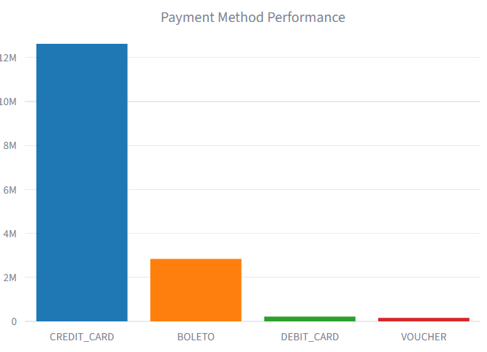
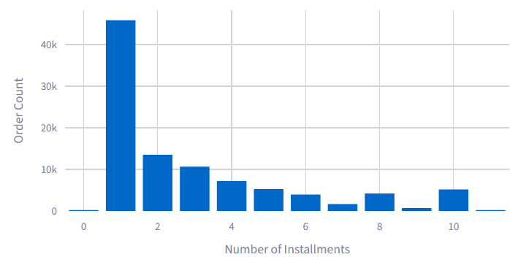
Key Findings
Payment Method Impact:
Credit card (77%) and Boleto (19.9%) overwhelmingly dominate payment mode
Usage of installments not common (~50%)

Slide 21
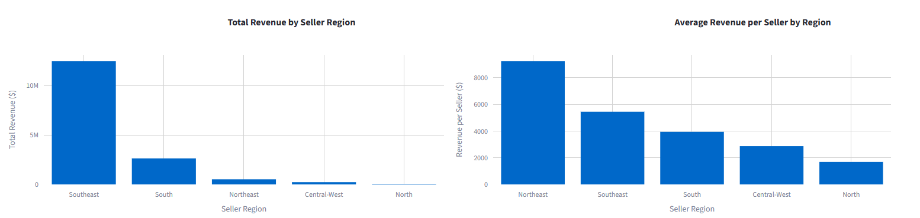
Key Findings
Seller Performance (1/2):
Top sales region is Southeast (significantly), while the northeast region leads by revenue per seller (followed by southeast)
Top 50 seller revenue ranges from ~$130k - $250k (across all years)
Majority of top sellers in Southeast region (SP)
Sellers carry products in 1 – 2 product categories (on average), with more than 50% of sellers being single category
Most top sellers sell < 200 unique products

Slide 22
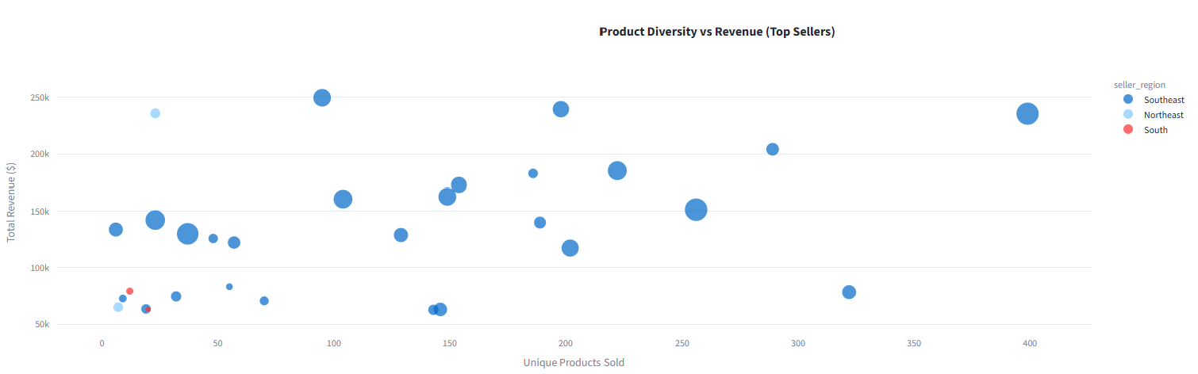
Key Findings
Seller Performance (2/2):
Top sales region is Southeast (significantly), while the northeast region leads by revenue per seller (followed by southeast)
Top 50 seller revenue ranges from ~$130k - $250k (across all years)
Majority of top sellers in Southeast region (SP)
Sellers carry products in 1 – 2 product categories (on average), with more than 50% of sellers being single category
Most top sellers sell < 200 unique products

Slide 23

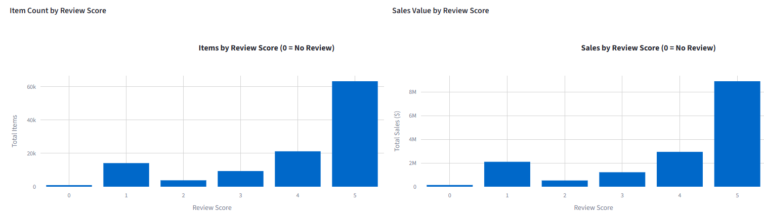
Key Findings
Review & Sales Correlation:
High review coverage (99.2%) -> Very involved buyers
Clear correlation: High review scores translates to more items sold and higher sales $

Slide 24
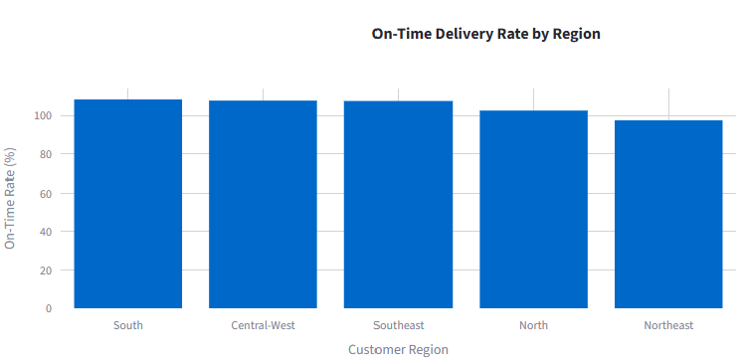
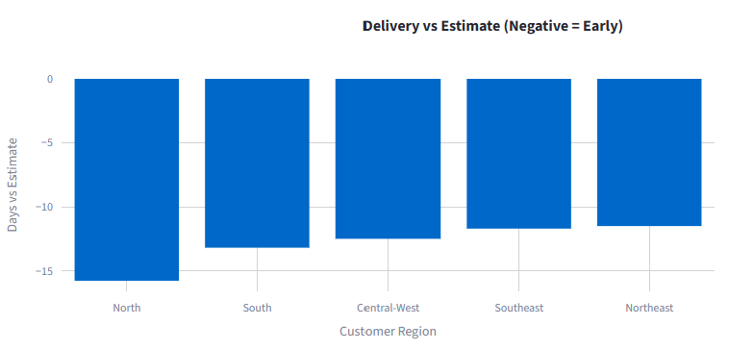
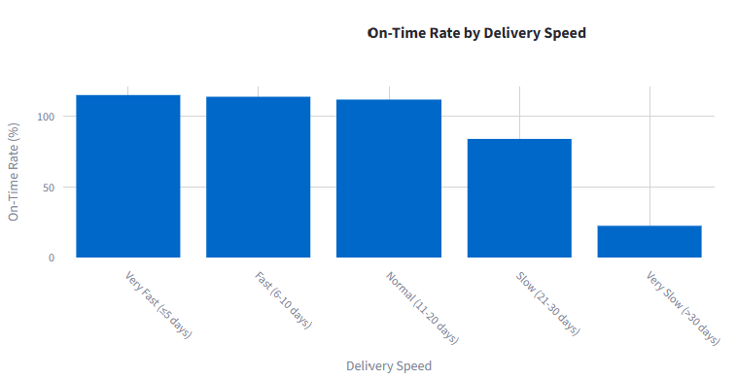
Key Findings
Delivery Time Patterns:
Delivery across regions have high rate of being on time (>=97.5%) with average delivery time being significantly earlier than estimated.
Estimated delivery date very well estimated, even when its “slow” (21-30 days) on time delivery date still 84%.

Slide 25
What we did right
Invested time to understand the data, agreed on business questions to answer, star schema needed, and envisioned data pipeline before coding.
This allowed a common view of final data mart needed and with that team could split up between data pipeline team and analysis team. Analysis team took in data and transformed data for needed data mart in the most straightforward manner and got down to working on analytics while pipeline team took time to figure out how to use the different tools to implement the envisioned pipeline. Connecting the two parts that proceeded in parallel was smooth because of the approach (and also because of Lawrence).
Structured use of AI to produce key project documents (prd.md and plan.md) also played an important role – plugged knowledge gap, basis for team communication, kept AI on point.

Slide 26
Where we messed up
Team did not read the data description properly and missed out an important detail on the customer unique id. Issue was detected only after schema was designed and data was loaded for analysis. Resulted in time spent to rework the schema and full ELT cycle.
Snapshot every raw table for first attempt -> very slow at re-runs. Refactored codes to only snapshot customer, seller and product tables, as tracking changes was meaningful for these only.

Slide 27
Next Steps / Roadmap
Incorporate predictive models (e.g., churn, demand forecasting)
Expand data sources beyond Olist (Marketing data -> analysis on efficiency of marketing $ spent on recruiting sellers)

Slide 28
Thank You / Q&A
GitHub Repository:
https://github.com/ninja-lawrence/md2_project_olis

