Slide 1
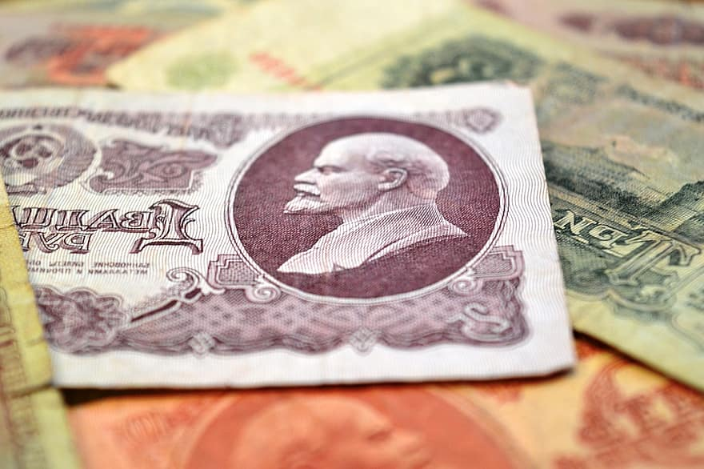
Marxist-Leninist Political Economy
Money
Thinh C.Nguyen • 01/2021

Slide 2
Introduction

Slide 3
What is commodity?

Slide 4
Commodity
Products of labor, satisfying certain human needs through exchange and purchase process.

Slide 5
Commodity
Be the unity of two attributes: use-value and value.
Use-value
Value

Slide 6
Use-value and value
Use-value
To satisfy all human demands
Commodity’s natural form
Directly perceived by the senses
Value
Crystallization of social labour
Commodity’s social form
Manifest itself only through exchange-value

Slide 7
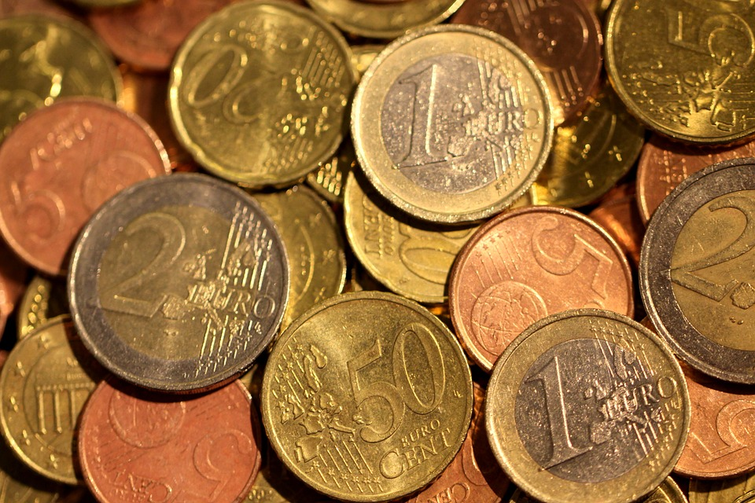
Money is the most prominent and typical form of value.

Slide 8
History of Money

Slide 9
Development of the Forms of Value.
The simplest form of value
The expanded form of value
The general form of value
The money form of value

Slide 10
The simplest form of value
The simplest form of value is the expression of the value of one commodity in terms of another commodity.
It includes two forms: relative form and equivalent form of value.
Exchange was a casual nature and took place in the form of direct exchange of one product for another
e.g. 1 axe = 20 kilograms of grain
Notes:
A commodity which expresses its value in another commodity has a relative form of value.
A commodity the use-value of which serves as the means of expressing the value of another commodity has an equivalent form
The use-value of one commodity, grain, thus becomes the form in which the value of another commodity, the axe, is expressed.
Under the elementary form of value, the value of an axe can be expressed only in the use-value of a single commodity; in the given example, grain.

Slide 11
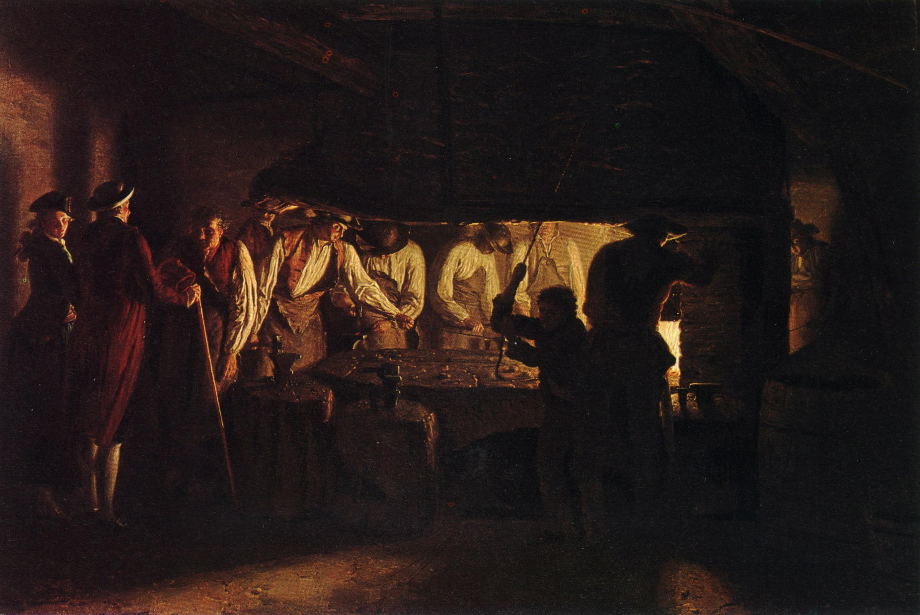
The expanded form of value
In the first major social division of labor
Produce a surplus of products
Exchange for the products they lack
e.g.
= 40 kg of grain, or
1 sheep
=20 m of cloth, or
= ...
Notes:
With the rise of the first major social division of labour-the separation of pastoral tribes-from the general mass of tribes exchange becomes more regular. Certain tribes, e.g., the cattle-raising ones, begin to produce a surplus of cattle products, which they exchange for products of agriculture or handicraft which they lack. To this level of the development of exchange corresponds the total or expanded form of value
The exchange rate has been more fixed, but it is still direct exchange of goods

Slide 12
The general form of value
The form of direct exchange of one commodity far another becomes inadequate
The direct exchange of one commodity for another gradually disappears.
e.g.
40 kg of grain =
20m of cloth =
1 sheep
⇒ 1 sheep becomes a common parity
2 axes =
Notes:
With the further development of the social division of labour and commodity production, the form of direct exchange of one commodity far another becomes inadequate
Difficulties arise in the process of exchange, engendered by the growth of the contradictions of commodity production, contradictions between individual and social labour, between the use-value and the value of a commodity
The value of all commodity is expressed in the use value of a commodity as a common parity value.

Slide 13
The money form of value
Commodity production, exchange grows, and expands across regions ⇒ need a uniform common parity (fixed on a particular commodity)
Appearing the form of money.
40 kg of grain =
20m of cloth =
3 grams of gold
2 axes =
1 sheep =

Slide 14
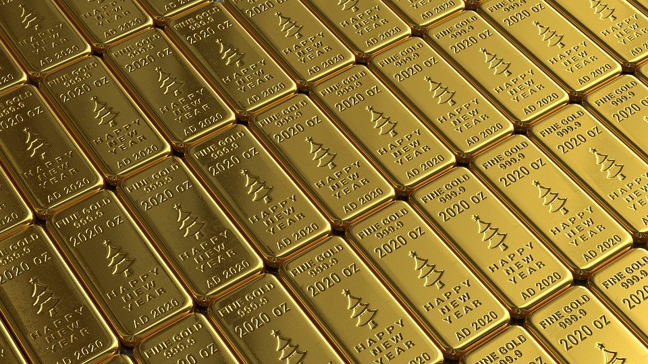
Why was gold used as a currency?

Slide 15
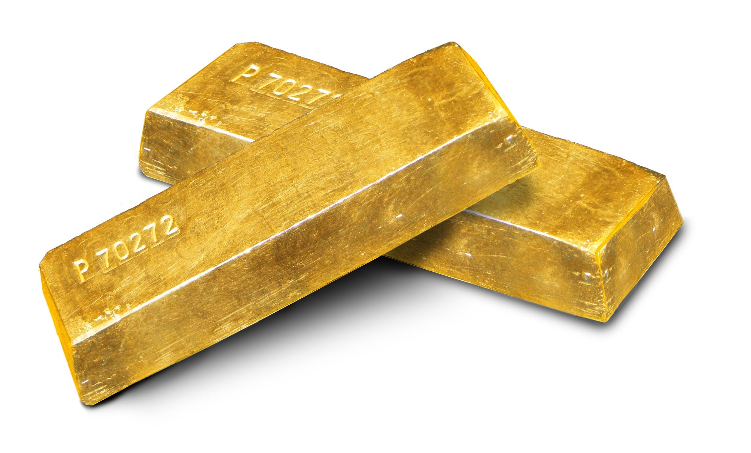
Why was gold used as a currency?
Durability
Homogenetic
High value with small amount
Divisibility

Slide 16
Nature of Money

Slide 17
Nature of Money
“Money is a special commodity that is separated from the world of commodities as an unified common parity for others. It represents social labor and the relationship between producers of the commodites.”
-Karl Marx-

Slide 18
Functions of Money

Slide 19
Functions of Money
The measure of value
The medium of circulation
The means of accumulation
The means of payment
World-wide currency

Slide 20
The measure of value
Money is used to measure and express the value of other commodities.
Only take an imaginary amount and requires no cash.
A commodity’s value expressed in money is called its price.
The unit of measure of money and its fractions is called the price standard.

Slide 21
The medium of circulation
The exchanging of commodities effected with the aid of money is called commodity circulation
Real cash is required when money is used as the medium of circulation.
Commodity circulation and monetary circulation are two sides of the process of interacting with each other.
Notes:
Before the money form, directly exchange C-C
After that, exchange C-M-C
inflationary

Slide 22
The means of accumulation
Money is withdrawn from circulation and stored, so it can be purchased as needed.
Types of storage:
Hiding (Only gold coins)
Send money to the bank

Slide 23
The means of payment
Money figures as a means of payment in cases is carried out on credit or payment deferred.
Appearance of credit money. It is issued by monetary payment function.
Cryptocurrency

Slide 24
World-wide currency
When the exchange of commodities expands beyond national borders and a trading system between countries forms.
WW Currency:
means of circulation
means of international payment
transfer wealth between countries

Slide 25
Gold money and Paper money
Because of the worn and devalued coins
→ The issue of paper money was engendered
Paper money is often used instead of gold coins
Issued by the country, which people are obliged to accept instead of gold so far as its function as circulation medium is concerned.
Notes:
Under conditions of developed commodity production, paper money is often used instead of gold coins.
The issue of paper money was engendered by the practice of the circulation of worn and devalued coins which had become transformed into symbols of gold, symbols of money.
Paper money means money tokens issued by the State, which people are obliged to accept instead of gold so far as its function as circulation medium is concerned.

Slide 26
Gold money and Paper money
Paper money has no value of its own
→ Not fulfil the function of measure of the value of commodities
Represents only the value of that quantity of gold which is necessary for commodity circulation to be maintained
But usually the country issues paper money to cover its expenses, without regard to the needs of commodity circulation
When the amount of country-issued paper money in circulation exceeds the amount needed for circulation, the value of the currency is reduced, inflation occurs.
Notes:
If paper money is issued in accordance with the amount of gold needed for circulation, the purchasing power of paper money coincides with the purchasing power of gold money.

Slide 27


