Slide 1

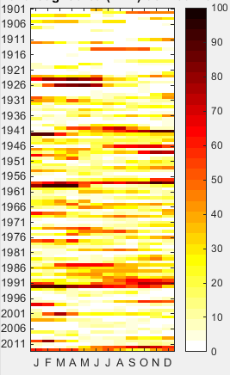




STAND-LS
Spatio-Temporal ANalysis of Large-Scale Drought: toolbox
Vitali Díaz Mercado, Gerald Corzo, Henny A.J. van Lanen, Dimitri Solomatine
vitalidime@gmail.com
gerald.corzo@gmail.com
github.com/hydroinfo4x

Slide 2
General
github.com/hydroinfo4x
STAND-LS
STAND-LS encompasses scripts to analyse, since a geospatial and temporal perspective, the variation of drought by using
drought indicators and
tools for spatiotemporal analysis
STAND_LS_NCDA.m
performs the Non-Contiguous Drought Analysis (NCDA) proposed by Corzo et al. (2011 HESS), on a monthly basis. Furthermore, it computes drought characteristics (i.e., Duration, Severity and Intensity=D/S) from one arrangement (rows x cols x time) containing drought indicator values.

Slide 3
General
github.com/hydroinfo4x
STAND-LS
STAND_LS_NCDA_application.m
Illustrates, step by step, the use of STAND_LS_NCDA.m by using the Standardized Precipitation Evaporation Index (SPEI) as drought indicator (Vicente-Serrano et al. 2010 JC), but it is possible to use another.
References
Corzo, G. A., Van Huijgevoort, M. H. J., Voß, F., & Van Lanen, H. A. J. (2011). On the spatio-temporal analysis of hydrological droughts from global hydrological models. Hydrology and Earth System Sciences, 15(9), 2963–2978. http://doi.org/10.5194/hess-15-2963-2011
Vicente-Serrano, S. M., Begueria, S., & Lopez-Moreno, J. I. (2010). A multiscalar drought index sensitive to global warming: The standardized precipitation evapotranspiration index. Journal of Climate, 23(7), 1696–1718. http://doi.org/10.1175/2009JCLI2909.1

Slide 4
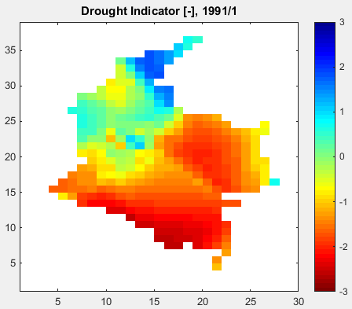
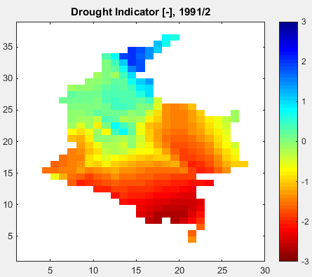
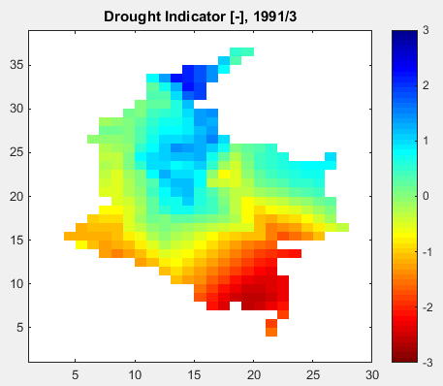
Some examples of results
github.com/hydroinfo4x
STAND-LS
STAND_LS_NCDA_application.m
Case study: Colombia
Drought indicator (DI): SPEI-06
1. Monitoring of drought indicator

Slide 5
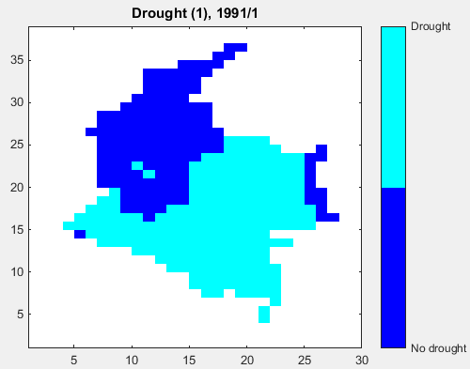
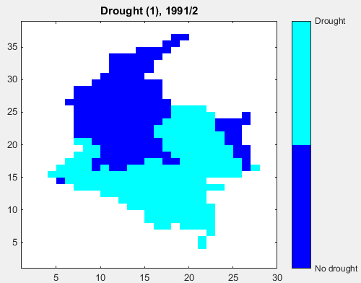
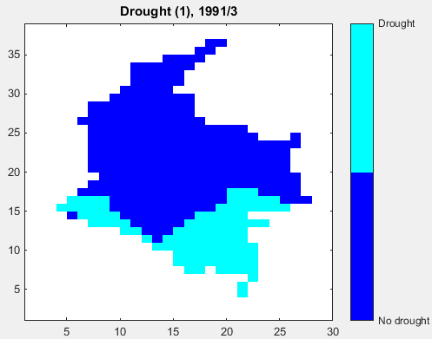
Some examples of results
github.com/hydroinfo4x
STAND-LS
STAND_LS_NCDA_application.m
Case study: Colombia
Drought indicator (DI): SPEI-06
2. Drought monitoring (as binary representation)

Slide 6
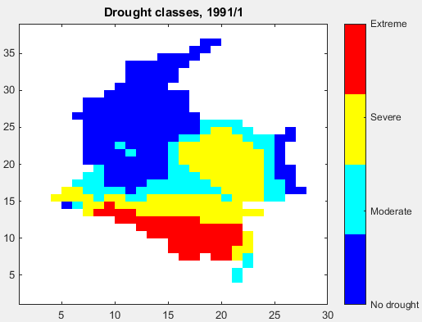
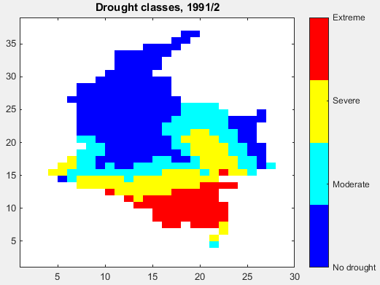
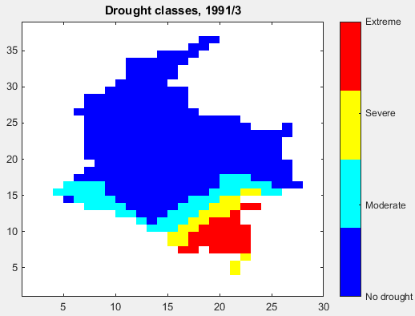
Some examples of results
github.com/hydroinfo4x
STAND-LS
STAND_LS_NCDA_application.m
Case study: Colombia
Drought indicator (DI): SPEI-06
3. Monitoring drought classes

Slide 7
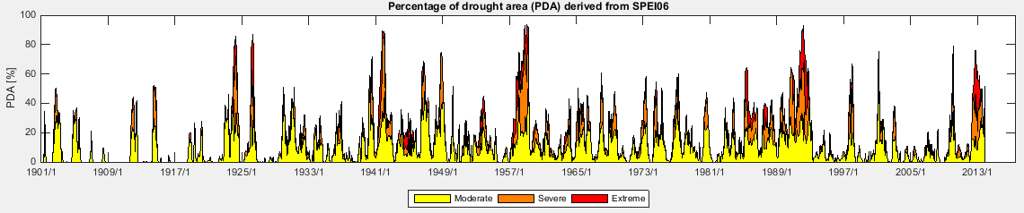
Some examples of results
github.com/hydroinfo4x
STAND-LS
STAND_LS_NCDA_application.m
Case study: Colombia
Drought indicator (DI): SPEI-06
4. Percentage of Drought Area (PDA)

Slide 8
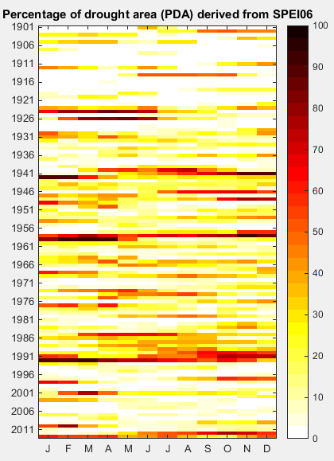
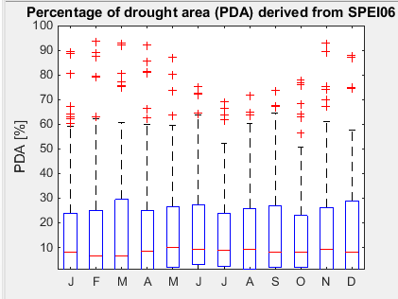
Some examples of results
github.com/hydroinfo4x
STAND-LS
STAND_LS_NCDA_application.m
Case study: Colombia
Drought indicator (DI): SPEI-06
5a. Percentage of Drought Area (PDA) – color-coded table & boxplot

Slide 9
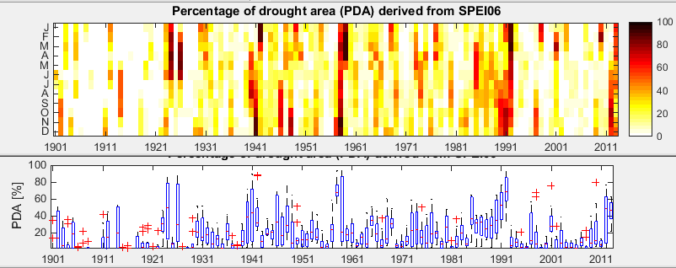
Some examples of results
github.com/hydroinfo4x
STAND-LS
STAND_LS_NCDA_application.m
Case study: Colombia
Drought indicator (DI): SPEI-06
5b. Percentage of Drought Area (PDA) – color-coded table & boxplot

Slide 10
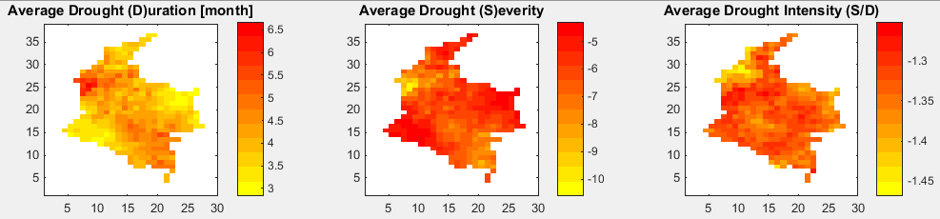
Some examples of results
github.com/hydroinfo4x
STAND-LS
STAND_LS_NCDA_application.m
Case study: Colombia
Drought indicator (DI): SPEI-06
6. Average Drought Duration/Severity/Intensity

