Slide 1
BARUGO LEVEL III PERFORMANCE REVIEW
MAY 2026

Slide 2
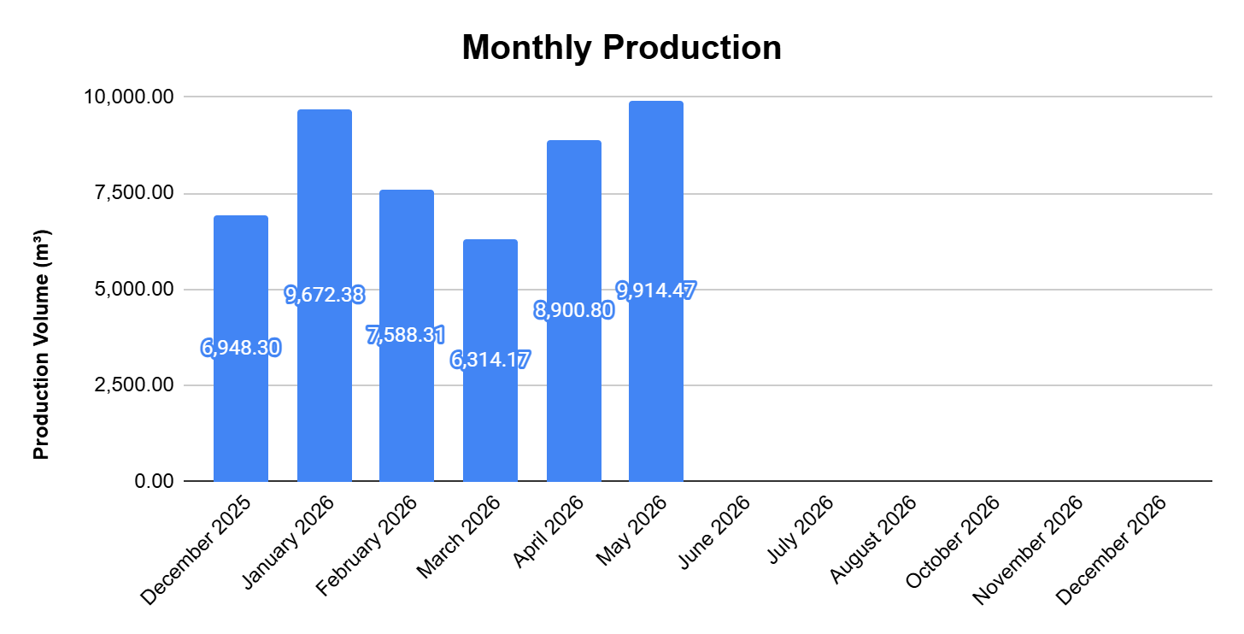
PRODUCTION - Monthly

Slide 3
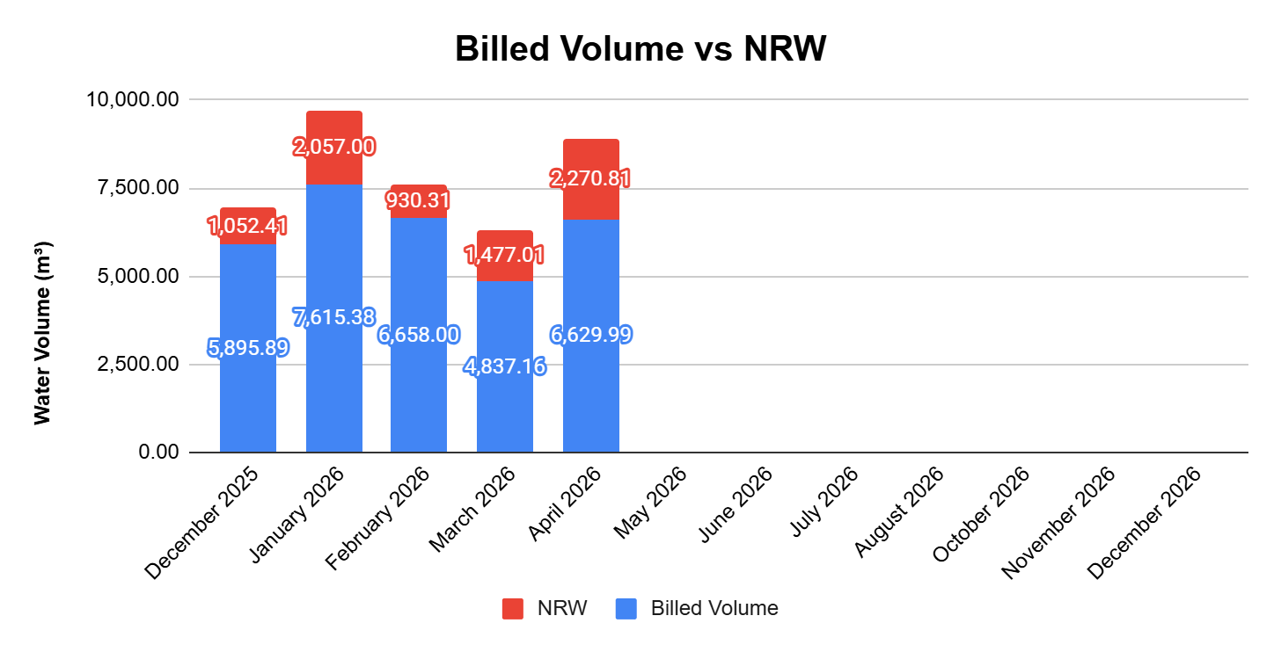
Billed Volume

Slide 4
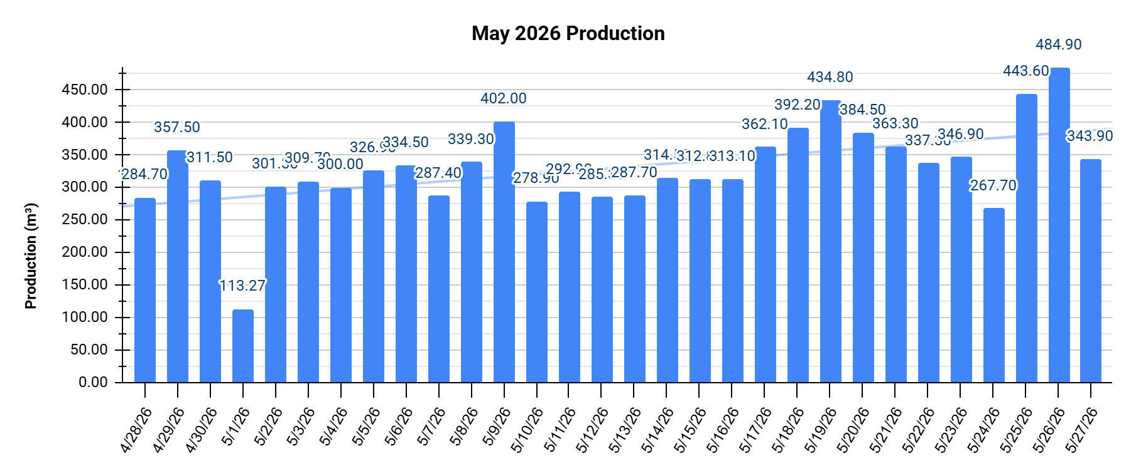
PRODUCTION - Daily

Slide 5
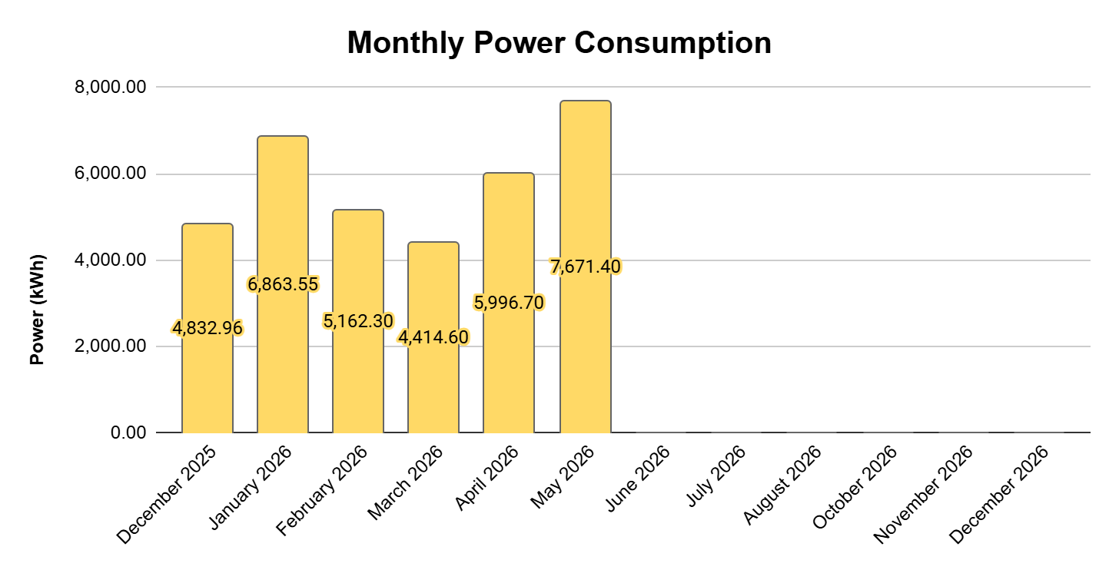
POWER CONSUMPTION

Slide 6
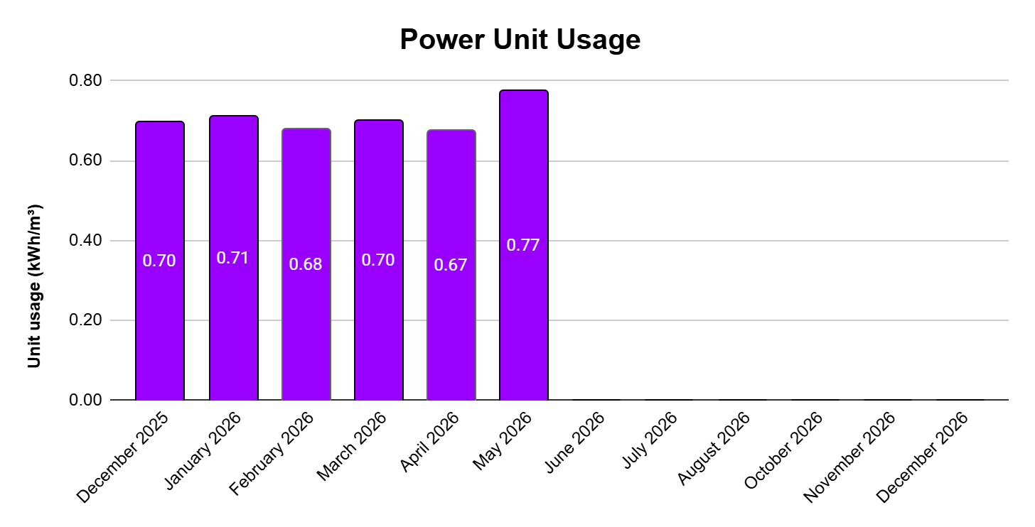
POWER UNIT USAGE

Slide 7
ELECTRIC BILL
Month | Chlorination & Intake House Power Consumption (kWh) | LEYECO III based Total Consumption (kWh) | Effective Rate per kWh (PHP) | Electric Bill (PHP)
December 2025 | 4,832.96 | 5,777.00 | ₱11.80 | ₱68,164.36
January 2026 | 6,863.55 | 6,310.00 | ₱14.09 | ₱88,899.61
February 2026 | 5,162.30 | 4,037.00 | ₱11.19 | ₱45,181.15
March 2026 | 4,414.60 | 4,338.00 | ₱13.13 | ₱56,951.04
April 2026 | 5,996.70 | 5,491.00 | ₱11.77 | ₱64,643.84
May 2026 | 7,671.40 | 7,657.00 | ₱10.21 | ₱78,151.73
June 2026
July 2026
August 2026
September 2026
October 2026
November 2026
December 2026
 |  |  | ₱12.03 | ₱401,991.73
 |  |  | Average Rate per kWh | Total Billing

Slide 8
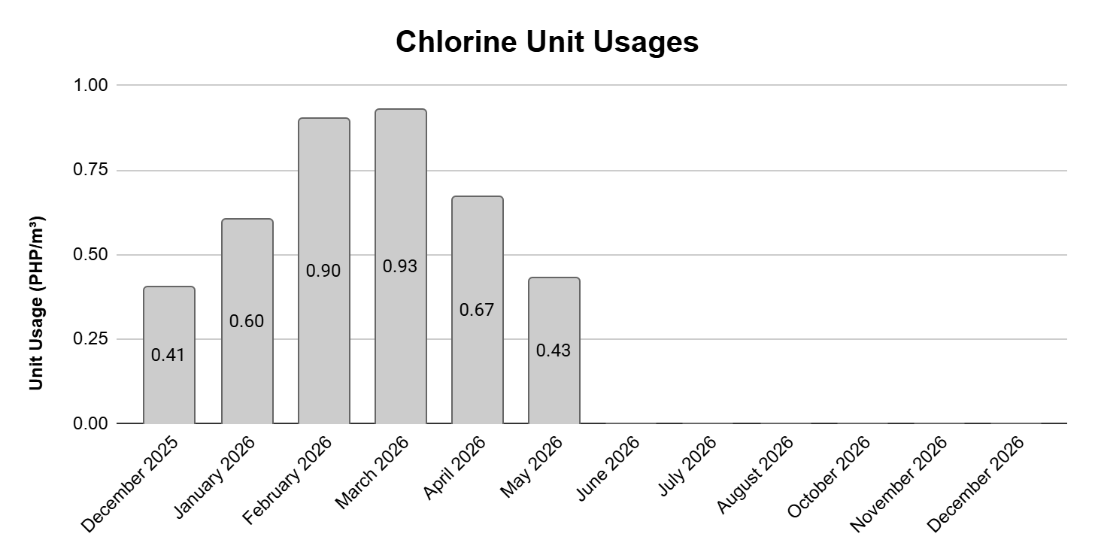
Unit Usage – Calcium Hypochlorite

Slide 9
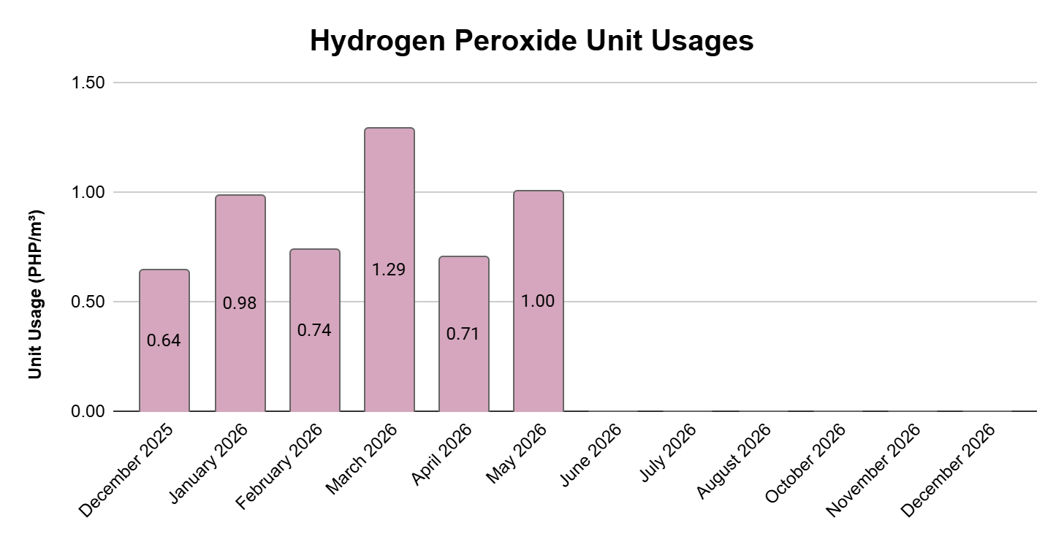
Unit Usage – Hydrogen Peroxide

Slide 10
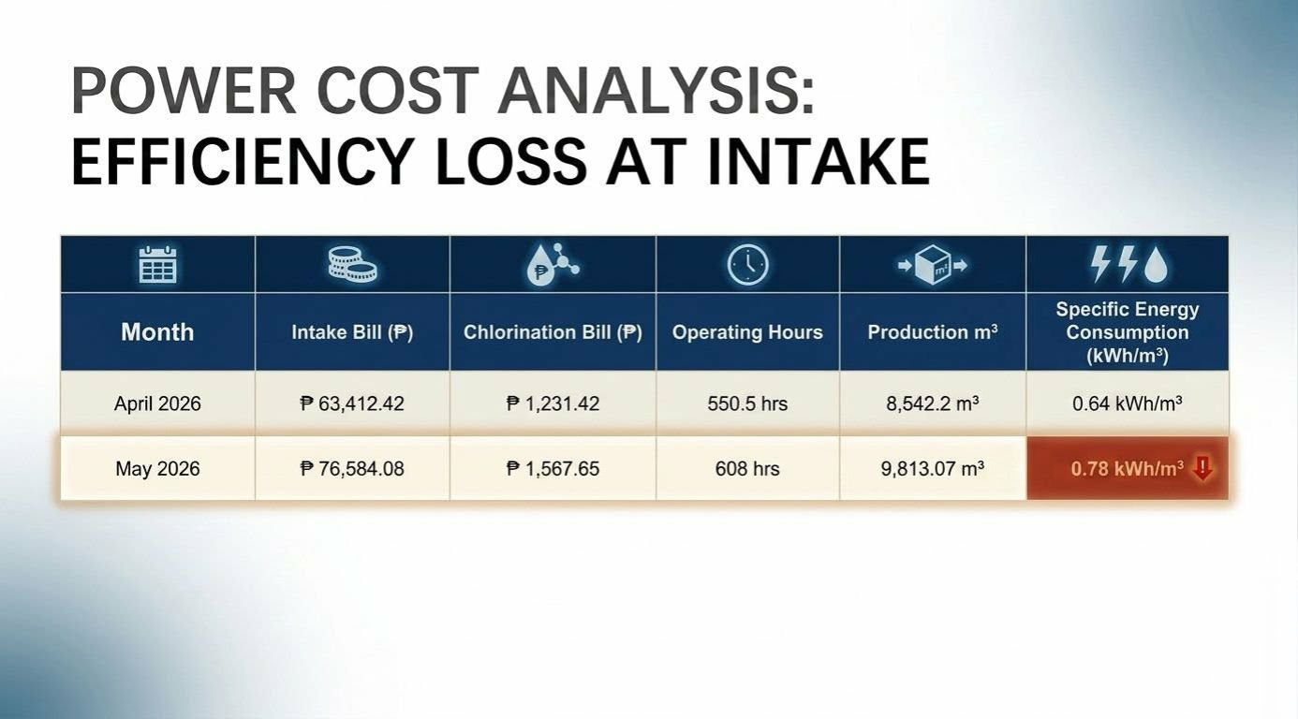

Slide 11
Intake Facility: Accounted for 98% of the cost increase (Spiked by ₱13,171.66).
Chlorination House: Remained stable and nominal, increasing by only ₱336.23.

Slide 12
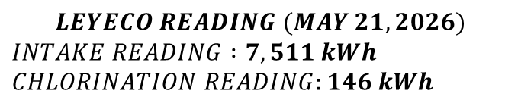
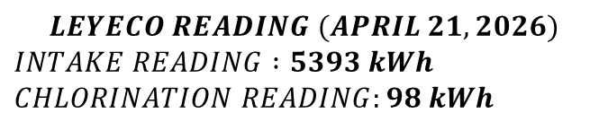



Month | Intake Bill (₱) | Chlorination Bill (₱) | Operating Hours | Production m³ | Specific Energy Consumption (kWh/m³)
April 21, 2026 | ₱ 63,412.42 | ₱ 1,231.42 | 550.5 hrs | 8,542.2 m³ | 0.64 kWh/m³
May 21, 2026 | ₱ 76,584.08 | ₱ 1,567.65 | 608 hrs | 9,813.07 m³ | 0.78 kWh/m³
The SEC value tells you exactly how many kilowatts of electricity your plant burns to process one cubic meter (m) of water.
$$SEC=\frac{Intake kWh+Chlorination kWh}{Total Production Volume}$$
$$LEYECO READING (APRIL 21, 2026)$$
$$INTAKE READING :5393 kWh$$
$$CHLORINATION READING:98 kWh$$
$$SEC=\frac{5,393 kWh+98 kWh}{8,542.2{ m}^{3}}=0.64kWh/m^{3}$$
$$LEYECO READING (MAY 21,2026)$$
$$INTAKE READING :7,511 kWh$$
$$CHLORINATION READING:146 kWh$$
$$SEC=\frac{7,511kWh+146kWh}{9,813.07{ m}^{3}}=0.78 kWh/m^{3}$$

Slide 13
Month | Intake Bill (₱) | Chlorination Bill (₱) | Operating Hours | Production m³ | Specific Energy Consumption (kWh/m³)
April 21, 2026 | ₱ 63,412.42 | ₱ 1,231.42 | 550.5 hrs | 8,542.2 m³ | 0.64 kWh/m³
May 21, 2026 | ₱ 76,584.08 | ₱ 1,567.65 | 608 hrs | 9,813.07 m³ | 0.78 kWh/m³
Water production volume increased by +14.9% (9,813.07 m³).
Specific Energy Consumption (SEC) spiked by +21.4%, jumping from (0.64 kWh/m³) to (0.78 kWh/m³).
Average hourly motor load jumped from (9.80 kW) to (12.35 kW) (+26.1%), proving the intake pumps are drawing significantly more current to operate just to move 1 cubic meter.

