Slide 1
Hauptseminar:
Rechnerarchitektur und Programmierung
Evaluation von Visualisierungsmethoden zur skalierbaren Darstellung von Laufzeit- und Strukturunterschieden in parallelen Programmabläufen
Ronny Brendel (ronny.brendel@tu-dresden.de)
Tutor: Matthias Weber (matthias.weber@tu-dresden.de)
26th April, 2014

Slide 2
Contents
Introduction
  Tracing, Vampir, Challenges
  Differences, Restrictions
Ideas & Evaluation
  Profile
  Call Matrix
Conclusion
Future Work
Sources

Slide 3
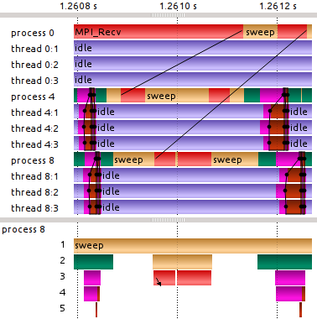
Introduction > Tracing
Profiling
  Information accumulated per function
Tracing
  Complete information about a program run
cumulative self
seconds seconds calls name
0.31 0.05 25195 QList::isEmpty()
0.40 0.04 30239 QList::Node::t()
0.44 0.04 12294 QList::end()
0.55 0.03 3696 QList::end()
0.70 0.03 4939 handleEnter
0.73 0.03 36939 handleLeave
0.88 0.02 99207 void std::swap()
Notes:
„information“:
- caller/callee relationship
- timing
- number of calls
- hardware performance counter
- variations and combinations of those
profiling:
- coarse
- usually displayed in a static way
tracing:
- fine grained
- usually displayed interactively due to the amount of data to be displayed

Slide 4
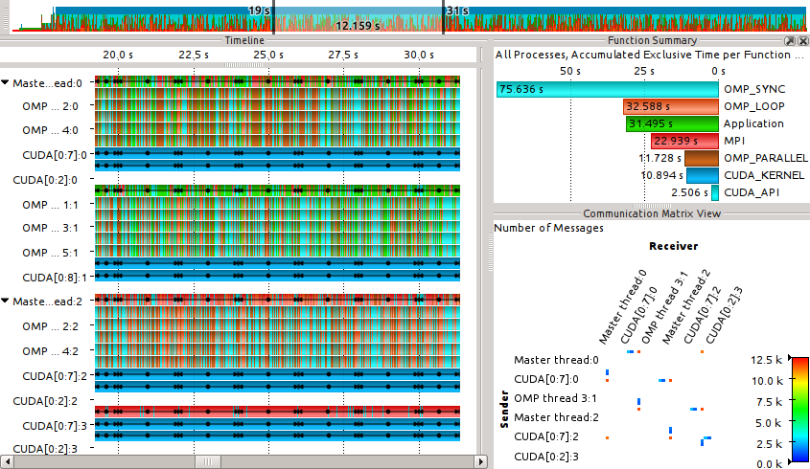
Introduction > Vampir
Notes:
~/uni/ss14/hauptseminar/traces/gromacs-mpmd-jens-doleschal-1

Slide 5
Introduction > Challenges
Datastructures & algorithms:
  Limited main memory size
  Achieving scalibility wrt the:
    Number of processes in the trace
    Number of processes used for analysis
    Trace length and detail
Visualisation:
  Limited number of Pixels on a screen
  Achieving scalibilty wrt the number of processes in the trace
  Aiding the user to gain insight into his program's behaviour and find performance problems
Notes:
„detail“:
- amount/rate of function calls
- amount/rate of auxiliar info like performance counters

Slide 6
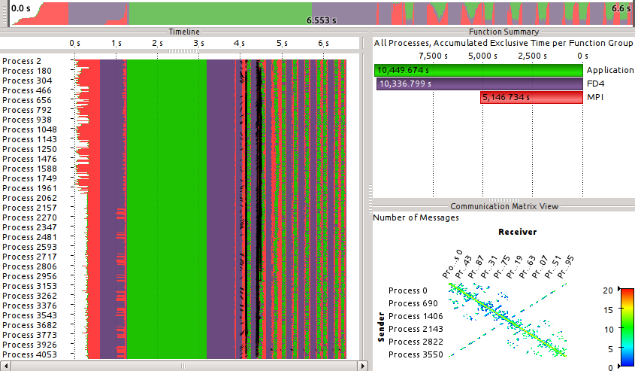
Introduction > Challenges
Notes:
- more processes than pixels vertically
- will soon reach tens of millions of processes/threads
- partially due to specialised processors like graphic accelerators and Xeon Phi
~/uni/ss14/hauptseminar/traces/bluegeneP_04096

Slide 7

Introduction > Differences
Why differences?
  Present new information
    Visualise timing differences between similar processes
    Visualise the impact of optimising a program
    Compare runs of the same program on different platforms
  Improve scalibity of existing views
    Preserve screen real estate by e.g. merging similar processes
  Aid automatic analysis
    Detect timing differences between structurally similar processes
Notes:
Optimizing by:
- changing code
- changing compiler flags
- etc.

Slide 8
Introduction > Restrictions
Because visualising differences between traces in general is much ground to cover, we focus on ...
  ... the function call stack + timing
  (no communication, no performance counters, ...)
  ... comparing processes inside the same program run
  ... offline analysis
  ... visualising/comparing profile-ish information
Notes:
- elaborate on why profilish
- first step ...
- todo

Slide 9
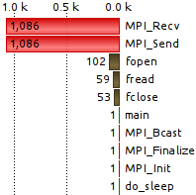
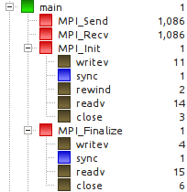
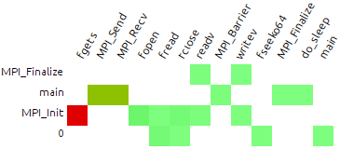
Ideas & Evaluation
Profil-ish information:
  Profile
    Accumulated information for each function
  Call Tree
    Accumulated information per call stack configuration
  Call Matrix
    Accumulated information per caller/callee pair
Notes:
- motivate call matrix
- simpler
- algorithmically
- less work
- visually
- ???
- more detailed than profiles
- some differences are expected to be harder to find in profiles.
- a process mostly sends and reads some might be distinguishable from another process because his „other duties“ cause him to call functions from other places

Slide 10
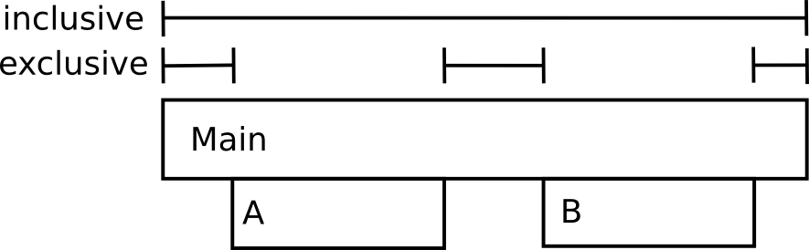

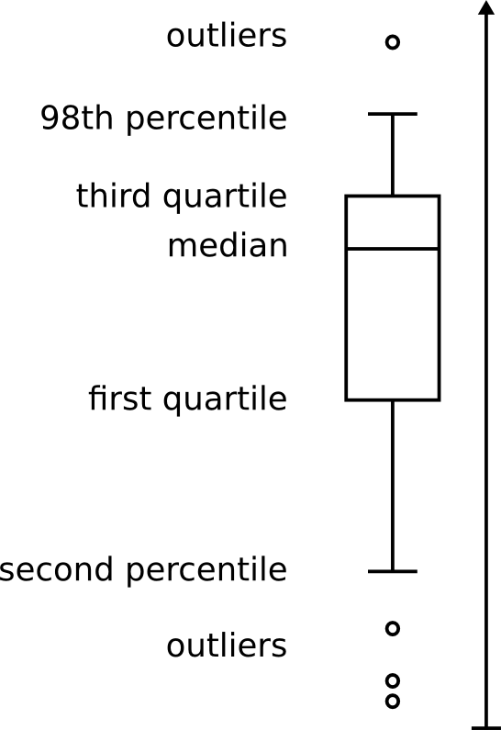
Ideas & Evaluation
What information are we comparing?
  Execution times
    Exclusive
    Inclusive
    Derived Values
      Min, max, average, standard deviation
      Median, Quartiles/Percentiles
      → Boxplot
  Number of invocations
Notes:
- explain quantiles / median
- 50% of values are between ...
- explain experiments
- standard deviation
- hard to interpret intuitively
- no distinction between lower/higher than average
- tried average difference from average. not as good as quartiles

Slide 11
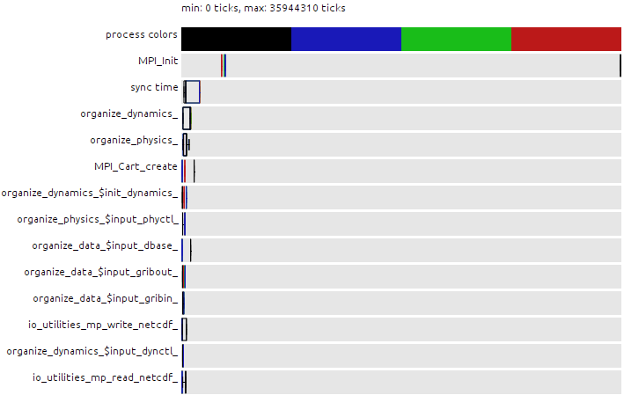
Ideas & Evaluation > Profile
Exclusive time, four processes
Notes:
~/uni/ss14/hauptseminar/traces/compare/app-optimization/cosmo-orig

Slide 12
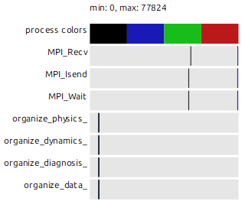
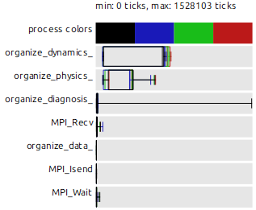
Ideas & Evaluation > Profile
Invocation count, four processes
Exclusive time, four processes

Slide 13
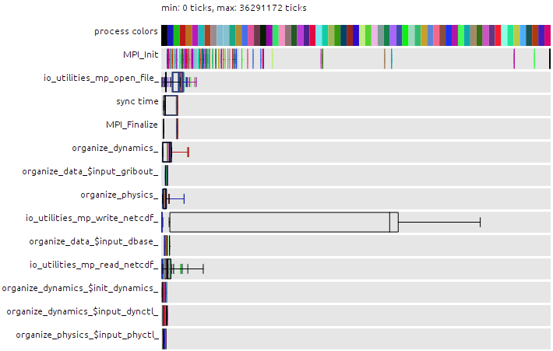
Ideas & Evaluation > Profile
Exclusive time, 64 processes

Slide 14
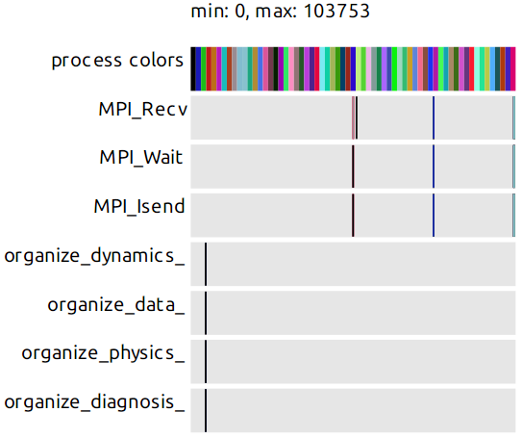
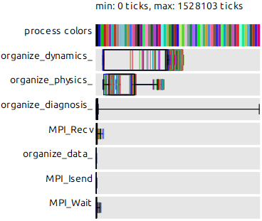
Ideas & Evaluation > Profile
Invocation count, 64 processes
Exclusive time, 64 processes
Notes:
schwaeche. keine anzahl der aufrufe sichtbar

Slide 15


Ideas & Evaluation > Call Matrix
Color-coded box plot
  Area is divided in 1 + 3 + 6 + 3 + 1 parts
  Linear gradient:
second percentile
first quartile
median
third quartile
98th percentile

Slide 16
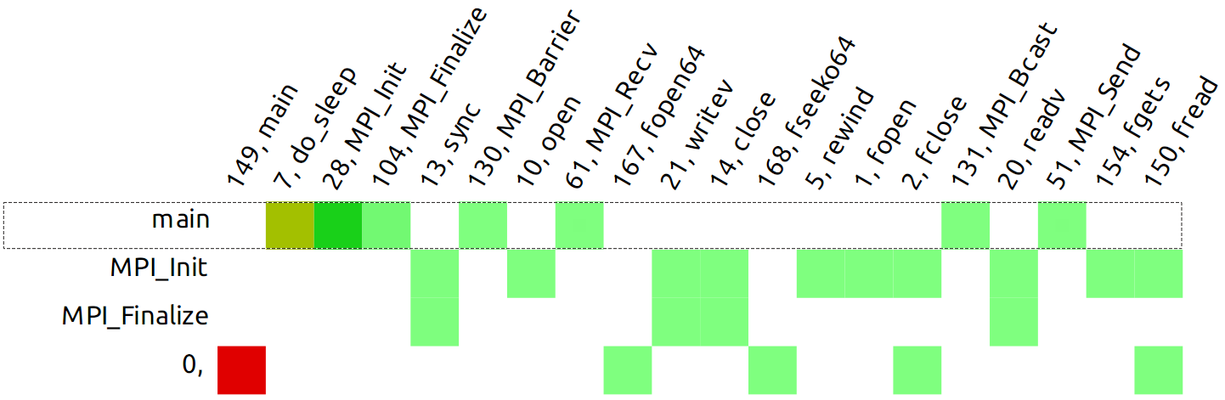
Ideas & Evaluation > Call Matrix
Ping pong example, 1 process, inclusive time

Slide 17
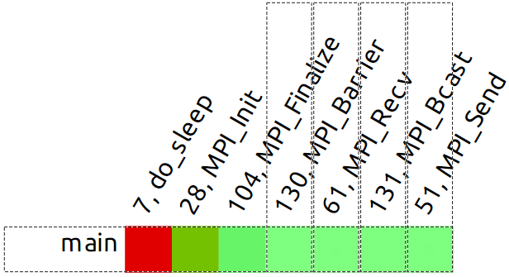
Ideas & Evaluation > Call Matrix
Ping pong example, 1 process, inclusive time
main selected

Slide 18
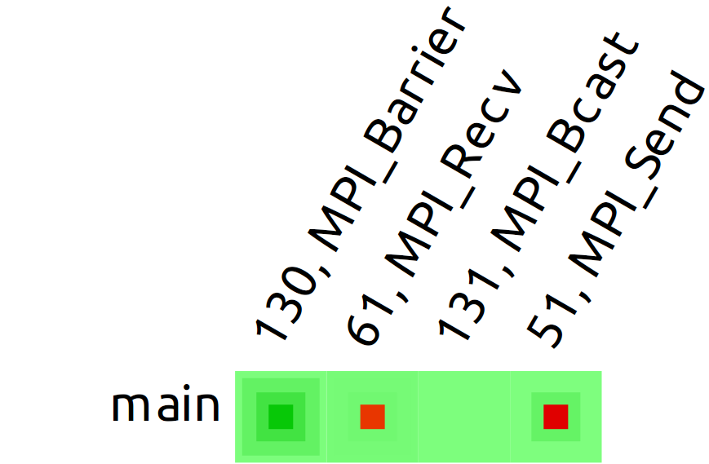
Ideas & Evaluation > Call Matrix
Ping pong example, 1 process, inclusive time
main + interesting sub-calls selected

Slide 19
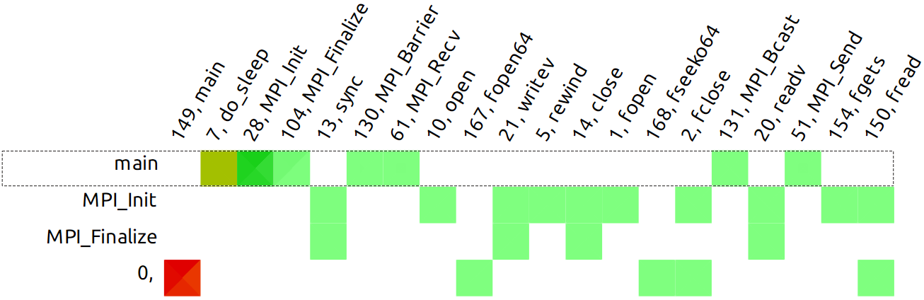
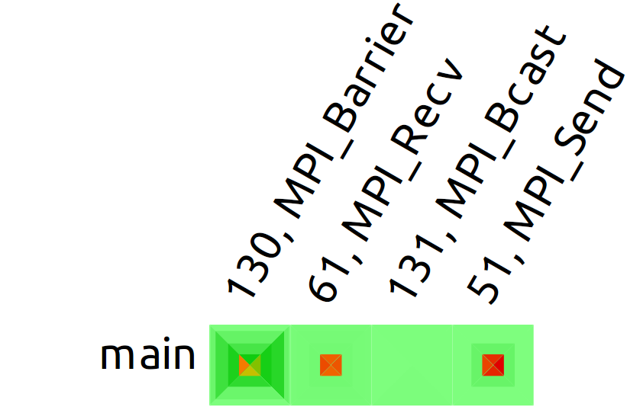
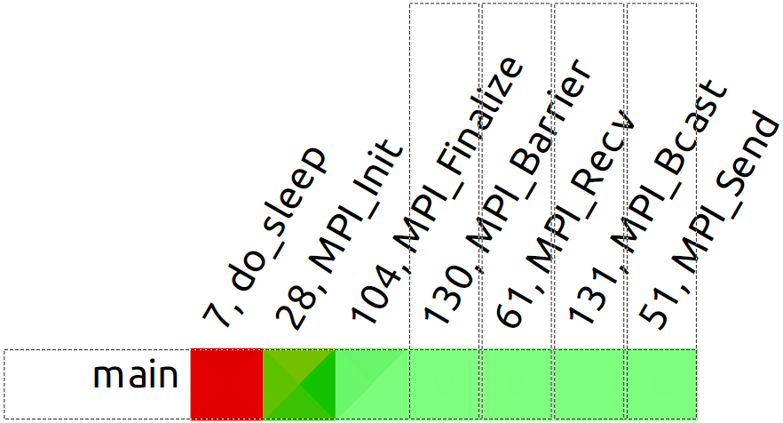
Ideas & Evaluation > Call Matrix
Ping pong example, 4 processes, inclusive time
Notes:
- explain how processes are laid out
- reiterate on problem with low call counts
- boxplots not super useful, gradient gets stretched by 98th percentile

Slide 20
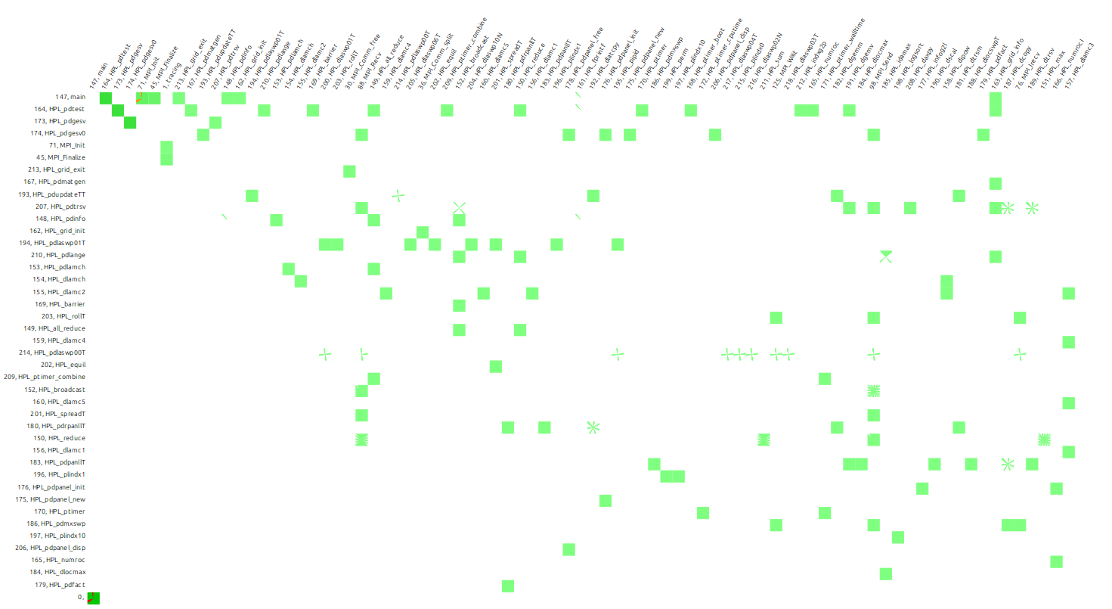
Ideas & Evaluation > Call Matrix
Linpack, 32 processes, inclusive time
Notes:
- only ~40 secs long
- scalibity with processes good
- many functions bad
- pre filtering + automatic grouping of processes
-> better overview and scalibity

Slide 21
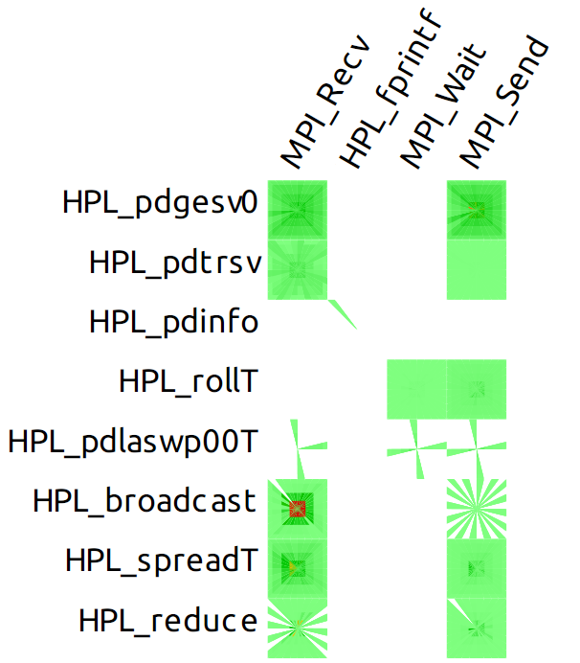
Ideas & Evaluation > Call Matrix
Linpack, 32 processes, inclusive time
Notes:
- prozesse vermutlich einteilbar in wer called wen „ueberhaupt“
- nie wildwuchs an caller/callee. anzahl der gruppen vermutlich ueberschaubar
- some traces show no pattern. every caller/callee pair is used by every process e.g. ~/uni/ss14/hauptseminar/traces/fd4-p1024

Slide 22
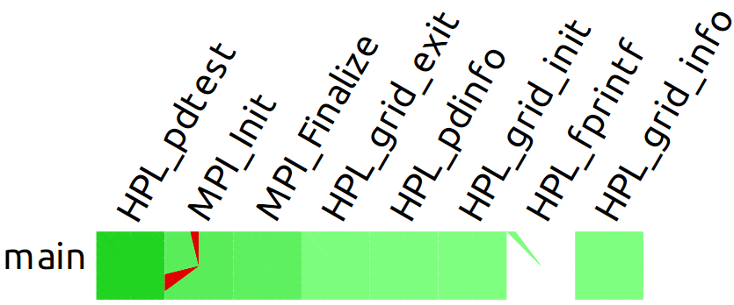

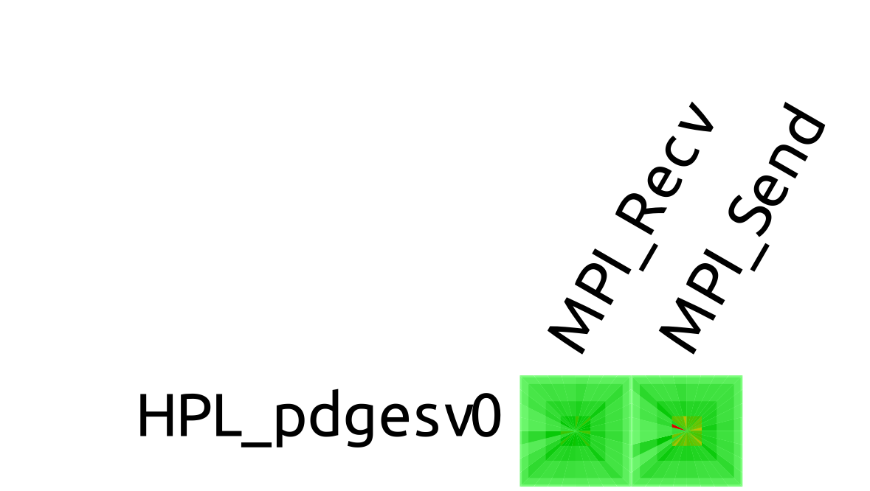
Ideas & Evaluation > Call Matrix
Linpack, 32 processes, inclusive time
Notes:
top left)
- init takes long on 3 processes
- others are quicker
bottom right)
- ever later start times
- same end time
bottom)
- prinzipiell wie die verteilung an send/recv aufrufzeiten zb aussehen kann

Slide 23
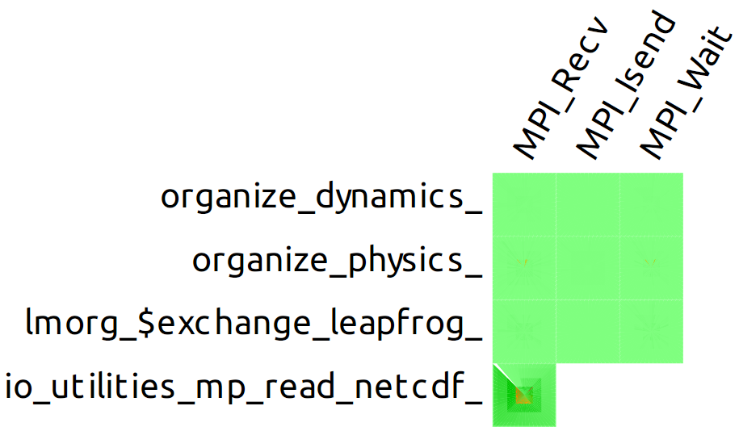
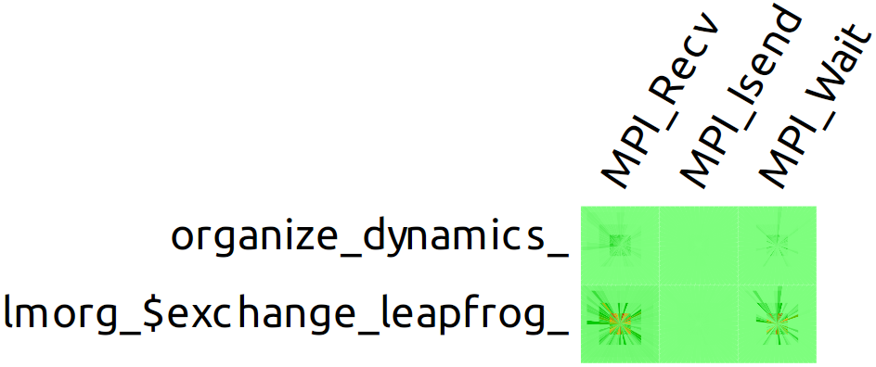
Ideas & Evaluation > Call Matrix
COSMO-SPECS, 32 processes, exclusive time

Slide 24
Conclusion
Comparing profiles:
  Good for getting a qualitative overview
  Not suitable for finding details
Comparing call matrixes:
  Not suitable for visualisation in its current state
  Improvable through automatic filtering/grouping of functions and processes
  Simple, scalable and helpful for automatic analysis
Generally:
  Boxplots are good
  Median/Percentiles are good (more difficult to determine, though)
  Filtering profiles by callers makes sense
Notes:
- automatic grouping of processes would help profiles, too. do not compare structurally different processes

Slide 25
Future Work
Short-term:
  Compare/Visualise call trees
  Develop similarity metrics based on profiles and call matrixes
  → Automatically group processes
Long-term:
  Visualise differences and similiarities in structure and timing of traces (not profiles, but stack over time)
Notes:
- automatic grouping for:
- to compare „similar“ processes in detail, but not the ones that are very different
- merge similar processes to preserve screen space

Slide 26
Sources
[1] Andreas Knüpfer, Holger Brunst, Jens Doleschal, Matthias Jurenz, Matthias Lieber, Holger Mickler, Matthias S. Müller, and Wolfgang E. Nagel. The Vampir Performance Analysis Tool-Set. In Tools for High Performance Computing, pages 139–155. Springer, 2008.
[2] Matthias Weber, Ronny Brendel, and Holger Brunst. Trace File Comparison with a Hierarchical Sequence Alignment Algorithm. In IEEE 10th International Symposium on Parallel and Distribut ed Processing with Applications, pages 247–254. IEEE, 2012.
[3] Matthias Weber, Kathryn Mohror, Martin Schulz, Bronis R. de Supinski, Holger Brunst, and Wolfgang E. Nagel. Alignment-Based Metrics for Trace Comparison. In Euro-Par 2013 Parallel Processing, pages 29–40. Springer, 2013.

Slide 27
Thank You!

