Slide 1
Hauptseminar Rechnerarchitektur und Programmierung
Zentrum für Informationsdienste und Hochleistungsrechnen (ZIH)
Adapteva Parallella:
Crowd-funded Low-budget Open-source HPC

Slide 2
Structure
Presentation of the Adapteva Parallella Platform
Company history of Adapteva
Motivation
Parallella board
Epiphany coprocessor
Implementation of 1D-FFT with filtering
Motivation and explanation
Details of implementation
Performance results
Comparison with actual architectures
Potential of this platform for HPC
2

Slide 3
Company history of Adapteva
Feb 2008: Founded by Andreas Oloffson
Goal: 10 times advancement in floating point processing energy efficiency
Jun 2009: Tapeout of Epiphany-I prototype (65nm)
Secured 1.5M US$ in Series-A funding from Bittware
May 2010: Tapeout of Epiphany-II 16-core prototype (65nm)
Dec 2010: Tapeout of Epiphany-III product (65nm)
May 2011: Sampled Epiphany-III (65nm) product
Aug 2012: Demonstration of 50 GFLOPS/Watt efficiency at 28nm
Oct 2012: Launch of Parallella kickstarter project
Dec 2012: Shipment of first Parallella prototypes
Jul 2013: first Parallella boards shipped to Kickstarter backers
Apr 2014: Completed shipping of all Parallella boards to Kickstarter backers
3

Slide 4
Parallella Kickstarter Program
Slogan: “The parallella project will make parallel computing accessible to everyone”
Kickstarter project gained 898.921$ from 4965 backers
Attributes:
Open Access: no NDAs or special access needed
Open Source: platform based on free open source development tools and libraries
Affordability: Parallella high performance computer at costs below 100$
→ Close the knowledge gap in parallel programing
→ Democratize access to parallel computing
4

Slide 5
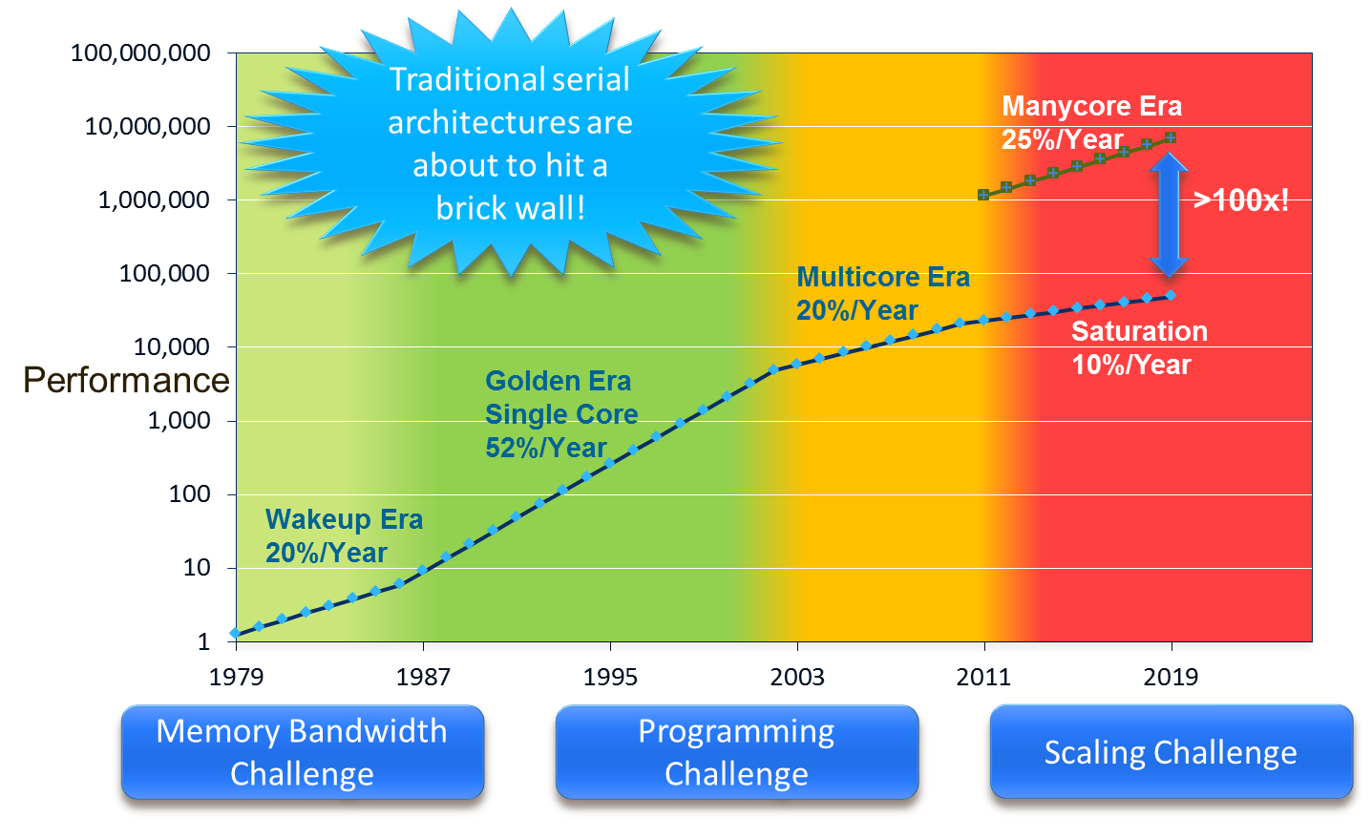
Motivation for Epiphany multicore architecture
5

Slide 6
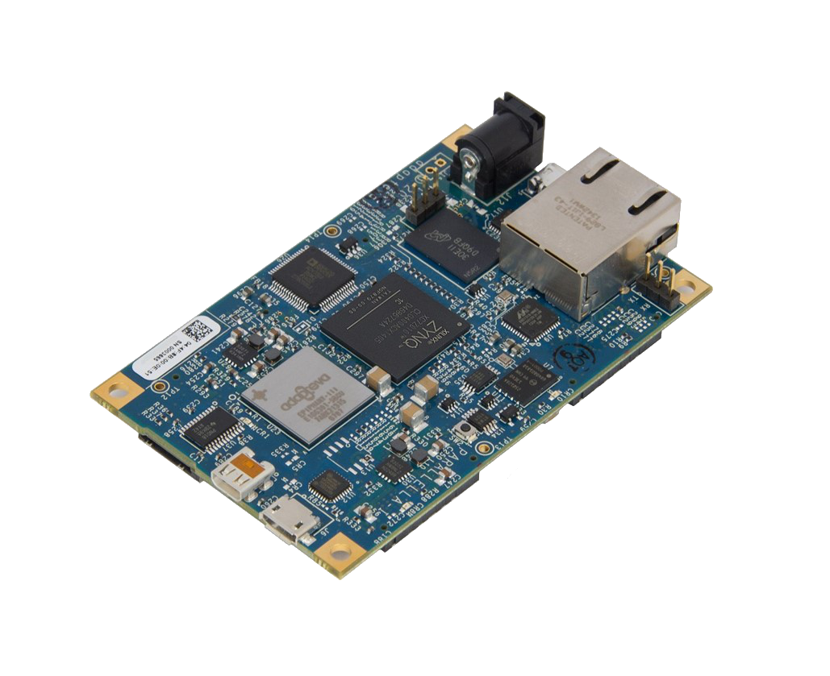

Parallella Board
Tech specs:
Dual-core ARM A9
16-core Epiphany Coprocessor
1 GB Ram
MicroSD Card
USB 2.0
Gigabit Ethernet
Linux operating system
6

Slide 7
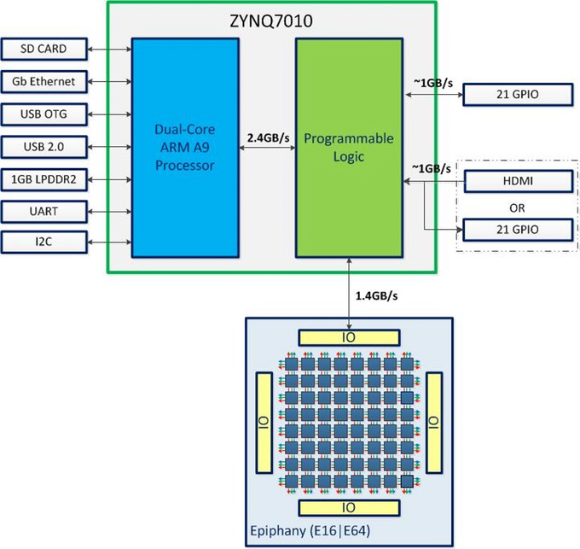
System overview of Parallella board
7

Slide 8
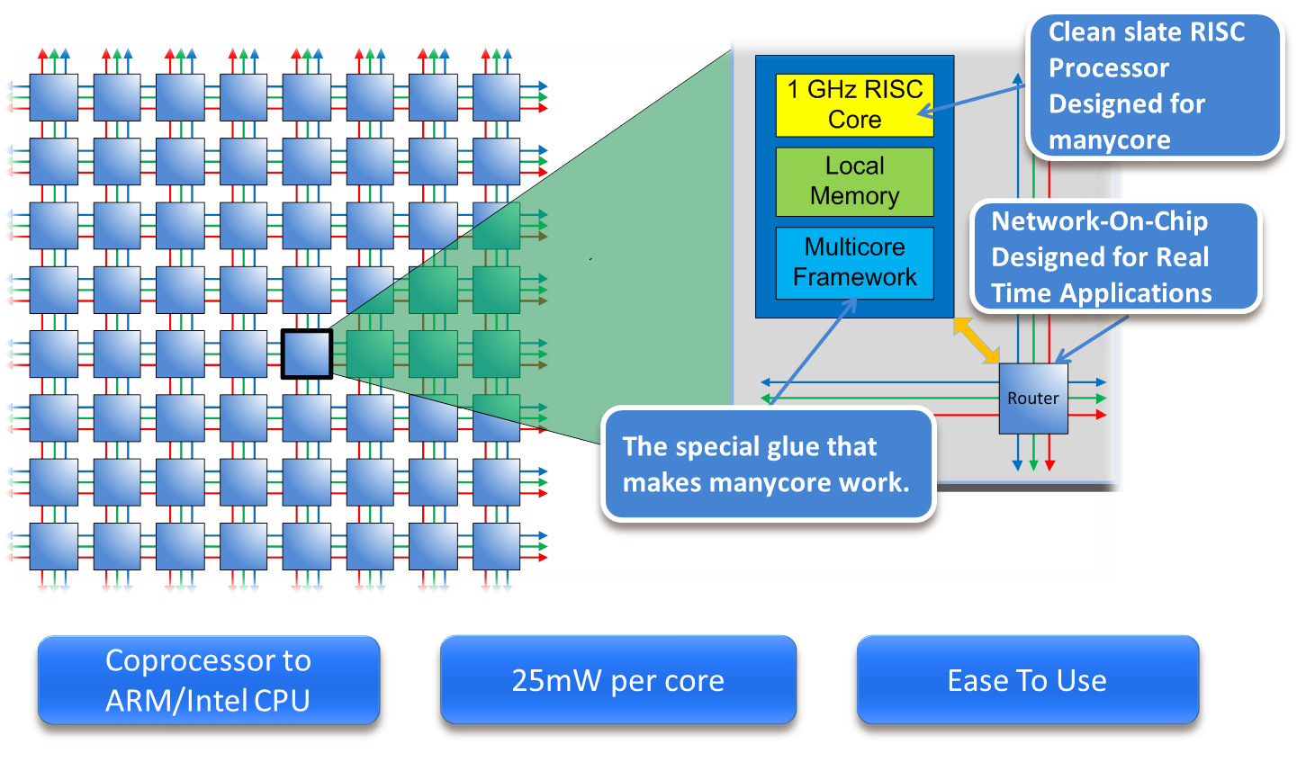
High level overview of the Epiphany architecture
8

Slide 9
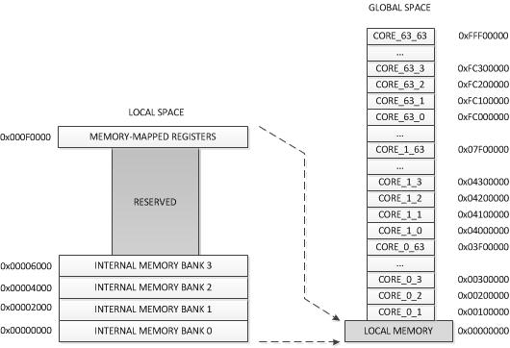
Memory scheme of the Epiphany architecture
Attributes:
flat 32 bit address space split into 4096 1-MiB chunks
Each core is assigned his own 1-MiB chunk
But has transparent access to memory of any other core
Optimal performance only if data is placed in local memory banks
9

Slide 11
Data transfer vs calculation time
Data transfer is main bottleneck
to increase performance, more calculation per memory transfer is necessary

