Slide 1
Hauptseminar Rechnerarchitektur und Programmierung
Zentrum für Informationsdienste und Hochleistungsrechnen (ZIH)
Adapteva Parallella:
Crowd-funded Low-budget Open-source HPC

Slide 2
Structure
Presentation of the Adapteva Parallella Platform
Company history of Adapteva
Motivation
Parallella board
Epiphany coprocessor
Implementation of 1D-FFT with filtering
Motivation and explanation
Details of implementation
Performance results
Comparison with actual architectures
Potential of this platform for HPC
2

Slide 3
Company history of Adapteva
Feb 2008: Founded by Andreas Oloffson
Goal: 10 times advancement in floating point processing energy efficiency
Jun 2009: Tapeout of Epiphany-I prototype (65nm)
Secured 1.5M US$ in Series-A funding from Bittware
May 2010: Tapeout of Epiphany-II 16-core prototype (65nm)
Dec 2010: Tapeout of Epiphany-III product (65nm)
May 2011: Sampled Epiphany-III (65nm) product
Aug 2012: Demonstration of 50 GFLOPS/Watt efficiency at 28nm
Oct 2012: Launch of Parallella kickstarter project
Dec 2012: Shipment of first Parallella prototypes
Jul 2013: first Parallella boards shipped to Kickstarter backers
Apr 2014: Completed shipping of all Parallella boards to Kickstarter backers
3

Slide 4
Parallella Kickstarter Program
Slogan: “The parallella project will make parallel computing accessible to everyone”
Kickstarter project gained 898.921$ from 4965 backers
Attributes:
Open Access: no NDAs or special access needed
Open Source: platform based on free open source development tools and libraries
Affordability: Parallella high performance computer at costs below 100$
→ Close the knowledge gap in parallel programing
→ Democratize access to parallel computing
4

Slide 5
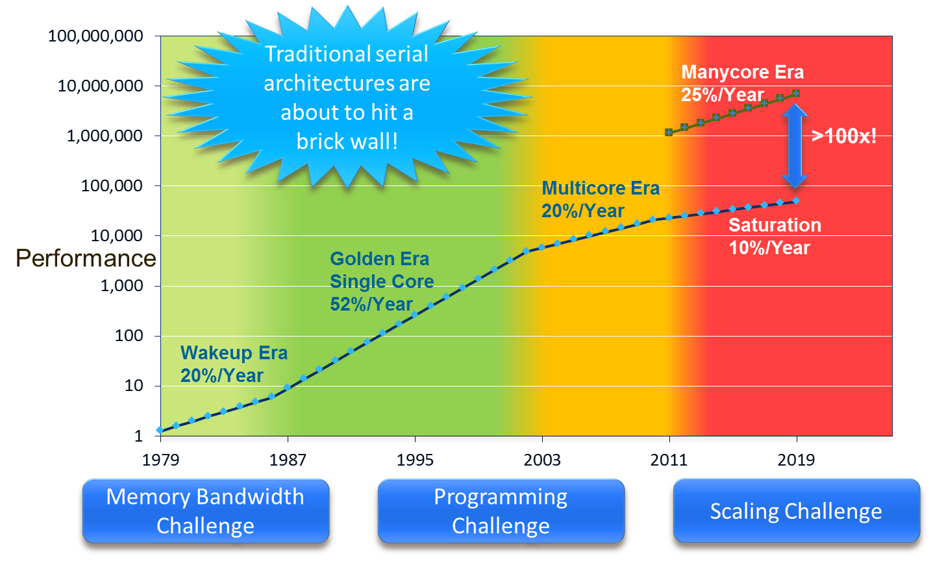
Motivation for Epiphany multicore architecture
5

Slide 6
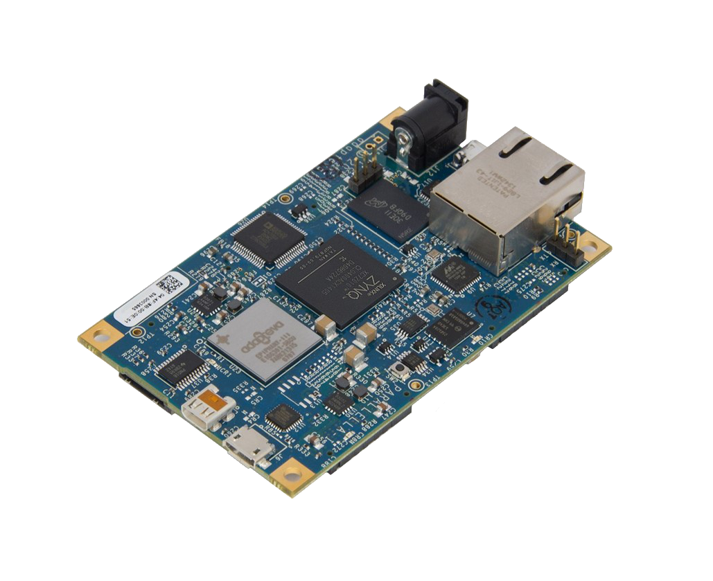

Parallella Board
Tech specs:
Dual-core ARM A9
16-core Epiphany Coprocessor
1 GB Ram
MicroSD Card
USB 2.0
Gigabit Ethernet
Linux operating system
6

Slide 7
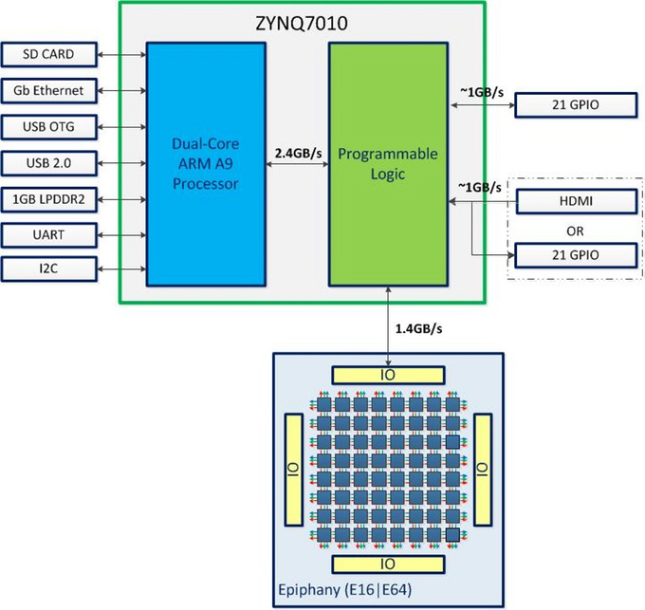
System overview of Parallella board
7

Slide 8
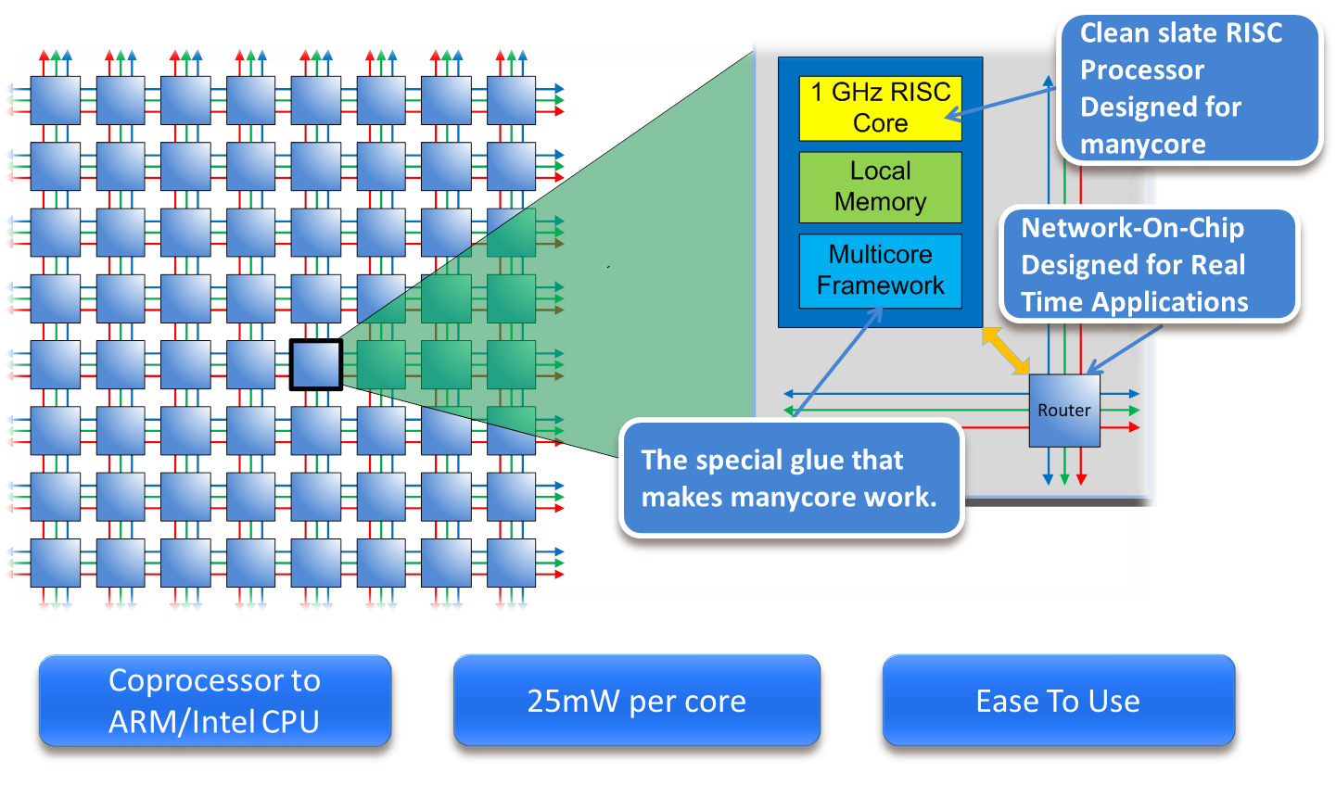
High level overview of the Epiphany architecture
8

Slide 9
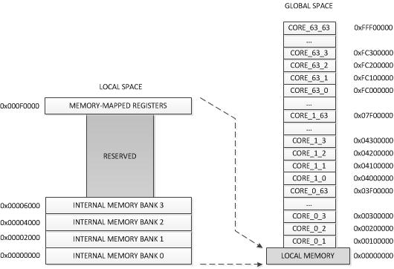
Memory scheme of the Epiphany architecture
Attributes:
flat 32 bit address space split into 4096 1-MiB chunks
Each core is assigned his own 1-MiB chunk
But has transparent access to memory of any other core
Optimal performance only if data is placed in local memory banks
9

Slide 11
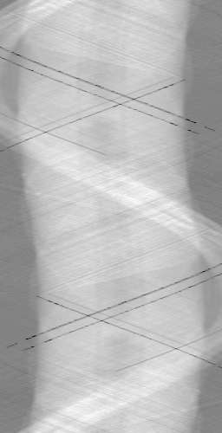
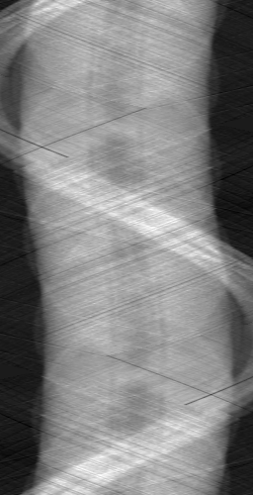
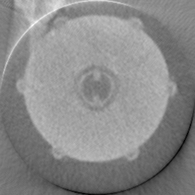
Motivation: Implementation of FFT on Epiphany
Fast Fourier Transform is basic operation for many applications
Algorithm to compute the discrete fourier transform
Concrete example: Filtered backprojection as CT-Reconstruction algorithm
FFT + Filtering
+ Inverse FFT
Backprojection
Implementation on Parallella

Slide 12
Details of implementation

Slide 13
Data transfer vs calculation time (16 cores)
Data transfer is main bottleneck
to increase performance, more calculation per memory transfer is necessary

Slide 14
Speedup

