Slide 1
Hauptseminar Rechnerarchitektur und Programmierung
Zentrum für Informationsdienste und Hochleistungsrechnen (ZIH)
Adapteva Parallella:
Crowd-funded Low-budget Open-source HPC

Slide 2
Structure
The Adapteva Parallella Platform
Company history of Adapteva
Motivation
The Parallella board
The Epiphany coprocessor
Implementation of the 1D-FFT with filtering
Motivation
Implementation details
Performance results
Comparison with current architectures - GPUs
Assessing the Parallella's potential for HPC
2

Slide 3
Company History of Adapteva
Feb 2008: Founded by Andreas Oloffson
Goal: 10 times advancement in floating point processing energy efficiency
Jun 2009: Tapeout of Epiphany-I prototype (65nm)
Secured 1.5M US$ in Series-A funding from Bittware
May 2011: Sampled Epiphany-III (65nm) product
Aug 2012: Demonstration of 50 GFLOPS/Watt efficiency at 28nm
Oct 2012: Launch of Parallella kickstarter project
Jul 2013: first Parallella boards shipped to Kickstarter backers
Apr 2014: Completed shipping of all Parallella boards to Kickstarter backers
3

Slide 4
Parallella Kickstarter Program
Slogan: “The parallella project will make parallel computing accessible to everyone”
Kickstarter project gained 898,921$ from 4,965 backers
Attributes:
Open Access: no NDAs or special access needed
Open Source: platform based on free open source development tools and libraries
Affordable: Parallella high performance computer at costs below 100$
→ Close the knowledge gap in parallel programing
→ Democratize access to parallel computing
4

Slide 5
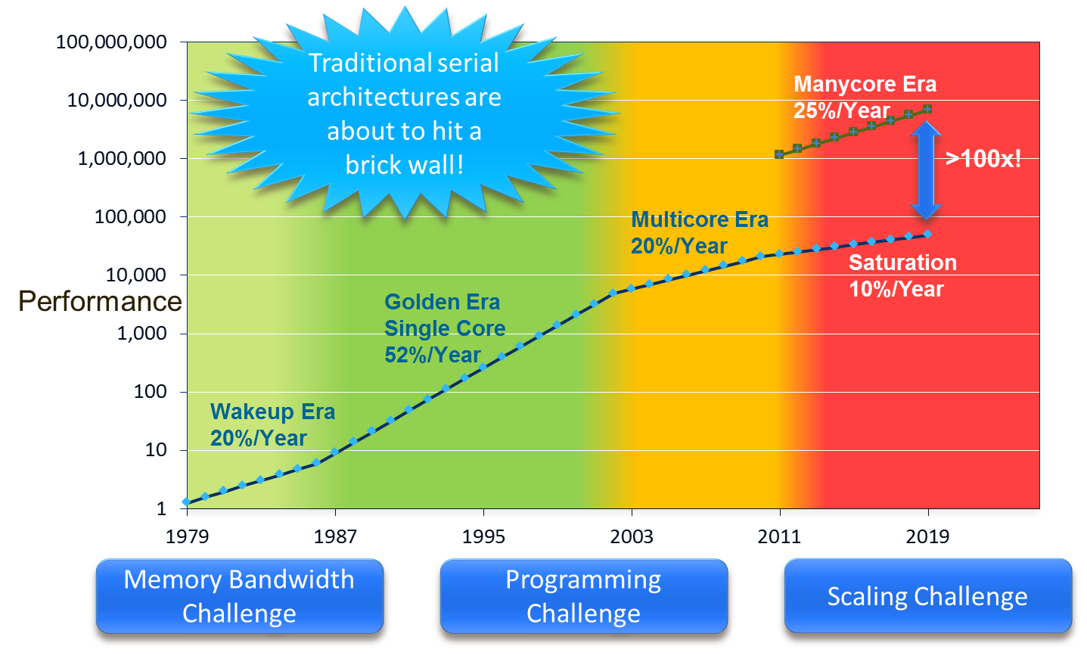
Motivation for Epiphany Multicore Architecture
5

Slide 6
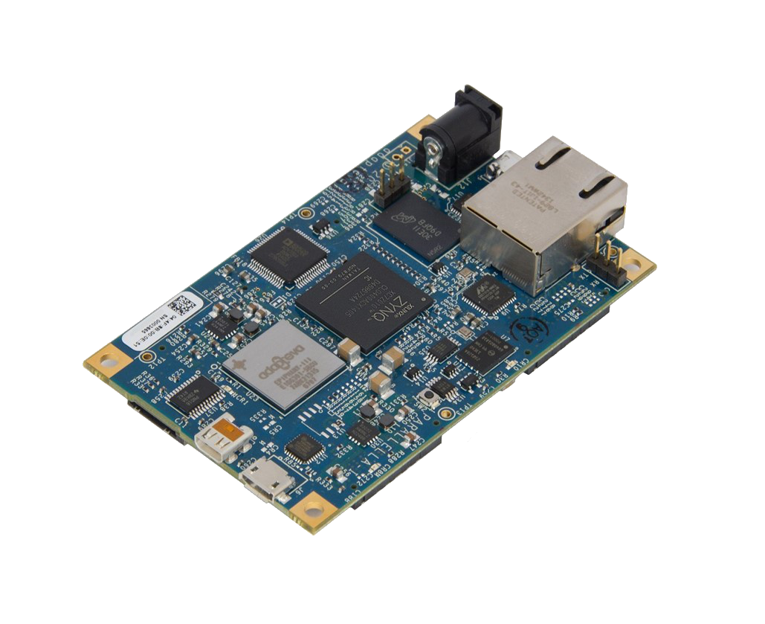

Parallella Board
Tech specs:
Dual-core ARM A9
16-core Epiphany Coprocessor
1 GB RAM
MicroSD Card
USB 2.0
Gigabit Ethernet
Linux
Peak Performance: 26 GFLOP/s (single precision)
2 Watt Energy Consumption
6

Slide 7
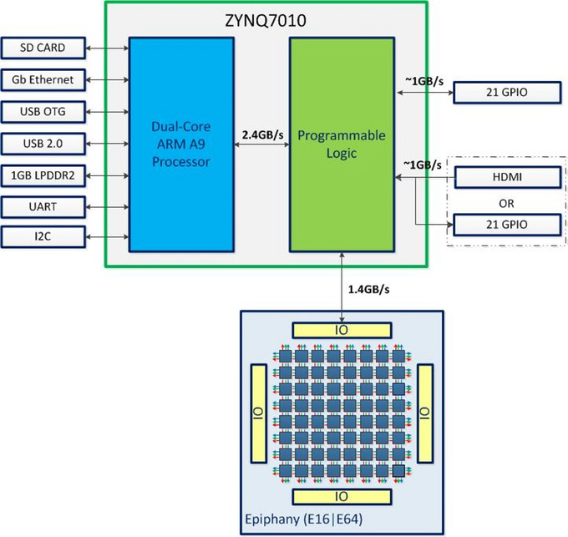
System Overview of Parallella Board
7

Slide 8
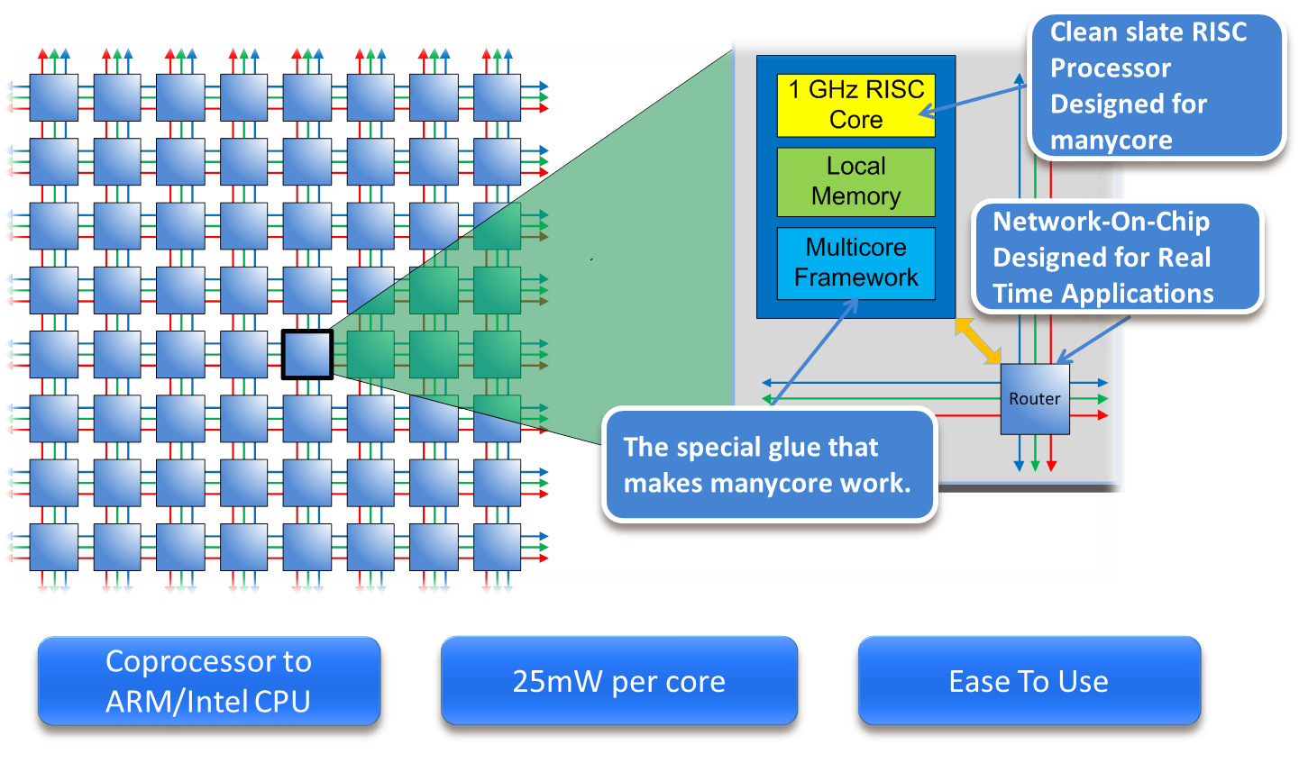
High Level Overview of the Epiphany Architecture
8

Slide 9
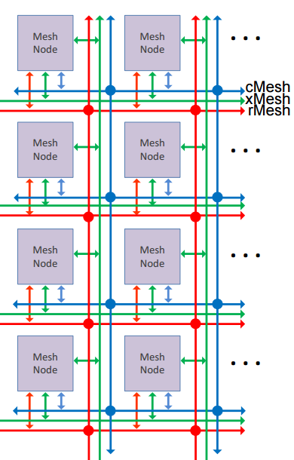
eMesh Network on Chip
Attributes:
Only nearest neighbor connections
Connections to North, East, South and West
1.5 clock cycles latency per hop (write)
Three separate orthogonal networks:
cMesh: used for on-chip write transactions
xMesh: used for off-chip write transactions
rMesh: used for all read requests
9

Slide 10
Memory Scheme of the Epiphany Architecture
Attributes:
Flat 32 bit address space split into 4096 1-MiB chunks
Each core is assigned his own 1-MiB chunk
But has transparent access to memory of any other core
Optimal performance only if data is placed in local memory banks
Magic address translation – each core can access all memory locations
10

Slide 11
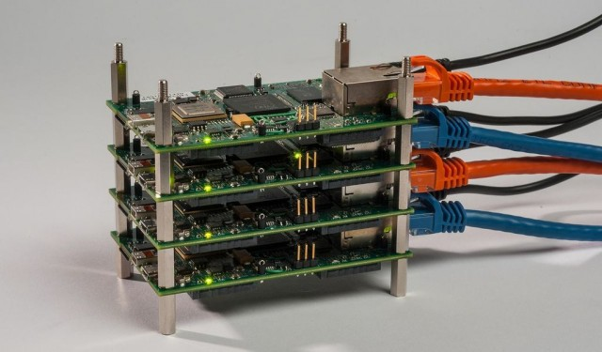
Example: Parallella as a Cluster
Boards can be combined to one cluster
Gigabit-Ethernet interconnect
→ With thousands of boards put together you can build a supercomputer at low cost
11

Slide 12
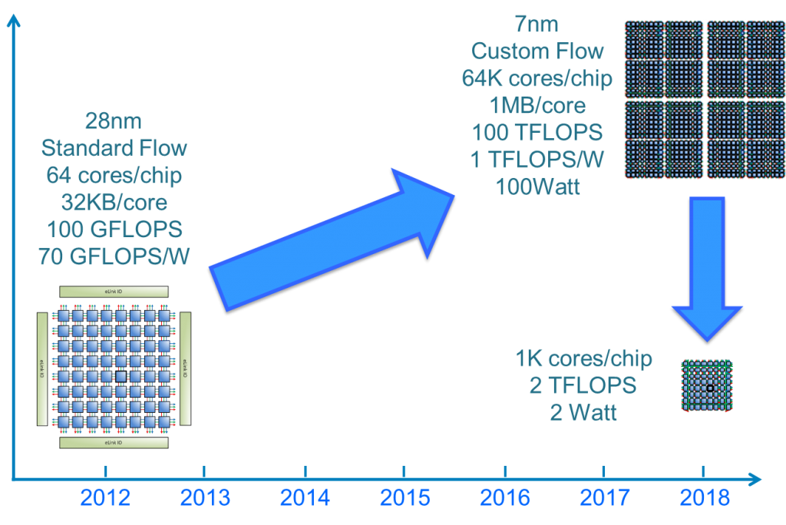
Future Ideas for Epiphany Architecture
12

Slide 13
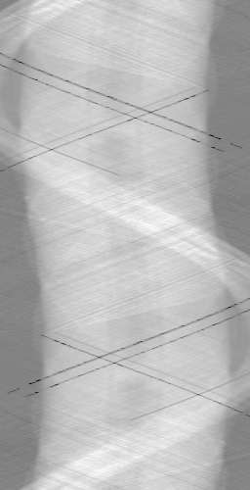
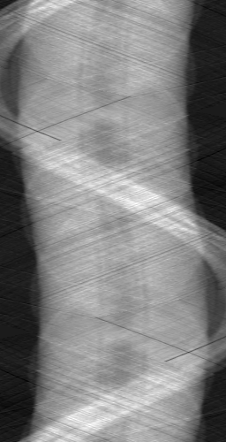
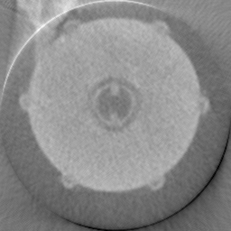
Motivation: Implementation of the 1D-FFT on Epiphany
Fast Fourier Transform is basic operation for many applications
Algorithm to compute the discrete fourier transform
Concrete example: Filtered backprojection as CT-Reconstruction algorithm
FFT + Filtering
+ Inverse FFT
Backprojection
Implementation on Parallella
13

Slide 14
Implementation details
Attributes:
Sinogram is divided into lines
16 cores calculate 64 lines in parallel to transfer as much data as possible
Data Transfer
(serial)
Data Transfer
(serial)
Read Tif-Image
Computation
Write Tif-Image
16x
16x
…
16x
…
…
Repeat until all lines are done
Hostprocessor
Epiphany-Coprocessor
14

Slide 15
Data Transfer vs Calculation Time (1 core)
Data transfer is the main bottleneck
To increase performance, more calculation per memory transfer is necessary
Due to Amdahls law speedup cannot exceed 2.5 with 16 cores
Maximum speedup of 2.9 possible
→TODO: reason
15

Slide 16
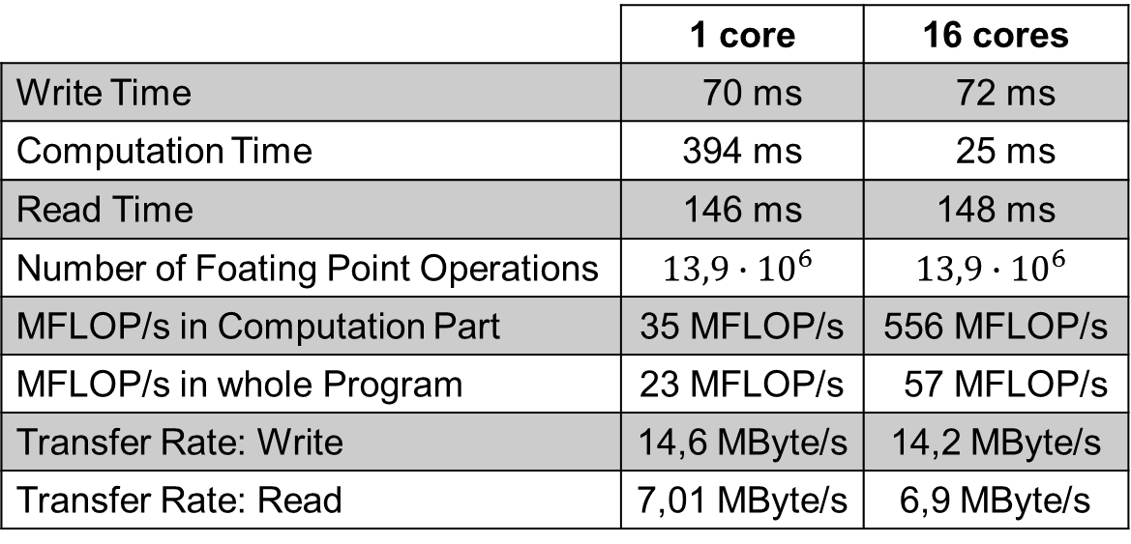
Performance Results
Results measured for 500 FFTs of size 256
Small memory transfer rate to local memory banks
Read = read + write → half performance compared to write
 | 1 core | 16 cores
Write Time | 70 ms | 72 ms
Computation Time | 394 ms | 25 ms
Read Time | 146 ms | 148 ms
Number of Foating Point Operations | $$13,9∙{10}^{6}$$ | $$13,9∙{10}^{6}$$
MFLOP/s in Computation Part | 35 MFLOP/s | 556 MFLOP/s
MFLOP/s in whole Program | 23 MFLOP/s | 57 MFLOP/s
Transfer Rate: Write | 14,6 MByte/s | 14,2 MByte/s
Transfer Rate: Read | 7,01 MByte/s | 6,9 MByte/s
16

Slide 17
Speedup of parallelisable Calculation Part
17

Slide 18
Overall Speedup
18

Slide 19
Excursion: Memory Bandwidth
19

Slide 20
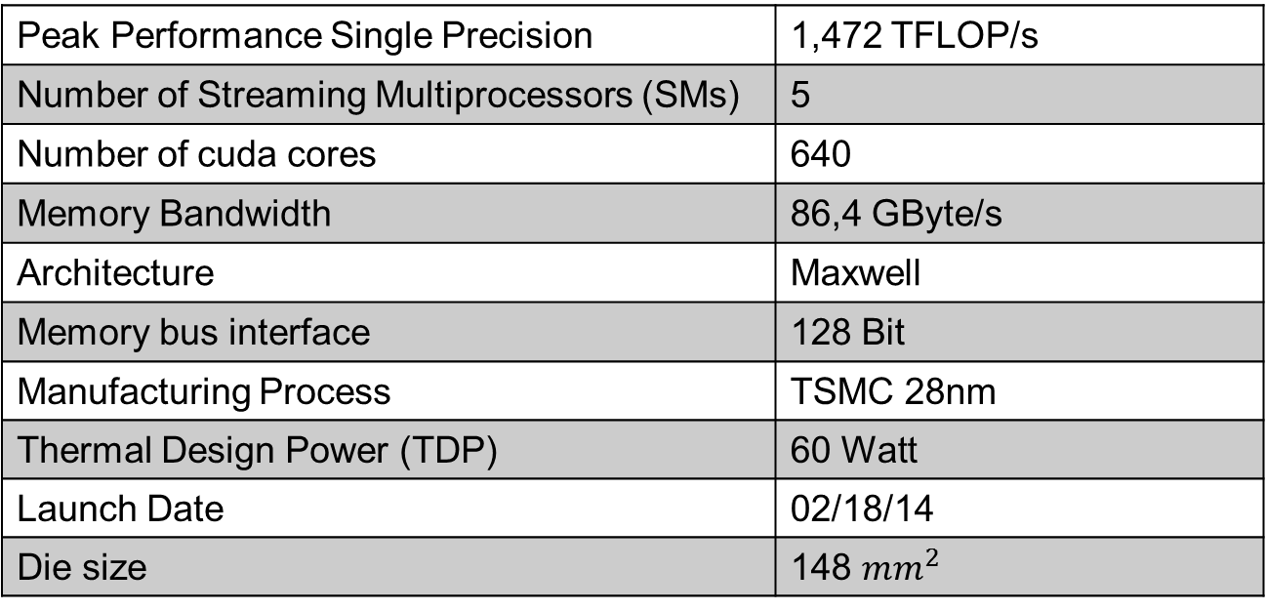
Comparison with current Architecture - GPUs
Comparison with Intel Core i7 2600 combined with Nvidia Geforce 750Ti in terms of energy efficiency
Identical implementation with use of cufft-Library from Nvidia
Peak Performance Single Precision | 1,472 TFLOP/s
Number of Streaming Multiprocessors (SMs) | 5
Number of cuda cores | 640
Memory Bandwidth | 86,4 GByte/s
Architecture | Maxwell
Memory bus interface | 128 Bit
Manufacturing Process | TSMC 28nm
Thermal Design Power (TDP) | 60 Watt
Launch Date | 02/18/14
Die size | 148 ${mm}^{2}$
20

Slide 21
Comparison of Parallella with GeForce 750 Ti
To stay fair comparison in terms of energy efficieny and chip area
Energy consumption/Picture [mWs]:
Initialization phase of cuFFT very time consuming
Due to low memory size, and small memory bandwidth, GPU can outperform Parallella in terms of energy efficiency in this case
Number of Pictures | Parallella | GPU
1 | 510 | 10200
100 | 510 | 114
1000 | 510 | 18,6
21

Slide 22
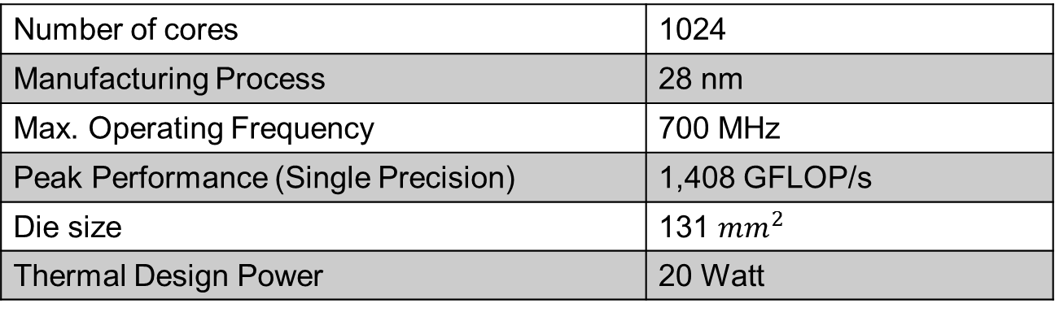
Comparison in Terms of Chip Area
Example configuration of Epiphany with 1024 cores:
Comparable to NVIDA Geforce 750 TI in terms of die size
Number of cores | 1024
Manufacturing Process | 28 nm
Max. Operating Frequency | 700 MHz
Peak Performance (Single Precision) | 1,408 GFLOP/s
Die size | 131 ${mm}^{2}$
Thermal Design Power | 20 Watt
22

Slide 23
Assessing the Parallella's Potential for HPC
Pros:
Interesting architecture
Cons:
Memory transfer bottleneck
Small local memory size
23

Slide 24
Thank you

