Slide 1
A lock-less shared memory barrier without atomic operations
Part 1: Theory
Ronny Brendel
Tutors: Marcus Völp, Sascha Klüppelholz
2013-03-22

Slide 2
Table of content
Introduction
Mc Guire's idea
The extended protocol
  Correctness
  Quantitative analysis
Conclusion
Future work
Notes:
* Introduction explain, motivate
* Mc Guire's idea pw/cs, his barrier idea
* The extended protocol explain
* Correctness
* Quantitative analysis
* Conclusion
* Future work

Slide 3
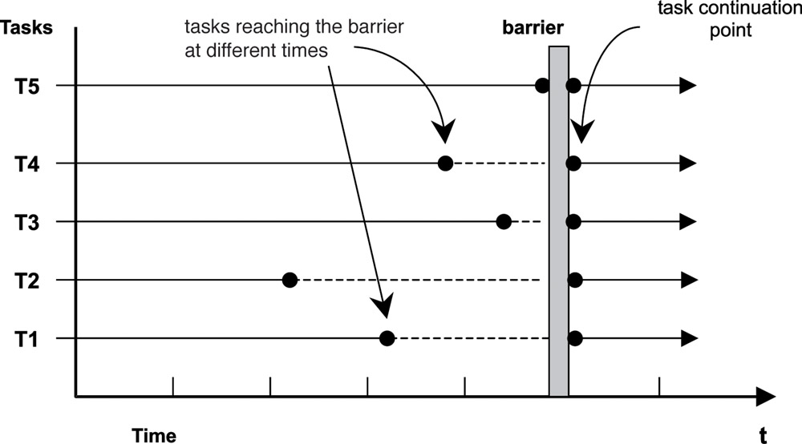
Introduction

Slide 4
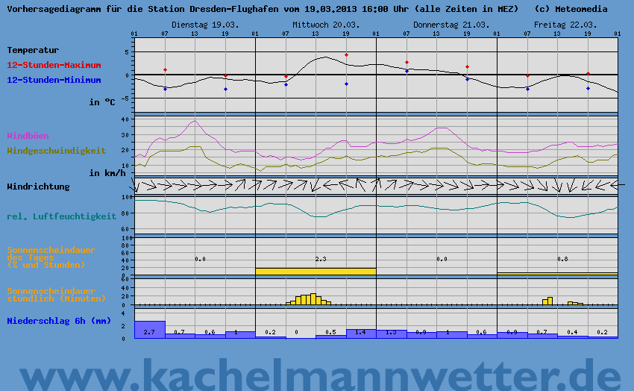
Introduction
Notes:
Common

Slide 5
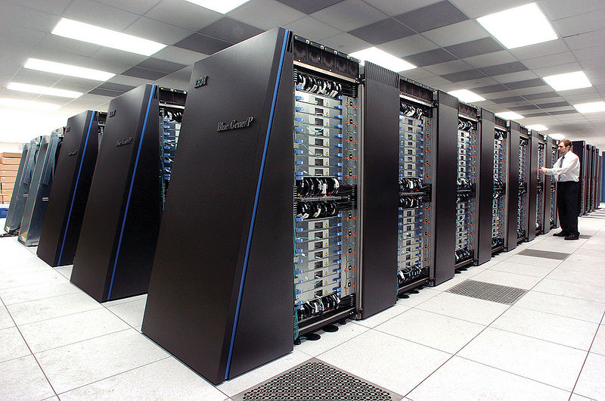
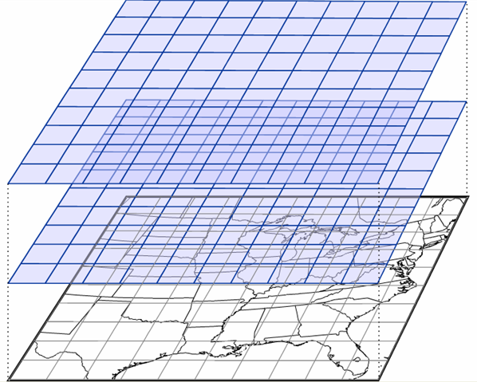

Introduction

Slide 6
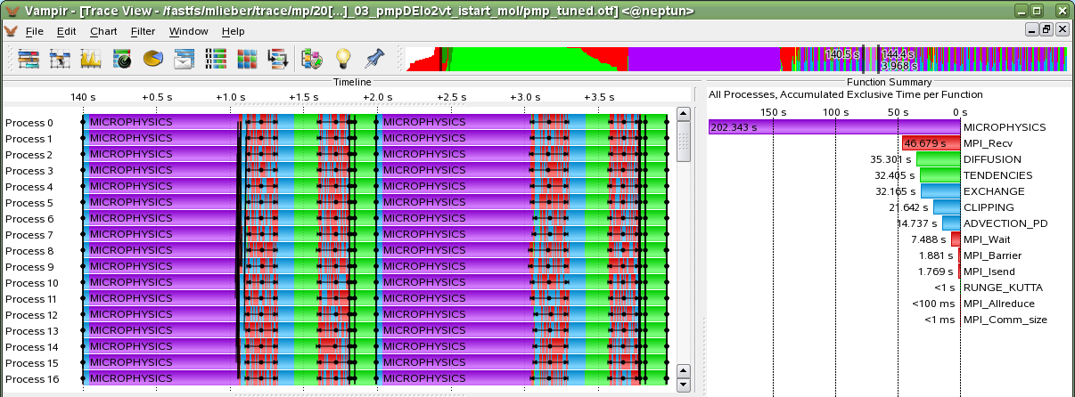
Introduction
Notes:
Lock-step / gleichschritt

Slide 7
Introduction
Usual Implementations include
  Atomic increment
  Hierarchical approaches
    e.g. combining tree
see sources [1]
Notes:
malen

Slide 8
Mc Guire's idea
Scalable locking is hard
  Relies on cache coherency
Locking is slow
Revisit existing algorithms/protocols for potential optimization through probabilistic approaches
  e.g. lock/mutex, barrier
see sources [2] abstract

Slide 9
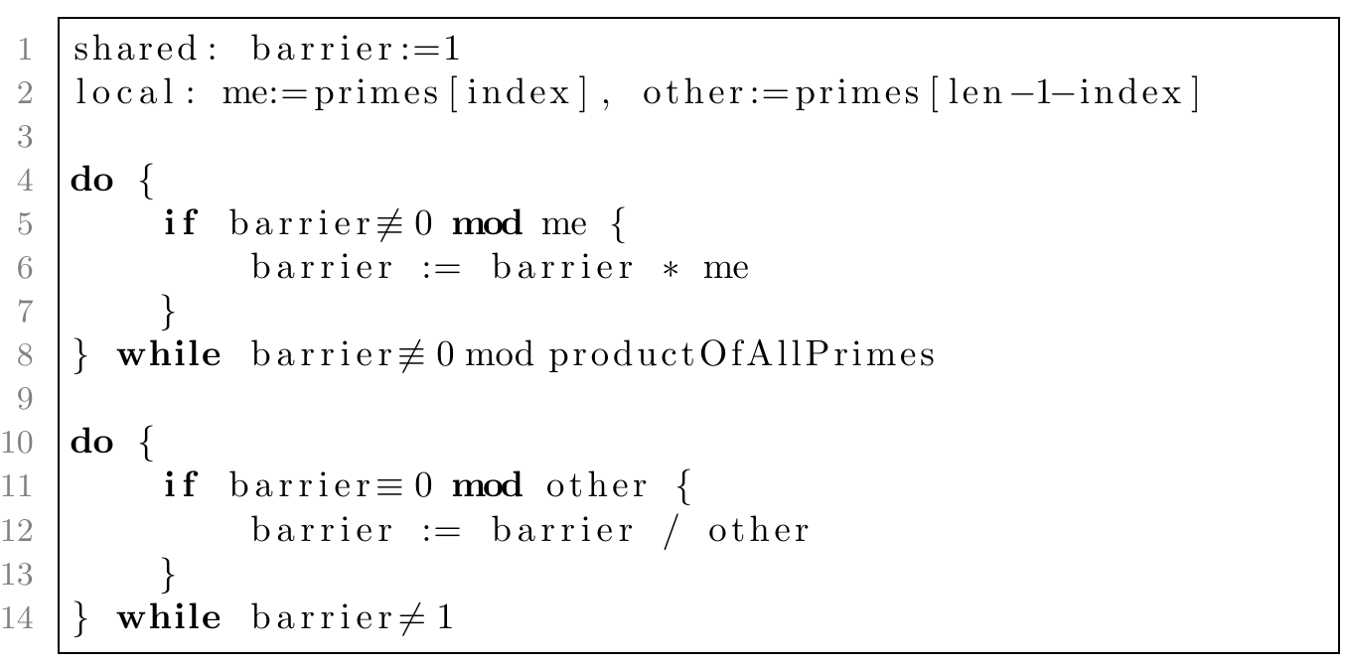
Mc Guire's idea
Notes:
* Rapid overwriting

Slide 10
Mc Guire's idea – Problem 1
Notes:
* Why not just one prime?

Slide 11
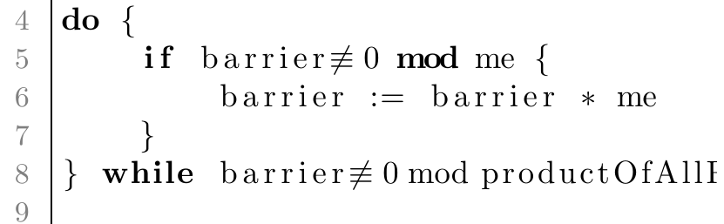
Mc Guire's idea – Problem 2
Notes:
* Test and set is not atomic: 2 reads 1 write
* potential overflow

Slide 12
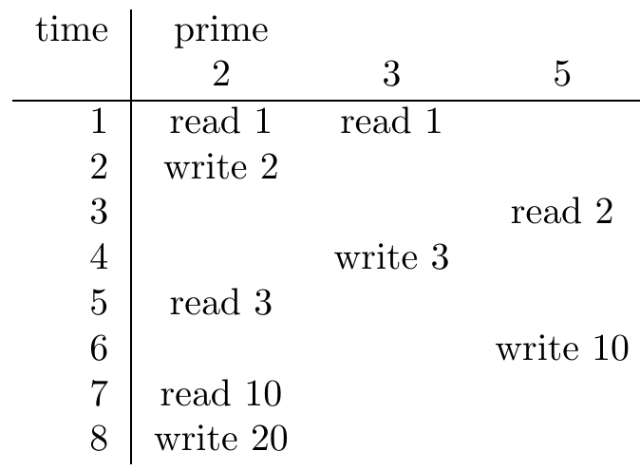
Mc Guire's idea – Problem 2
20 = 2 * 2 * 5
Notes:
* Test and set is not atomic: 2 reads 1 write
* potential overflow

Slide 13
Mc Guire's idea – Problem 3
Notes:
One leaves and another overwrites the completed barrier with an uncomplete one

Slide 14
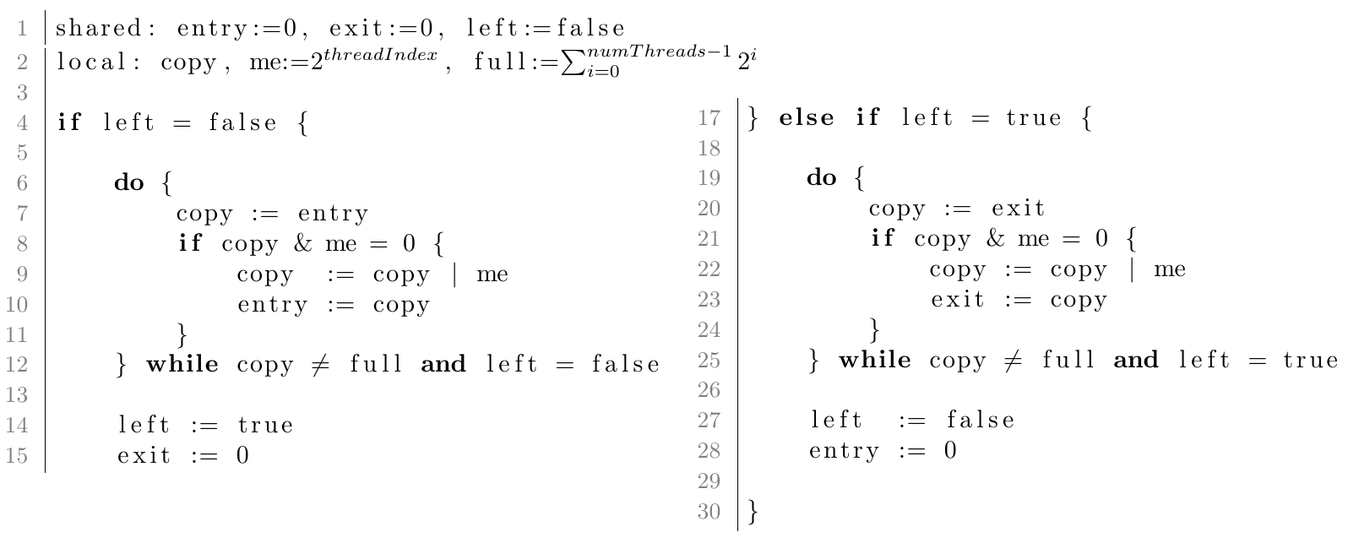
The extended protocol
Notes:
* bits not primes
* only one loop per visit
* 32 thread limit

Slide 15
Correctness
Correctness = deadlock freedom + consistency
Deadlock
  ¬[ □◇(loc_i=14) ∧ □◇(loc_i=27) ]
Consistency
  ¬◇( loc_i=14 & loc_i=27 & i≠j )
Notes:
For all I 0..thread count

Slide 16
Correctness
Correctness = deadlock freedom + consistency
Deadlock
  ¬[ □◇(loc_i=14) ∧ □◇(loc_i=27) ] ✓
Consistency
  ¬◇( loc_i=14 & loc_i=27 & i≠j ) ✓

Slide 17
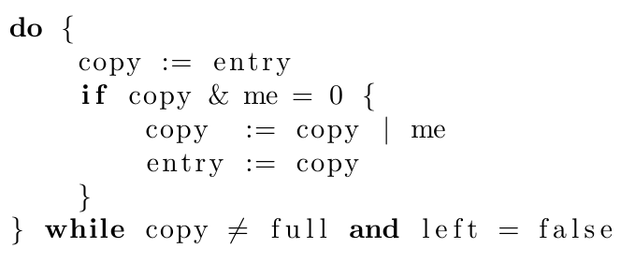
Correctness
Intuitive argument for deadlock freedom: If all threads have looped at least once, at least one thread has been successfully committed to entry/exit. Repeat n times. The barrier is complete.

Slide 18
Quantitative analysis
Determine expensive operations
  Shared memory access

Slide 19
Quantitative analysis
Determine expensive operations
  Shared memory access

Slide 20
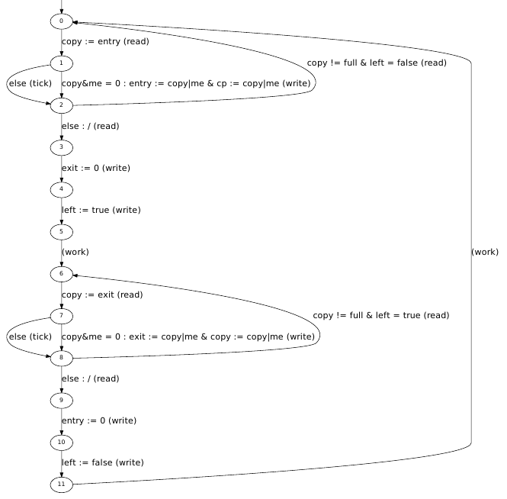
Quantitative analysis
Notes:
* tick = 1 cycle / instant
* work = work period
* read/write depends → explain next

Slide 21
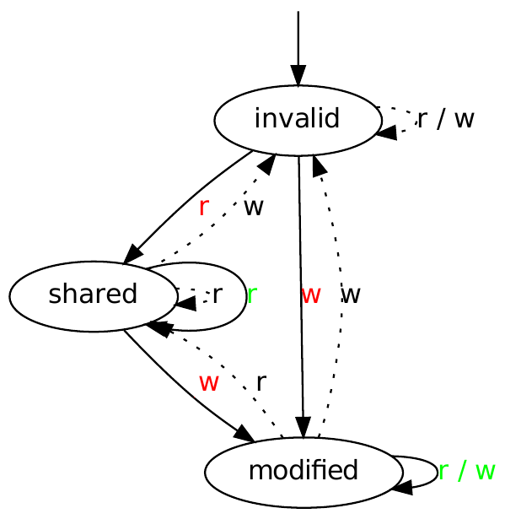
Quantitative analysis
  Expensive: red
  Cheap: green
Notes:
r = 50 cycles
w = 100 cycles

Slide 22
Quantitative analysis
Per thread:
Interleave all threads
Too large for four threads already → future work
X
Notes:
synchronous transitions for read/write and cache state changes

Slide 23
Quantitative analysis
(1) How long does it take for one thread to pass the barrier?
(2) How long does it take for all threads to pass the barrier?
(3) If one thread has left the barrier, how long does it take until all of them complete the barrier?

Slide 24


Quantitative analysis
(1) How long does it take for one thread to pass the barrier?
(2) How long does it take for all threads to pass the barrier?
(3) If one thread has left the barrier, how long does it take until all of them complete the barrier?

Slide 25
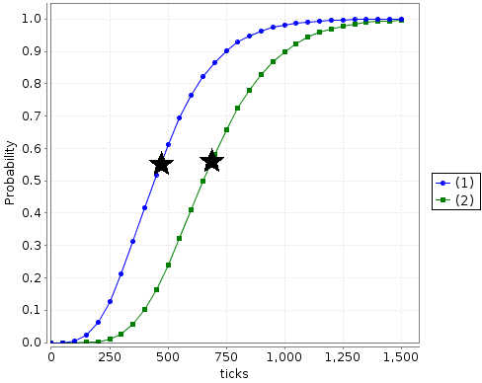
Quantitative analysis
Notes:
Star is expected cycle count
470
680

Slide 26
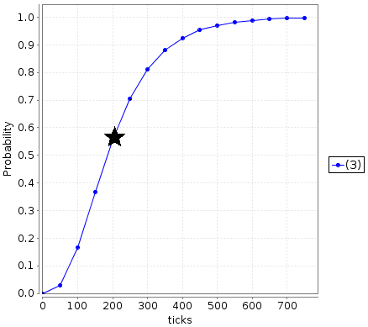
Quantitative analysis
Notes:
209

Slide 27
Conclusion
New barrier protocol
  + No locks
  + No atomic operations
  + Correct
  Potentially quicker than existing protocols
  Brief quantitative analysis
Modeled cache behaviour

Slide 28
Future work
Model more threads
→ extend quantitative analysis
Optimize
Work around the 32 thread limit
Evaluate potential of the protocol for distributed memory systems
Notes:
Optimize = keep track who you already saw

Slide 29
Sources
[1] Evaluation of publicly available Barrier-Algorithms and Improvement of the Barrier-Operation for large-scale Cluster-Systems with special Attention on InfiniBandTM Networks
http://archiv.tuchemnitz.de/pub/2005/0073/data/diploma.pdf
[2] Probabilistic write copy select, Paper,
In 13th Real-Time Linux Workshop, pages 195–206, Oct. 2011
[3] PRISM, Website, 13-03-019
http://www.prismmodelchecker.org
[4] SPIN, Website, 13-01-08
http://spinroot.com
[5] Waiting for Locks How Long Does It Usually Take?, Paper
http://dx.doi.org/10.1007/978-3-642-32469-7_4

Slide 30
Thank you!
Slides and report are available at
http://automaton2000.com/barrier-slides.pdf
http://automaton2000.com/barrier-report.pdf

Slide 31
A lock-less shared memory barrier without atomic operations
Part 2: Implementation and measurement
Ronny Brendel
Tutors: Marcus Völp, Sascha Klüppelholz
2013-03-22

Slide 32
Table of content
Benchmark
  Setup
  Results
Quantifying cache latency
  Setup
  Results
Conclusion
Future work

Slide 33
Benchmark
Straightforward translation to C

Slide 34
Setup
New protocol vs GNU OpenMP, PThreads:
Spawn n threads and pin them to cores
Repeatedly visit barrier
Emulate work period by sleeping
Measure the whole runtime of the program
Conducted on: 64 thread / 32 core / 4 socket AMD Opteron 6274 board
Notes:
What is OpenMP, PThreads

Slide 35
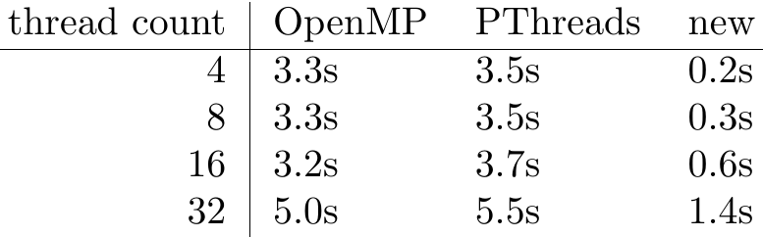
Results
No work period

Slide 36
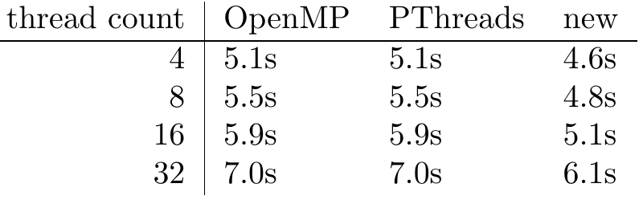
Results
200,000 cycles / 0.1 millisec work period

Slide 37
Results
Drawbacks:
  Busy waiting
  False-sharing strains cache, but only ~1% bandwidth is lost
  There exist mitigation strategies
    Sleep, mwait, pause [5]

Slide 38
Quantifying cache latency
Question: How does the number of to-be-invalidated cache line copies influence the latency of a shared read/write
Answer leads to more precise quantitative models of cache-heavy algorithms

Slide 39
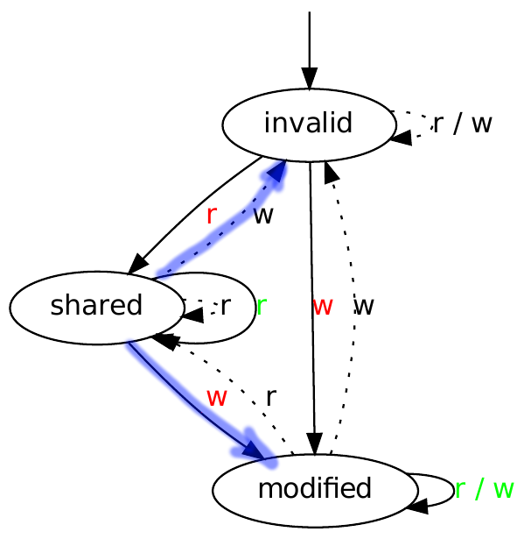
Setup
One shared date
All threads read the date
First thread writes and measures the duration
Conducted on:
  AMD Opteron 6274 (Bulldozer)
  Xeon L5630 (Sandybridge)

Slide 40
Results
Measuring the write duration proves difficult
  Out-of-order execution
  Buffered memory operations
  Measurement duration is very short: 50-400 cycles (30 of which are the measurement itself)
Results vary between instant and very very long
Notes:
* 30 (mearurement itself) and 2000 cycles
* up to 300 are expected

Slide 41
Results
Conclusion:
  AMD: no obvious tendency / wild
  Intel: pretty much constant
  CPUs work in mysterious ways: It is hard to analyse and quantify
Notes:
Changes with every new CPU architecture

Slide 42
Results
Surprising / interesting:
  AMD: atomic operations duration depends on thread count regardless of what threads do
  Intel: on one core (2 HT threads) invalidation still takes as much time as multiple cores do (not the case on AMD)
  Allocating threads sparsely across cores/CPUs increases latency
Notes:
Suggests a clever cache

Slide 43
Conclusion
New barrier protocol performs well, even in the most straightforward implementation
Quantifying cache coherency latency is hard
  Assuming constant latency for shared read/write seems good
Notes:
Using an average for instant and long operations has to account for the thread count → is a function of the number of threads

Slide 44
Future work
Optimize the implementation
  mwait/pause instructions
Redo benchmarks
Put more effort into quantifying cache coherency latency

Slide 45
Sources
[1] GNU C Library, Website, 13-03-19
http://www.gnu.org/software/libc
[2] GNU OpenMP, Website, 13-03-19
http://gcc.gnu.org/projects/gomp
[3] Message Passing Interface, Website, 13-03-19
http://mpi-forum.org
[4] OpenMP, Website, 13-03-19
http://openmp.org
[5] Stack Overflow: How does x86 pause [..], Website, 13-03-19
http://stackoverflow.com/questions/4725676/how-does-x86-pause-instruction-work-in-spinlock-and-can-it-be-used-in-other-sc

Slide 46
Thank you!
Slides and report are available at
http://automaton2000.com/barrier-slides.pdf
http://automaton2000.com/barrier-report.pdf

