Slide 1

Identification of hydrologic events
Conrad Wasko, Danlu Guo
conrad.wasko@unimelb.edu.au, danlu.guo@unimelb.edu.au

Slide 2
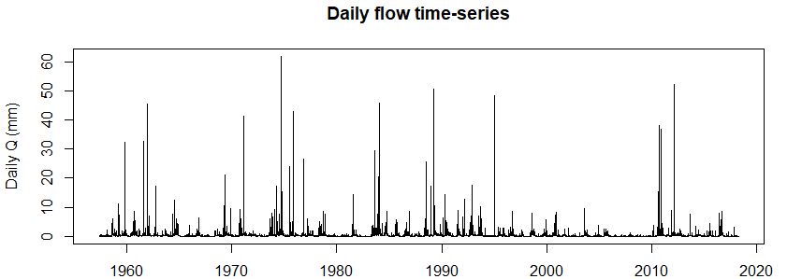
How many of you need to identify events in time series?
How do you go about doing it?
How long would it take you to identify all events within this flow time series?
What about doing it for all flow monitoring sites across a country?

Slide 4
https://CRAN.R-project.org/package=hydroEvents
https://doi.org/10.1002/hyp.14563
Notes:
Apologies that this won’t particularly be hands on due to our virtual attendance

Slide 7
What does the package do?

Slide 10
What doesn’t the package do?
Doesn’t perform any QA
Currently the BFI method is limited to just using our baseflow filtering
Doesn’t implement methods based on recession slope

Slide 11
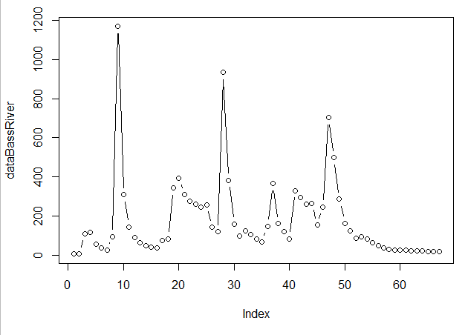
Example 1 – identifying events
library(hydroEvents)
dataBassRiver
plot(dataBassRiver, type = ‘b’)
[1] 5 7 108 117 57 36 26 95 1169 308 144 89 62 48 40 35 73 82 342 393 310 275 260 245 256 141 119 934 382 158
[31] 96 122 103 83 67 148 366 161 119 82 330 294 261 266 153 247 703 498 286 163 124 85 94 81 62 47 37 30 26 24
[61] 24 22 21 20 19 18 18

Slide 12
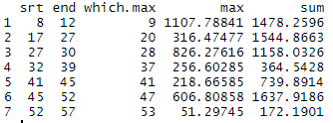
Example 1 – identifying events
bf = baseflowB(dataBassRiver)
Max_res = eventMaxima(dataBassRiver-bf$bf, delta.y = 10, delta.x = 1, threshold = 0)
Min_res = eventMinima(dataBassRiver-bf$bf, delta.y = 100, delta.x = 3, threshold = 0)
PoT_res = eventPOT(dataBassRiver-bf$bf, threshold = 0, min.diff = 1)
BFI_res = eventBaseflow(dataBassRiver, BFI_Th = 0.5, min.diff = 1)
Min_res

Slide 13
Example 1 – identifying events
par(mfrow = c(2, 2), mar = c(3, 2.7, 2, 1))
plotEvents(data = dataBassRiver, events = PoT_res, ymax = 1160, xlab = "Index",
ylab = "Flow (ML/day)", colpnt = "#E41A1C", colline = "#377EB8", main = "eventPOT")
lines(1:length(bf$bf), bf$bf, lty = 2)
plotEvents(data = dataBassRiver, events = Max_res, ymax = 1160, xlab = "Index",
ylab = "Flow (ML/day)", colpnt = "#E41A1C", colline = "#377EB8", main = "eventMaxima")
lines(1:length(bf$bf), bf$bf, lty = 2)
plotEvents(data = dataBassRiver, events = Min_res, ymax = 1160, xlab = "Index",
ylab = "Flow (ML/day)", colpnt = "#E41A1C", colline = "#377EB8", main = "eventMinima")
lines(1:length(bf$bf), bf$bf, lty = 2)
plotEvents(data = dataBassRiver, events = BFI_res, ymax = 1160, xlab = "Index",
ylab = "Flow (ML/day)", colpnt = "#E41A1C", colline = "#377EB8", main = "eventBaseflow")
lines(1:length(bf$bf), bf$bf, lty = 2)

Slide 15
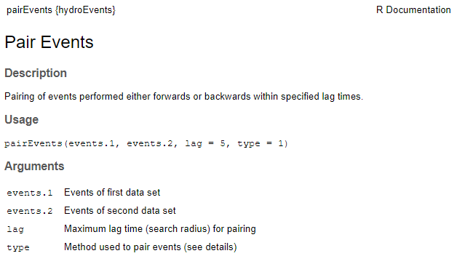
Example 2 – pair events

Slide 16
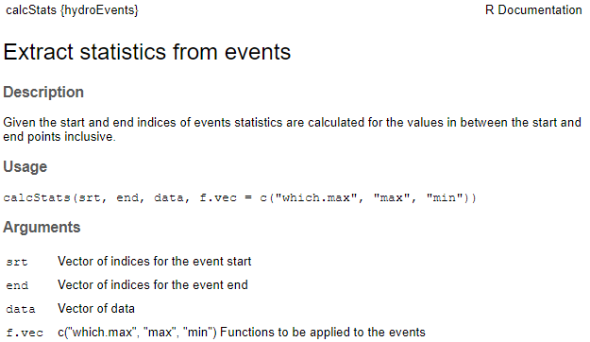
Example 2 – pair events

Slide 17
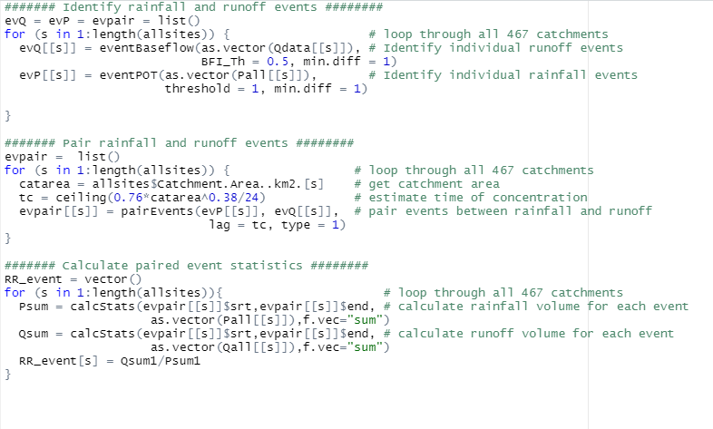
Example 2a – pair events

Slide 18
Example 2b – calculate event statistics
Notes:
I used another 5 lines of script to calculate the event-scale RR coef – with the calcStats function

Slide 19
Notes:
We got event-scale RR coef across Aus for the first time!

Slide 21
What other features would you like to see in future versions of this package?
What analyses would you use this package for?

Slide 22
Wasko, C., Guo, D., 2022. Understanding event runoff coefficient variability across Australia using the hydroEvents R package. Hydrol. Process. 36, 1–14. https://doi.org/10.1002/hyp.14563
Conrad Wasko, Danlu Guo
conrad.wasko@unimelb.edu.au, danlu.guo@unimelb.edu.au

