Slide 1
http://bit.ly/ynus_wrangle_data
Download these files!
(git clone or download zip)

Slide 2

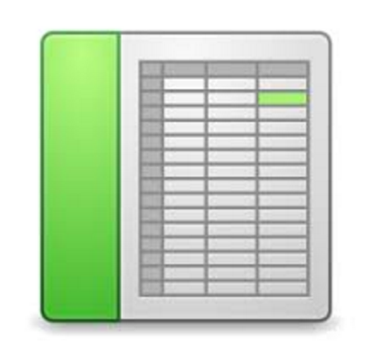

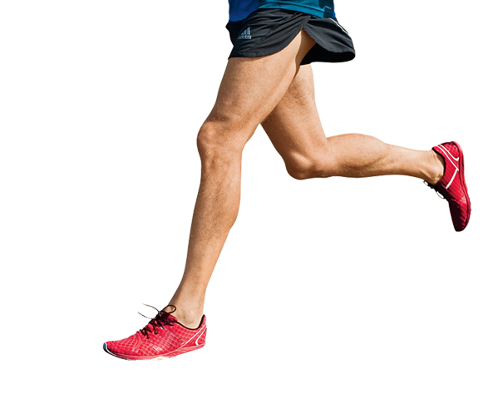
See It to Clean It
Interactive Data Wrangling
Yale NUS Data Hackathon 2017
Cameron Yick

Slide 3
Anscombe’s Quartet
Avg X: 9
Avg Y: 7.5
VarX: 11
VarY: 4.12
corr(x,y)=0.816
Line of best fit:
y = 0.5x + 3
I |  | II |  | III |  | IV
x | y | x | y | x | y | x | y
10.0 | 8.04 | 10.0 | 9.14 | 10.0 | 7.46 | 8.0 | 6.58
8.0 | 6.95 | 8.0 | 8.14 | 8.0 | 6.77 | 8.0 | 5.76
13.0 | 7.58 | 13.0 | 8.74 | 13.0 | 12.74 | 8.0 | 7.71
9.0 | 8.81 | 9.0 | 8.77 | 9.0 | 7.11 | 8.0 | 8.84
11.0 | 8.33 | 11.0 | 9.26 | 11.0 | 7.81 | 8.0 | 8.47
14.0 | 9.96 | 14.0 | 8.10 | 14.0 | 8.84 | 8.0 | 7.04
6.0 | 7.24 | 6.0 | 6.13 | 6.0 | 6.08 | 8.0 | 5.25
4.0 | 4.26 | 4.0 | 3.10 | 4.0 | 5.39 | 19.0 | 12.50
12.0 | 10.84 | 12.0 | 9.13 | 12.0 | 8.15 | 8.0 | 5.56
7.0 | 4.82 | 7.0 | 7.26 | 7.0 | 6.42 | 8.0 | 7.91
5.0 | 5.68 | 5.0 | 4.74 | 5.0 | 5.73 | 8.0 | 6.89

Slide 4
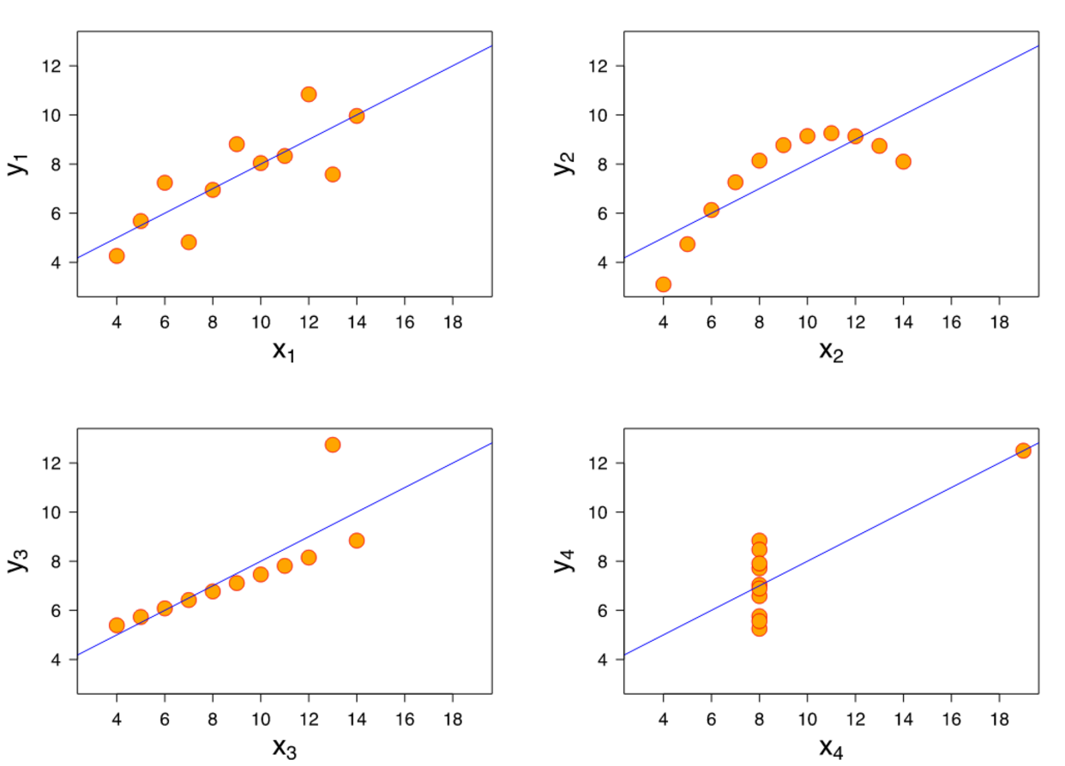
Notes:
Outliers on 3 and 4, outliers… parabola

Slide 5
-> secret.csv
Secret Code?

Slide 6
“Mapping Data to Visual Properties”
Categorical (Red, Blue, Green)
Numerical (1, 4, 12)
Network

Slide 7
