Slide 1














Resume
Parser
Presented by Harshit Joshi

Slide 2

Origin of the idea
Recruiting has been an integral part of every organization, and the way we do it has changed immensely over time. Back in the day, it was all about calling up potential candidates and scheduling an interview.
Now, with countless job applications pouring in every day, it can be overwhelming to find the right fit. This is where resume parsing comes into play – a technology that has become a recruiter’s best friend.
Resume parsing is the process of extracting and categorizing job applicants’ data electronically

Slide 3
01.
Save time - Quickly Process Resume and saves into Segregated columns
Project vision and mission
Eliminate Bias - disable the fields like age, gender etc.
02.
The main aim =of Resume parser is to extract the skills and other important keywords from the resume like name, number , skills and previous company .
Improve Candidate Experience-Record important information on your candidate profiles.
03.

Slide 4

The First Resumes
Leonardo da Vinci's 1482 resumé was the first printed resume, detailing accomplishments, background, and abilities. Before computers, hiring managers and recruiters manually sorted resumes for job requirements, a laborious and error-prone process. Automated resume parsing became necessary as the job market expanded.

Slide 5

The Birth of Resume Parsing
Resume parsing, dating back to the 1980s, was developed by big businesses to identify the most qualified applicants for open positions. Resumix was the first tool, identifying keywords, work experience, and educational background from resumes, helping recruiters scan thousands of resumes.

Slide 6
Advancements in Artificial Intelligence
NLP and machine learning algorithms have revolutionized resume parsers, enabling them to parse resumes in various formats, including Word, HTML, and PDF files, and are multilingual. These technologies assess resumes based on context, sentiment, and purpose, recognizing and matching semantic linkages between experiences, job titles, and talents.
AI

Slide 7

Benefits of Resume Parsing
HR recruiters are increasingly utilizing AI-powered resume parsing to streamline the hiring process, reducing bias and promoting inclusivity. With over 90% of large firms using this tool, recruiters can focus on interacting with applicants, setting up interviews, and selecting employees.

Slide 8

Technology Used
Python 3.7.16-used for developing websites and software, task automation, data analysis, and data visualisation
Django 5.0-used to build almost any type of website — from content management systems and wikis, through to social networks and news sites.
HTML5-to structure a web page and its content
CSS3-to style and layout web pages — for example, to alter the font, color

Slide 9





Working of A Resume Parser

Slide 10

Creation process
pyresparser
A simple resume parser used for extracting information from resumes
For NLP operations we use spacy and nltk. Install them using below commands
`
# spaCy
python -m spacy download en_core_web_sm
# nltk
python -m nltk.downloader words
Supported File Formats
PDF and DOCx files are supported on all Operating Systems
If you want to extract DOC files you can install textract for your OS (Linux, MacOS)
Note: You just have to install textract (and nothing else) and doc files will get parsed easily

Slide 11
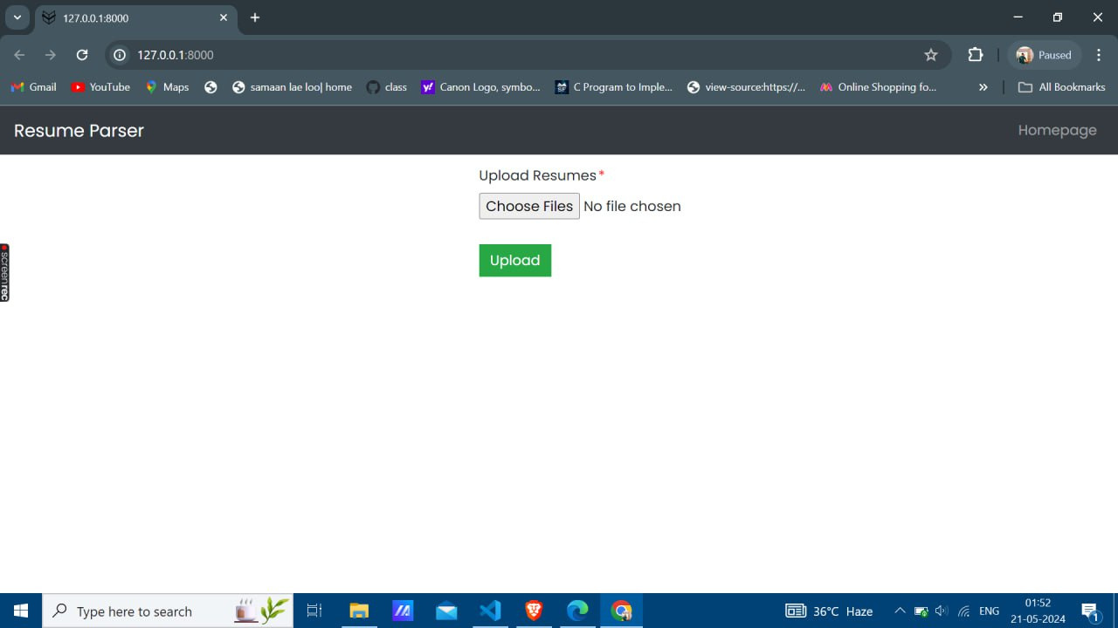
User-Interface

Slide 12
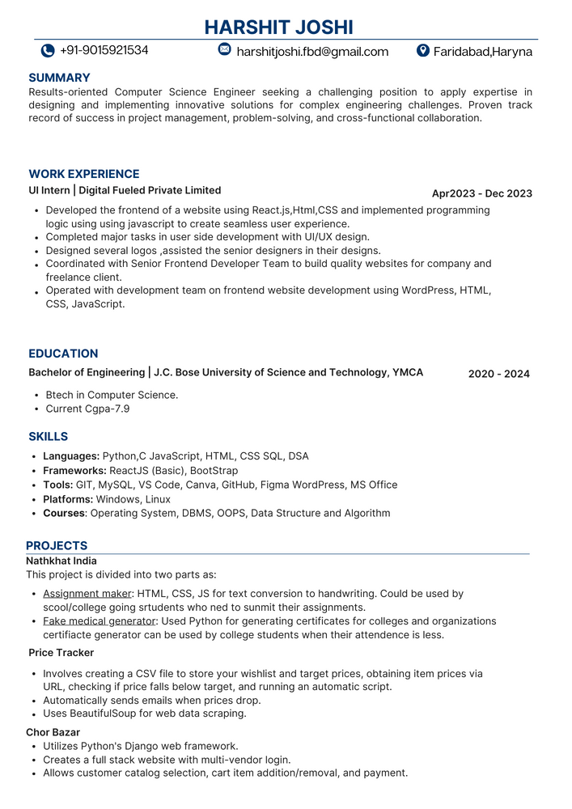

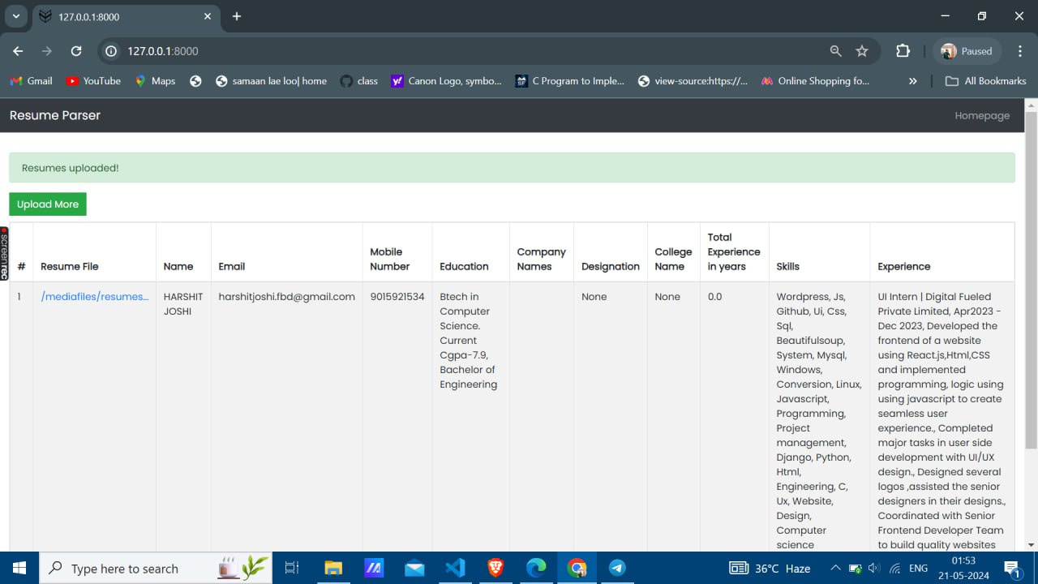

User-Interface
all the important keywords like names,mobile ,skills and experience got extracted and stored in the forrm of tables

Slide 13
95%
Success cases
Recruiting has evolved significantly over time, with the rise of job applications and the need for efficient recruitment processes. Resume parsing, a technology that automates the recruitment process, has become a valuable tool for recruiters.E nabling recruiters to find the right fit. The first known printed resume, written by Leonardo da Vinci
in 1482, contained detailed information about skills, experience, and achievements. The need for automated resume parsing emerged in the 1980s when large coranalyze resumes based on context, sentiment, and intent. These tools can match skills, job titles, and experiences to job requirements, making them a valuable tool for recruiters.

Slide 14

Weaknesses
Threats
It is 90% accurate sometimes it mixes the skills and the project work there is a scope of improvement which could happen very easily
Moreover at this time resume parser can only be operated on the local machine only.
The uploaded Resumes are safe it do not saves the resumes,if we delete the tab then the resume is not saved.
Onkly resume are saved at the cache memory only,which automatically deletes if we delete the tab.
Strengths
Opportunities
The resume parser can be used by both HR and the candidate to extract the useful info from the resumes like keywords, skills
The uploaded Resumes are safe it do not save the resumes, if we delete the tab then the resume is not saved< I had used sessions to store the data.
Only resumes are saved in the cache memory only, which automatically deletes if we delete the tab.

Slide 15

Final reflections and future steps
The present model can only be operated on local machines in the future, there could be an update through which this parser could be operated from anywhere i.e. I would like to host the parser on the web so that it is easily accessible to all.
Secondly, I am going to add a JD and then will upload the resume if the skills match the resume then only that candidate will be shortlisted and the candidates who are not shortlisted those candidates will receive mail that says they are not eligible will send the mail through SMTP, i.e Simple Mail Transfer Protocol

Slide 16
Thank you very much!
BY - Harshit Joshi

