Slide 1








Normalize
Construct
Matrix $\hat{g}$
Input: image $g$
Graph $\left\{W\right\}$
$k$ smallest eigen-vectors
Quantum computer
Classical computer
Output: segmented image
Hybrid quantum – classical Lanczos algorithm

Slide 2
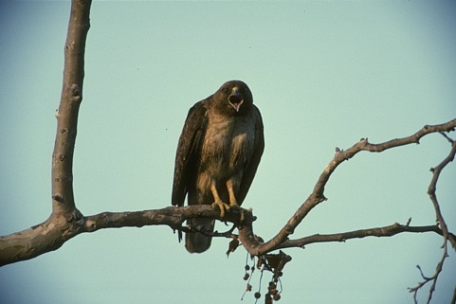
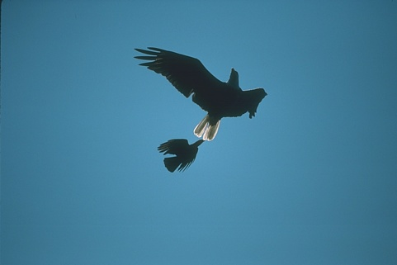
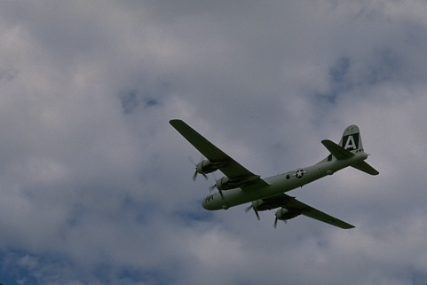
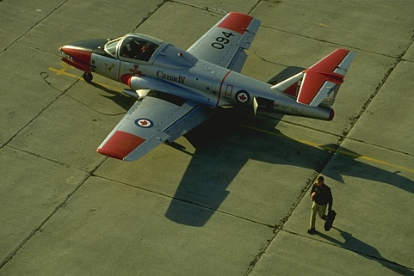
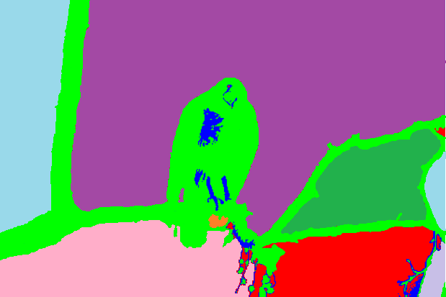


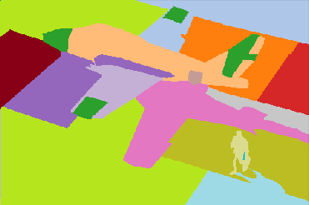
(a)
(b)
(c)
(d)

Slide 3




















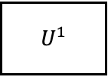















(a)
$$|0⟩$$
$$H$$
$$H$$
$$|0⟩$$
$$U^{1}$$
$$×$$
$$|0⟩$$
$$×$$
$$⋮$$
$$⋮$$
$$U^{2}$$
$$|0⟩$$
$$×$$
(b)
$$CSWAP$$
$$U\left(θ^{\left(t\right)}\right)$$
$$V^{†}\left(x\right)$$
Measurement
$$|0⟩$$
$p_{0}$
$$𝒞\left(θ\right)$$
False
$$θ^{(t+1)}$$
$$𝒞\left(θ,x\right)<τ$$
True
$$θ^{∗}$$
(c)
$$R_{x}$$
$$R_{y}$$
$$R_{z}$$
$$×$$
$$R_{x}$$
$$R_{y}$$
$$R_{z}$$
$$×$$
$$R_{x}$$
$$R_{y}$$
$$R_{z}$$
$$⋮$$
$$×$$
$$R_{x}$$
$$R_{y}$$
$$R_{z}$$
$$×L$$

Slide 4





















(a)
$$|0⟩$$
$$H$$
$$H$$
$$|0⟩$$
$$U^{1}$$
$$×$$
$$|0⟩$$
$$×$$
$$⋮$$
$$⋮$$
$$U^{2}$$
$$|0⟩$$
$$×$$
(b)
$$CSWAP$$
$$U\left(θ^{\left(t\right)}\right)$$
$$V^{†}\left(x\right)$$
Measurement
$$|0⟩$$
$p_{0}$
$$𝒞\left(θ\right)$$
False
$$θ^{(t+1)}$$
$$𝒞\left(θ,x\right)<τ$$
True
$$θ^{∗}$$
(c)
$$R_{x}$$
$$R_{y}$$
$$R_{z}$$
$$R_{x}$$
$$R_{y}$$
$$R_{z}$$
$$×$$
$$R_{x}$$
$$R_{y}$$
$$R_{z}$$
$$×$$
$$R_{x}$$
$$R_{y}$$
$$R_{z}$$
$$×$$
$$R_{x}$$
$$R_{y}$$
$$R_{z}$$
$$×$$
$$R_{x}$$
$$R_{y}$$
$$R_{z}$$
$$×$$
$$R_{x}$$
$$R_{y}$$
$$R_{z}$$
$$R_{x}$$
$$R_{y}$$
$$R_{z}$$
$$×$$
$$R_{x}$$
$$R_{y}$$
$$R_{z}$$

Slide 5
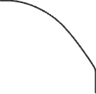







Slide 6








Slide 7
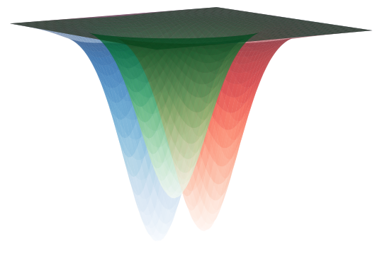




$$θ_{0}$$
$$θ_{C}^{∗}$$
$$θ_{A}^{∗}$$
$$θ_{B}^{∗}$$

Slide 8
