Slide 1
Computational Simulation for Self-assembled Nanogel with MOLSIM
Tonje Skjong
Hye-jeong Cheon
Anders Hagen Jarmund
Molecular Biophysics (TFY4310, H17)
Department of Physics
Norges Teknisk-Naturvitenskapelige Universitet
Notes:
BG image : http://molsim.lifesciences.autodesk.com/
Xyloglucan-Cholesterol

Slide 2
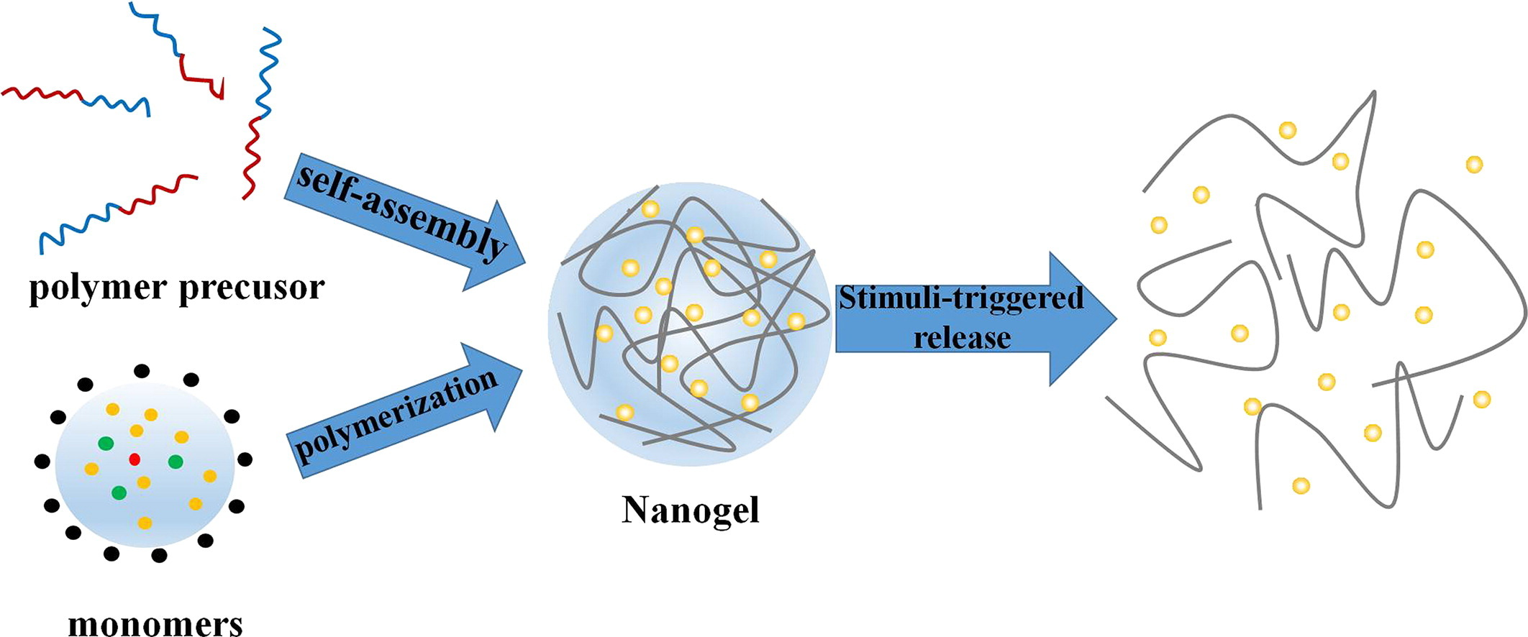
Introduction
http://www.sciencedirect.com/science/article/pii/S0928493115305749
Notes:
Introduction
Backgrounds and knowledge what is xg?
which components consist of XG?
which property is used in this study?
what/which is Cholesterol used in this study and why we induce this in cells or body
How do they connect each other and make nanogel (in structure)
- This study the aim of our simulation is comparing the results like Ree, Potential energy, Rh, Figures with research paper (real data) and Molsim simulation.

Slide 3
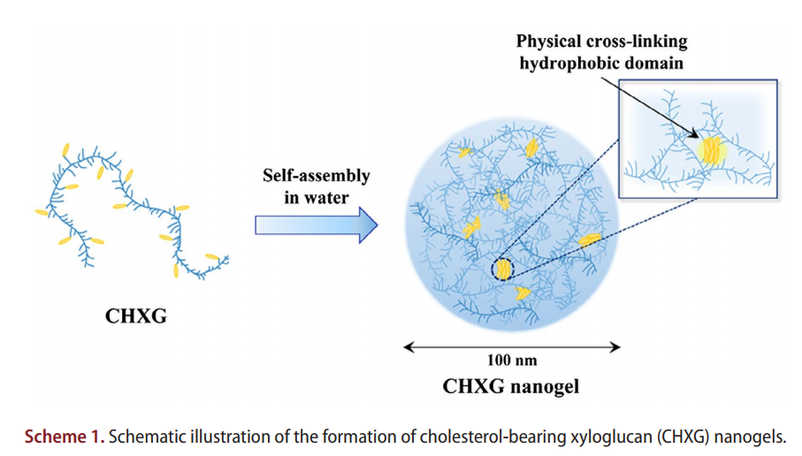
Introduction
https://www.ncbi.nlm.nih.gov/pubmed/28423990
Notes:
ref

Slide 4
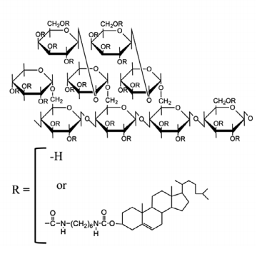
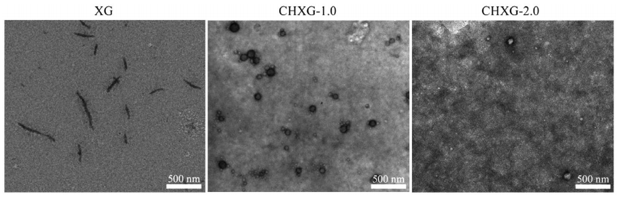
System: Scheme
https://www.ncbi.nlm.nih.gov/pubmed/28423990
Xyloglucan(XG)
: glucose+xylose+galactose
Self-assembled Nanogel
Cholesterol group(CH)
Notes:
Why cholesterol?

Slide 5
System: Simulation para.
Simulation Mode
Monte Carlo
Canonical ensemble
R_{g}
R_{ee}
 | Parameters for Simulation
Parameter | nct | npptct(1,1) | Npptct(1,2) | npt | nppt | natpt | massat | radat
Units | # | → | → | → | → | → | g/mol | Ȧ
XG w/o CH (CHXG0) | 2 | 50,0 | 2,0 | 2 | 560,0 | 1,1 | 10.0 | 2.0
XG w/ single CH (CHXG1) | 2 | 50,0 | 2,2 | 2 | 560,160 | 1,1 | 10.0 | 2.0
XG w/ double CH (CHXG2) | 2 | 50,0 | 2,4 | 2 | 560,320 | 1,1 | 10.0 | 2.0
Notes:
In statistical mechanics, a canonical ensemble is the statistical ensemble that represents the possible states of a mechanical system in thermal equilibrium with a heat bath at a fixed temperature.^{[1]} The system can exchange energy with the heat bath, so that the states of the system will differ in total energy.
Explaination
And number
mode
quantity unit
-------- ----
length 1.000E-10 m
mass 1.000E-03 kg/mol
temperature 1.000E+00 k
time 1.000E-12 s
energy 1.000E+03 j/mol
heat capacity 1.000E+00 j/mol*k
diff. coeff. 1.000E-09 m**2/s
pressure 1.000E+06 pa
volume 1.000E-30 m**3
linear vel. 1.000E+02 m/s
linear acc. 1.000E+14 m/s**2
force 1.000E+11 n/mol
moment of inertia 1.000E-23 kg*m**2/mol
angle 1.745E-02 rad

Slide 6
System: B/U data
Molecules |  | M_{w} [g/mol] | Density [g/cm3] | V [cm3/mol] | R [ratio]
Xyloglucan(XG) | Glucose | 180.16 | 1,54 | 116,99 | 4,89
 | Xylose | 150.13 | 1,52 | 98,77 | 4,62
 | Galactose | 180.16 | 1,72 | 104,74 | 4,71
Cholesterol(CH) | HDC | 232.27 | 0,84 | 276,51 | 6,51
 | Cholesterol | 386.65 | 1,05 | 367,54 | 7,16
 | Parameters for Simulation
Parameter | nct | npptct(1,1) | Npptct(1,2) | npt | nppt | natpt | massat | radat
Units | → | → | → | → | → | → | g/mol | Ȧ
XG w/o CH (CHXG0) | 2 | 50,0 | 2,0 | 2 | 560,0 | 1,1 | 10.0 | 2.0
XG w/ single CH (CHXG1) | 2 | 50,0 | 2,2 | 2 | 560,160 | 1,1 | 10.0 | 2.0
XG w/ double CH (CHXG2) | 2 | 50,0 | 2,4 | 2 | 560,320 | 1,1 | 10.0 | 2.0
Notes:
quantity unit
-------- ----
length 1.000E-10 m
mass 1.000E-03 kg/mol
temperature 1.000E+00 k
time 1.000E-12 s
energy 1.000E+03 j/mol
heat capacity 1.000E+00 j/mol*k
diff. coeff. 1.000E-09 m**2/s
pressure 1.000E+06 pa
volume 1.000E-30 m**3
linear vel. 1.000E+02 m/s
linear acc. 1.000E+14 m/s**2
force 1.000E+11 n/mol
moment of inertia 1.000E-23 kg*m**2/mol
angle 1.745E-02 rad

Slide 7
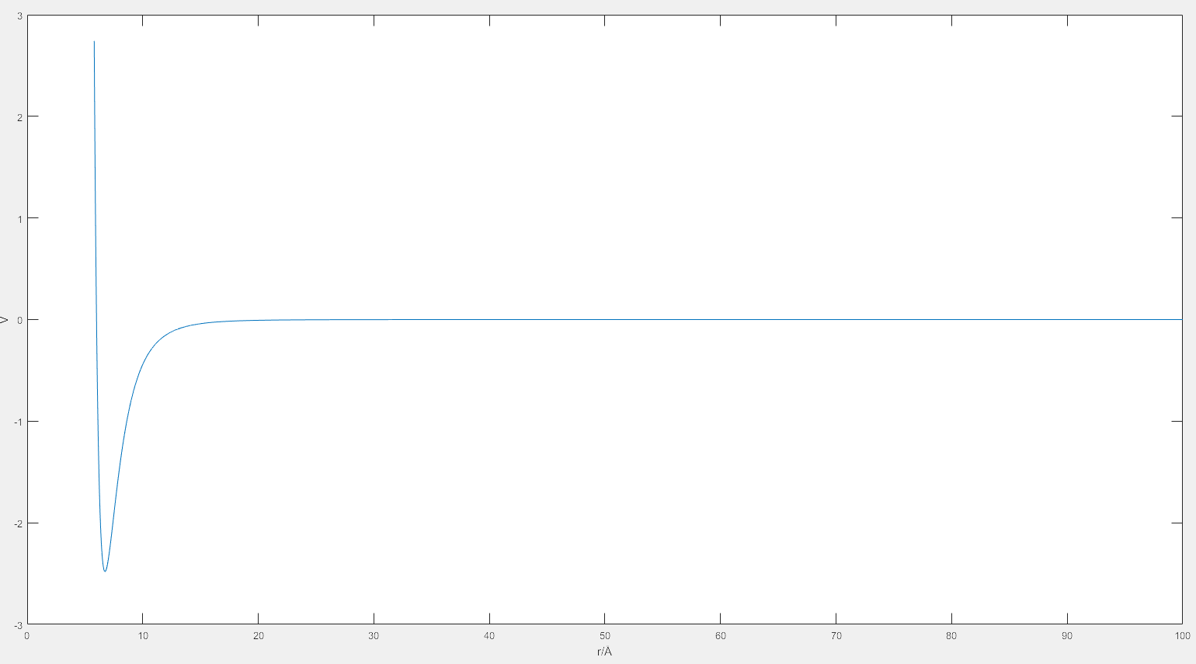
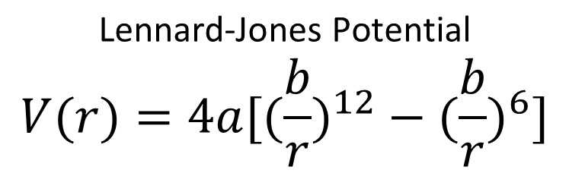
System: L-J Potential
V(r)
[kJ/mol]
Ε=2,48
σ=6,00
Constants : a, b
$$\text{Lennard}\text{−}\text{Jones} \text{Potential}$$
$$V(r)=4a[({\frac{b}{r})}^{12}−({\frac{b}{r})}^{6}]$$
V(r) = 4*a*[(b/r)^12-(b/r)^6]
r [Ȧ]
Notes:
The Lennard-Jones potential (also termed the L-J potential, 6-12 potential, or 12-6 potential) is a mathematically simple model that approximates the interaction between a pair of neutral atoms or molecules. A form of this interatomic potential was first proposed in 1924 by John Lennard-Jones.^{[1]} The most common expressions of the L-J potential are
energy 1.000E+03 j/mol

Slide 8
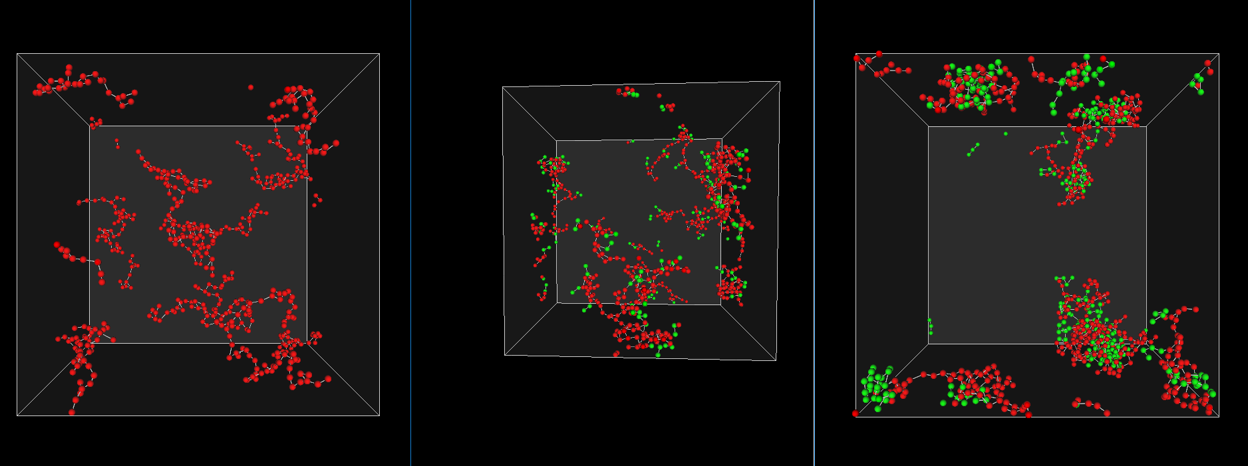
Results: 3D Images
XG w/o CH (CHXG0)
XG w/ single CH (CHXG1)
XG w/ double CH (CHXG2)
N = 10 000

Slide 9
Results: 3D Images
XG w/o CH (CHXG0)
XG w/ single CH (CHXG1)
XG w/ double CH (CHXG2)
N = 400 000

Slide 10
Results: 3D Images
XG w/o CH (CHXG0)
XG w/ single CH (CHXG1)
XG w/ double CH (CHXG2)
N = 400 000

Slide 11
Results: 3D Images
XG w/o CH (CHXG0)
XG w/ single CH (CHXG1)
XG w/ double CH (CHXG2)
N = 400 000

Slide 12
Results: 3D Images
XG w/o CH (CHXG0)
XG w/ single CH (CHXG1)
XG w/ double CH (CHXG2)
N = 400 000

Slide 13
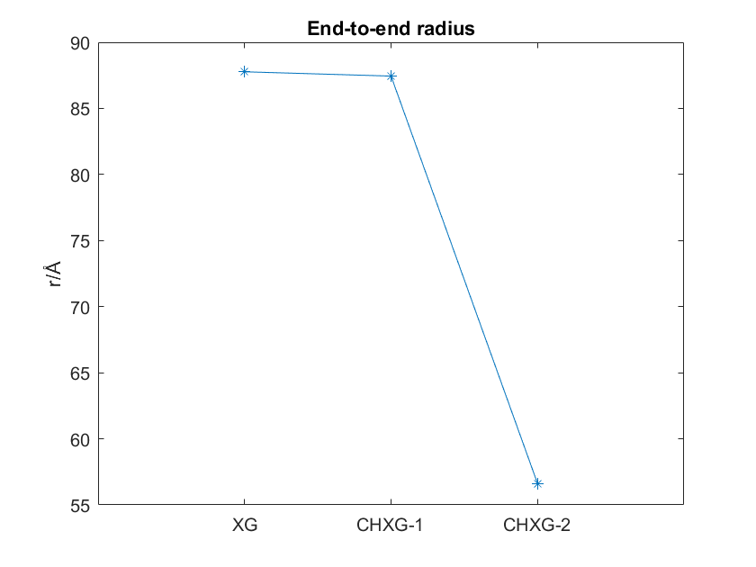
Results: Ree
R_{g}
R_{ee}

Slide 14
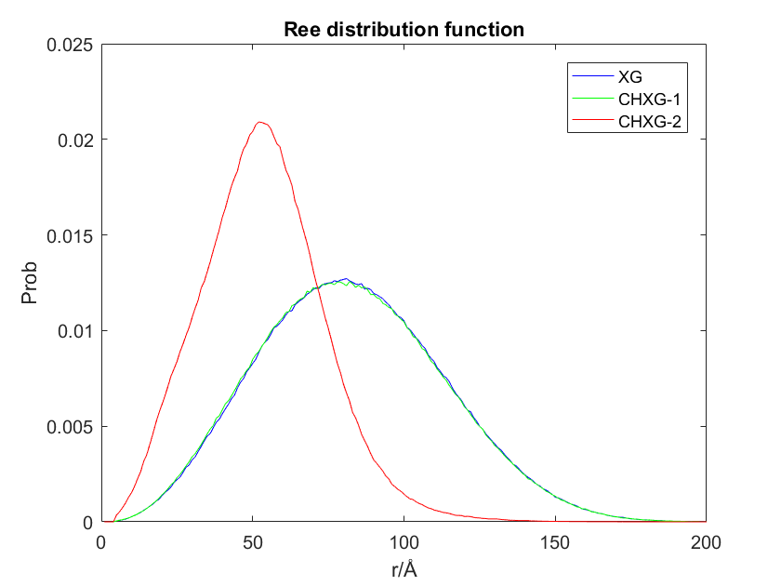
Results: Rdf
R_{g}
R_{ee}

Slide 15
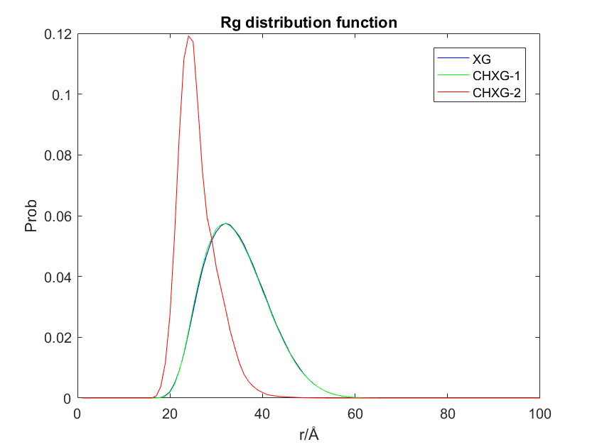
Results: Radius of gyration
R_{g}
R_{ee}

Slide 16
Conclusion & Future Work
Increasing Cholesterol group - self assembly ↑
→ Relationship between # of Cholesterol – Self assembly(Rg)
: Questions about limitation of increasing CH group
How do we improve self-assembly?
→ Increasing # of CH group
→ Structure of Cholesterol/Xyloglucan
: # or side chain, Structure(Un/Saturated), Persistent length
How do we improve simulation method?
→ Changing assumption for Cholesterol structure

Slide 17
References
Background image
http://molsim.lifesciences.autodesk.com
Introduction
New progress and prospects: The application of nanogel in drug delivery, Hui Zhang, Materials Science and Engineering :C, 2015 Nov
http://www.sciencedirect.com/science/article/pii/S0928493115305749
Self-assembled nanogel of cholesterol-bearing xyloglucan as a drug delivery nano carrier, Sawada SI, J Biomater Sci Polym, 2017 April
https://www.ncbi.nlm.nih.gov/pubmed/28423990
Systems
Self-assembled nanogel of cholesterol-bearing xyloglucan as a drug delivery nano carrier, Sawada SI, J Biomater Sci Polym
https://www.ncbi.nlm.nih.gov/pubmed/28423990
Notes:
NCBI
Skip to main content
Skip to navigation
Resources
How To
About NCBI Accesskeys
Sign in to NCBI
PubMed
US National Library of MedicineNational Institutes of Health
Search databaseSearch term
Search
Advanced
Help
Result Filters
Format: Abstract
Send to
J Biomater Sci Polym Ed. 2017 Jul - Aug;28(10-12):1183-1198. doi: 10.1080/09205063.2017.1320827. Epub 2017 Apr 27.
Self-assembled nanogel of cholesterol-bearing xyloglucan as a drug delivery nanocarrier.
Sawada SI^{1,2}, Yukawa H¹, Takeda S¹, Sasaki Y¹, Akiyoshi K^{1,2}.
Materials Science and Engineering: C
Volume 60, 1 March 2016, Pages 560-568
Review
New progress and prospects: The application of nanogel in drug delivery
Author links open overlay panelHuiZhangªYingjieZhaiªJuanWang^{b}GuangxiZhaiª

Slide 18
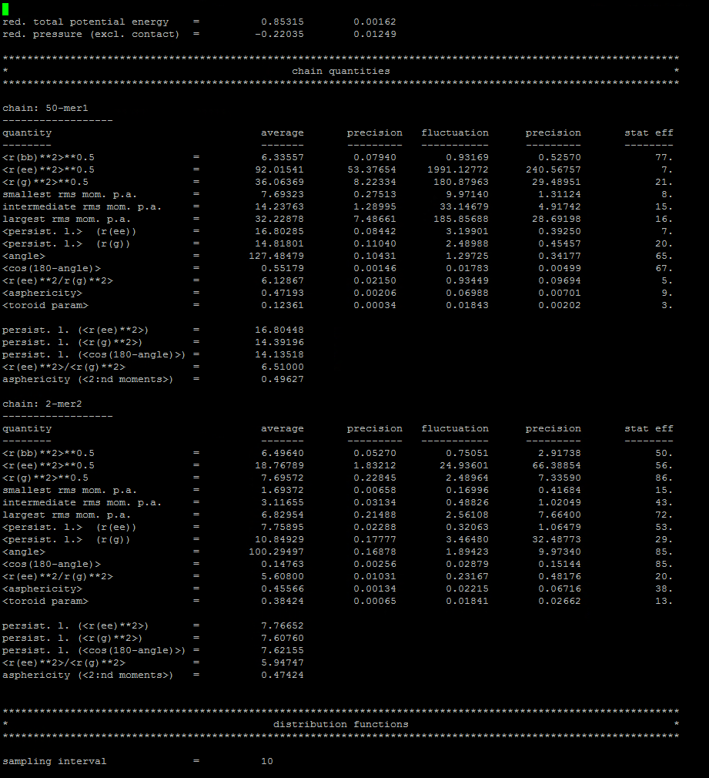
Results
Simulation Data | Total Potential | R_{G} | R_{ee}
XG
CHXG-1.0
CHXG-2.0
Real Data | DS of Ch_{(degree of substitution)} [# of Ch/100 Glu] | R_{H} [nm] | M_{w} [g/mol] | N_{CH} [g/mol]
XG | - | 33.2±18.9 | 1.94×10⁵
CHXG-1.0 | 1.00 | 54.9±3.1
CHXG-2.0 | 2.00 | 53.6±3.9

Slide 19
Results: Ree (XG-XG)
Units
R=[Ȧ]

Slide 20
Results: Rgh (XG-XG)
Units
R=[Ȧ]

Slide 21
Results: Rdf (XG-XG, CH-CH)
Units
R=[Ȧ]

Slide 22
Notes:
Self-assembled nanogel of cholesterol-bearing xyloglucan as a drug delivery nanocarrier, Journal of Biomaterials Science. Shin-ichi Sawada, Hiroko Yukawa, Shigeo Takeda, Yoshihiro Sasaki & Kazunari Akiyoshi Journal of Biomaterials Science,

Slide 23
Molecules |  | M_{w} [g/mol] | R [nm]
In Xyloglucan(XG) | Glucose | 180.16
 | Xylose | 150.13
 | Galactose | 180.16
Cholesterol |  | 386.65
Notes:
Self-assembled nanogel of cholesterol-bearing xyloglucan as a drug delivery nanocarrier, Journal of Biomaterials Science. Shin-ichi Sawada, Hiroko Yukawa, Shigeo Takeda, Yoshihiro Sasaki & Kazunari Akiyoshi Journal of Biomaterials Science,

