Slide 1
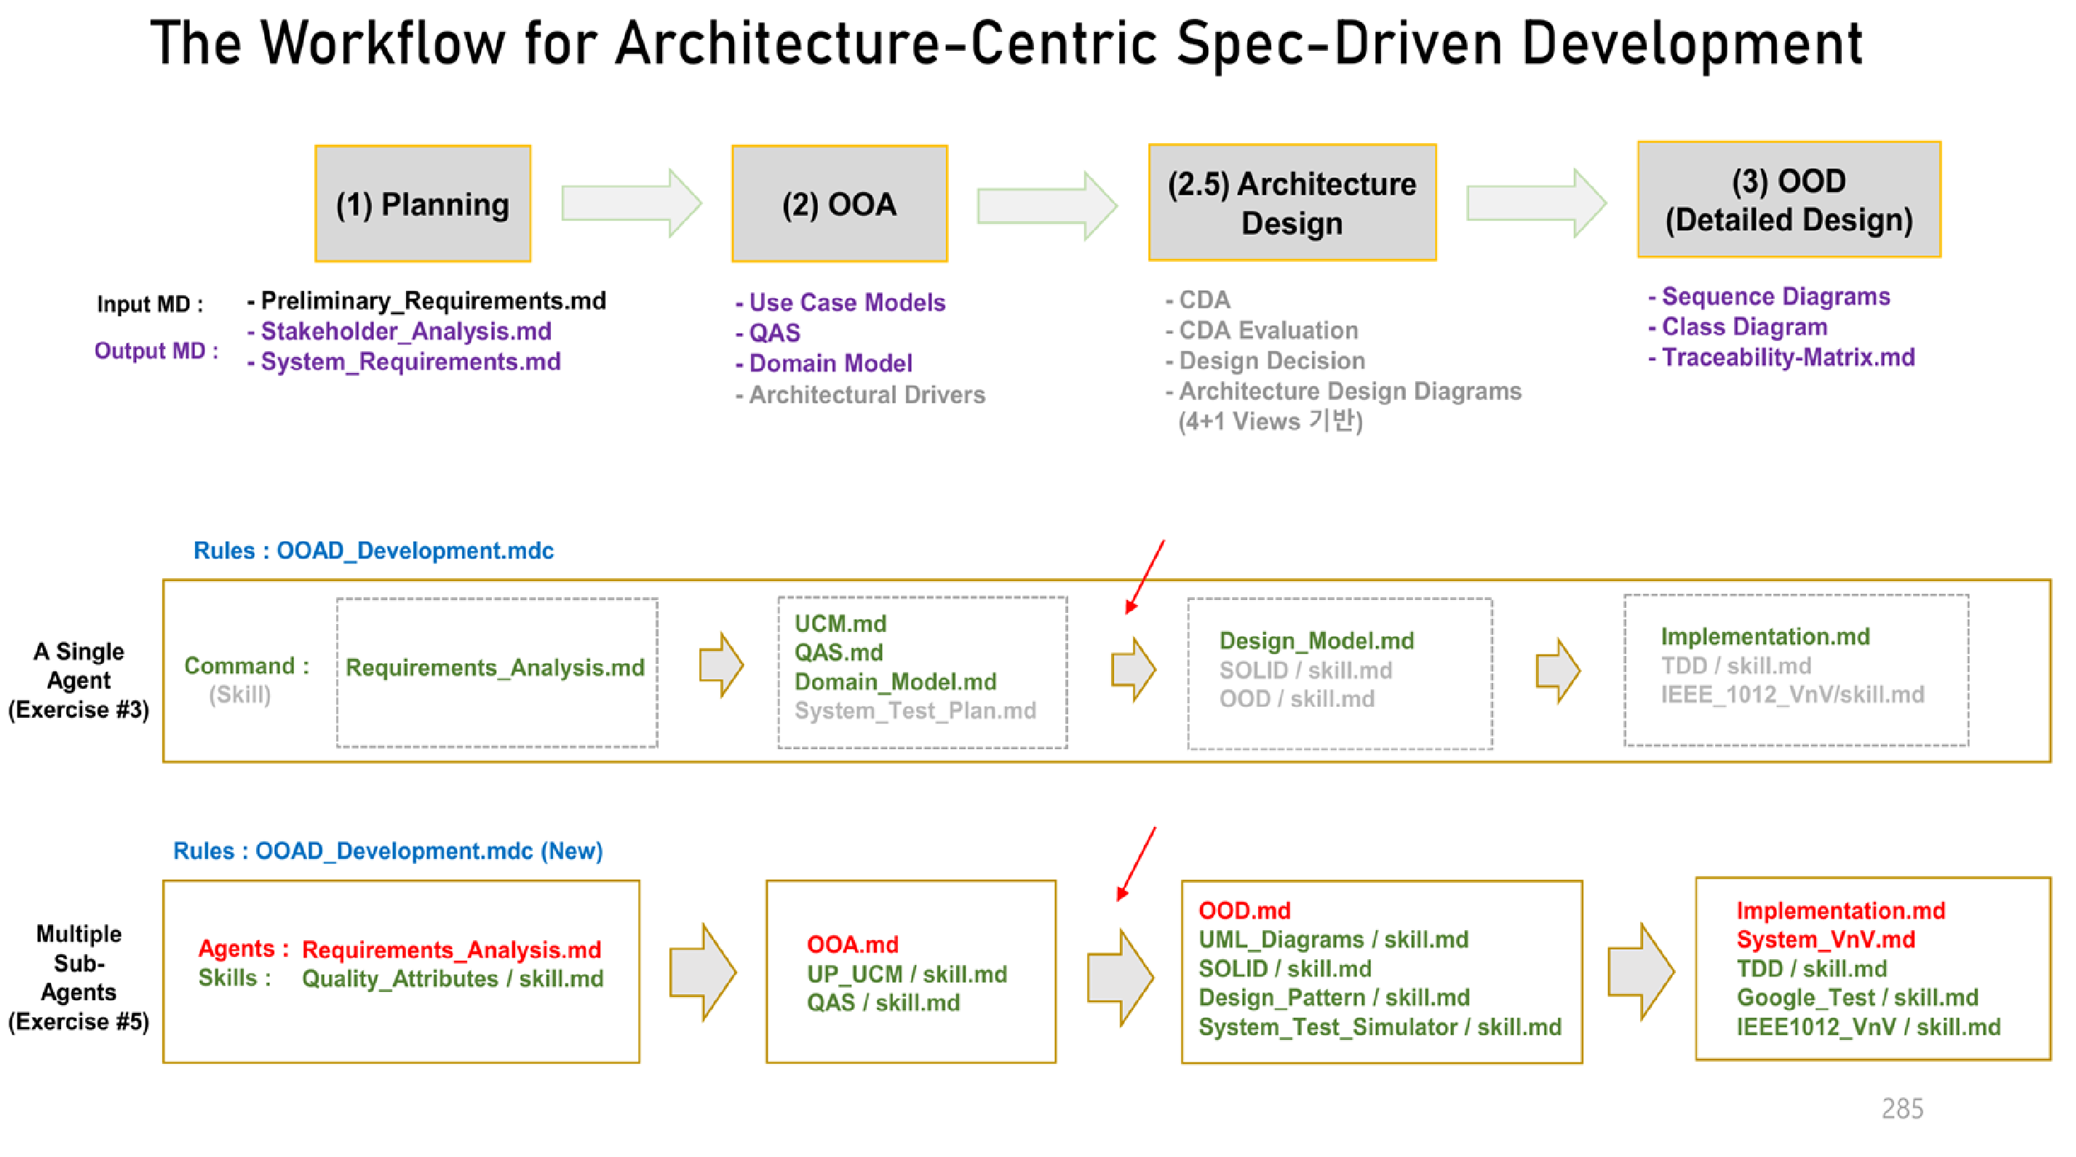
Detailed_Design.md
Candidate_Design_Architecture.md
Domain_Model.md
CDA_Evaluation_and_Design_Decision.md
Architectural_Drivers.md
Architecture_Design.md
Architecture_Verification_Report.md

