Slide 1



Nonparametric Bayesian Methods
Tamara Broderick
ITT Career Development Assistant Professor EECS
MIT
Michael I. Jordan
Pehong Chen Distinguished Professor EECS, Statistics
UC Berkeley
Notes:
Why are we even doing this? Getting intuition.
Basic idea: Learning about the data, as we get more of it.

Slide 2
Nonparametric Bayesian Methods: Part I
Tamara Broderick
ITT Career Development Assistant Professor EECS
MIT

Slide 3
Nonparametric Bayes
1

Slide 4
Nonparametric Bayes
•
Bayesian
1

Slide 5
Nonparametric Bayes
Bayesian
$$ℙ\left(parameters \right|data)∝ℙ\left(data \right|parameters)ℙ(parameters)$$
1
Notes:
The Bayesian aspect: We are going to build up a generative model for our data. We have some hidden parameters we are interested in learning (some latent parameters).
Prior: We have some distribution over them that expresses our knowledge going into the problem.
We have likelihood and prior. Use Bayes theorem to get the state of knowledge of the parameters given the data.
generative model: a type of machine learning model that learns the probability distribution of data so it can generate new examples that look like the original data.

Slide 6
Nonparametric Bayes
Bayesian
$$ℙ\left(parameters \right|data)∝ℙ\left(data \right|parameters)ℙ(parameters)$$
Not parametric (i.e. not finite parameter, unbounded/growing/infinite number of parameters)
1

Slide 7
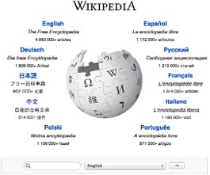
Nonparametric Bayes
Bayesian
$$ℙ\left(parameters \right|data)∝ℙ\left(data \right|parameters)ℙ(parameters)$$
Not parametric (i.e. not finite parameter, unbounded/growing/infinite number of parameters)
[wikipedia.org]
1
Notes:
Example: Wikipedia A Long Track Home. About something in alaska. You go search about the author online. You find yourself reading about Alaska. That takes you to another link about Pacific Rim and soon she reads about plate tectonics
I can spend all day on wikipedia doing this. No matter how much you have spent your time on Wikipedia, you can find new topics to explore and learn.

Slide 8
Nonparametric Bayes
Bayesian
$$ℙ\left(parameters \right|data)∝ℙ\left(data \right|parameters)ℙ(parameters)$$
Not parametric (i.e. not finite parameter, unbounded/growing/infinite number of parameters)
“Wikipedia phenomenon”
[wikipedia.org]
1

Slide 9
Nonparametric Bayes
Bayesian
$$ℙ\left(parameters \right|data)∝ℙ\left(data \right|parameters)ℙ(parameters)$$
Not parametric (i.e. not finite parameter, unbounded/growing/infinite number of parameters)
[wikipedia.org]
1

Slide 10
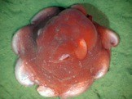
Nonparametric Bayes
Bayesian
$$ℙ\left(parameters \right|data)∝ℙ\left(data \right|parameters)ℙ(parameters)$$
Not parametric (i.e. not finite parameter, unbounded/growing/infinite number of parameters)
[Ed Bowlby, NOAA]
[wikipedia.org]
1
Notes:
Another example: species discovery. New species discovered all the time.

Slide 11
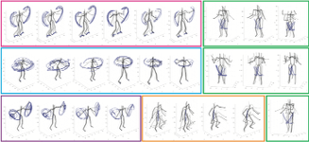
Nonparametric Bayes
Bayesian
$$ℙ\left(parameters \right|data)∝ℙ\left(data \right|parameters)ℙ(parameters)$$
Not parametric (i.e. not finite parameter, unbounded/growing/infinite number of parameters)
[Ed Bowlby, NOAA]
[Fox et al 2014]
[wikipedia.org]
1
Notes:
Ask your friends what exercies they are doing, you will probably discover new exercises as you ask more and more friends.

Slide 12
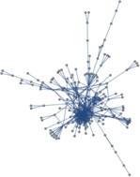
Nonparametric Bayes
Bayesian
$$ℙ\left(parameters \right|data)∝ℙ\left(data \right|parameters)ℙ(parameters)$$
Not parametric (i.e. not finite parameter, unbounded/growing/infinite number of parameters)
[Lloyd et al 2012; Miller
et al 2010]
[Ed Bowlby, NOAA]
[Fox et al 2014]
[wikipedia.org]
1
Notes:
If you analyze social networks, it's likely that as the social networks grow, or you analyze more of a social network, you will find more friend groups, more interest groups more different components of that social network, more to learn as it's growing or as you are learning more about it.

Slide 13
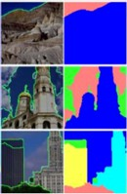
Nonparametric Bayes
Bayesian
$$ℙ\left(parameters \right|data)∝ℙ\left(data \right|parameters)ℙ(parameters)$$
Not parametric (i.e. not finite parameter, unbounded/growing/infinite number of parameters)
[Lloyd et al 2012; Miller
et al 2010]
[Ed Bowlby, NOAA]
[Fox et al 2014]
[wikipedia.org]
[Sudderth,
Jordan 2009]
1
Notes:
If you look at images: you expect to find more unique objects in those images as you get more and more images.

Slide 14
Nonparametric Bayes
Bayesian
$$ℙ\left(parameters \right|data)∝ℙ\left(data \right|parameters)ℙ(parameters)$$
Not parametric (i.e. not finite parameter, unbounded/growing/infinite number of parameters)
[Lloyd et al 2012; Miller
et al 2010]
[Ed Bowlby, NOAA]
[Fox et al 2014]
[Ewens 1972;
Hartl, Clark 2003]
[wikipedia.org]
[Sudderth,
Jordan 2009]
1
Notes:
Genetic analysis, look at people's genomes, you can find more and more unique ancestral population as you see more and more genomes

Slide 15


Nonparametric Bayes
Bayesian
$$ℙ\left(parameters \right|data)∝ℙ\left(data \right|parameters)ℙ(parameters)$$
Not parametric (i.e. not finite parameter, unbounded/growing/infinite number of parameters)
[Lloyd et al 2012; Miller
et al 2010]
[Ed Bowlby, NOAA]
[Fox et al 2014]
[Ewens 1972;
[wikipedia.org]
Hartl,
Clark 2003]
[Saria
et al 2010]
[Sudderth,
Jordan 2009]
1
Notes:
newborns entering a hospital or really anyone entering a hospital, you expect to find more unique health issues as you examine more and more of this population.

Slide 16
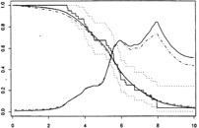
Nonparametric Bayes
Bayesian
$$ℙ\left(parameters \right|data)∝ℙ\left(data \right|parameters)ℙ(parameters)$$
Not parametric (i.e. not finite parameter, unbounded/growing/infinite number of parameters)
[Lloyd et al 2012; Miller
et al 2010]
[Ed Bowlby, NOAA]
[Fox et al 2014]
[Arjas, Gasbarra 1994]
[Ewens 1972;
[wikipedia.org]
Hartl,
Clark 2003]
[Saria
et al 2010]
[Sudderth,
Jordan 2009]
1
Notes:
Even if you're just doing something like survival analysis, you can see more groups and more different behaviors as you analyze more individuals

Slide 17
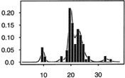
Nonparametric Bayes
Bayesian
$$ℙ\left(parameters \right|data)∝ℙ\left(data \right|parameters)ℙ(parameters)$$
Not parametric (i.e. not finite parameter, unbounded/growing/infinite number of parameters)
[Lloyd et al 2012; Miller
et al 2010]
[Ed Bowlby, NOAA]
[Fox et al 2014]
[Arjas, Gasbarra 1994]
[Ewens 1972;
Hartl, Clark 2003]
[wikipedia.org]
[Escobar, West 1995; Ghosal
[Saria
[Sudderth,
et al 1999]
et al
2010]
Jordan 2009]
1
Notes:
or something like density estimation. maybe if you have a few data points, a Gaussian might be an adequate model for that.
But as you get more and more data points,
you want more nuance and you might find that you have something that requires more and more nuance to really express what's going on with that distribution.
so for all of these reasons, we might want a growing set of parameters as we get more data basically to express more nuance in the data.
That's the idea of nonparametric Bayes.
This first set of slides get to more of a sense of exactly how that works in practice.

Slide 18
Roadmap
•
Example problem: clustering
Example NPBayes model: Dirichlet process
•
•
Big questions
Why NPBayes?
What does a growing/infinite number of parameters really mean (in NPBayes)?
Why is NPBayes challenging but practical?
Notes:
Focus on this specific example: clustering or mixture models the Bayes model that we're gonna build up to, the Dirichlet process.
This is not the entirety of nonparametric Bayesian but this example is good to build an intuition about what we are trying to accomplish in general.
Please note that when we say growing/infinite number of parameters, the underlying model isn't changing. It's what we're inferring about that model that's changing.

Slide 19

Clustering
Notes:
Start with this clustering example.

Slide 20
Clustering
4
Notes:
Start with a collection of data.
Goal: assign our data points to one and only one group. That's the nature of the latent structure that we are trying to find in clustering.

Slide 21
Clustering
4

Slide 22
Clustering
$$ℙ\left(parameters \right|data)∝ℙ\left(data \right|parameters)ℙ(parameters)$$
4
Notes:
The natural Bayesian model for this:
we want to say how this data could be generated with some set of latent parameters would be the following.

Slide 23
Generative model
$$ℙ\left(parameters \right|data)∝ℙ\left(data \right|parameters)ℙ(parameters)$$
4
Notes:
first we have to think about what our latent parameters would be.

Slide 24
Generative model
$$ℙ\left(parameters \right|data)∝ℙ\left(data \right|parameters)ℙ(parameters)$$
•
Finite Gaussian mixture model (K=2 clusters)
4
Notes:
usually when we're trying to do something like clustering :
when we have something like a Gaussian mixture model, our parameters are something like the centers of the clusters.

Slide 25
Generative model
$$ℙ\left(parameters \right|data)∝ℙ\left(data \right|parameters)ℙ(parameters)$$
•
Finite Gaussian mixture model (K=2 clusters)
µ_{k}
4
Notes:
They might also be the shapes of the clusters.
Tamara sticks with the centers just because
that's an easier story to tell.

Slide 26
Generative model
$$ℙ\left(parameters \right|data)∝ℙ\left(data \right|parameters)ℙ(parameters)$$
•
Finite Gaussian mixture model (K=2 clusters)
µ_{k}
z_{n}
4
Notes:
Anther set of parameters: assignments of data points to clusters.

Slide 27

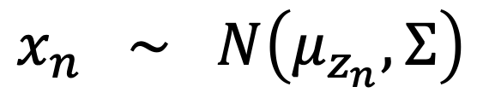
Generative model
$$ℙ\left(parameters \right|data)∝ℙ\left(data \right|parameters)ℙ(parameters)$$
•
Finite Gaussian mixture model (K=2 clusters)
µ_{k}
z_{n}
$$indep$$
$$x_{n} ∼ N\left(μ_{z_{n}}, Σ\right)$$
4
Notes:
Once we have these two parameters, we can say what our likelihood is. : The probability of our data given the parameters. Typically, it's something like this.
let's generate our data points normally distributed around the center for a particular cluster with some shape, some covariance matrix.

Slide 28

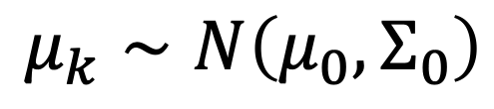
Generative model
$$ℙ\left(parameters \right|data)∝ℙ\left(data \right|parameters)ℙ(parameters)$$
•
Finite Gaussian mixture model (K=2 clusters)
$$iid$$
$$μ_{k}∼N\left(μ_{0},Σ_{0}\right)$$
z_{n}
$$indep$$
$$x_{n} ∼ N\left(μ_{z_{n}}, Σ\right)$$
4
Notes:
For bayesian, we have to put down some prior distributions over the parameters.
Natural prior for the centers = normal distribution.

Slide 29


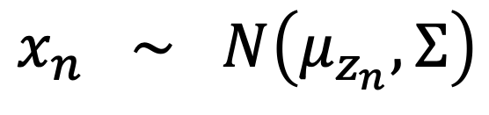
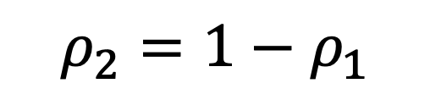
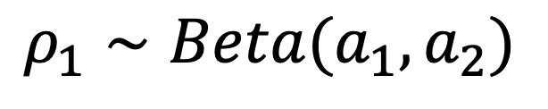


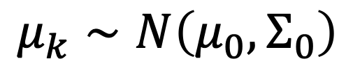
Generative model
$$ℙ\left(parameters \right|data)∝ℙ\left(data \right|parameters)ℙ(parameters)$$
•
Finite Gaussian mixture model (K=2 clusters)
$$iid$$
$$μ_{k}∼N\left(μ_{0},Σ_{0}\right)$$
$$ρ_{1}∼Beta(a_{1},a_{2})$$
$$ρ_{2}=1−ρ_{1}$$
z_{n}
$$ρ_{1}$$
$$ρ_{2}$$
$$indep$$
$$x_{n} ∼ N\left(μ_{z_{n}}, Σ\right)$$
4
Notes:
We don't really know what percentage of data points come from each cluster to begin with.
So let's put down a distribution over that.
Beta distribution is a natural prior for the assignments of data points to clusters.
Let's say that the percentage of data points in the first cluster is Beta distributed because that's a nice distribution that gives us a value between zero and one.
And then let's say we have rho two for the remaining mass, what goes to the second cluster.

Slide 30


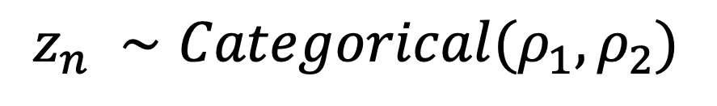

Generative model
$$ℙ\left(parameters \right|data)∝ℙ\left(data \right|parameters)ℙ(parameters)$$
•
Finite Gaussian mixture model (K=2 clusters)
$$iid$$
$$μ_{k}∼N\left(μ_{0},Σ_{0}\right)$$
$$ρ_{1}∼Beta(a_{1},a_{2})$$
$$ρ_{2}=1−ρ_{1}$$
$$iid$$
$$z_{n} ∼Categorical(ρ_{1},ρ_{2})$$
$$ρ_{1}$$
$$ρ_{2}$$
$$indep$$
$$x_{n} ∼ N\left(μ_{z_{n}}, Σ\right)$$
4
Notes:
Finally, We're gonna say for each data point, each, the nth data point, we choose that it belongs to cluster one with probability rho one and cluster two with probability rho two.

Slide 31
Generative model
$$ℙ\left(parameters \right|data)∝ℙ\left(data \right|parameters)ℙ(parameters)$$
•
Finite Gaussian mixture model (K=2 clusters)
$$iid$$
$$μ_{k}∼N\left(μ_{0},Σ_{0}\right)$$
$$ρ_{1}∼Beta(a_{1},a_{2})$$
$$ρ_{2}=1−ρ_{1}$$
$$iid$$
$$z_{n} ∼Categorical(ρ_{1},ρ_{2})$$
$$ρ_{1}$$
$$ρ_{2}$$
$$indep$$
$$x_{n} ∼ N\left(μ_{z_{n}}, Σ\right)$$
4
Notes:
Note that the probability of assignment, rhos, were chosen with beta because of convenience. When you are actually doing data analysis, you should ask if these are appropriate choices and can make better choices that have different properties.
This is a standard mixture model set up. So suppose we are pretty comfortable with the setup.
Now. Let’s review the beta distribution in particular, at least to know what assumptions that we’re making for the moment.

Slide 32
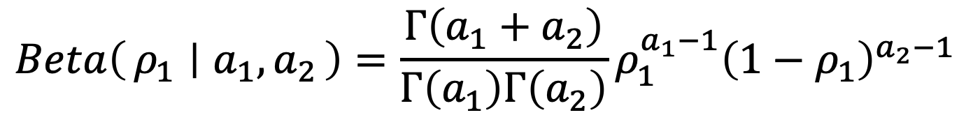


Beta distribution review
$$Beta\left(ρ_{1} ∣ a_{1},a_{2}\right)=\frac{Γ\left(a_{1}+a_{2}\right)}{Γ\left(a_{1}\right)Γ\left(a_{2}\right)}ρ_{1}^{a_{1}−1}{\left(1−ρ_{1}\right)}^{a_{2}−1}$$
$$ρ_{1}∈\left(0,1\right)$$
$$a_{1},a_{2}>0$$
5

Slide 33
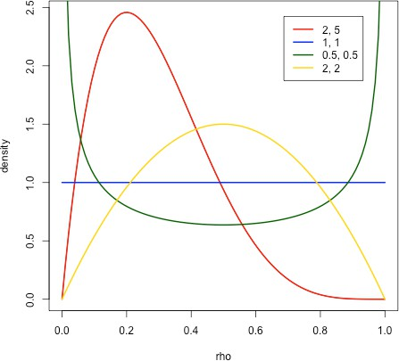
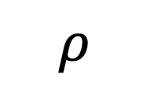
Beta distribution review
$$Beta\left(ρ_{1} ∣ a_{1},a_{2}\right)=\frac{Γ\left(a_{1}+a_{2}\right)}{Γ\left(a_{1}\right)Γ\left(a_{2}\right)}ρ_{1}^{a_{1}−1}{\left(1−ρ_{1}\right)}^{a_{2}−1}$$
$$ρ_{1}∈\left(0,1\right)$$
$$a_{1},a_{2}>0$$
density
$$ρ$$
5
Notes:
Setting:
a1=a2=1: uniform (0,1) over rho 1
a1 & a2 > 1 => concave function. More mass for rho 1 towards middle probabilities
a1 & a2 < 1 => concave function. More probabilities that are extreme (either small or large).

Slide 34
Beta distribution review
$$Beta\left(ρ_{1} ∣ a_{1},a_{2}\right)=\frac{Γ\left(a_{1}+a_{2}\right)}{Γ\left(a_{1}\right)Γ\left(a_{2}\right)}ρ_{1}^{a_{1}−1}{\left(1−ρ_{1}\right)}^{a_{2}−1}$$
$$ρ_{1}∈\left(0,1\right)$$
$$a_{1},a_{2}>0$$
What happens?
density
$$ρ$$
5
Notes:
To get a better intuition of beta distribution over different values of a1 and a2, we will simulate them and show in plots plot rho 1 and 2.
Run ex1_beta.R file.

Slide 35

Beta distribution review
$$Beta\left(ρ_{1} ∣ a_{1},a_{2}\right)=\frac{Γ\left(a_{1}+a_{2}\right)}{Γ\left(a_{1}\right)Γ\left(a_{2}\right)}ρ_{1}^{a_{1}−1}{\left(1−ρ_{1}\right)}^{a_{2}−1}$$
$$ρ_{1}∈\left(0,1\right)$$
$$a_{1},a_{2}>0$$
What happens?
$${a =a}_{1}=a_{2}→0$$
density
$${a =a}_{1}=a_{2}→∞$$
$$a_{1}>a_{2}$$
[demo]
$$ρ$$
5

Slide 36
Beta distribution review
⇢₁ 2 (0, 1)
a₁, a₂ > 0
Г(a₁ + a₂)
Г(a₁)Г(a₂)
Beta(⇢₁|a₁, a₂) =
⇢
a —1
(1 — ⇢ )
a —1
1
1
1
2
•
What happens?
a = a₁ = a₂ ! 0 a = a₁ = a₂ ! 1 a₁ > a₂
density
[demo]
ρ1
5

Slide 37
Generative model
$$ℙ\left(parameters \right|data)∝ℙ\left(data \right|parameters)ℙ(parameters)$$
Finite Gaussian mixture model (K clusters)
6
Notes:
That’s the finite mixture model where we have two clusters.
But in general, we would have more than two clusters.
We might have something like K clusters.
And so what would thegenerative model there be?

Slide 38
Generative model
$$ℙ\left(parameters \right|data)∝ℙ\left(data \right|parameters)ℙ(parameters)$$
Finite Gaussian mixture model (K clusters)
6

Slide 39

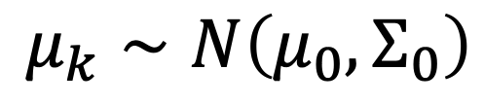
Generative model
$$ℙ\left(parameters \right|data)∝ℙ\left(data \right|parameters)ℙ(parameters)$$
Finite Gaussian mixture model (K clusters)
$$iid$$
$$μ_{k}∼N\left(μ_{0},Σ_{0}\right)$$
6
Notes:
It would be pretty much exactly the same thing.
choose the mu_Ks according to some prior distribution, we will stick to the same priors as before.
The colored boxes are our cluster centers

Slide 40





Generative model
$$ℙ\left(parameters \right|data)∝ℙ\left(data \right|parameters)ℙ(parameters)$$
Finite Gaussian mixture model (K clusters)
$$iid$$
$$μ_{k}∼N\left(μ_{0},Σ_{0}\right)$$
$$ρ_{1:K}∼Dirichlet\left(a_{1:K}\right)$$
$$ρ_{1}$$
$$ρ_{2}$$
$$ρ_{3}$$
6
Notes:
Choose the prior for cluster proportion.
The natural extension of beta distribution is Dirichlet distribution.
[left bottom corner] We want some probability on each of our clusters.

Slide 41

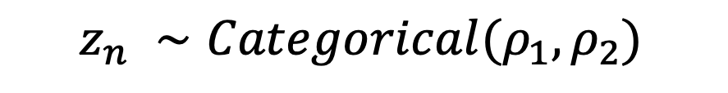
Generative model
$$ℙ\left(parameters \right|data)∝ℙ\left(data \right|parameters)ℙ(parameters)$$
Finite Gaussian mixture model (K clusters)
$$iid$$
$$μ_{k}∼N\left(μ_{0},Σ_{0}\right)$$
$$ρ_{1:K}∼Dirichlet\left(a_{1:K}\right)$$
$$iid$$
$$z_{n} ∼Categorical(ρ_{1},ρ_{2})$$
$$ρ_{1}$$
$$ρ_{2}$$
$$ρ_{3}$$
6
Notes:
Again, we choose each data point to belong to a cluster, according to the Categorical distribution.
So a data point belongs to
- cluster one with probability rho one,
- cluster two with probability rho two,
- cluster three with probability rho three.

Slide 42

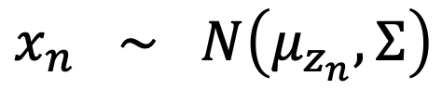
Generative model
$$ℙ\left(parameters \right|data)∝ℙ\left(data \right|parameters)ℙ(parameters)$$
Finite Gaussian mixture model (K clusters)
$$iid$$
$$μ_{k}∼N\left(μ_{0},Σ_{0}\right)$$
$$ρ_{1:K}∼Dirichlet\left(a_{1:K}\right)$$
$$iid$$
$$z_{n} ∼Categorical(ρ_{1},ρ_{2})$$
$$indep$$
$$x_{n} ∼ N\left(μ_{z_{n}}, Σ\right)$$
$$ρ_{1}$$
$$ρ_{2}$$
$$ρ_{3}$$
6
Notes:
And finally, we generate the actual data, normally distributed around whatever cluster center that data point was assigned to, and with some shape(the Sigma) that we have determined beforehand.

Slide 43
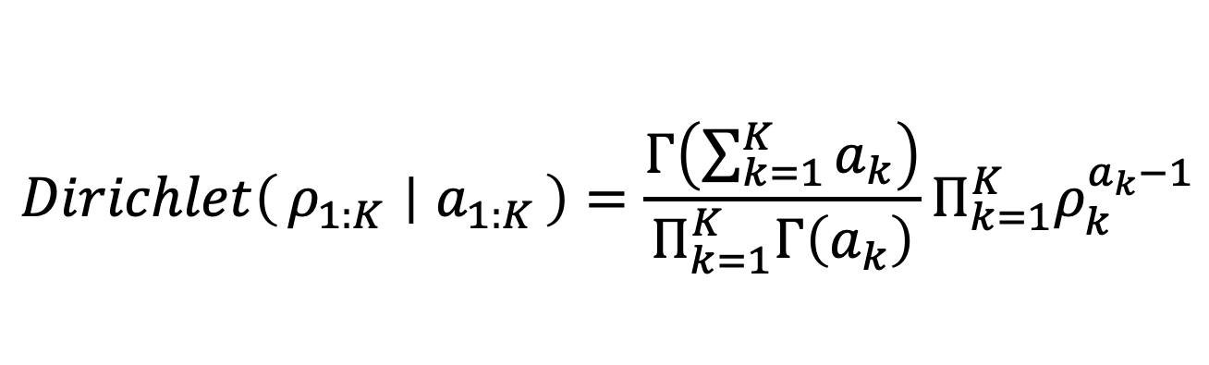
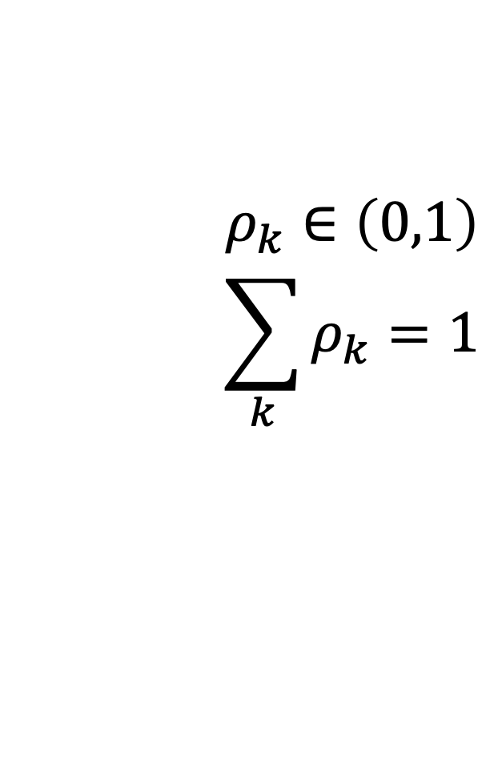
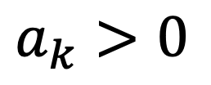
Dirichlet distribution review
$$Dirichlet\left(ρ_{1:K} ∣ a_{1:K}\right)=\frac{Γ\left(\sum_{k=1}^{K}{a_{k}}\right)}{Π_{k=1}^{K}Γ\left(a_{k}\right)}Π_{k=1}^{K}ρ_{k}^{a_{k}−1}$$
$$a_{k}>0$$
$$ρ_{k}∈\left(0,1\right)$$
$$\sum_{k}{ρ_{k}}=1$$
a = a_{k} = 1 a = a_{k} ! 0 a = a_{k} ! 1
7
Notes:
The probabilities adds up to one.
So these probabilities are not a set of independent numbers.
[skip?] It is simplex. That is, the space of all valid probability distributions over the clusters. Or even more simply, the shape formed by all vectors of probabilities that sum to one.

Slide 44
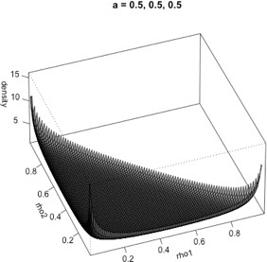
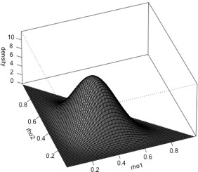
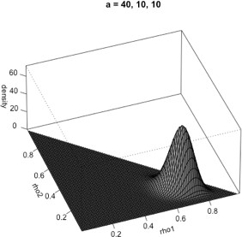
Dirichlet distribution review
$$Dirichlet\left(ρ_{1:K} ∣ a_{1:K}\right)=\frac{Γ\left(\sum_{k=1}^{K}{a_{k}}\right)}{Π_{k=1}^{K}Γ\left(a_{k}\right)}Π_{k=1}^{K}ρ_{k}^{a_{k}−1}$$
$$a_{k}>0$$
$$ρ_{k}∈\left(0,1\right)$$
$$\sum_{k}{ρ_{k}}=1$$
a=(0.5, 0.5, 0.5)
a=(5,5,5)
a=(40, 10, 10)
a = a_{k} = 1 a = a_{k} ! 0 a = a_{k} ! 1
7
Notes:
a=(5,5,5) => hyperparameters < 1, the shape will tend to middle
a=(0.5,0.5,0.5) => hyperparameters <1, the shape will go towards the edge
a=(40,10,10) => hyperparameters are not symmetric => we won’t get a symmetric distribution.

Slide 45
Dirichlet distribution review
$$Dirichlet\left(ρ_{1:K} ∣ a_{1:K}\right)=\frac{Γ\left(\sum_{k=1}^{K}{a_{k}}\right)}{Π_{k=1}^{K}Γ\left(a_{k}\right)}Π_{k=1}^{K}ρ_{k}^{a_{k}−1}$$
$$a_{k}>0$$
$$ρ_{k}∈\left(0,1\right)$$
$$\sum_{k}{ρ_{k}}=1$$
a=(0.5, 0.5, 0.5)
a=(5,5,5)
a=(40, 10, 10)
a = a_{k} = 1 a = a_{k} ! 0 a = a_{k} ! 1
[demo]
7
Notes:
Go through ex2 simulation

Slide 46
So far K << N. What if not?
8
Notes:
In the illustrations that she's shown so far, we assumed that we saw all clusters. We saw like 2 or three clusters, within each we saw a whole bunch of points.
important thing is that we "see" all clusters.

Slide 47




So far K << N. What if not?
 |  |  |  | …
$$ρ_{1}$$
$$ρ_{2}$$
$$ρ_{3}$$
$$ρ_{1000}$$
8
Notes:
In general, if I had like 1000 clusters and only have 100 data points, there will be at least 900 empty clusters.
In Bayesian inference is we're saying,
"Let's make a story about how we would generate the data given the parameters and
then the parameters as well."
And so this is a generative model.
It says, "Here's a story of how I could simulate data."
And then Bayes' theorem is what's gonna turn that around and say,
"Okay. Here's the probability of the parameters given the data."
And so what we're doing right now is we're just exploring that story.
We're exploring its assumptions because if it has the wrong assumptions or whatever its behaviors are,
we're gonna capture those behaviors again when we turn things around.

Slide 48
So far K << N. What if not?
e.g. Species sampling, topic modeling, groups on a social network, etc.
 |  |  |  | …
$$ρ_{1}$$
$$ρ_{2}$$
$$ρ_{3}$$
$$ρ_{1000}$$
8
Notes:
What if there are a ton of groups/clusters/species that is just not filled with the data?

Slide 49
So far K << N. What if not?
e.g. Species sampling, topic modeling, groups on a social network, etc.
 |  |  |  | …
$$ρ_{1}$$
$$ρ_{2}$$
$$ρ_{3}$$
$$ρ_{1000}$$
Components: number of latent groups
8

Slide 50
So far K << N. What if not?
e.g. Species sampling, topic modeling, groups on a social network, etc.
 |  |  |  | …
$$ρ_{1}$$
$$ρ_{2}$$
$$ρ_{3}$$
$$ρ_{1000}$$
Components: number of latent groups
Clusters: number of components represented in the data
8

Slide 51
So far K << N. What if not?
e.g. Species sampling, topic modeling, groups on a social network, etc.
 |  |  |  | …
$$ρ_{1}$$
$$ρ_{2}$$
$$ρ_{3}$$
$$ρ_{1000}$$
Components: number of latent groups
Clusters: number of components represented in the data
[demo 3 and 4]
8

Slide 52
So far K << N. What if not?
e.g. Species sampling, topic modeling, groups on a social network, etc.
 |  |  |  | …
$$ρ_{1}$$
$$ρ_{2}$$
$$ρ_{3}$$
$$ρ_{1000}$$
Components: number of latent groups
Clusters: number of components represented in the data
Number of clusters is random
8

Slide 53
So far K << N. What if not?
e.g. Species sampling, topic modeling, groups on a social network, etc.
 |  |  |  | …
$$ρ_{1}$$
$$ρ_{2}$$
$$ρ_{3}$$
$$ρ_{1000}$$
Components: number of latent groups
Clusters: number of components represented in the data
Number of clusters is random
Number of clusters grows with N
8

Slide 54
Here, difficult to choose finite K in advance (contrast with small K): don’t know K, difficult to infer, streaming data
9
Notes:
we don't know the number of species.
There's work on trying to estimate it, but it's not something that we definitely know.
We don't know the number of topics that are out there. We don't know the number of groups in a social network that are out there.
And so, if we put some particular large K,
so that we can have this randomness in the number of clusters and have it grow.
What if we were wrong? IF the number of components were not big.
Then we are using a bunch of parameters that we didn't need to. That is going to create computational burden, and slow things down.
On the other hand, if K is too small, we might hit up against K.
It might be difficult to infer, so maybe we could know it, but maybe we don't.
So the point is that choosing a particlar K can be problematic.

Slide 55
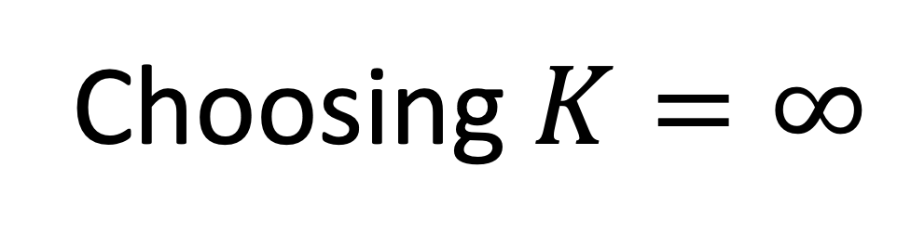
Here, difficult to choose finite K in advance (contrast with small K): don’t know K, difficult to infer, streaming data
Choosing $K=∞$
9
Notes:
we will have to choose K=infinity to make sure that K doesn't hit up against the end.
How? How to actually calculate it?
But for the moment, let's go crazy.
Let's try K equals infinity and say,
"What are the properties of this model? Do they have the properties that we want?”
So how could we even do this, first of all?
-------------
Note: For gaussian mixture model, there won't be consistency in K. For density, we will have consistency in density.
------------- Note: Fundamentally, we are working with stationary model, where the model isn't changing over time. But the usual way that the people would start working with something that's non-stationary is to the field has evolved to non-stationary in a lot of these domains is that this is a building block of a larger non-stationary model.
For instance, something that might be done is maybe you're looking at all of the articles of nature. And the topics that people study in science changes over time, you know. Every 10 years we're gonna have a totally different set of, new problems in science that people are addressing.
And so what you can do is you can have something like a Dirichlet process that is slowly changing its components, but you could think of this as being a building block within that model.

Slide 56
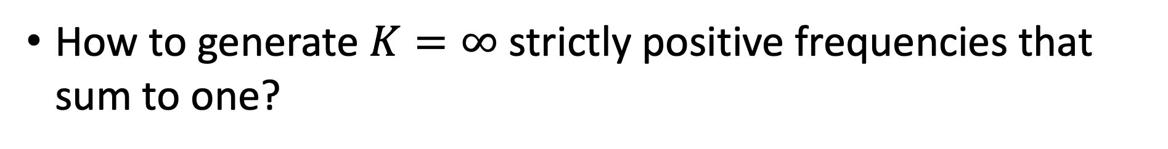
Here, difficult to choose finite K in advance (contrast with small K): don’t know K, difficult to infer, streaming data
Choosing $K=∞$
How to generate $K=∞$ strictly positive frequencies that sum to one?
9
Notes:
we will have to choose K=infinity to make sure that K doesn't hit up against the end.
How? How to actually calculate it?
But for the moment, let's go crazy.
Let's try K equals infinity and say,
"What are the properties of this model? Do they have the properties that we want?”
So how could we even do this, first of all?
-------------
Note: For gaussian mixture model, there won't be consistency in K. For density, we will have consistency in density.
------------- Note: Fundamentally, we are working with stationary model, where the model isn't changing over time. But the usual way that the people would start working with something that's non-stationary is to the field has evolved to non-stationary in a lot of these domains is that this is a building block of a larger non-stationary model.
For instance, something that might be done is maybe you're looking at all of the articles of nature. And the topics that people study in science changes over time, you know. Every 10 years we're gonna have a totally different set of, new problems in science that people are addressing.
And so what you can do is you can have something like a Dirichlet process that is slowly changing its components, but you could think of this as being a building block within that model.

Slide 57
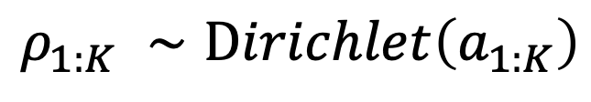
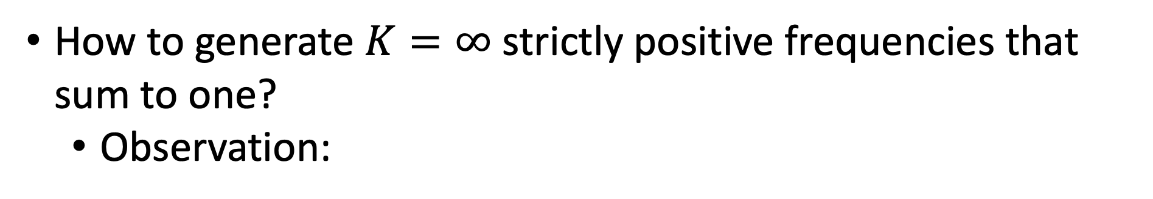
Here, difficult to choose finite K in advance (contrast with small K): don’t know K, difficult to infer, streaming data
Choosing $K=∞$
How to generate $K=∞$ strictly positive frequencies that sum to one?
Observation:
$$ρ_{1:K} ∼Dirichlet\left(a_{1:K}\right)$$
9
Notes:
So let's first make an observation about the Dirichlet distribution that might prime us on how to do this.

Slide 58
Here, difficult to choose finite K in advance (contrast with small K): don’t know K, difficult to infer, streaming data
Choosing $K=∞$
How to generate $K=∞$ strictly positive frequencies that sum to one?
Observation:
$$ρ_{1:K} ∼Dirichlet\left(a_{1:K}\right)$$
9
Notes:
one way of generating Dirichlet distribution is to use a canned Rpackage and generate the random variable.

Slide 59
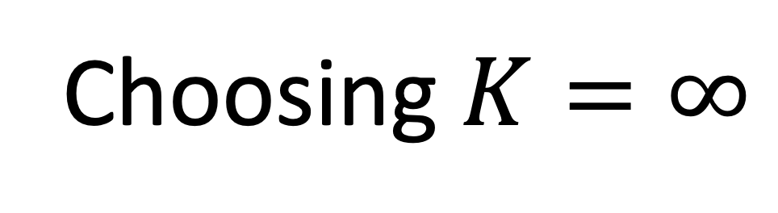

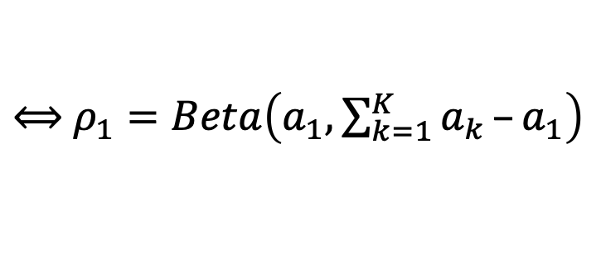
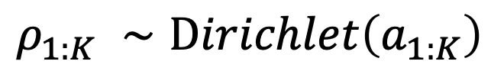
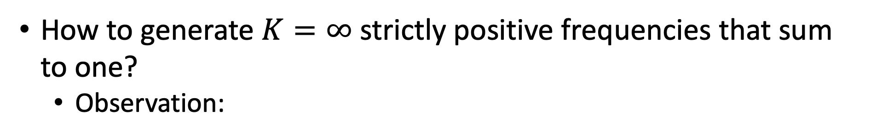
Here, difficult to choose finite K in advance (contrast with small K): don’t know K, difficult to infer, streaming data
Choosing $K=∞$
How to generate $K=∞$ strictly positive frequencies that sum to one?
Observation:
$$ρ_{1:K} ∼Dirichlet\left(a_{1:K}\right)$$
$$d$$
$⟺$ $ρ_{1}=Beta\left(a_{1},\sum_{k=1}^{K}{a_{k}}–a_{1}\right)$
9
Notes:
Another way is to use a sequence of beta distributions.
And so here's an observation.
If I want a Dirichlet distributed random variable,
it would be equivalent to first,

Slide 60
Here, difficult to choose finite K in advance (contrast with small K): don’t know K, difficult to infer, streaming data
Choosing $K=∞$
How to generate $K=∞$ strictly positive frequencies that sum to one?
Observation:
$$ρ_{1:K} ∼Dirichlet\left(a_{1:K}\right)$$
$$d$$
$⟺$ $ρ_{1}=Beta\left(a_{1},\sum_{k=1}^{K}{a_{k}}–a_{1}\right)$
9
Notes:
generate a beta random variable,

Slide 61
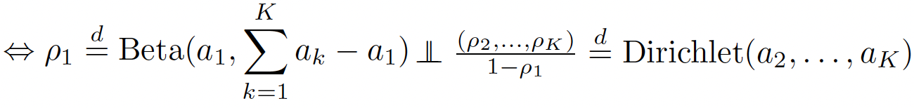
Here, difficult to choose finite K in advance (contrast with small K): don’t know K, difficult to infer, streaming data
Choosing $K=∞$
How to generate $K=∞$ strictly positive frequencies that sum to one?
Observation:
$$ρ_{1:K} ∼Dirichlet\left(a_{1:K}\right)$$
9
Notes:
and then generate the remaining mass proportions according
to a Dirichlet.

Slide 62
Here, difficult to choose finite K in advance (contrast with small K): don’t know K, difficult to infer, streaming data
Choosing $K=∞$
How to generate $K=∞$ strictly positive frequencies that sum to one?
Observation:
$$ρ_{1:K} ∼Dirichlet\left(a_{1:K}\right)$$
9
Notes:
This is basically an observation that was made earlier. So what does this tell us?

Slide 63
Here, difficult to choose finite K in advance (contrast with small K): don’t know K, difficult to infer, streaming data
Choosing $K=∞$
How to generate $K=∞$ strictly positive frequencies that sum to one?
Observation:
$$ρ_{1:K} ∼Dirichlet\left(a_{1:K}\right)$$
9
Notes:
here's a way that I could generate a Dirichlet distribution.

Slide 64
Here, difficult to choose finite K in advance (contrast with small K): don’t know K, difficult to infer, streaming data
Choosing $K=∞$
How to generate $K=∞$ strictly positive frequencies that sum to one?
Observation:
$$ρ_{1:K} ∼Dirichlet\left(a_{1:K}\right)$$
“Stick breaking”
9
Notes:
here's a way that I could generate a Dirichlet distribution.
I could take my whole probability mass, 0 to 1, and let's call that a stick.
and I could break mass off of it.

Slide 65

Here, difficult to choose finite K in advance (contrast with small K): don’t know K, difficult to infer, streaming data
Choosing $K=∞$
How to generate $K=∞$ strictly positive frequencies that sum to one?
Observation:
$$ρ_{1:K} ∼Dirichlet\left(a_{1:K}\right)$$
“Stick breaking”
$V_{1}∼Beta\left(a_{1},a_{2}+a_{3}+a_{4}\right)$
9
Notes:
First, breakoff a proportion, which is beta a_1 and then the sum of all the parameters minus a_1.

Slide 66


Here, difficult to choose finite K in advance (contrast with small K): don’t know K, difficult to infer, streaming data
Choosing $K=∞$
How to generate $K=∞$ strictly positive frequencies that sum to one?
Observation:
$$ρ_{1:K} ∼Dirichlet\left(a_{1:K}\right)$$
“Stick breaking”
$V_{1}∼Beta\left(a_{1},a_{2}+a_{3}+a_{4}\right)$
$$ρ_{1}=V_{1}$$
9
Notes:
So, I break off that proportion.
My first probability will be exactly that proportion.

Slide 67

Here, difficult to choose finite K in advance (contrast with small K): don’t know K, difficult to infer, streaming data
Choosing $K=∞$
How to generate $K=∞$ strictly positive frequencies that sum to one?
Observation:
$$ρ_{1:K} ∼Dirichlet\left(a_{1:K}\right)$$
“Stick breaking”
$V_{1}∼Beta\left(a_{1},a_{2}+a_{3}+a_{4}\right)$
$$ρ_{1}=V_{1}$$
$$1−V_{1}$$
9
Notes:
Now at this point, I have 1 minus V_1 left in my stick.

Slide 68

Here, difficult to choose finite K in advance (contrast with small K): don’t know K, difficult to infer, streaming data
Choosing $K=∞$
How to generate $K=∞$ strictly positive frequencies that sum to one?
Observation:
$$ρ_{1:K} ∼Dirichlet\left(a_{1:K}\right)$$
“Stick breaking”
$V_{1}∼Beta\left(a_{1},a_{2}+a_{3}+a_{4}\right)$
$$ρ_{1}=V_{1}$$
$V_{2}∼Beta\left(a_{2}, a_{3}+a_{4}\right)$
9
Notes:
and I can do the same thing recursively.
I can say, ”That's just Dirichlet distributed, so I'llbreak off proportion A_2 and the remaining hyperparameters.”
And so that probability will be1 minus V1 because that was the
remaining part of the stick fromthe step from the first part,
and then V2 proportionwe took off here.
Now I can do the same thing.

Slide 69

Here, difficult to choose finite K in advance (contrast with small K): don’t know K, difficult to infer, streaming data
Choosing $K=∞$
How to generate $K=∞$ strictly positive frequencies that sum to one?
Observation:
$$ρ_{1:K} ∼Dirichlet\left(a_{1:K}\right)$$
“Stick breaking”
$V_{1}∼Beta\left(a_{1},a_{2}+a_{3}+a_{4}\right)$
$$ρ_{1}=V_{1}$$
$V_{2}∼Beta\left(a_{2}, a_{3}+a_{4}\right)$
$$ρ_{2}={(1−V}_{1}) V_{2}$$
9
Notes:
And so that probability will be1 minus V1 because that was the
remaining part of the stick from the step from the first part,
and then V2 proportion we took.
Now I can do the same thing.

Slide 70

Here, difficult to choose finite K in advance (contrast with small K): don’t know K, difficult to infer, streaming data
Choosing $K=∞$
How to generate $K=∞$ strictly positive frequencies that sum to one?
Observation:
$$ρ_{1:K} ∼Dirichlet\left(a_{1:K}\right)$$
“Stick breaking”
$V_{1}∼Beta\left(a_{1},a_{2}+a_{3}+a_{4}\right)$
$$ρ_{1}=V_{1}$$
$V_{2}∼Beta\left(a_{2}, a_{3}+a_{4}\right)$
$$ρ_{2}={(1−V}_{1}) V_{2}$$
$V_{3}∼Beta\left(a_{3}, a_{4}\right)$
9
Notes:
At this point I have a Dirichlet(a_3, a_4), which is just a beta(a_3,a_4).

Slide 71

Here, difficult to choose finite K in advance (contrast with small K): don’t know K, difficult to infer, streaming data
Choosing $K=∞$
How to generate $K=∞$ strictly positive frequencies that sum to one?
Observation:
$$ρ_{1:K} ∼Dirichlet\left(a_{1:K}\right)$$
“Stick breaking”
$V_{1}∼Beta\left(a_{1},a_{2}+a_{3}+a_{4}\right)$
$$ρ_{1}=V_{1}$$
$V_{2}∼Beta\left(a_{2}, a_{3}+a_{4}\right)$
$$ρ_{2}={(1−V}_{1}) V_{2}$$
$V_{3}∼Beta\left(a_{3}, a_{4}\right)$
$$ρ_{3}={(1−V}_{1}) {(1−V}_{2})V_{3}$$
9
Notes:
I can break off that proportion.
What was left of the stick before I broke
off this proportion was (1- V1 )times (1 - V2,)
and now I'm breaking off proportion V3.

Slide 72
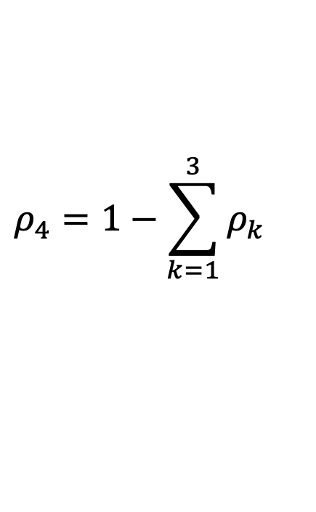

Here, difficult to choose finite K in advance (contrast with small K): don’t know K, difficult to infer, streaming data
Choosing $K=∞$
How to generate $K=∞$ strictly positive frequencies that sum to one?
Observation:
$$ρ_{1:K} ∼Dirichlet\left(a_{1:K}\right)$$
“Stick breaking”
$V_{1}∼Beta\left(a_{1},a_{2}+a_{3}+a_{4}\right)$
$$ρ_{1}=V_{1}$$
$V_{2}∼Beta\left(a_{2}, a_{3}+a_{4}\right)$
$$ρ_{2}={(1−V}_{1}) V_{2}$$
$V_{3}∼Beta\left(a_{3}, a_{4}\right)$
$$ρ_{3}={(1−V}_{1}) {(1−V}_{2})V_{3}$$
$$ρ_{4}=1−\sum_{k=1}^{3}{ρ_{k}}$$
9
Notes:
And then finally, I just have whatever's left over.
So, here's a way that I could have an infinity of random
frequencies that sum up to 1.

Slide 73
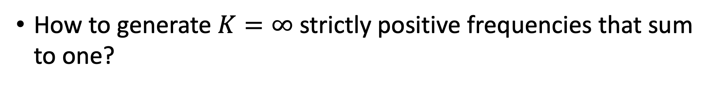
Here, difficult to choose finite K in advance (contrast with small K): don’t know K, difficult to infer, streaming data
Choosing $K=∞$
How to generate $K=∞$ strictly positive frequencies that sum to one?
9
Notes:
So, here's a way that I could have an infinity of random
frequencies that sum up to 1.

Slide 74
Here, difficult to choose finite K in advance (contrast with small K): don’t know K, difficult to infer, streaming data
Choosing $K=∞$
How to generate $K=∞$ strictly positive frequencies that sum to one?
…
9
Notes:
I could just have not stopped.

Slide 75
Choosing K = ∞
•
Here, difficult to choose finite K in advance (contrast with small K): don’t know K, difficult to infer, streaming data
How to generate K = ∞ strictly positive frequencies that sum to one?
•
• Dirichlet process stick-breaking: ak = 1, bk = ↵ > 0
• Griffiths-Engen-McCloskey (GEM) distribution:
10
Notes:
So I’m going to do the same thing

Slide 76

Choosing K = ∞
•
Here, difficult to choose finite K in advance (contrast with small K): don’t know K, difficult to infer, streaming data
How to generate K = ∞ strictly positive frequencies that sum to one?
•
$V_{1}∼Beta\left(a_{1},b_{1}\right)$
10
Notes:
I'm gonna say,
“ Okay, a way to get a random
number between 0 and 1 is a beta distribution.”

Slide 77


Choosing K = ∞
•
Here, difficult to choose finite K in advance (contrast with small K): don’t know K, difficult to infer, streaming data
How to generate K = ∞ strictly positive frequencies that sum to one?
•
• Dirichlet process stick-breaking: ak = 1, bk = ↵ > 0
• Griffiths-Engen-McCloskey (GEM) distribution:
$V_{1}∼Beta\left(a_{1},b_{1}\right)$
$${ρ_{1} ∼V}_{1}$$
10
Notes:
So, I'm gonna break off a beta distributive random
variable from my stick, from my 0, 1 stick.

Slide 78

Choosing K = ∞
•
Here, difficult to choose finite K in advance (contrast with small K): don’t know K, difficult to infer, streaming data
How to generate K = ∞ strictly positive frequencies that sum to one?
•
• Dirichlet process stick-breaking: ak = 1, bk = ↵ > 0
• Griffiths-Engen-McCloskey (GEM) distribution:
$V_{1}∼Beta\left(a_{1},b_{1}\right)$
$${ρ_{1} ∼V}_{1}$$
$V_{2}∼Beta\left(a_{2},b_{2}\right)$
10
Notes:
Now, I have some mass left, and I'll break off another
random proportion between 0 and 1 from that,

Slide 79


Choosing K = ∞
•
Here, difficult to choose finite K in advance (contrast with small K): don’t know K, difficult to infer, streaming data
How to generate K = ∞ strictly positive frequencies that sum to one?
•
• Dirichlet process stick-breaking: ak = 1, bk = ↵ > 0
• Griffiths-Engen-McCloskey (GEM) distribution:
$V_{1}∼Beta\left(a_{1},b_{1}\right)$
$${ρ_{1} =V}_{1}$$
$V_{2}∼Beta\left(a_{2},b_{2}\right)$
$${ρ_{2} =(1−V}_{1}) V_{2}$$
10
Notes:
and I'll call it V2.
And so I take my remaining mass,1 minus V1 from the first round,
break off this V2 proportion, and I have my second row.
Now I'll do this again.
I'll say, &quot;Oh,I've got some
remaining mass,I'll break off V3,&quot;
and I'll just keep doingthis on and on forever.
And on the Kth step,I'll break off VK.
What I had before theKth step was this,
and then I multiply by VK.

Slide 80
Choosing K = ∞
•
Here, difficult to choose finite K in advance (contrast with small K): don’t know K, difficult to infer, streaming data
How to generate K = ∞ strictly positive frequencies that sum to one?
•
• Dirichlet process stick-breaking: ak = 1, bk = ↵ > 0
• Griffiths-Engen-McCloskey (GEM) distribution:
$V_{1}∼Beta\left(a_{1},b_{1}\right)$
$${ρ_{1} =V}_{1}$$
$V_{2}∼Beta\left(a_{2},b_{2}\right)$
$${ρ_{2} =(1−V}_{1}) V_{2}$$
10
Notes:
Now I'll do this again.

Slide 81
Choosing K = ∞
•
Here, difficult to choose finite K in advance (contrast with small K): don’t know K, difficult to infer, streaming data
How to generate K = ∞ strictly positive frequencies that sum to one?
•
• Dirichlet process stick-breaking: ak = 1, bk = ↵ > 0
• Griffiths-Engen-McCloskey (GEM) distribution:
$V_{1}∼Beta\left(a_{1},b_{1}\right)$
$${ρ_{1} =V}_{1}$$
$V_{2}∼Beta\left(a_{2},b_{2}\right)$
$${ρ_{2} =(1−V}_{1}) V_{2}$$
…
10
Notes:
I'll say, “Oh, I've got some
remaining mass, I'll break off V3“
and I'll just keep doing this on and on forever.

Slide 82

Choosing K = ∞
•
Here, difficult to choose finite K in advance (contrast with small K): don’t know K, difficult to infer, streaming data
How to generate K = ∞ strictly positive frequencies that sum to one?
•
• Dirichlet process stick-breaking: ak = 1, bk = ↵ > 0
• Griffiths-Engen-McCloskey (GEM) distribution:
$V_{1}∼Beta\left(a_{1},b_{1}\right)$
$${ρ_{1} =V}_{1}$$
$V_{2}∼Beta\left(a_{2},b_{2}\right)$
$${ρ_{2} =(1−V}_{1}) V_{2}$$
…
$V_{k}∼Beta\left(a_{k},b_{k}\right)$
10
Notes:
And on the Kth step, I'll break off VK.

Slide 83

Choosing K = ∞
•
Here, difficult to choose finite K in advance (contrast with small K): don’t know K, difficult to infer, streaming data
How to generate K = ∞ strictly positive frequencies that sum to one?
•
• Dirichlet process stick-breaking: ak = 1, bk = ↵ > 0
• Griffiths-Engen-McCloskey (GEM) distribution:
$V_{1}∼Beta\left(a_{1},b_{1}\right)$
$${ρ_{1} =V}_{1}$$
$V_{2}∼Beta\left(a_{2},b_{2}\right)$
$${ρ_{2} =(1−V}_{1}) V_{2}$$
…
$V_{k}∼Beta\left(a_{k},b_{k}\right)$
$$ρ_{k}=\left[Π_{j=1}^{k−1}\left(1−V_{j}\right)\right]V_{k}$$
10
Notes:
What I had before the Kth step was
This [the project term in rho_k],
and then I multiply by VK.
Now questions.
1. How are we going to do this? We have to assume something about a_1 and b_1 in order to make sure these sum to 1.

Slide 84
Choosing K = ∞
•
Here, difficult to choose finite K in advance (contrast with small K): don’t know K, difficult to infer, streaming data
How to generate K = ∞ strictly positive frequencies that sum to one?
•
• Dirichlet process stick-breaking: ak = 1, bk = ↵ > 0
• Griffiths-Engen-McCloskey (GEM) distribution:
$V_{1}∼Beta\left(a_{1},b_{1}\right)$
$${ρ_{1} =V}_{1}$$
$V_{2}∼Beta\left(a_{2},b_{2}\right)$
$${ρ_{2} =(1−V}_{1}) V_{2}$$
…
$V_{k}∼Beta\left(a_{k},b_{k}\right)$
$$ρ_{k}=\left[Π_{j=1}^{k−1}\left(1−V_{j}\right)\right]V_{k}$$
10
[Ishwaran, James 2001]
Notes:
For that, I will direct you to the reference.
We are going to take one step further. It will be pain in the butt if we have to choose an infinity of these a_k and b_k values. So it would be nicer if we just simplified this drastically, for instance,

Slide 85
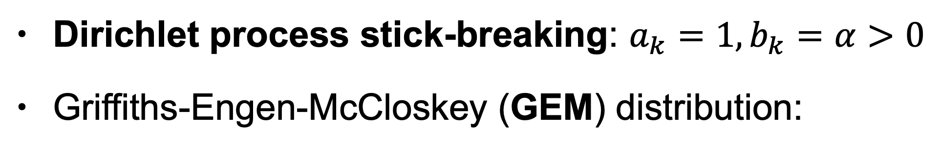
Choosing K = ∞
•
Here, difficult to choose finite K in advance (contrast with small K): don’t know K, difficult to infer, streaming data
How to generate K = ∞ strictly positive frequencies that sum to one?
•
• Dirichlet process stick-breaking: $a_{k}=1,b_{k}=α>0$
• Griffiths-Engen-McCloskey (GEM) distribution:
$V_{1}∼Beta\left(a_{1},b_{1}\right)$
$${ρ_{1} =V}_{1}$$
$V_{2}∼Beta\left(a_{2},b_{2}\right)$
$${ρ_{2} =(1−V}_{1}) V_{2}$$
…
$V_{k}∼Beta\left(a_{k},b_{k}\right)$
$$ρ_{k}=\left[Π_{j=1}^{k−1}\left(1−V_{j}\right)\right]V_{k}$$
10
[Ishwaran, James 2001]
Notes:
by choosing all of the a_k’s to be 1 and all of the b_k’s to be alpha.
This vastly simplifies the choice.

Slide 86
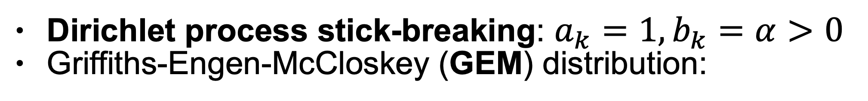

Choosing K = ∞
•
Here, difficult to choose finite K in advance (contrast with small K): don’t know K, difficult to infer, streaming data
How to generate K = ∞ strictly positive frequencies that sum to one?
•
• Dirichlet process stick-breaking: $a_{k}=1,b_{k}=α>0$
• Griffiths-Engen-McCloskey (GEM) distribution:
$$ρ=\left(ρ_{1},ρ_{2},…\right)∼GEM\left(α\right)$$
$V_{1}∼Beta\left(a_{1},b_{1}\right)$
$${ρ_{1} =V}_{1}$$
$V_{2}∼Beta\left(a_{2},b_{2}\right)$
$${ρ_{2} =(1−V}_{1}) V_{2}$$
…
$V_{k}∼Beta\left(a_{k},b_{k}\right)$
$$ρ_{k}=\left[Π_{j=1}^{k−1}\left(1−V_{j}\right)\right]V_{k}$$
10
[Ishwaran, James 2001]
Notes:
To be more particular,
the distribution over the rhos, rho-1, rho-2, rho-3,
this infinity of rhos ,is known as the GEM (gee-ee-em)
distribution when we make this choice
after Griffiths, Engen, and McCloskey's very early work in this area.
Show example 5.

Slide 87
Choosing K = ∞
•
Here, difficult to choose finite K in advance (contrast with small K): don’t know K, difficult to infer, streaming data
How to generate K = ∞ strictly positive frequencies that sum to one?
•
• Dirichlet process stick-breaking: $a_{k}=1,b_{k}=α>0$
• Griffiths-Engen-McCloskey (GEM) distribution:
$$ρ=\left(ρ_{1},ρ_{2},…\right)∼GEM\left(α\right)$$
[demo 5]
$V_{1}∼Beta\left(a_{1},b_{1}\right)$
$${ρ_{1} =V}_{1}$$
$V_{2}∼Beta\left(a_{2},b_{2}\right)$
$${ρ_{2} =(1−V}_{1}) V_{2}$$
…
$V_{k}∼Beta\left(a_{k},b_{k}\right)$
$$ρ_{k}=\left[Π_{j=1}^{k−1}\left(1−V_{j}\right)\right]V_{k}$$
10
[Ishwaran, James 2001]
Notes:
Okay! Let’s look at GEM distribution.
Show example 5.

Slide 88
Dirichlet process mixture model
_{µ⇤} i⇠id _{G}
n
12
Notes:
So let's talk about how this fits into our mixture model or clustering frame work that we were building up from the beginning.

Slide 89

Dirichlet process mixture model
Gaussian mixture model
$$ρ=\left(ρ_{1},ρ_{2}\right)∼Beta\left(a_{1},a_{2}\right)$$
1 2
_{µ⇤} i⇠id _{G}
n
12
Notes:
Previously, if we have two clusters, then we draw rho1 and rho2 from a beta distribution.

Slide 90
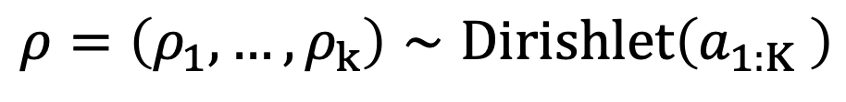
Dirichlet process mixture model
Gaussian mixture model
$$ρ=\left(ρ_{1},…,ρ_{k}\right)∼Dirishlet\left(a_{1:K} \right)$$
1 2 3
_{µ⇤} i⇠id _{G}
n
12
Notes:
If we have K clusters, we will draw them from Dirichlet distribution.

Slide 91
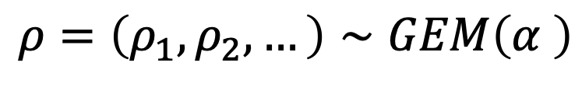
Dirichlet process mixture model
Gaussian mixture model
$$ρ=\left(ρ_{1},ρ_{2},…\right)∼GEM\left(α \right)$$
…
1 2 3 4
…
_{µ⇤} i⇠id _{G}
n
12
Notes:
And now we've built up this GEM distribution,
which is the generalization of that.

Slide 92


Dirichlet process mixture model
Gaussian mixture model
$$ρ=\left(ρ_{1},ρ_{2},…\right)∼GEM\left(α \right)$$
$$iid$$
…
$$μ_{k}∼N\left(μ_{0},Σ_{0}\right),$$
$$K=1,2,…$$
…
1 2 3 4
_{µ⇤} i⇠id _{G}
n
…
12
Notes:
We will do the same thing.
We'll draw our new Ks, we'll draw an infinity of them.
Now let's think about what we would do next at this point.
So if we have this collection of means and probabilities, what we would do is we would say,
“ Okay, I have my data point
And I'm going to draw that data point from cluster two,
the probability rho 2, and then I'm going to assign
it to the the mu 2 mean.”

Slide 93

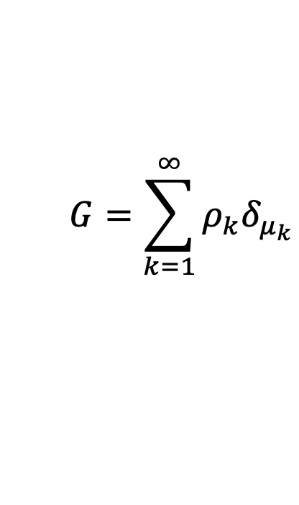


Dirichlet process mixture model
Gaussian mixture model
$$ρ=\left(ρ_{1},ρ_{2},…\right)∼GEM\left(α \right)$$
$$iid$$
…
$$μ_{k}∼N\left(μ_{0},Σ_{0}\right),$$
$$K=1,2,…$$
…
1 2 3 4
$$G=\sum_{k=1}^{∞}{ρ_{k}δ_{μ_{k}}}$$
i.e.
$$ρ_{2}$$
$$μ_{2}$$
$$ℝ^{D}$$
…
12
Notes:
A completely equivalent way that I could have done
that would be to say,
”Okay, well actually what I'm gonna do is I'm going to draw it
from the cluster with mean mu2, with probability rho two”
So I could have made a probability distribution that
puts rho 2 on mu2 rather than separating out choosing two
with probability rho 2 and then choosing mu2.
So if we describe this distribution where we put
probability $ρ_{1}$ on mu1,
probably $ρ_{2}$ on mu2,
et cetera,
Which is what I'm saying here,
we'll take each $ρ_{k}$ and put it at the location mu K, this cluster center

Slide 94


Dirichlet process mixture model
Gaussian mixture model
$$ρ=\left(ρ_{1},ρ_{2},…\right)∼GEM\left(α \right)$$
$$iid$$
…
$$μ_{k}∼N\left(μ_{0},Σ_{0}\right),$$
$$K=1,2,…$$
…
1 2 3 4
$$G=\sum_{k=1}^{∞}{ρ_{k}δ_{μ_{k}}}=DP\left(α,N\left(μ_{0},Σ_{0}\right)\right)$$
Dirichlet
Process
$$d$$
i.e.
$$ρ_{2}$$
$$μ_{2}$$
$$ℝ^{D}$$
…
12
Notes:
This is actually what’s known as the Dirichlet process.
We technically haven’t described a Dirichlet process up until this point.
This is an example of one, the two parameters that it takes are
the alpha parameter of the GEM, and
the base measure from which we draw the locations in the probability distribution.
what's going on here is
these two lines,
1. the drawing the GEM and
2. the drawing these cluster locations
are equivalent to this line where we just draw from a Dirichlet process.

Slide 95

Dirichlet process mixture model
Gaussian mixture model
$$ρ=\left(ρ_{1},ρ_{2},…\right)∼GEM\left(α \right)$$
$$iid$$
…
$$μ_{k}∼N\left(μ_{0},Σ_{0}\right),$$
$$K=1,2,…$$
…
1 2 3 4
$$G=\sum_{k=1}^{∞}{ρ_{k}δ_{μ_{k}}}=DP\left(α,N\left(μ_{0},Σ_{0}\right)\right)$$
Dirichlet
Process
$$d$$
i.e.
$$ρ_{2}$$
$$iid$$
$$z_{n}∼Categorical\left(ρ\right)$$
$$μ_{2}$$
$$ℝ^{D}$$
…
12
Notes:
Next up:
Draw categorical from my rhos.
To say “this data point belongs to this cluster”

Slide 96

Dirichlet process mixture model
Gaussian mixture model
$$ρ=\left(ρ_{1},ρ_{2},…\right)∼GEM\left(α \right)$$
$$iid$$
…
$$μ_{k}∼N\left(μ_{0},Σ_{0}\right),$$
$$K=1,2,…$$
$$iid$$
1 2 3 4
…
$$G=\sum_{k=1}^{∞}{ρ_{k}δ_{μ_{k}}}=DP\left(α,N\left(μ_{0},Σ_{0}\right)\right)$$
Dirichlet
Process
$$d$$
i.e.
$$ρ_{2}$$
$$iid$$
$$z_{n}∼Categorical\left(ρ\right)$$
$$μ_{2}$$
$$ℝ^{D}$$
$$μ_{n}^{∗}=μ_{z},$$
…
12
Notes:
I would say,: "Okay, this data point, the Nth data point is going to be somewhere around the mean indexed by z_n.”
But again, just as I said, the top two steps are equivalent to this third step, …

Slide 97

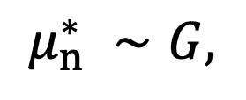
Dirichlet process mixture model
Gaussian mixture model
$$ρ=\left(ρ_{1},ρ_{2},…\right)∼GEM\left(α \right)$$
$$iid$$
…
$$μ_{k}∼N\left(μ_{0},Σ_{0}\right),$$
$$K=1,2,…$$
$$iid$$
1 2 3 4
…
$$G=\sum_{k=1}^{∞}{ρ_{k}δ_{μ_{k}}}=DP\left(α,N\left(μ_{0},Σ_{0}\right)\right)$$
Dirichlet
Process
$$d$$
i.e.
$$ρ_{2}$$
$$iid$$
$$z_{n}∼Categorical\left(ρ\right)$$
$$μ_{2}$$
$$ℝ^{D}$$
$$μ_{n}^{∗}=μ_{z},$$
$$iid$$
i.e.
$$μ_{n}^{∗} ∼G,$$
…
12
Notes:
These two steps are equivalent to just making a draw from this distribution saying:
"This data point is gonna be around the mean that I've drawn from this distribution."
And because it's a discrete distribution, I will get those means repeated alot, and I will get data points in the same cluster.

Slide 98
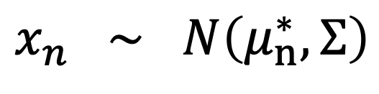

Dirichlet process mixture model
Gaussian mixture model
$$ρ=\left(ρ_{1},ρ_{2},…\right)∼GEM\left(α \right)$$
$$iid$$
…
$$μ_{k}∼N\left(μ_{0},Σ_{0}\right),$$
$$K=1,2,…$$
$$iid$$
1 2 3 4
…
$$G=\sum_{k=1}^{∞}{ρ_{k}δ_{μ_{k}}}=DP\left(α,N\left(μ_{0},Σ_{0}\right)\right)$$
Dirichlet
Process
$$d$$
i.e.
$$ρ_{2}$$
$$iid$$
$$z_{n}∼Categorical\left(ρ\right)$$
$$μ_{2}$$
$$ℝ^{D}$$
$$μ_{n}^{∗}=μ_{z},$$
$$iid$$
i.e.
$$μ_{n}^{∗} ∼G,$$
$$indep$$
$$x_{n} ∼ N\left(μ_{n}^{∗}, Σ\right)$$
…
12
Notes:
And then finally I'll draw my data points actually normal around the cluster center to which they were assigned. (Move to next page and show the right bottom plot).

Slide 99
Dirichlet process mixture model
Gaussian mixture model
$$ρ=\left(ρ_{1},ρ_{2},…\right)∼GEM\left(α \right)$$
$$iid$$
…
$$μ_{k}∼N\left(μ_{0},Σ_{0}\right),$$
$$K=1,2,…$$
$$iid$$
1 2 3 4
…
$$G=\sum_{k=1}^{∞}{ρ_{k}δ_{μ_{k}}}=DP\left(α,N\left(μ_{0},Σ_{0}\right)\right)$$
Dirichlet
Process
$$d$$
i.e.
$$ρ_{2}$$
$$iid$$
$$z_{n}∼Categorical\left(ρ\right)$$
$$μ_{2}$$
$$ℝ^{D}$$
$$μ_{n}^{∗}=μ_{z},$$
$$iid$$
i.e.
$$μ_{n}^{∗} ∼G,$$
$$indep$$
$$x_{n} ∼ N\left(μ_{n}^{∗}, Σ\right)$$
[Demo 6]
12
Notes:
Now show demo 6. Last one.

Slide 100
Roadmap
•
Example problem: clustering
Example NPBayes model: Dirichlet process
•
•
Big questions
Why NPBayes?
What does a growing/infinite number of parameters really mean (in NPBayes)?
Why is NPBayes challenging but practical?
13

Slide 101
Roadmap
•
Example problem: clustering
Example NPBayes model: Dirichlet process
•
•
Big questions
Why NPBayes? Learn more from more data
What does a growing/infinite number of parameters really mean (in NPBayes)?
Why is NPBayes challenging but practical?
13

Slide 102
Roadmap
•
Example problem: clustering
Example NPBayes model: Dirichlet process
•
•
Big questions
Why NPBayes? Learn more from more data
What does a growing/infinite number of parameters really mean (in NPBayes)? Components vs clusters; latent vs. realized
Why is NPBayes challenging but practical?
13

Slide 103
Roadmap
•
Example problem: clustering
Example NPBayes model: Dirichlet process
•
•
Big questions
Why NPBayes? Learn more from more data
What does a growing/infinite number of parameters really mean (in NPBayes)? Components vs clusters; latent vs. realized
Why is NPBayes challenging but practical? Infinite dimensional parameter, but finitely many realized
13

Slide 104
Roadmap
•
Example problem: clustering
Example NPBayes model: Dirichlet process
•
•
Big questions
Why NPBayes? Learn more from more data
What does a growing/infinite number of parameters really mean (in NPBayes)? Components vs clusters; latent vs. realized
Why is NPBayes challenging but practical? Infinite dimensional parameter, but finitely many realized
Typical approaches:
13

Slide 105
Roadmap
•
Example problem: clustering
Example NPBayes model: Dirichlet process
•
•
Big questions
Why NPBayes? Learn more from more data
What does a growing/infinite number of parameters really mean (in NPBayes)? Components vs clusters; latent vs. realized
Why is NPBayes challenging but practical? Infinite dimensional parameter, but finitely many realized
Typical approaches:
Integrate out the infinite parameter
13

Slide 106
Roadmap
•
Example problem: clustering
Example NPBayes model: Dirichlet process
•
•
Big questions
Why NPBayes? Learn more from more data
What does a growing/infinite number of parameters really mean (in NPBayes)? Components vs clusters; latent vs. realized
Why is NPBayes challenging but practical? Infinite dimensional parameter, but finitely many realized
Typical approaches:
Integrate out the infinite parameter
Truncate the infinite parameter
13

Slide 107
References (page 1 of 4)
DJ Aldous. Exchangeability and related topics. Springer, 1983.
CE Antoniak. Mixtures of Dirichlet processes with applications to Bayesian nonparametric problems. The Annals of Statistics, 1974.
E Arjas and D Gasbarra. Nonparametric Bayesian inference from right censored survival data, using the Gibbs sampler.
Statistica Sinica, 1994.
J Bertoin. Random Fragmentation and Coagulation Processes. Cambridge University Press, 2006.
D Blackwell and JB MacQueen. Ferguson distributions via Pólya urn schemes. The Annals of Statistics, 1973.
E Bowlby. NOAA/Olympic Coast NMS; NOAA/OAR/Office of Ocean Exploration - NOAA Photo Library. Retrieved from: https://en.wikipedia.org/wiki/Opisthoteuthis_californiana#/media/File:Opisthoteuthis_californiana.jpg
T Broderick, MI Jordan, and J Pitman. Beta processes, stick-breaking, and power laws. Bayesian Analysis, 2012.
T Broderick, MI Jordan, and J Pitman. Cluster and feature modeling from combinatorial stochastic processes. Statistical Science, 2013.
T Broderick, J Pitman, and MI Jordan. Feature allocations, probability functions, and paintboxes. Bayesian Analysis, 2013.
T Broderick, AC Wilson, and MI Jordan. Posteriors, conjugacy, and exponential families for completely random measures. arXiv preprint arXiv:1410.6843, 2014.
T Campbell*, JH Huggins*, J How, T Broderick. Truncation random measures. arXiv preprint arXiv:1603.00861, 2016. S Engen. A note on the geometric series as a species frequency model. Biometrika, 1975.
MD Escobar and M West. Bayesian density estimation and inference using mixtures. Journal of the American Statistical Association, 1995.

Slide 108
References (page 2 of 4)
W Ewens. The sampling theory of selectively neutral alleles. Theoretical Population Biology, 1972.
W Ewens. Population genetics theory -- the past and the future. Mathematical and Statistical Developments of Evolutionary Theory, 1987.
TS Ferguson. A Bayesian analysis of some nonparametric problems. The Annals of Statistics, 1973.
TS Ferguson. Bayesian density estimation by mixtures of normal distributions. Recent Advances in Statistics, 1983.
EB Fox, personal website. Retrieved from: http://www.stat.washington.edu/~ebfox/research.html --- Associated paper: EB Fox, MC Hughes, EB Sudderth, and MI Jordan. The Annals of Applied Statistics, 2014.
S Ghosal, JK Ghosh, and RV Ramamoorthi. Posterior consistency of Dirichlet mixtures in density estimation. The Annals of Statistics, 1999.
S Goldwater, TL Griffiths, and M Johnson. Interpolating between types and tokens by estimating power-law generators.
NIPS, 2005.
A Gnedin, B Hansen, and J Pitman. Notes on the occupancy problem with infinitely many boxes: general asymptotics and power laws. Probability Surveys, 2007.
TL Griffiths and Z Ghahramani. Infinite latent feature models and the Indian buffet process. NIPS, 2005. DL Hartl and AG Clark. Principles of Population Genetics, Fourth Edition. 2003.
E Hewitt and LJ Savage. Symmetric measures on Cartesian products. Transactions of the American Mathematical Society, 1955.
NL Hjort. Nonparametric Bayes estimators based on beta processes in models for life history data. The Annals of Statistics, 1990.
DN Hoover. Relations on probability spaces and arrays of random variables, Preprint, Institute for Advanced Study, 1979.

Slide 109
References (page 3 of 4)
FM Hoppe. Pólya-like urns and the Ewens' sampling formula. Journal of Mathematical Biology, 1984.
H Ishwaran and LF James. Gibbs sampling methods for stick-breaking priors. Journal of the American Statistical Association, 2001.
L James. Poisson latent feature calculus for generalized Indian buffet processes. arXiv preprint arXiv:1411.2936, 2014. Y Kim. Nonparametric Bayesian estimators for counting processes. The Annals of Statistics, 1999.
JFC Kingman. The representation of partition structures. Journal of the London Mathematical Society, 1978. JFC Kingman. On the genealogy of large populations. Journal of Applied Probability, 1982.
JFC Kingman. Poisson processes, 1992.
JR Lloyd, P Orbanz, Z Ghahramani, and DM Roy. Random function priors for exchangeable arrays with applications to graphs and relational data. NIPS, 2012.
SN MacEachern and P Müller. Estimating mixtures of Dirichlet process models. Journal of Computational and Graphical Statistics, 1998.
JW McCloskey. A model for the distribution of individuals by species in an environment. Ph.D. thesis, Michigan State University, 1965.
K Miller, MI Jordan, and TL Griffiths. Nonparametric latent feature models for link prediction. NIPS, 2009. RM Neal. Density modeling and clustering using Dirichlet diffusion trees. Bayesian Statistics, 2003.
P Orbanz. Construction of nonparametric Bayesian models from parametric Bayes equations. NIPS, 2009. P Orbanz. Conjugate Projective Limits. arXiv preprint arXiv:1012.0363, 2010.
P Orbanz, DM Roy. Bayesian models of graphs, arrays and other exchangeable random structures. IEEE TPAMI, 2015.

Slide 110
References (page 4 of 4)
GP Patil and C Taillie. Diversity as a concept and its implications for random communities. Bulletin of the International Statistical Institute, 1977.
J Pitman and M Yor. The two-parameter Poisson-Dirichlet distribution derived from a stable subordinator. The Annals of Probability, 1997.
A Rodríguez, DB Dunson & AE Gelfand. The nested Dirichlet process. Journal of the American Statistical Association, 2008.
S Saria, D Koller, and A Penn. Learning individual and population traits from clinical temporal data. NIPS, 2010. J Sethuraman. A constructive definition of Dirichlet priors. Statistica Sinica, 1994.
EB Sudderth and MI Jordan. Shared segmentation of natural scenes using dependent Pitman-Yor processes. NIPS, 2009.
YW Teh. A hierarchical Bayesian language model based on Pitman-Yor processes. ACL, 2006.
YW Teh, C Blundell, and L Elliott. Modelling genetic variations using fragmentation-coagulation processes. NIPS, 2011.
YW Teh, MI Jordan, MJ Beal, and DM Blei. Hierarchical Dirichlet processes. Journal of the American Statistical Association, 2006.
R Thibaux and MI Jordan. Hierarchical beta processes and the Indian buffet process. ICML, 2007. J Wakeley. Coalescent Theory: An Introduction, Chapter 3, 2008.
M West, P Müller, and MD Escobar. Hierarchical Priors and Mixture Models, With Application in Regression and Density Estimation. Aspects of Uncertainty, 1994.

