Slide 1


HeaLog
Hello, My Health Log
DevelopedBy_유혜한_김혜민_신유영

Slide 2



“ ”
PT
communicate
personalize
non-contact

Slide 3
Diary
connect
with
exercise
subscribe
feedback
condition
Trainer
personal training
recommend
meal

Slide 4
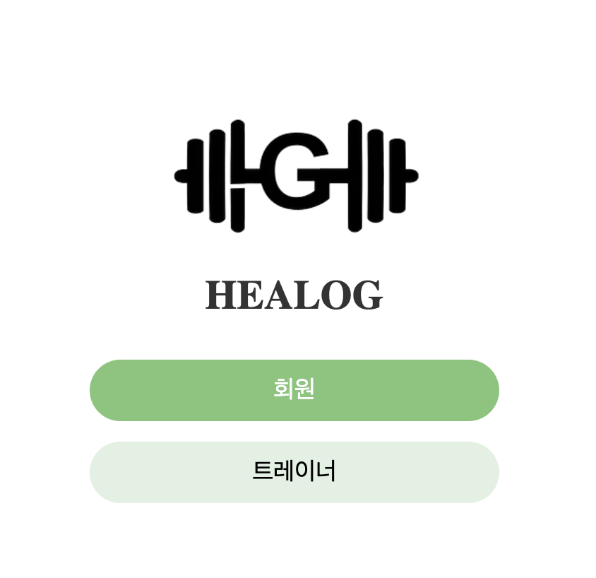
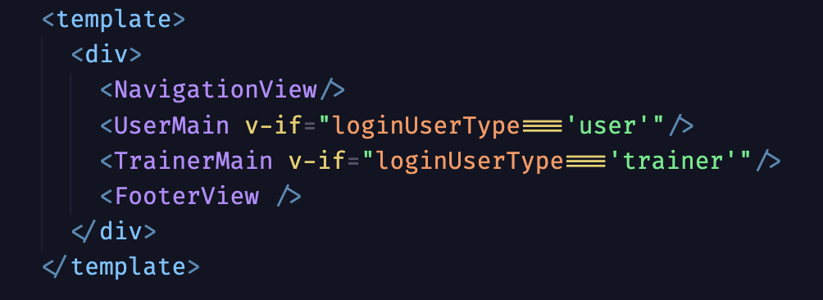
Account

Slide 5
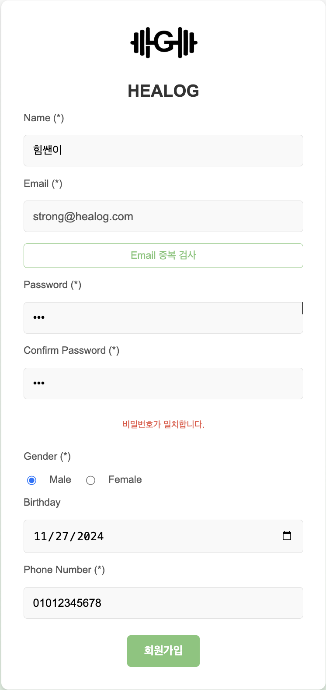
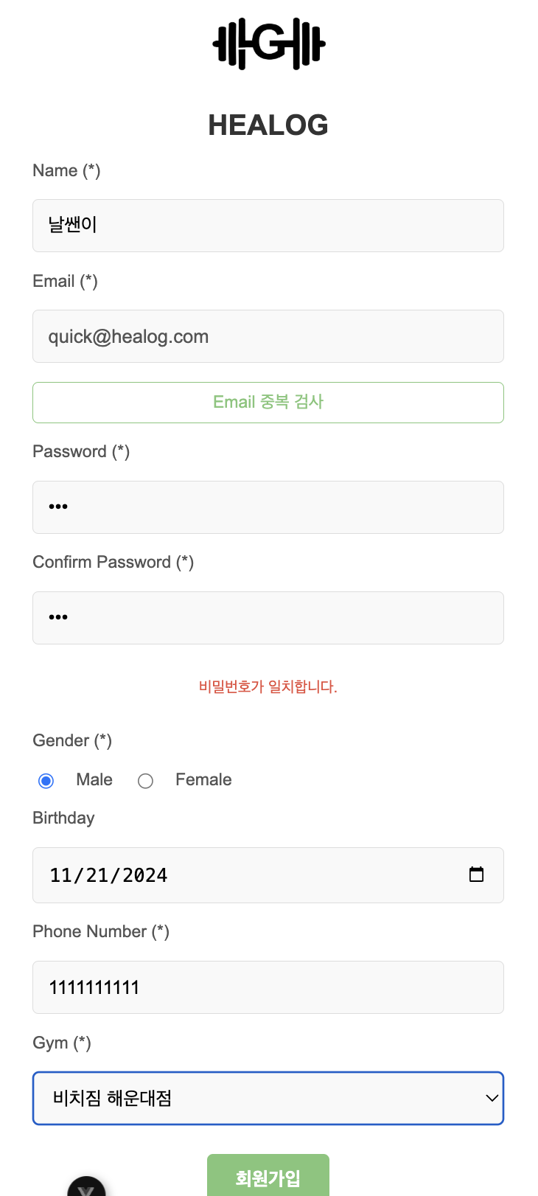
Account
UUID
해시 암호화

Slide 6
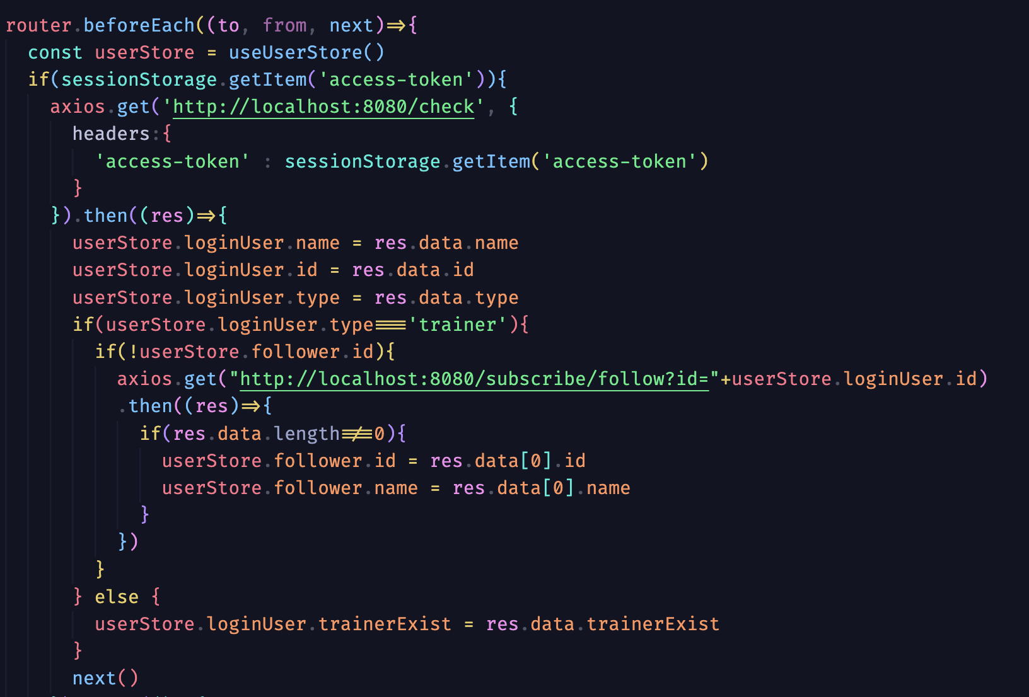
Account
JWT

Slide 7
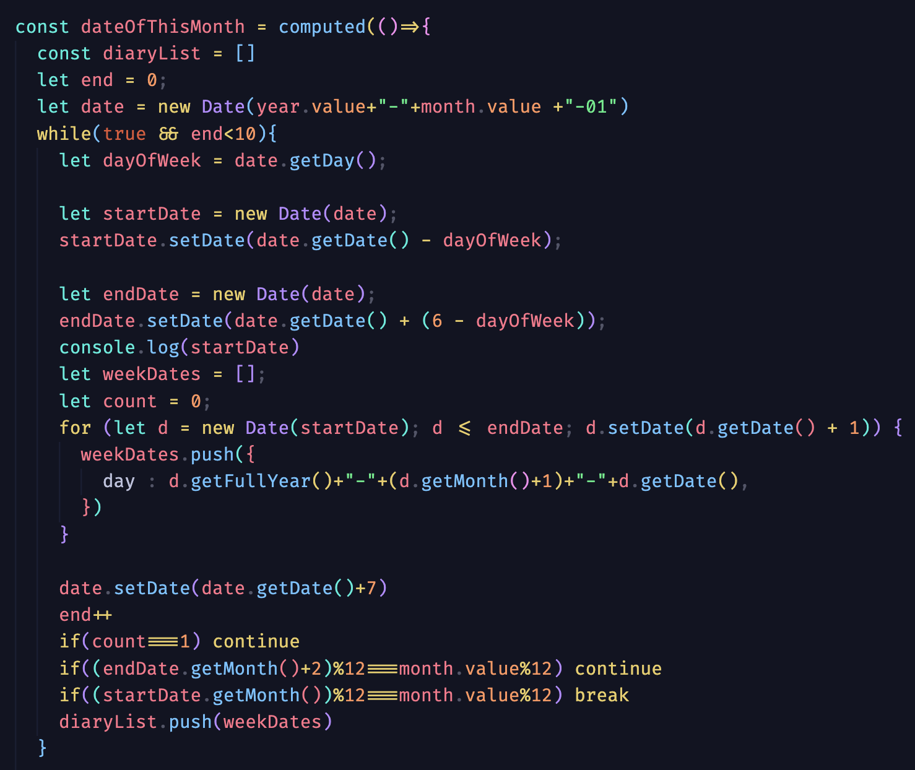
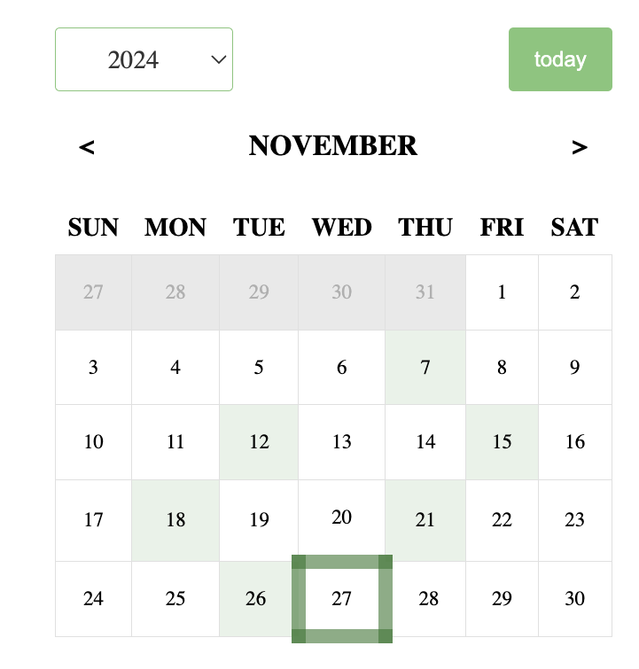
Calender

Slide 8
Calender

Slide 9
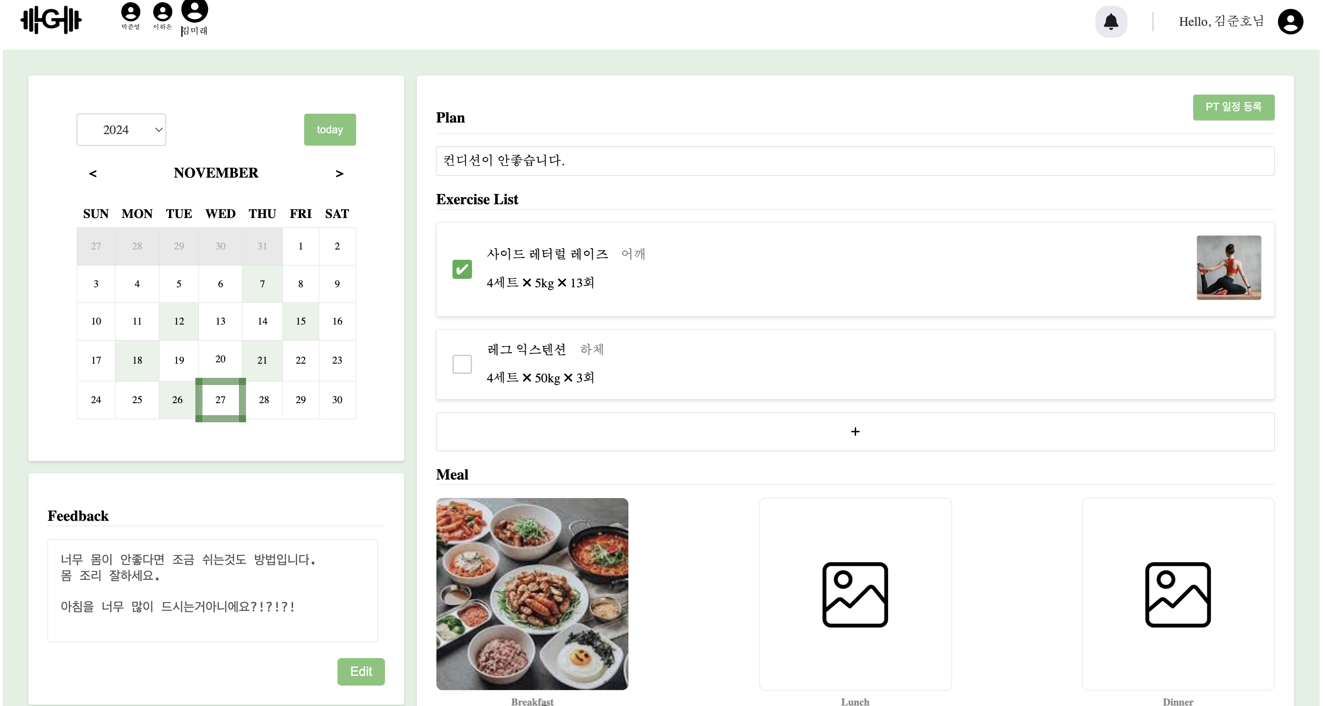

Slide 10
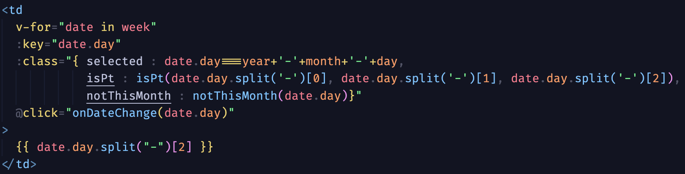
Calender

Slide 11


PersonalTraing
INSERT
회원
트레이너
UPDATE
DELETE

Slide 12

PersonalTraing
회원
트레이너
Request
Accept
Deny
Check
DB

Slide 13
PersonalTraing
STATE
0 : invalid | 1 : valid
승인
요청
확인
거절
5
1
(수정 후)
UPDATE
2
1
8
3
6
1
INSERT
9
0
4
7
0
DELETE
10
1

Slide 14




Furthermore
Technic
Business
Thank You

