Slide 1
REVENUE LEAK
INTELLIGENCE
Where is the business losing money?
Where should intervention start?
BigQuery → dbt → Advanced SQL → Python reporting → Executive recommendations
Huyen Le | MS Business Analytics
2026

Slide 2
EXECUTIVE SUMMARY
The problem is large - but concentrated enough to prioritize
Current modeled snapshot based on the project’s direct-leakage definition.
$2.65M
24.0%
61.7%
$1.26M
Direct revenue leakage identified
Leakage from Outerwear + Jeans
Leakage from top 5 distribution centers
Leakage associated with 4,820 severe-leak high-value customers
What management should know
Cancellation is the dominant leakage mechanism across the highest-impact product categories.
Traffic source appears to be an exposure dimension rather than a demonstrated root cause.
Absolute leakage is rising as transaction volume scales; normalized leakage rates remain broadly stable.
The best near-term opportunity is targeted intervention: high-value customers, high-dollar categories, and high-volume fulfillment nodes.

Slide 3
ANALYTICAL APPROACH
From raw ecommerce events to decision-ready leakage metrics
A reproducible analytics workflow with explicit transformation, validation, and reporting layers.
BigQuery
dbt staging
Intermediate
Marts / SQL
Python
PPT
TheLook Ecommerce
typed + standardized
order-item enrichment
leakage + lifecycle
report visuals
executive decisions
180K+
108
GitHub-first
Order-item records modeled
Automated dbt tests passing
Code, docs, charts, and report packaged for recruiter review
Analytical principle: distinguish dollar exposure from normalized failure rate before labeling a segment as operationally “bad.”

Slide 4
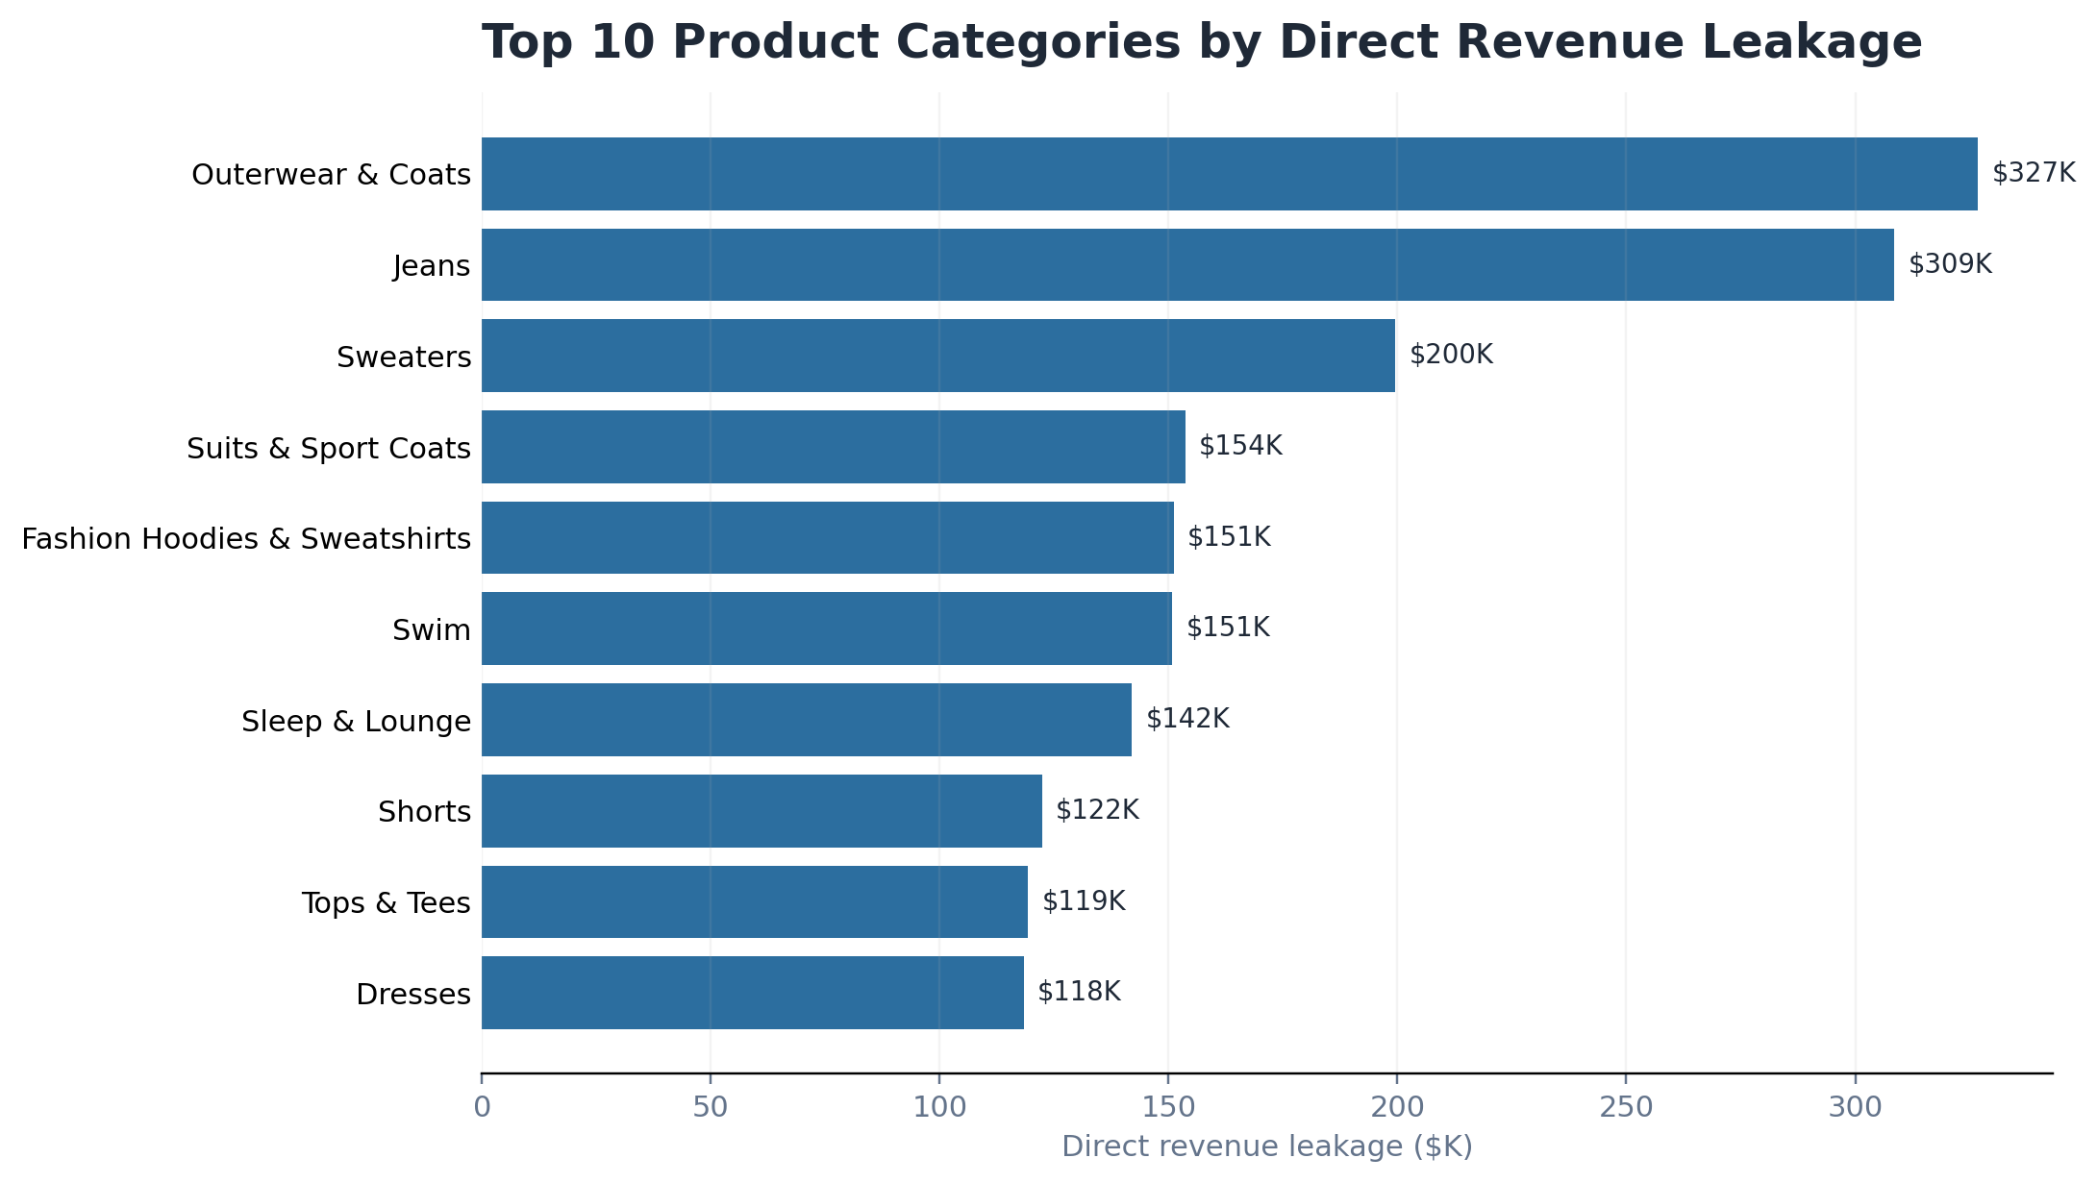
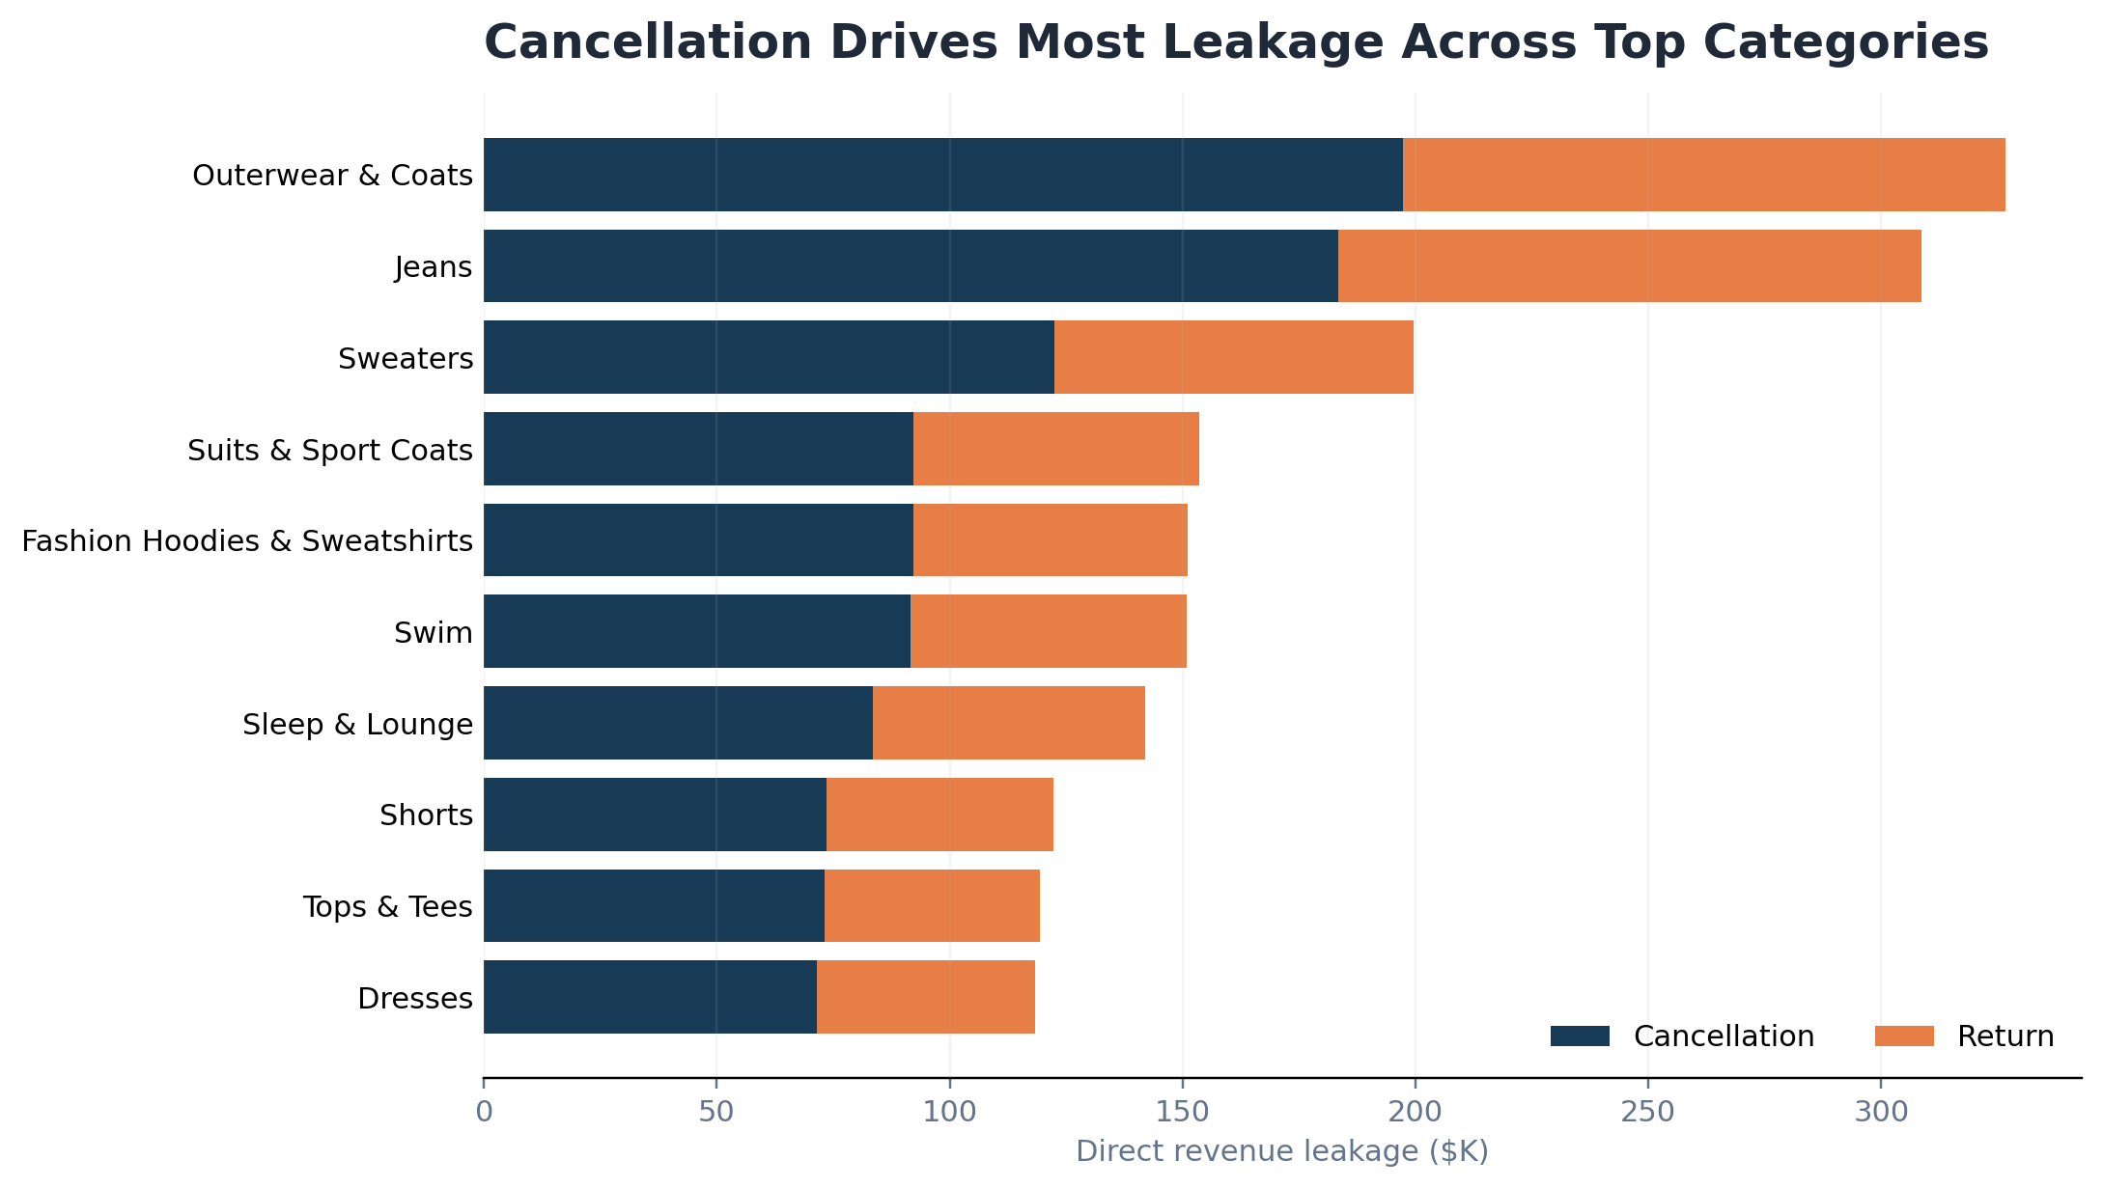
PRODUCT ROOT CAUSE
Two categories drive one quarter of all direct leakage
Outerwear & Coats and Jeans combine for ~$635K of direct leakage.
Priority: reduce cancellation in the highest-dollar categories before applying broad catalog-wide interventions.

Slide 5
CUSTOMER LIFECYCLE RISK
High-value severe-leak customers represent outsized financial exposure
The segment is small enough to target, but large enough to matter materially.
4,820
Customer prioritization lens
High Value / Severe Leak customers
Low value
High leakage
HIGH VALUE
SEVERE LEAK
Leakage severity ↑
≈$1.26M
Low value
Low leakage
High value
Lower leakage
Leakage associated with the segment
Customer value →
Business implication
Protect economic value first: prioritize retention, cancellation prevention, and recovery actions for this segment before optimizing by customer count alone.

Slide 6
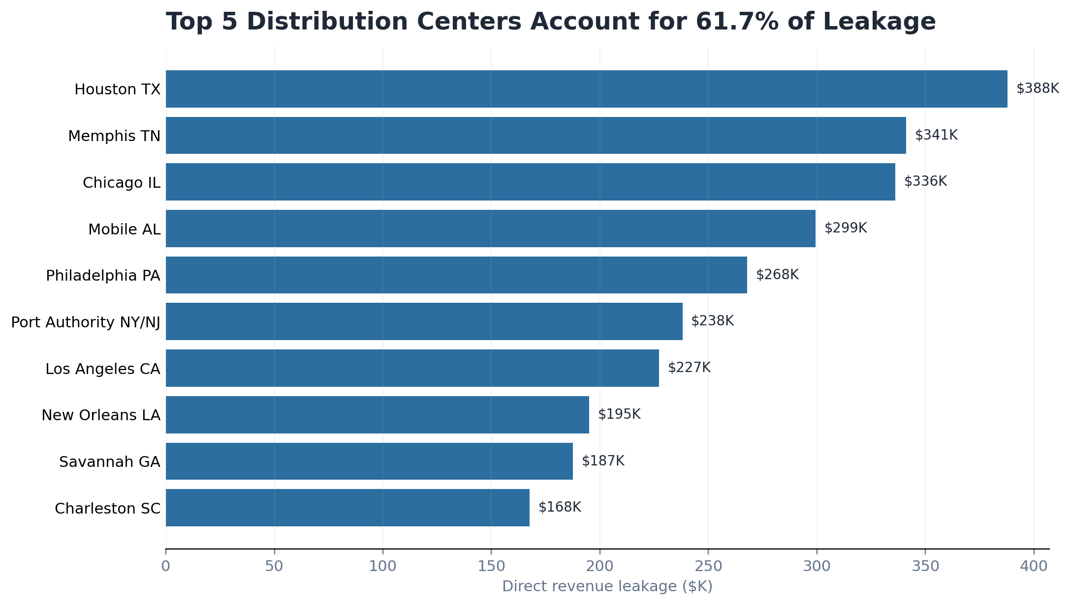
FULFILLMENT CONCENTRATION
Dollar exposure is concentrated — normalized rates are not
The top 5 distribution centers account for 61.7% of leakage, but their leakage rates cluster near 24–25%.
Interpretation
Houston has the highest dollar leakage, but not the highest leakage rate.
Charleston ranks #1 on leakage rate, yet only #10 on leakage dollars.
Prioritize high-volume DCs for investigation — without assuming unique process failure.
Exposure ≠ root cause

Slide 7
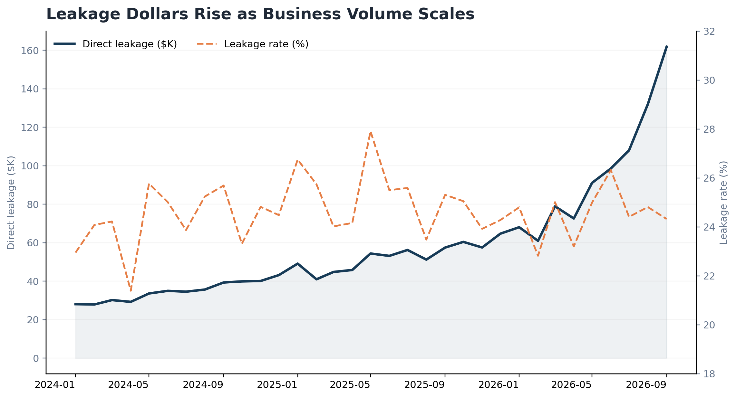
SCALE EFFECT
Leakage dollars are rising faster because the business is larger - not because the rate is deteriorating
Jan–Sep 2026 direct leakage +138%; gross sales +143%; leakage rate -0.48 percentage points.
+138%
Direct leakage, Jan→Sep 2026
+143%
Gross sales, Jan→Sep 2026
−0.48 pp
Leakage rate change, Jan→Sep 2026
Implication: a stable leakage rate becomes more expensive as volume scales, so even modest rate improvement has increasing dollar value.

Slide 8
RECOMMENDED ACTIONS
Prioritize by recoverable financial exposure
Focus where high value × high leakage × high volume creates the largest opportunity.
1
Reduce category cancellations
Start with Outerwear & Coats and Jeans; review cancellation reasons, inventory signals, and fulfillment handoffs.
2
Protect severe-leak high-value customers
Use retention/recovery actions on the 4,820-customer segment before broad customer-wide tactics.
3
Investigate high-volume fulfillment nodes
Audit Houston, Memphis, Chicago, Mobile, and Philadelphia while controlling for transaction mix and rate.
4
Monitor rate + dollars together
Track absolute leakage, normalized leakage rate, and exposure to avoid mistaking growth for process deterioration.
Next analytical step: quantify recoverable revenue under realistic intervention scenarios rather than assuming 100% leakage recovery.

