Slide 1
Minimum Spanning Trees
Prof. Ki-Hoon Lee
Dept. of Computer Engineering
Kwangwoon University

Slide 2
Spanning Trees
A spanning tree is a minimal subgraph, G’, of G such that V(G’) = V(G), and G’ is connected
A complete graph and three of its spanning trees

Slide 3
Spanning Trees (cont.)
Any connected graph with n vertices must have at least (n – 1) edges
All connected graphs with n – 1 edges are trees
A spanning tree for a graph with n vertices has n – 1 edges

Slide 4
Minimum Spanning Tree (MST)
The cost of a spanning tree of a weighted, undirected graph = the sum of the costs (weights) of the edges in the spanning tree
A minimum spanning tree (MST) is a spanning tree of least cost
Application: communication network design

Slide 5
Example
8
10
14
1
3
5
7
7
12
6
3
2
4
2
4
6
8
9
Network has n = 8 vertices.
Spanning tree has n – 1 = 7 edges.
Find a MST

Slide 6
Greedy Methods
We construct a solution in stages
At each stage, we make the best decision (using some criterion) possible at the time
Typically, the decision is based on either a least-cost or a highest profit criterion
In many problems, a greedy method may yield locally optimal solutions that approximate a global optimal solution in a reasonable time

Slide 7
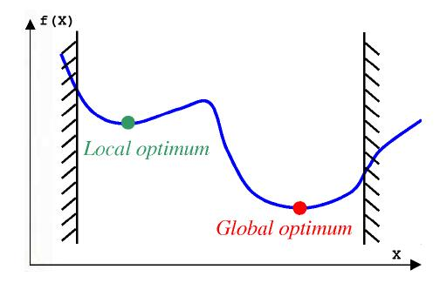
Local vs Global Optimum

Slide 8
Greedy Methods for MSTs
To construct a MST, we use a least-cost criterion
Our solution must satisfy the following constraints:
We must use only edges within the graph
We must use exactly n – 1 edges
We may not use edges that produce a cycle
Three methods: Kruskal’s, Prim’s, and Sollin’s methods

Slide 9
Kruskal’s Method
Build a minimum-cost spanning tree T by adding edges to T one at a time
Select the edges for inclusion in T in ascending order of their cost
An edge is added to T if it does not form a cycle with the edges that are already in T

Slide 10
Kruskal’s Method (cont.)
8
10
14
1
3
5
7
1
3
5
7
7
4
12
6
3
2
2
4
6
8
2
4
6
8
9
Start with a forest that has no edges.
Consider edges in ascending order of cost.
Edge (1,2) is considered first and added to the forest.

Slide 11
Kruskal’s Method (cont.)
8
10
14
1
3
5
7
1
3
5
7
7
3
7
4
6
3
2
4
12
6
2
2
4
6
8
2
4
6
8
9
Edge (7,8) is considered next and added.
Edge (3,4) is considered next and added.
Edge (5,6) is considered next and added.
Edge (2,3) is considered next and added.
Edge (1,3) is considered next and rejected because it creates a cycle.

Slide 12
Kruskal’s Method (cont.)
8
10
14
10
14
1
3
5
7
1
3
5
7
7
3
7
4
6
3
2
4
12
6
2
2
4
6
8
2
4
6
8
9
Edge (2,4) is considered next and rejected because it creates a cycle.
Edge (3,5) is considered next and added.
Edge (3,6) is considered next and rejected.
Edge (5,7) is considered next and added.

Slide 13
Kruskal’s Method (cont.)
8
10
14
10
14
1
3
5
7
1
3
5
7
7
3
7
4
6
3
2
4
12
6
2
2
4
6
8
2
4
6
8
9
n – 1 edges have been selected and no cycle formed.
So we must have a spanning tree.
Cost is 46.
MST is unique when all edge costs are different.

Slide 14
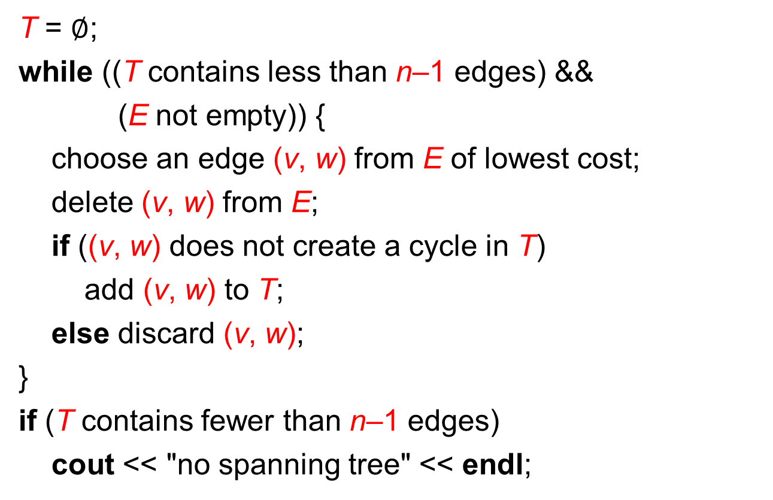
Kruskal’s Method (cont.)
T = $∅$;
while ((T contains less than n–1 edges) &&
(E not empty)) {
choose an edge (v, w) from E of lowest cost;
delete (v, w) from E;
if ((v, w) does not create a cycle in T)
add (v, w) to T;
else discard (v, w);
}
if (T contains fewer than n–1 edges)
cout << "no spanning tree" << endl;

Slide 15
Implementation
choose an edge (v, w) from E of lowest cost;
Use a min heap (O(log e))
if ((v, w) does not create a cycle in T) add (v, w) to T;
Determine if the vertices v and w are already connected by the earlier selection of edges. If they are not, then (v, w) is to be added to T.
To determine this, place all vertices in the same connected component of T into a set. Then, v and w are connected in T iff they are in the same set.
Use the methods WeightedUnion and CollapsingFind for disjoint sets

Slide 16
Data Structures for Kruskal’s Method
Edge set E.
Operations are:
Is E empty?
Select and remove a least-cost edge.
Use a min heap of edges.
Initialize. O(e) time.
Remove and return least-cost edge. O(log e) time.

Slide 17
Data Structures for Kruskal’s Method
Set of selected edges T.
Operations are:
Does T have n - 1 edges?
Does the addition of an edge (u, v) to T result in a cycle?
Add an edge to T.

Slide 18
Data Structures for Kruskal’s Method
Use an array for the edges of T.
Does T have n - 1 edges?
Check number of edges in array. O(1) time.
Does the addition of an edge (u, v) to T result in a cycle?
Not easy.
Add an edge to T.
Add at right end of edges in array. O(1) time.

Slide 19
Data Structures for Kruskal’s Method
Does the addition of an edge (u, v) to T result in a cycle?
1
3
5
7
7
4
6
3
2
2
4
6
8
Each component of T is a tree.
When u and v are in the same component, the addition of the edge (u,v) creates a cycle.
When u and v are in the different components, the addition of the edge (u,v) does not create a cycle.

Slide 20
Data Structures for Kruskal’s Method
1
3
5
7
7
4
6
3
2
2
4
6
8
Each component of T is defined by the vertices in the component.
Represent each component as a set of vertices.
{1, 2, 3, 4}, {5, 6}, {7, 8}
Two vertices are in the same component iff they are in the same set of vertices.

Slide 21
Data Structures for Kruskal’s Method
1
3
5
7
7
4
6
3
2
2
4
6
8
When an edge (u, v) is added to T, the two components that have vertices u and v combine to become a single component.
In our set representation of components, the set that has vertex u and the set that has vertex v are united.
{1, 2, 3, 4} U {5, 6} => {1, 2, 3, 4, 5, 6}

Slide 22
Data Structures for Kruskal’s Method
Initially, T is empty.
1
3
5
7
2
4
6
8
Initial sets are:
{1} {2} {3} {4} {5} {6} {7} {8}
Does the addition of an edge (u, v) to T result in a cycle? If not, add edge to T.
s1 = Find(u); s2 = Find(v);
if (s1 != s2) Union(s1, s2);

Slide 23
Data Structures for Kruskal’s Method
Use fast solution for disjoint sets.
Initialize.
O(n) time.
At most 2e finds and n-1 unions.
Very close to O(n + e).
Min heap operations to get edges in increasing order of cost take O(e log e).
Overall complexity of Kruskal’s method is O(n + e log e).

Slide 24
Prim’s Method
At each stage of the algorithm, the set of selected edges forms a tree
Begins with a tree T that contains a single vertex
Add a least-cost edge (u, v) to T such that T U {(u, v)} is also a tree, where exactly one of u or v is in T

Slide 25
Prim’s Method (cont.)
8
10
14
10
14
1
3
5
7
1
3
5
7
7
3
7
4
6
3
2
4
12
6
2
2
4
6
8
2
4
6
8
9
Start with any single vertex tree.
Get a 2-vertex tree by adding a cheapest edge.
Get a 3-vertex tree by adding a cheapest edge.
Grow the tree one edge at a time until the tree has n - 1 edges (and hence has all n vertices).

Slide 26
Prim’s Method (cont.)
0
0
0
10
1
10
1
10
1
5
5
5
6
2
6
2
6
2
0
25
25
10
28
4
4
4
1
5
14
16
3
3
22
3
24
6
2
25
4
(a)
(b)
(c)
18
12
22
3
0
0
0
10
1
10
1
10
1
16
14
16
5
5
5
6
2
6
2
6
2
25
25
25
4
4
4
12
12
12
22
3
22
3
22
3
(d)
(e)
(f)

Slide 27
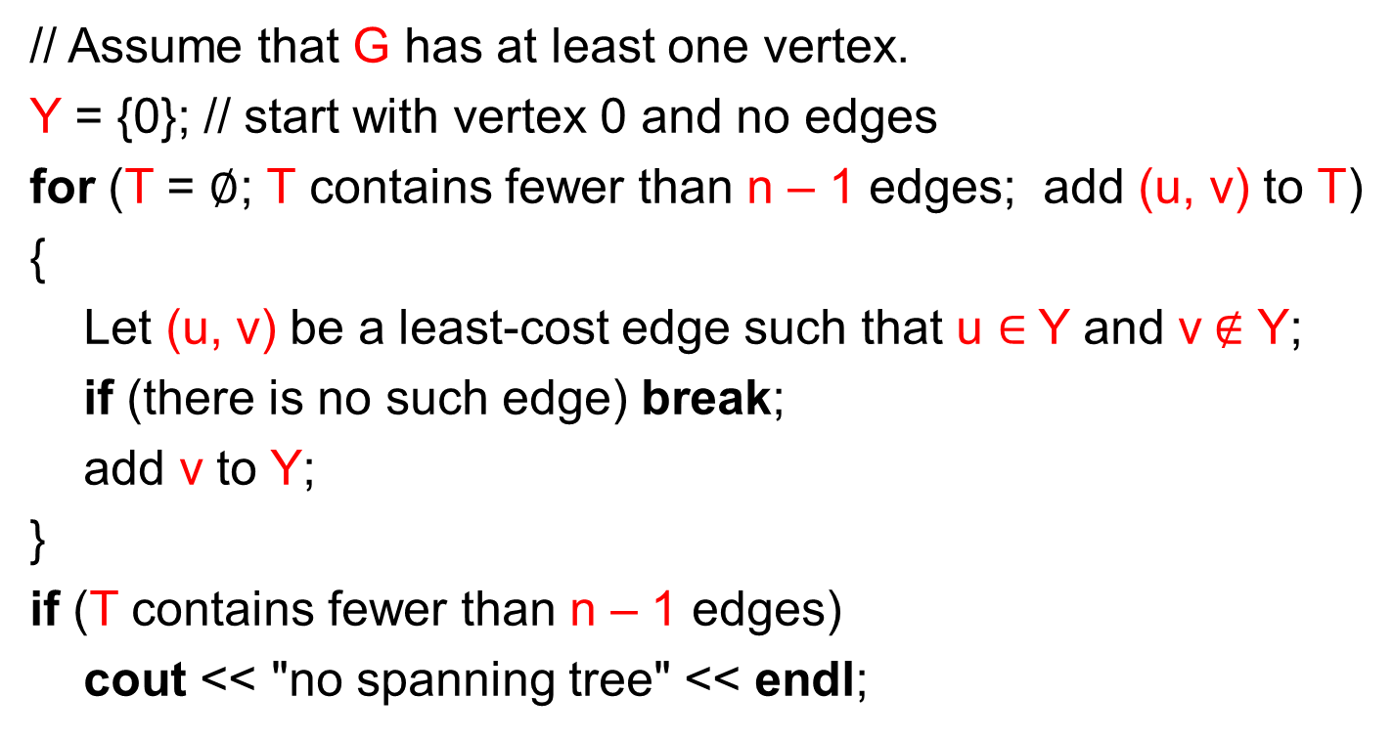
Prim’s Method (cont.)
// Assume that G has at least one vertex.
Y = {0}; // start with vertex 0 and no edges
for (T = $∅$; T contains fewer than n – 1 edges; add (u, v) to T)
{
Let (u, v) be a least-cost edge such that u $∈$Y and v$∉$ Y;
if (there is no such edge) break;
add v to Y;
}
if (T contains fewer than n – 1 edges)
cout << "no spanning tree" << endl;

Slide 28
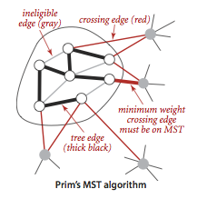
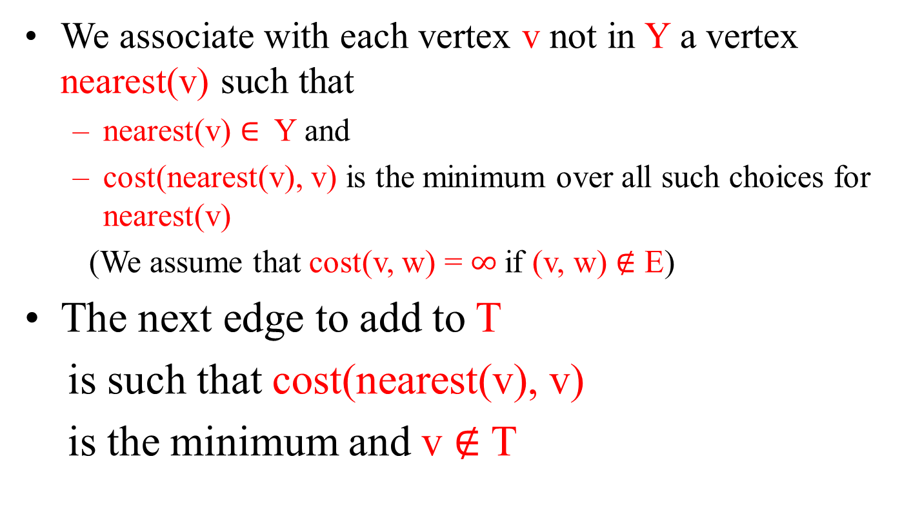
Prim’s Method (cont.)
We associate with each vertex v not in Y a vertex nearest(v) such that
nearest(v) $∈$ Y and
cost(nearest(v), v) is the minimum over all such choices for nearest(v)
(We assume that cost(v, w) = $∞$if (v, w) $∉$ E)
The next edge to add to T
is such that cost(nearest(v), v)
is the minimum and v $∉$ T
Y

Slide 29
Prim’s Method (cont.)
Prim’s algorithm starts with an empty subset of edges F and a subset of vertices Y initialized to contain an arbitrary vertex.
We will initialize Y to {v₁}. A vertex nearest to Y is a vertex in V − Y that is connected to a vertex in Y by an edge of minimum weight.
Assume that v₂ is nearest to Y when Y = {v₁}. The vertex that is nearest to Y is added to Y and the edge is added to F. Ties are broken arbitrarily.
In this case, v₂ is added to Y, and (v₁, v₂) is added to F. This process of adding nearest vertices is repeated until Y = V .

Slide 30
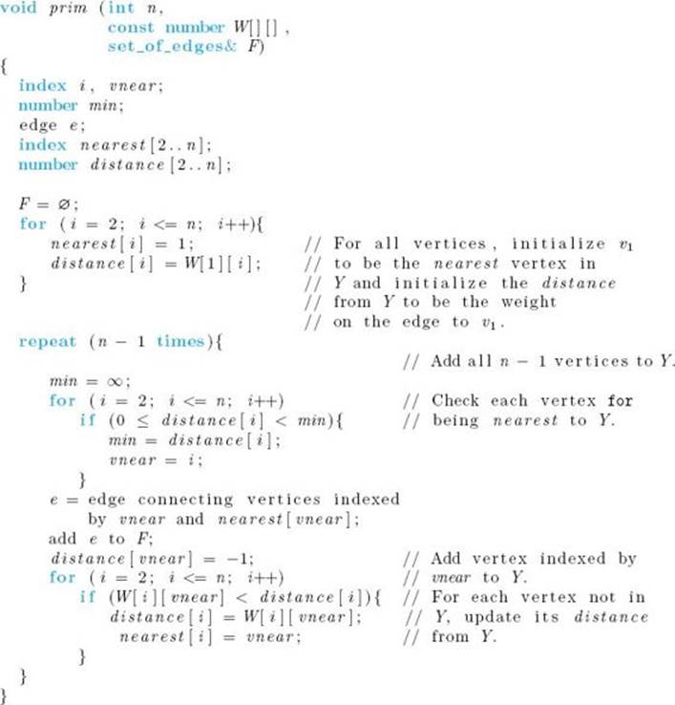
Y
e
v₁
vnear
w_{i}

Slide 31
Minimum Spanning Tree Methods
Can prove that all the three methods result in a minimum-cost spanning tree.
Prim’s method is fastest.
O(n²) using an implementation similar to that of Dijkstra’s shortest-path method.
O(e + n log n) using a Fibonacci heap.
Kruskal’s uses union-find trees to run in O(n + e log e) time.
Notes:
Dijkstrta’s method is done in the next lecture. Fibonacci heaos are in Chapter 9.

