Slide 1
Chat, for spirent internship
Hyunkyun.Moon

Slide 2
Table of Contents
Purpose - Protocol
Workflow - FlowChart
Language - Design Pattern
Issue Management - Documentation
Library - Prepare For Demo

Slide 3
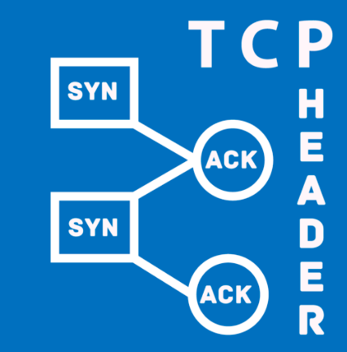

Purpose

Slide 4
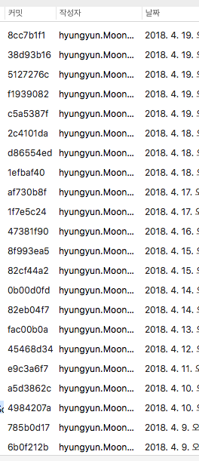
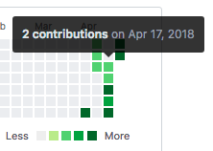

Workflow
Notes:
On this occasion, I wanted to study Spring with an internship project.
However, there are so many things to study in such as annotation, jpa, and others that I don't think I can finish it in a due, so I would like to make it into a C++

Slide 5


Language
C++ for server
Objective-C for client

Slide 6
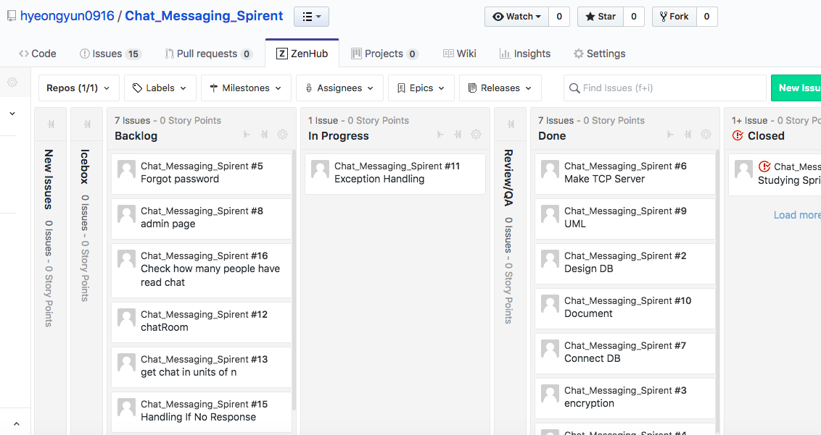
Issue Management
Notes:
I managed the issue with zenhub.

Slide 7




Library
Server
mysql-connector-c++
for connect Database
boost for using
mysql-connector-c++
jsoncpp for protocol

Slide 8


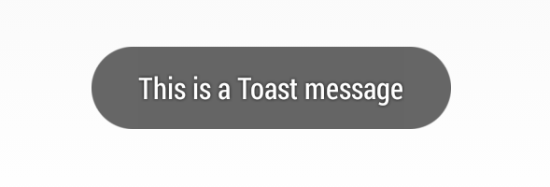
Library
Client
CocoaAsyncSocket for tcp
COCOAPODS
as Dependency manager
Toast for toast

Slide 9
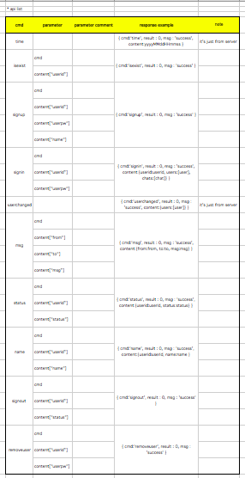
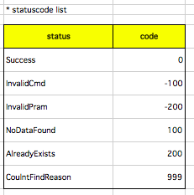
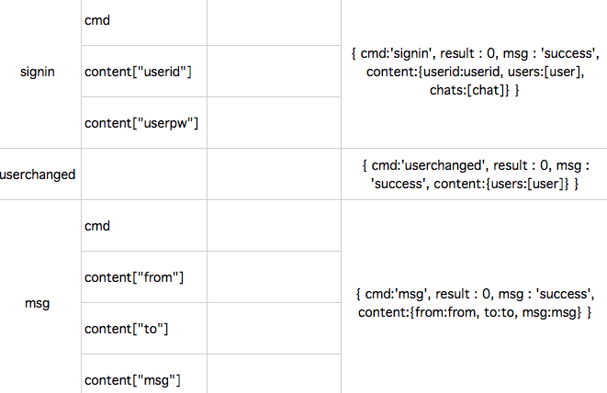
Protocol
./api_v0.0.1.xlsx
Notes:
I matched the format of json.

Slide 10
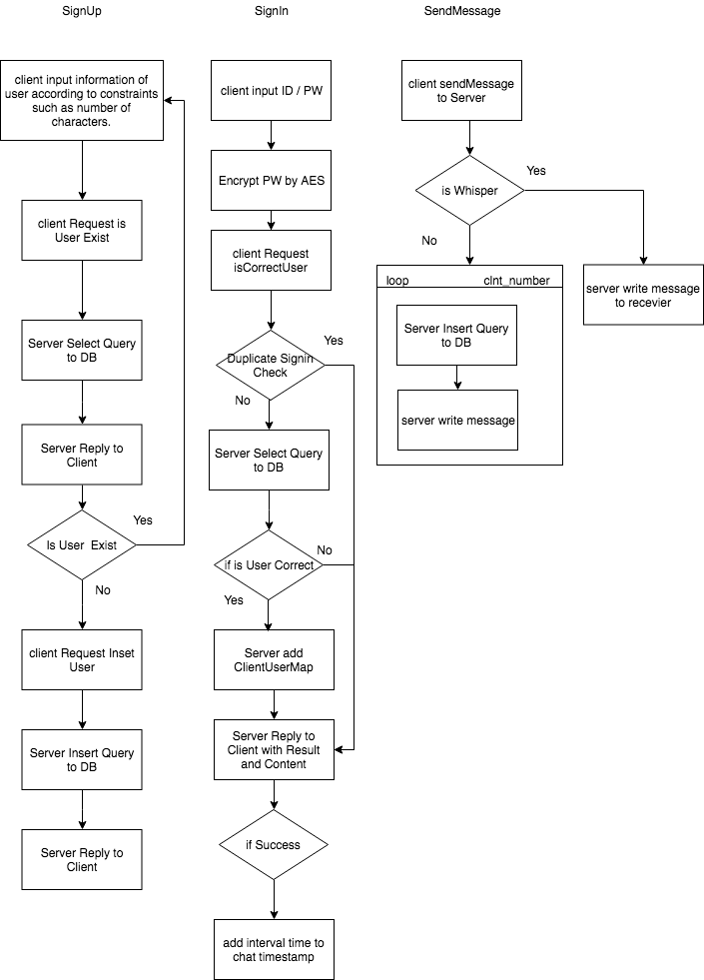
Flowchart
Of some feature
Notes:
The Flowchart is as follows :

Slide 11
Desgin Pattern
Singleton(SocketSingleton, Singleton)
Delegate(SockDelegate)
Notes:
For Wrapper CocoaAsyncSocket, For process toast or store interval between server and client
To process what is read from the socket.

Slide 12
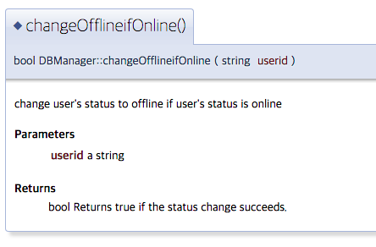
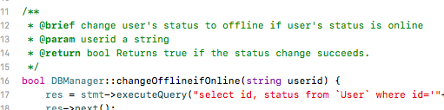
Documentation
./Server/Server/Doxygen/html/index.html

Slide 13
Prepare For Demo
Create a database using ‘./Init_SQL-v0.0.1.txt’
Insert the data ./DB_test_data/Message.csv
and ./DB_test_data/Message.csvUser.csv
To run follow README.md

Slide 14
Additional features
Handling If there is No Response
Get chat in units of n
Change encryption method from AES to scrypt
Password Reset
Show how many people have read chat
Chat Room
Notes:
In the future, I want add the following features :

