Slide 1
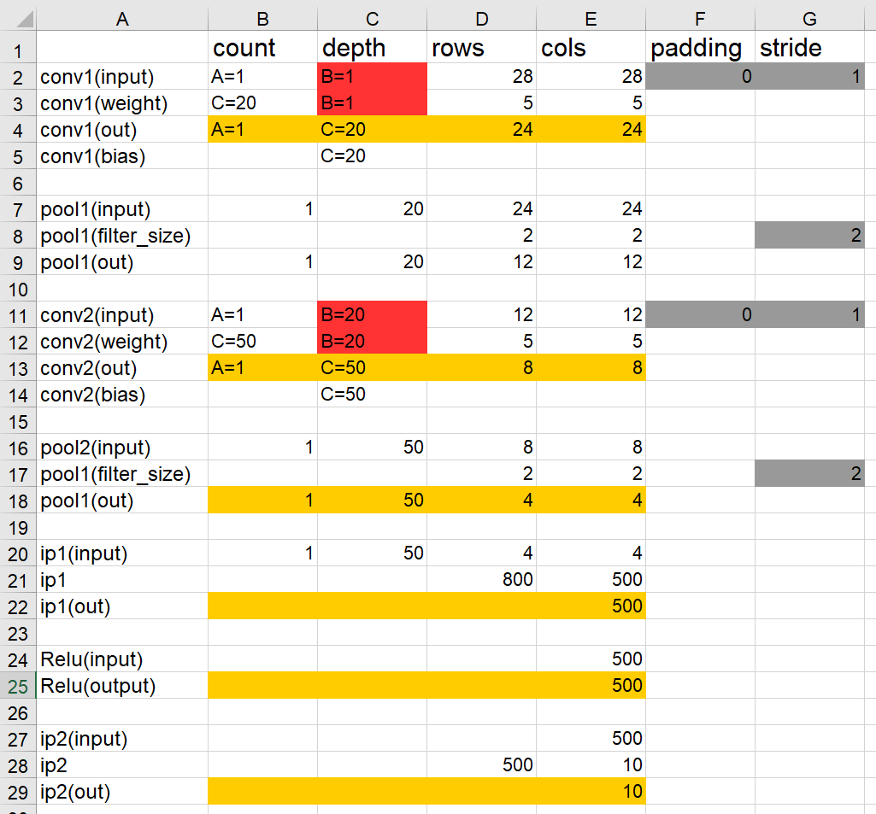
Lenet – reference C-model

Slide 2
3x3 Convolution Structure

Slide 3
3x3 Convolution Timing Diagram

Slide 4
3x3 Convolution Timing Diagram

Slide 5
3x3 Convolution Timing Diagram
y1
y2
y3
y4
y5
y6
y7
y8
y9

Slide 6
5x5 Convolution Structure
x[i]
D
PE
w1
w2
w3
w4
w5
delay27
0
D
D
D
D
D
sat
D
D
PE x 5
sat +delay27
PE x 5
sat +delay27
PE x 5
sat +delay27
PE x 5
sat
y_out

Slide 7
5x5 Convolution Structure
32
Win
27
Xin
delay27
D
D
sat
D
D
32
Process element
Input feacture

Slide 8
AXI4 Structure
AXI4(sub)
AXI4(top)
slv_reg_set
cnnip_ctrl
cnnip
int_mem_if
mem_if
1. to_input_mem
2. to_weight_mem
3. to_feature_mem
int_mem_if
axi4l_int
mem_if
1. to_input_mem
2. to_weight_mem
3. to_feature_mem
addr_gen
CMD_START
MODE_KERNEL_SIZE
MODE_KERNEL_NUMS
MODE_STRIDE
MODE_PADDING
CMD_DONE
CMD_DONE_VALID
CMD_START
MODE_KERNEL_SIZE
MODE_KERNEL_NUMS
MODE_STRIDE
MODE_PADDING
CMD_START
MODE_KERNEL_SIZE
MODE_KERNEL_NUMS
MODE_STRIDE
MODE_PADDING
address multiplexer
reg_set_interconnect
1. input_mem_ext
2. weight_mem_ext
3. feature_mem_ext
from_axi4l_mem_if
address multiplexer
CMD_DONE
CMD_DONE_VALID
CMD_DONE
CMD_DONE_VALID
to_register_if
to_input_mem_if
to_weight_mem_if
to_feature_mem_if
blk_input
blk_weight
blk_feacture
1. input_mem_int
2. weight_mem_int
3. feature_mem_int
slv_reg
slv_reg[0]
slv_reg[1]
slv_reg[2]
slv_reg[3]
1. mem_if_a
2. mem_if_a
3. mem_if_a
1. mem_if_b
2. mem_if_b
3. mem_if_b

Slide 9
Cnnip_timing
 |  |  | CONDITION
Ip | SIGNAL | PORT_TYPE | HIGH | LOW
cnnip_ctrl | CMD_START | OUT | slv_reg[0] = 0xFFFF | CMD_DONE
cnnip_ctrl | CMD_VALID | IN
cnnip_ctrl | CMD_DONE | IN
cnnip | CMD_START | IN | slv_reg[0] = 0xFFFF | CMD_DONE
cnnip | CMD_VALID | OUT
cnnip | CMD_DONE | OUT

Slide 10
Cnnip_timing
 |  |  | CONDITION
Ip | SIGNAL | TYPE | HIGH | LOW
cnnip_ctrl | CMD_START | Port: OUT | slv_reg[0] = 0xFFFF | CMD_DONE
cnnip | CMD_START | Port: IN | ctl: CMD_START | Conv_end
cnnip | CMD_START_DELAY | Reg | CMD_START | CMD_START
cnnip | DATA_LOAD_START | wire | CMD_START == 1 && CMD_START_DELAY ==0 | else
Cnnip | Weight_renable | reg | DATA_LOAD_START | Weight_rcoutner==24

Slide 11
Input and Output Parameter
parameter | value
Input | 32x32 = 1024
Kernel | 5x5x256 = 6400
Out | 28x28 = 784
Stride | 1
Padding | 0

Slide 12
Block Memory Data Load
Block Memory
NAME
blk_mem | Input_data [31:0] x 1024
reserved | reserved
blk_mem | Kernel_data [31:0] x 25
reserved | Reserved
blk_mem | Out_data[31:0] x 784
read
Win
read
Xin
D
D
write
Process element

Slide 13
Memory map
NAME | ADDRESS | ADDRESS | MAX_COUNT
slv_reg[0] | 0x43c00000 | - | 1 | START [31:0]
slv_reg[1] | 0x43c00004 | - | 1 | DONE [31:0]
slv_reg[2] | 0x43c00008 | - | 1 | [31:24] Reserved | [23:16] KERNEL_SIZE | [15:8] reserved | [7:0] KERNEL_NUM
slv_reg[3] | 0x43c0000C | - | 1 | [31:17] reserved | [16] PADDING | [15:2] reserved | [1:0] STRIDE
reserved | 0x43c0000F | 0x43c000FC | - | reserved
blk_mem | 0x43c01000 | 0x43c01FFC | 1024 | Input_data [31:0] x 1024
reserved | 0x43c02000 | 0x43c02FFC | - | reserved
blk_mem | 0x43c03000 | 0x43c03FFC | 1024 | Kernel_data [31:0] x 25
reserved | 0x43c04000 | 0x43c04FFC | - | Reserved
blk_mem | 0x43c05000 | 0x43c05FFC | 1024 | Out_data[31:0] x 784

Slide 14
ADDRESS WIDTH = 12
DATA WIDTH = 31
AXI4
BLK_MEMORY
CONV_IP
s00_axi_addr [11:2]
s00_axi_wdata
s00_axi_rdata
enable
w_enable
addra[9:0]
dina
douta
ena
wea
addrb
dinb
doutb
enb
wea
addr[11:2]
wdata
rdata
enable
w_enable
CLK

Slide 15
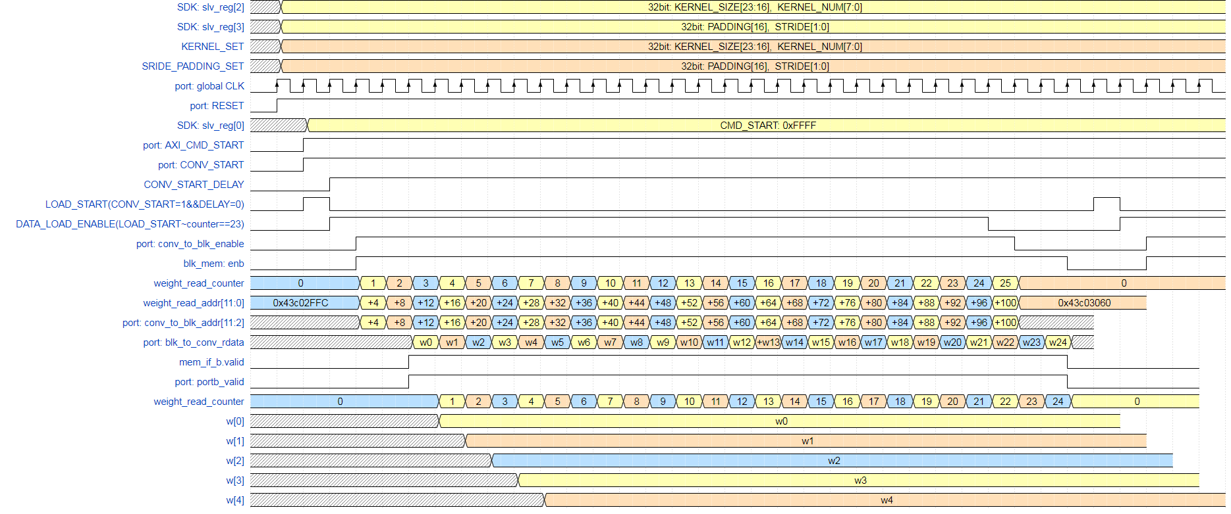

Slide 16
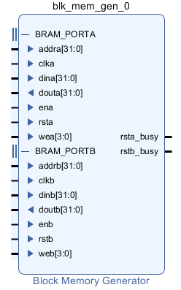
SDK에서 AXI_SLV_REG[0]
0x43c00000= 0xFFFF
AXI에서 AXI_SLV_REG[0] = 0xFFFF
CMD_START = 1
Conv_ip에서는 input port로 START를 선언하고 AXI의 outport인 CMD_START에 연결한다

Slide 17
blk_mem_kernel
Conv_ip
enb
addrb[4:0]
doutb[31:0]
weight_enable
addr[4:0]
weight_data[31:0]
clk
reset
clk
reset

