Slide 1
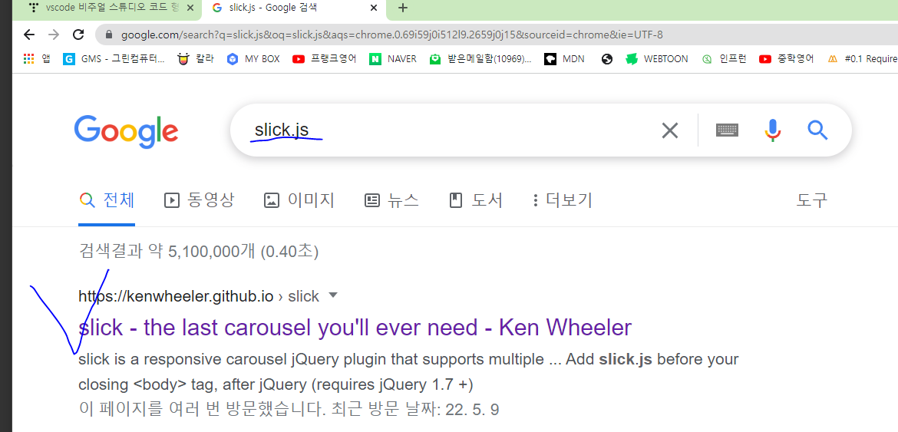

Slide 2
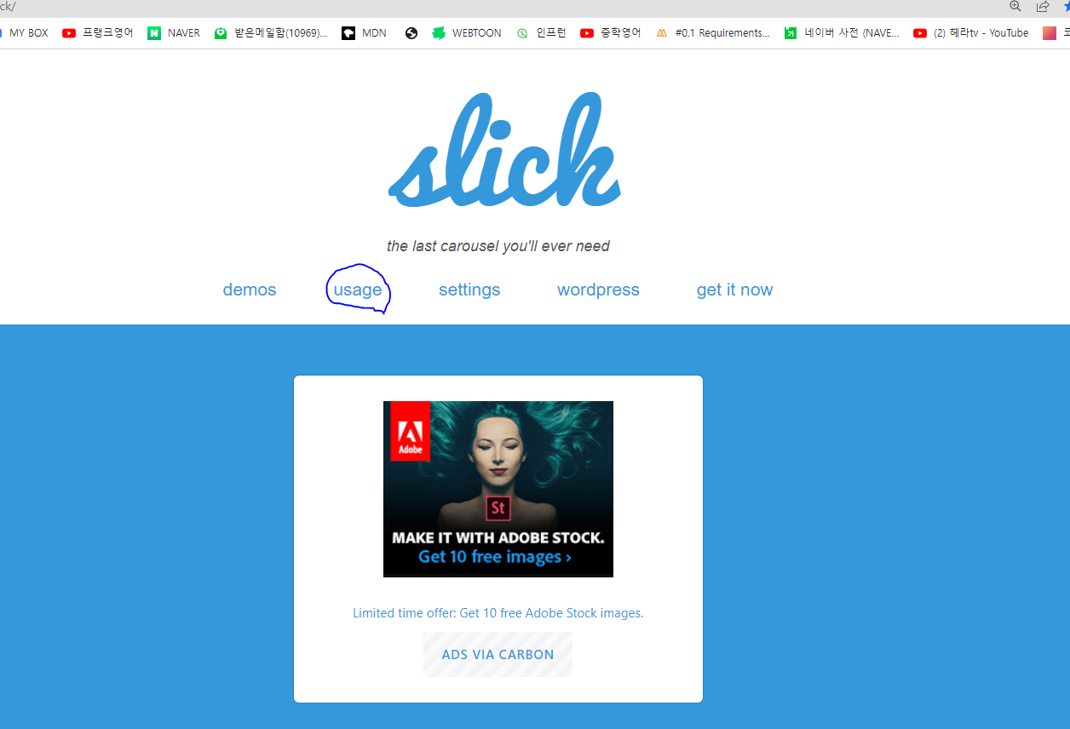

Slide 3
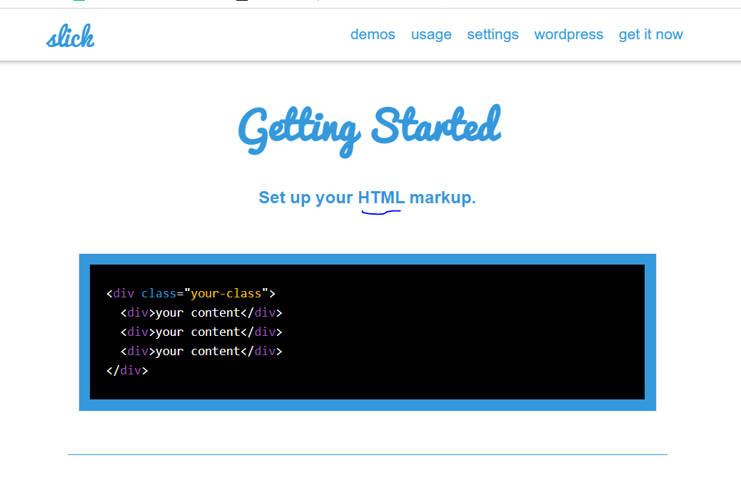


Slide 4
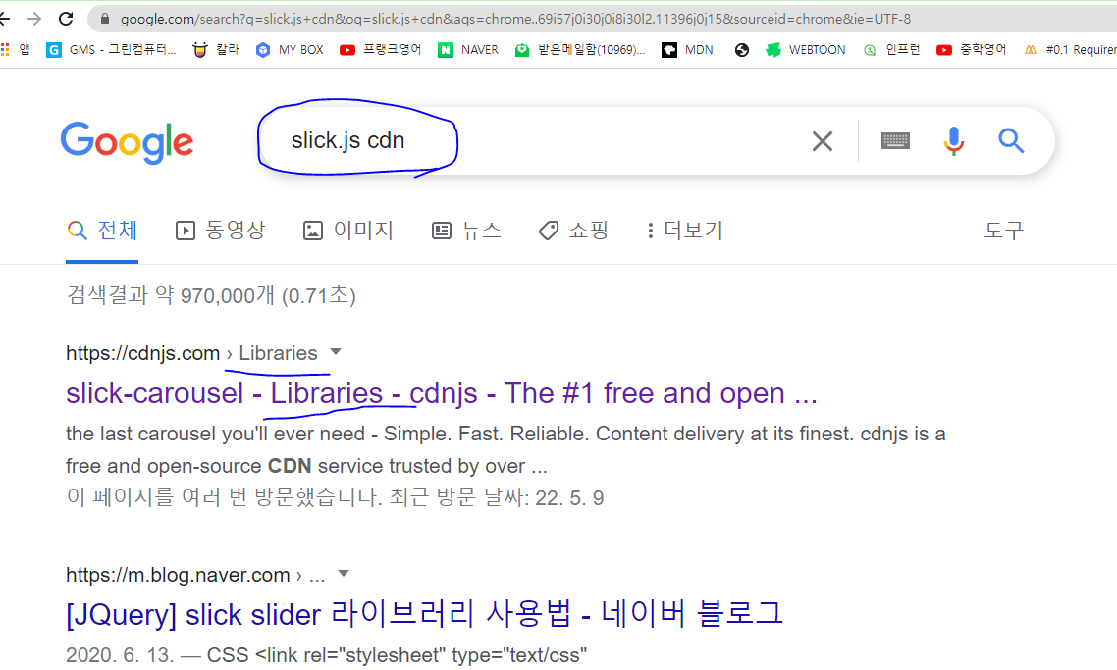

Slide 5
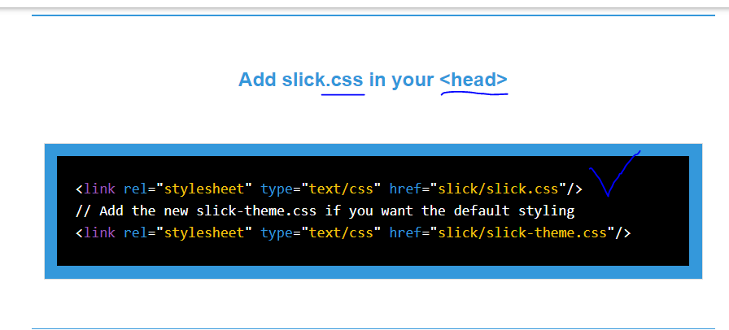


Slide 6

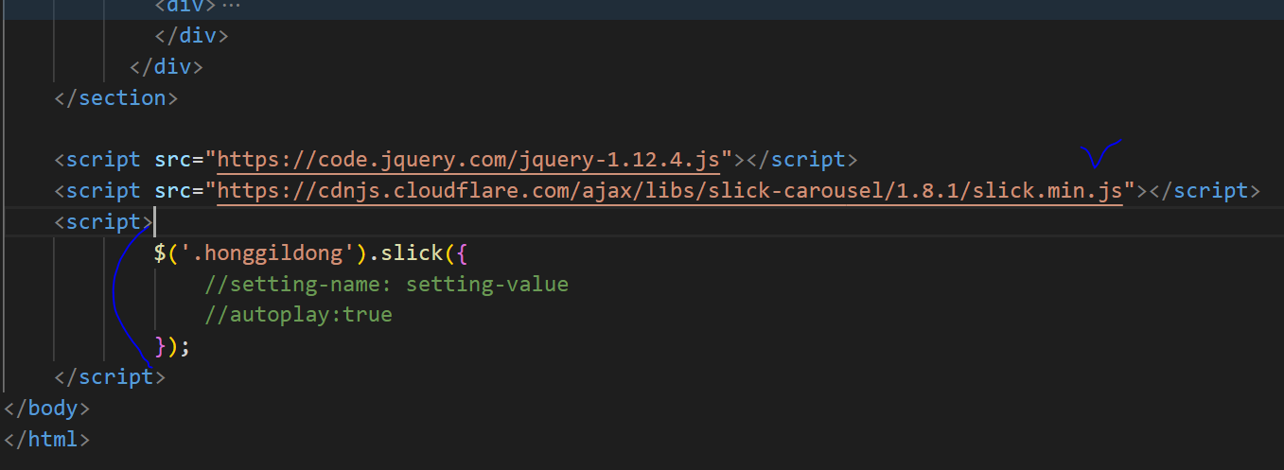

Slide 7
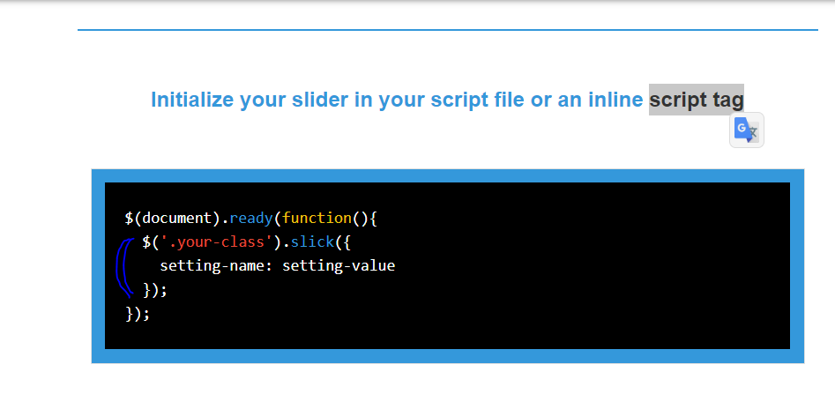


Slide 8
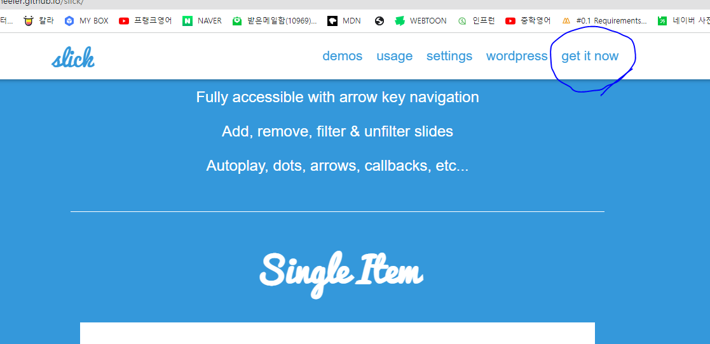
옵션

Slide 9
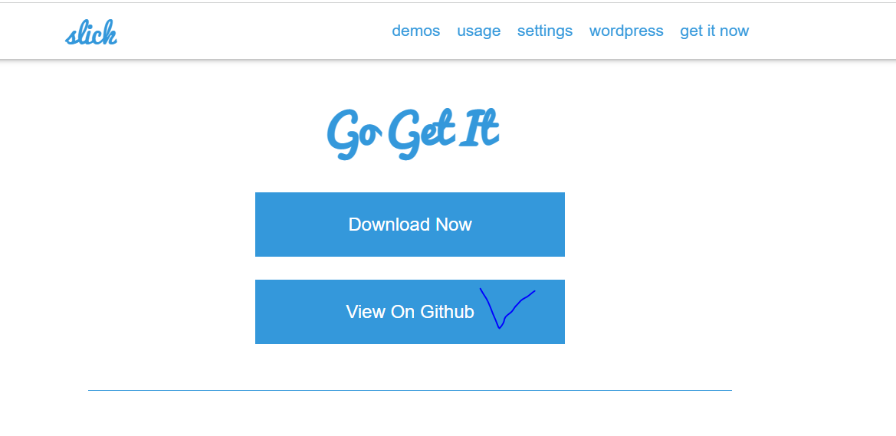

Slide 10
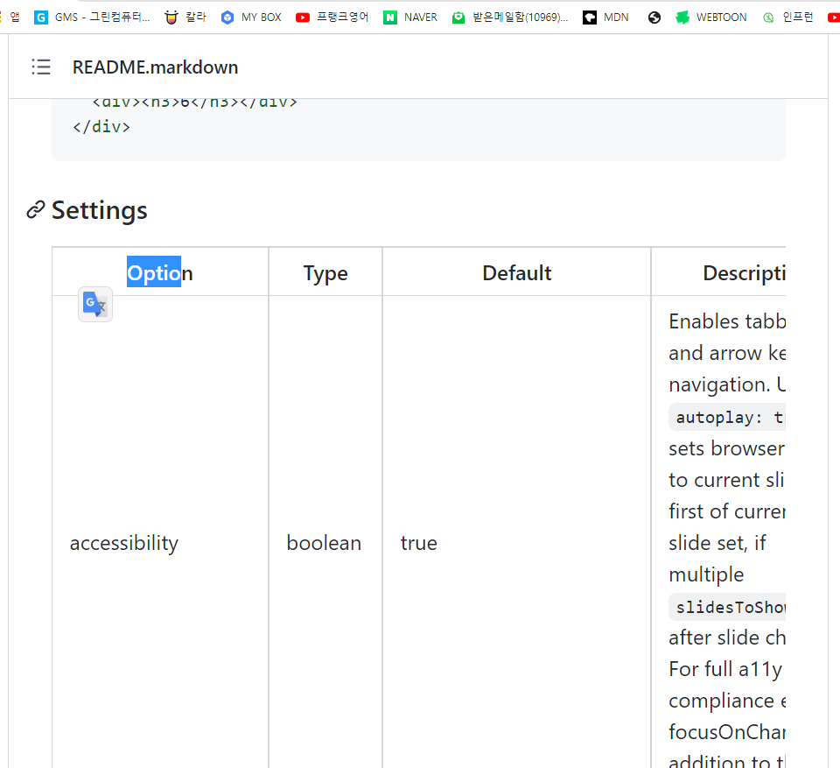

Slide 11
view-source:https://poetic-pixie-43e122.netlify.app/
https://poetic-pixie-43e122.netlify.app/css/style.css
view-source:https://moonlit-kitten-eafcd4.netlify.app/
https://moonlit-kitten-eafcd4.netlify.app/style.css

