Slide 1
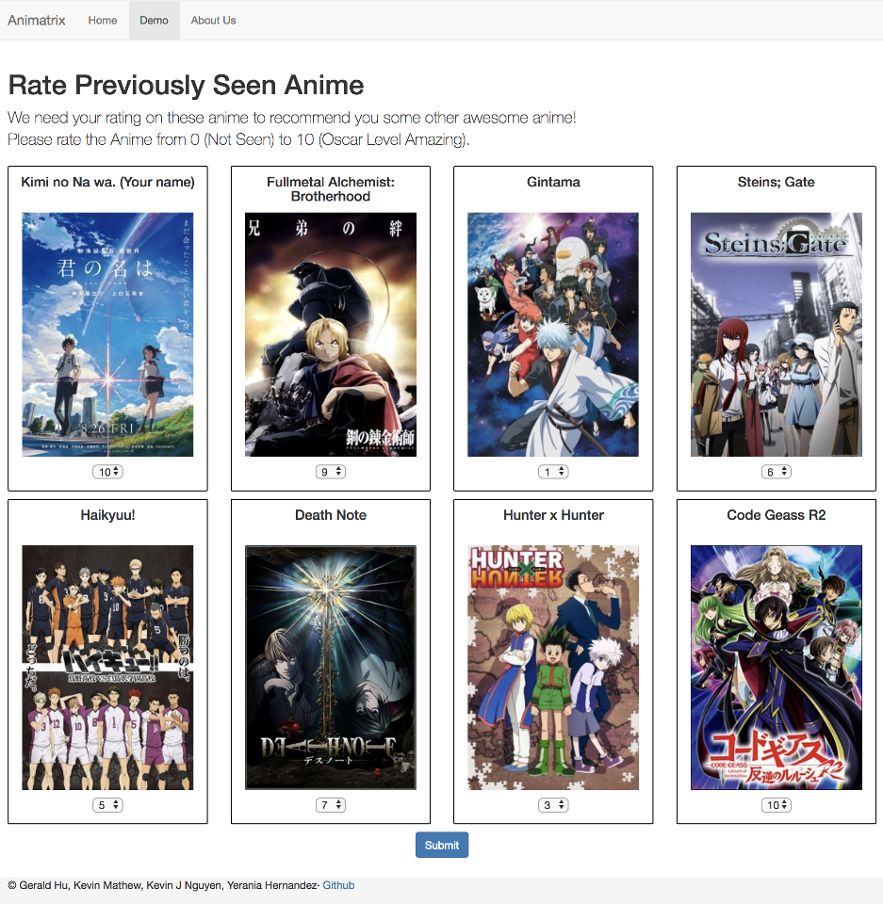

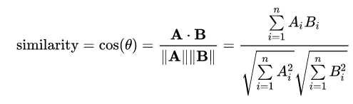
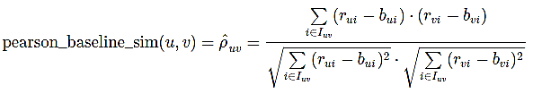


Animatrix: Anime Recommender System
Gerald Hu, Kevin Matthew, Kevin J Nguyen, Yerania Hernandez
Computer Science and Engineering, Texas A&M University
Motivation
Challenges
An anime recommender system is a useful tool for anime fans who would like to expand their taste in anime based on recommendations from like-minded people.
Similar to the music and eCommerce industry, the anime industry contains too much content to be consumed normally.
Currently, MyAnimeList has over a million registered users who discuss anime recommendations on forums which tends to get repetitive. [2]
This tool could eliminate the need of forum threads dedicated to recommendations and provide more customized anime choices to users.
Vagueness in model-based algorithms for collaborative filtering
Naïve Bayes was difficult to model due to the various extensions and few examples [4]
Tradeoff between accuracy measures and response time on server to provide predictions
Calculated based on duration of the training and prediction of the data subset
Limitation of memory provided on the server to process large data sets
Imbalance of practicality for usability and prediction accuracy
Lack of abundant data for further analysis on other anime datasets besides the source being MyAnimeList
Background
Evaluation and Results
Two main types of collaborative filtering: memory-based and model-based
Within memory-based algorithms, we implemented neighborhood-based, user-to-user top-N, and item-to-item top-N using cosine and Pearson similarity measures to compute the similarities between anime and users.
Explored memory-based algorithms by attempting to implement Naive Bayes and successfully implementing SVD.
Used root mean square error (RMSE) and mean absolute error (MAE) as accuracy measures
Evaluated algorithms through the use of RMSE and MAE in order to minimize the loss of the functions
Main goal is to try to achieve a minimal loss in order to make a prediction as close as possible to the actual rating.
RMSE will help understand the effect large error terms have compared to smaller error terms.
MAE resolves the issues mentioned for RMSE and is less sensitive to outliers, holding steady results despite an increase in variance.
Recommender system takes into consideration accuracy measures and execution time of system to provide predictions on a new user
Recommended anime based on SVD implementation
Overall Approach
Dataset
Sourced from MyAnimeList and consisted of user preference data from approximately 70,000 users and over 12,000 animes. [1]
Subset we considered to train our models considered is approximately 6,000 users due to the high computation times needed (hours at a time) to provide error measures and predictions for all the animes and users in this set.
With this subset, we created a split for training and testing datasets based on 80% of the data being for training and leaving 20% of the data for testing.
Similarity Weight
Cosine Similarity
Pearson Similarity
Memory-Based Algorithms
K Nearest Neighbors: Used similarities between users, isolated the ‘k’ most similar users to each target user, and then predict the ratings of the target users using the ratings [3]
Top-N User-to-User: Similarity between users and selected the top N users that are most similar to the current user who rated the same anime item
Top-N Item-to-Item: Similarity between items and selected the top N items that are most similar to the current item who were rated by the users [5]
Model-Based Algorithms
SVD: Changed the default values in order to improve RMSE and MAE by increasing latent factors and regularization value
Execution Time Frame for Collaborative Filtering Methods
Type of Collaborative Filtering | Total Duration (Training/Prediction Evaluation)
k-Nearest Neighbors | ~ 3 min. 35 sec.
User-User Top-N Cosine Similarity | ~ 2 hrs. 45 min.
User-User Top-N Pearson Similarity | ~ 2 hrs. 45 min.
Item-Item Top-N Cosine Similarity | ~ 6 hrs. 30 min.
Item-Item Top-N Pearson Similarity | ~ 6 hrs. 30 min.
SVD | ~ 20 s
Accuracy Measures for CF Implementations
Type of Collaborative Filtering | MAE | RMSE
k-Nearest Neighbors | 0.8878 | 1.206
User-User Top-N Cosine Similarity | 0.8976 | 1.182
User-User Top-N Pearson Similarity | 0.9086 | 1.195
Item-Item Top-N Cosine Similarity | 0.8696 | 1.154
Item-Item Top-N Pearson Similarity | 0.8654 | 1.153
SVD | 0.8886 | 1.202
Next Steps
References
Increasing the data subset to use a larger proportion of the original data or use the entirety of the original data yet still obtain a reasonable response rate
Further investigation in implementing model-based algorithms
Exploration of SVD latent factors, regularization values, and additional parameters to improve the accuracy measures
Exploration of other model-based algorithms for comparison
Make use of memory-based algorithms but improve the response rate as efficiently as SVD
Examine the potential effects of implicit feedback in order to improve the accuracy results along with the conjunction of multiple algorithm implementations
[1] CooperUnion. Anime Recommendations Database | Kaggle, 21 Dec. 2016,
www.kaggle.com/CooperUnion/anime-recommendations-database.
[2] “Collaborative Filtering on Anime Data.” Kaggle, www.kaggle.com/ajmichelutti/collaborative-filtering-on-anime-data.
[3] “k-NN Inspired Algorithms.” k-NN Inspired Algorithms - Surprise 1 Documentation, surprise.readthedocs.io/en/stable/knn_inspired.html#surprise.prediction_algorithms.knns. KNNBaseline.
[4] Koren, Yehuda. “Factor in the Neighbors.” ACM Transactions on Knowledge Discovery from Data, vol. 4, no. 1, Jan. 2010, pp. 1–24., doi:10.1145/1644873.1644874.
[5] Mayank-Bhatia. “Mayank-Bhatia/Anime-Recommender.” GitHub, github.com/Mayank-Bhatia/Anime-Recommender.

