Slide 1


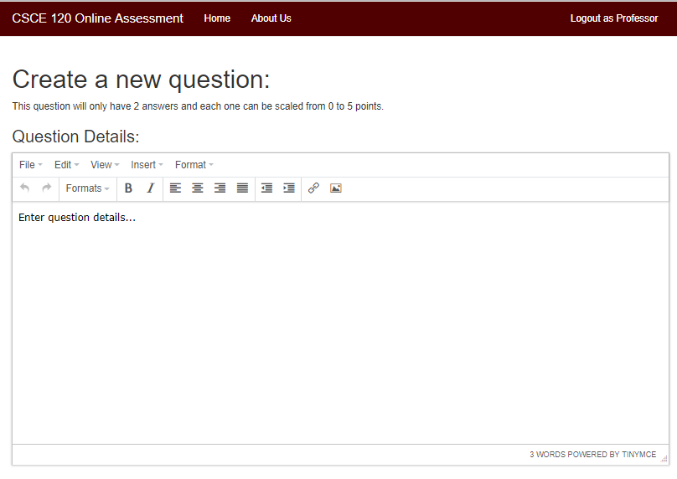
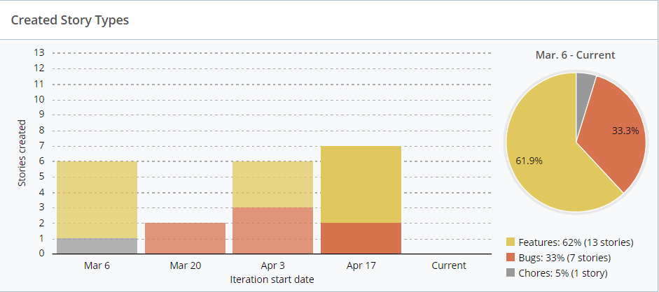
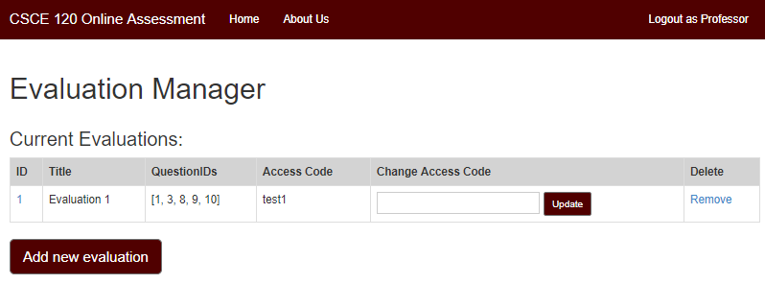
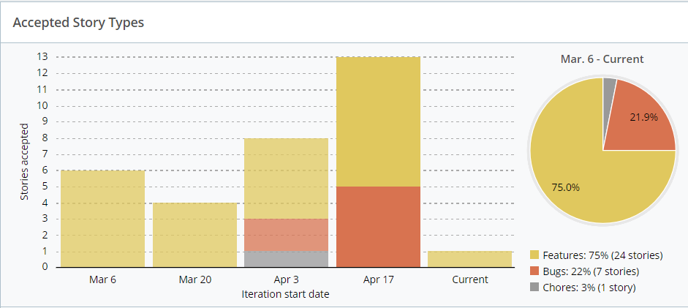
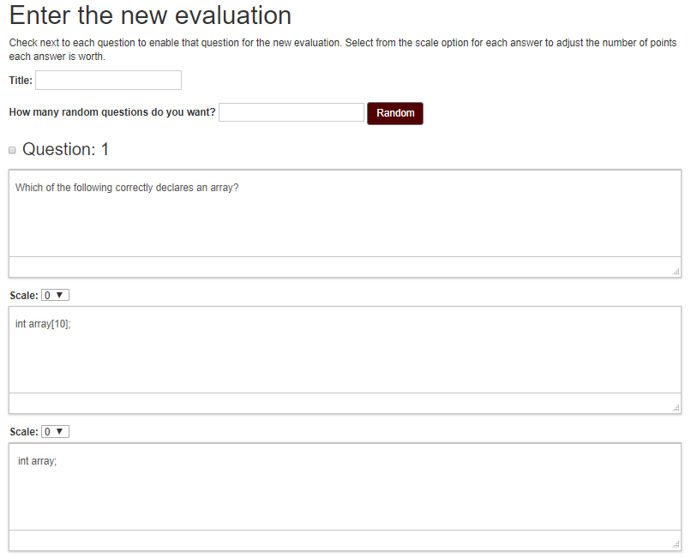
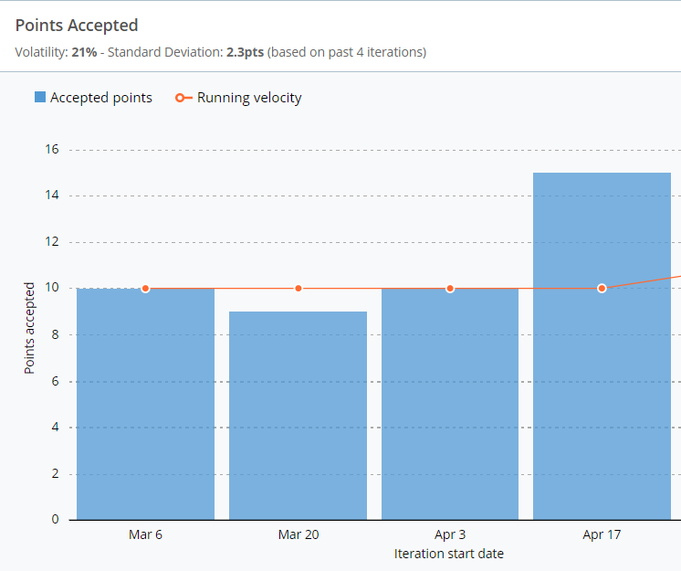
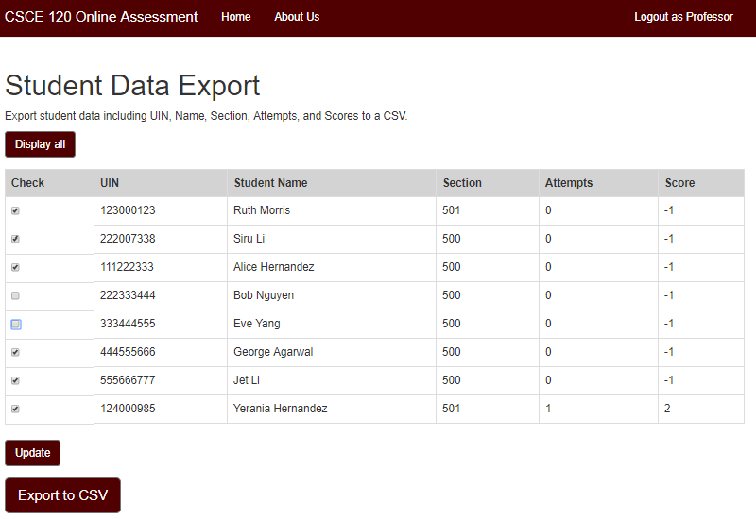
CSCE 120 Self-Evaluation System
Amulya Agarwal, Yerania Hernandez, Siru Li, Kevin J Nguyen, Yang Yang
Computer Science and Engineering, Texas A&M University
Motivation
Next Steps
A need to evaluate an incoming student’s knowledge on introductory programming concepts.
An evaluation that a student can take prior to the start of the course that will help professors gauge the student’s knowledge and inform the student about possible need for further preparation to succeed in the course.
As the course requires students to have certain prior programming experience, our team developed an application that could integrate scaling of questions, code snippets, images, and various other features.
The system provides an evaluation score depicting the student’s preparedness to take the course.
Professors will have the ability to decide what changes and adjustments are needed to the introductory material and what should be covered so that the students complete this course successfully.
Addressing a variety of question types for additional flexibility
Implementing free-response questions, with a different grading system from the administrative side
Developing questions with multiple selections of answers
Further development on data analytics
Provide graphical representation of data instead of tabular (histograms, bar graphs, line graphs, etc.)
Add filters to data from each database, such as by sections, by question type or by scores.
Increase the login security for the administrative and client side
Currently using a SHA1 (Secure Hash Algorithm 1) encryption for admin login and using a student’s personal UIN for client login
Implement using Central Authentication Service system from Texas A&M
Overall Approach
Challenges
Environment
Language: Ruby and Rails
Development: Github and Amazon Web Services Cloud9
Front-End: Bootstrap and ERB(Embedded Ruby)
Production Releases: Heroku
Features
Handling unpredictable user behavior that are not covered through test cases
Caching of site
Back button while in the middle of a session
Maintaining browser sessions
Multiple redirects in a single page
TinyMCE: Used to display questions with images, code snippets, tables, and any other HTML tags for customization
Access Codes: Each evaluation has a unique access code for a student to access that specific evaluation
Results
Used GitHub as our team’s collaborative version and source control
Used Pivotal Tracker as an Agile Project Management tool
Completed and implemented 22 different user stories successfully
Accepted over 46 story points
Resolved and fixed at least 8 different bug branches
Question Scaling: Each question can have up to five different answer choices and each answer choice can have different points assigned (scale)
Export Data: Student database and question database can be exported to CSV files for further data analysis
References
[1] “CSCE606 Project.” Pivotal Tracker, www.pivotaltracker.com/n/projects/2153120.
[2] Constantin, Lucian. “The SHA1 Hash Function Is Now Completely Unsafe.” Computerworld, IDG News Service, 23 Feb. 2017, www.computerworld.com/article/3173616/security/the-sha1-hash-function-is-now-completely-unsafe.html.
Notes:
archi - Page 1.png

