Slide 1
Deep Photo Enhancer
Authors: Yu-Sheng Chen, Yu-Ching Wang, Man-Hsin Kao, Yung-Yu Chuang Presented by: Nitin and Yerania

Slide 2
Problem
Noisy, incomplete images in color range and limited in resolution and the dynamic range
Incoming Light
Camera sensors respond linearly
Human perception responds non-linearly
Highly dependent on skills and aesthetic judgment when using software

Slide 3
Our Approach
Image enhancement by learning from photographs that have the characteristics the user want in their photographs
Implemented modified 1-Way GAN
U-Net augmentation with global features
Adaptive weighting scheme for Wasserstein GAN (WGAN)
Individual Batch Normalization

Slide 4
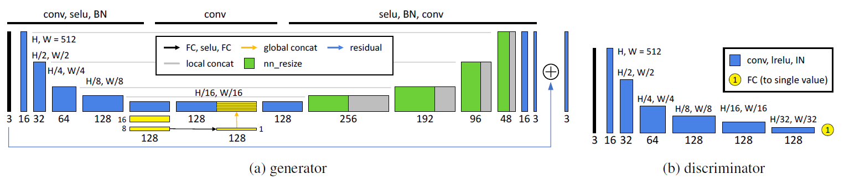
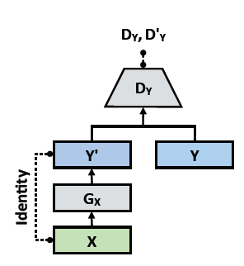
1-Way GAN Architecture

Slide 5
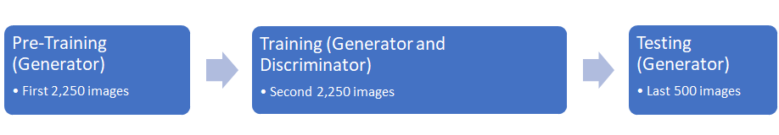
1-Way GAN Implementation

Slide 6
Challenges
Image Dataset
Conversion from DNG to TIF
Lost quality of images with PNG
Training Network
Learning Rate
Batch Size
Epochs
D/G Ratio
Time

Slide 7
Final Hyperparameters
Learning Rate: 0.00001
Batch Size: 5
Epochs: 100
D/G Ratio: 50 to 1
Pre-Training Time: ~15 hours
Training Time: ~30 hours

Slide 8
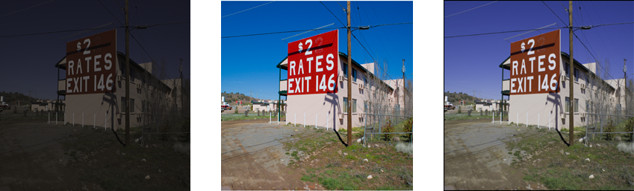
Results: Image Comparison
Input
Ground Truth
Our Approach

Slide 9
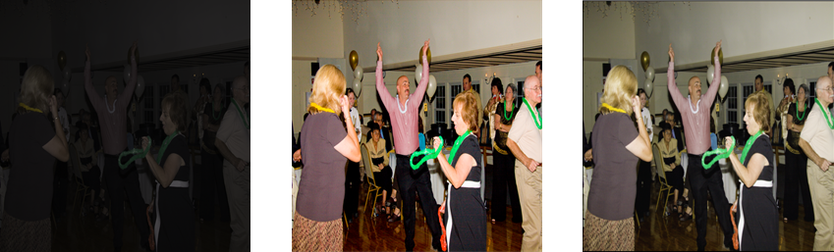
Results: Image Comparison
Input
Ground Truth
Our Approach

Slide 10
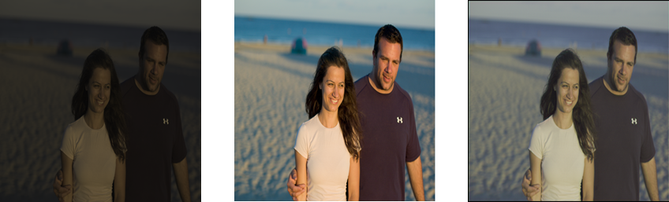
Results: Image Comparison
Input
Ground Truth
Our Approach

Slide 11
Conclusion
1-Way GAN Implementation
Promising results from PSNR score
Images visually appealing compared to input
Improvements
Train 2-Way GAN
Analyze hyperparameters for 2-Way GAN

Slide 12
Thank you!
Any questions?

