Slide 1
Canadian Bioinformatics Workshops
www.bioinformatics.ca

Slide 2
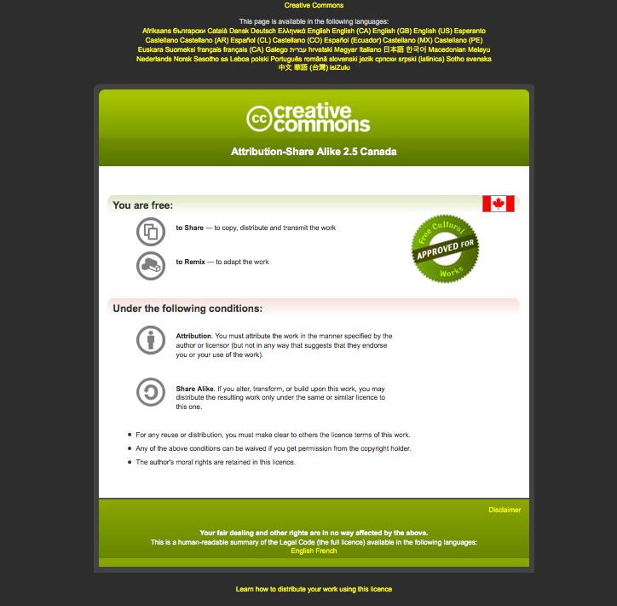
Module #: Title of Module

Slide 3
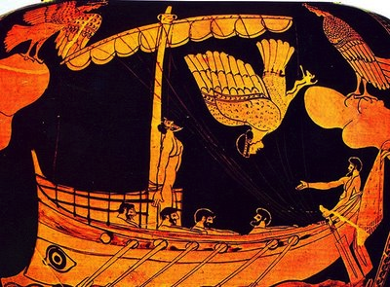

EDA Datasets
Boris Steipe
Exploratory Data Analysis of Biological Data using R
Odysseus listening to the song of the sirens. Late Archaic (500–480 BCE)
DEPARTMENT OF
BIOCHEMISTRY
DEPARTMENT OF
MOLECULAR GENETICS

Slide 4
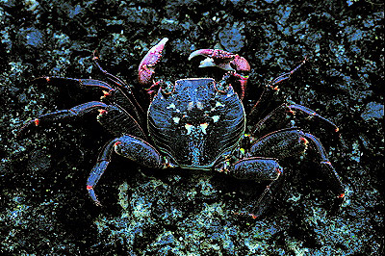
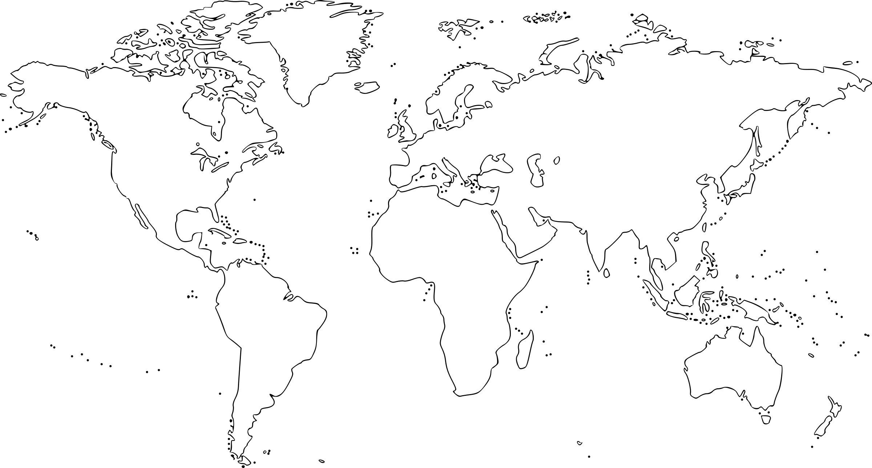
crabs data
The crabs data frame has 200 rows and 8 columns, describing 5 morphological measurements on 50 crabs each of two colour forms and both sexes, of the species Leptograpsus variegatus collected at Fremantle, W. Australia.
Source: Campbell, N.A. and Mahon, R.J. (1974) A multivariate study of variation in two species of rock crab of genus Leptograpsus. Australian Journal of Zoology 22, 417–425.
data(crabs, package = "MASS")
head(crabs)
sp sex index FL RW CL CW BD
1 B M 1 8.1 6.7 16.1 19.0 7.0
2 B M 2 8.8 7.7 18.1 20.8 7.4
3 B M 3 9.2 7.8 19.0 22.4 7.7
4 B M 4 9.6 7.9 20.1 23.1 8.2
5 B M 5 9.8 8.0 20.3 23.0 8.2
6 B M 6 10.8 9.0 23.0 26.5 9.8

Slide 5
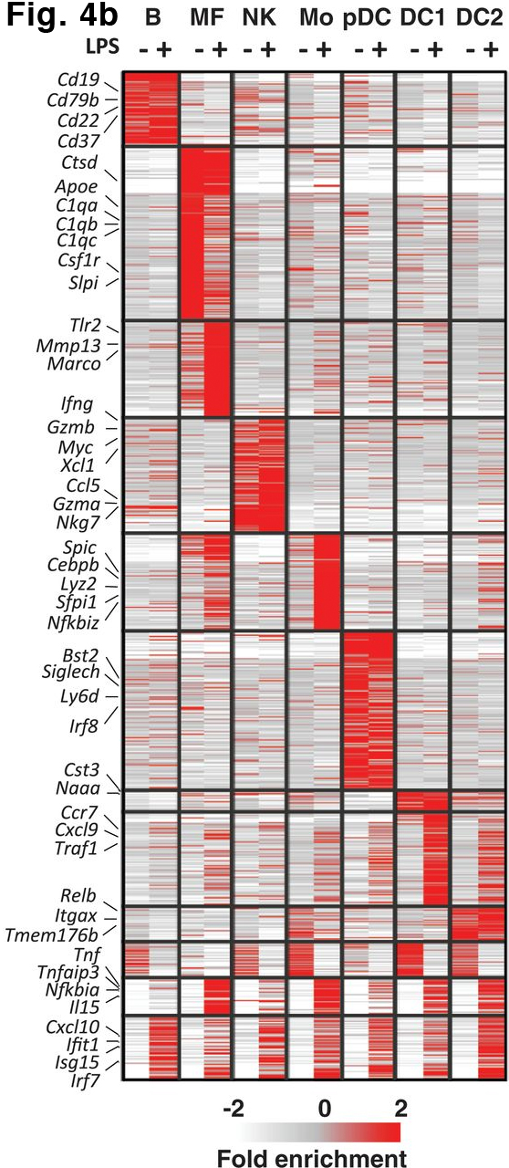
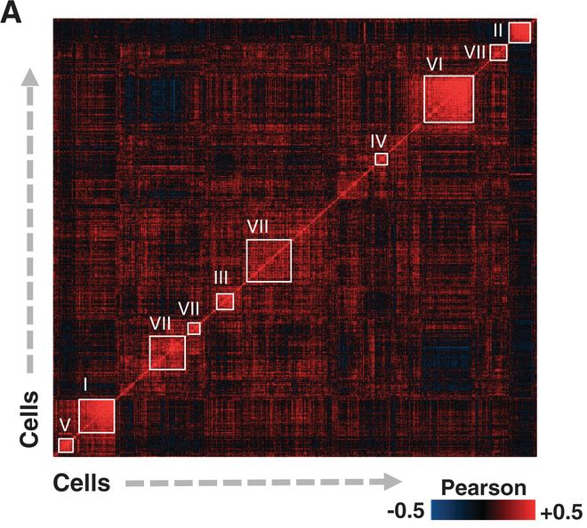
Single-cell expression data
Massively Parallel Single-Cell RNA-Seq for Marker-
Free Decomposition of Tissues into Cell Types
Diego Adhemar Jaitin, Ephraim Kenigsberg, Hadas Keren-Shaul, Naama Elefant, Franziska
Paul, Irina Zaretsky, Alexander Mildner, Nadav Cohen, Steffen Jung, Amos Tanay, Ido Amit
Science (2014) 343:776-779
Single cell RNA-seq can be used to cluster cells. The clustered cells correspond to traditional classifications based on cell-surface antigen markers! Tissue specific response to LPS immune stimulus can be observed.

Slide 6
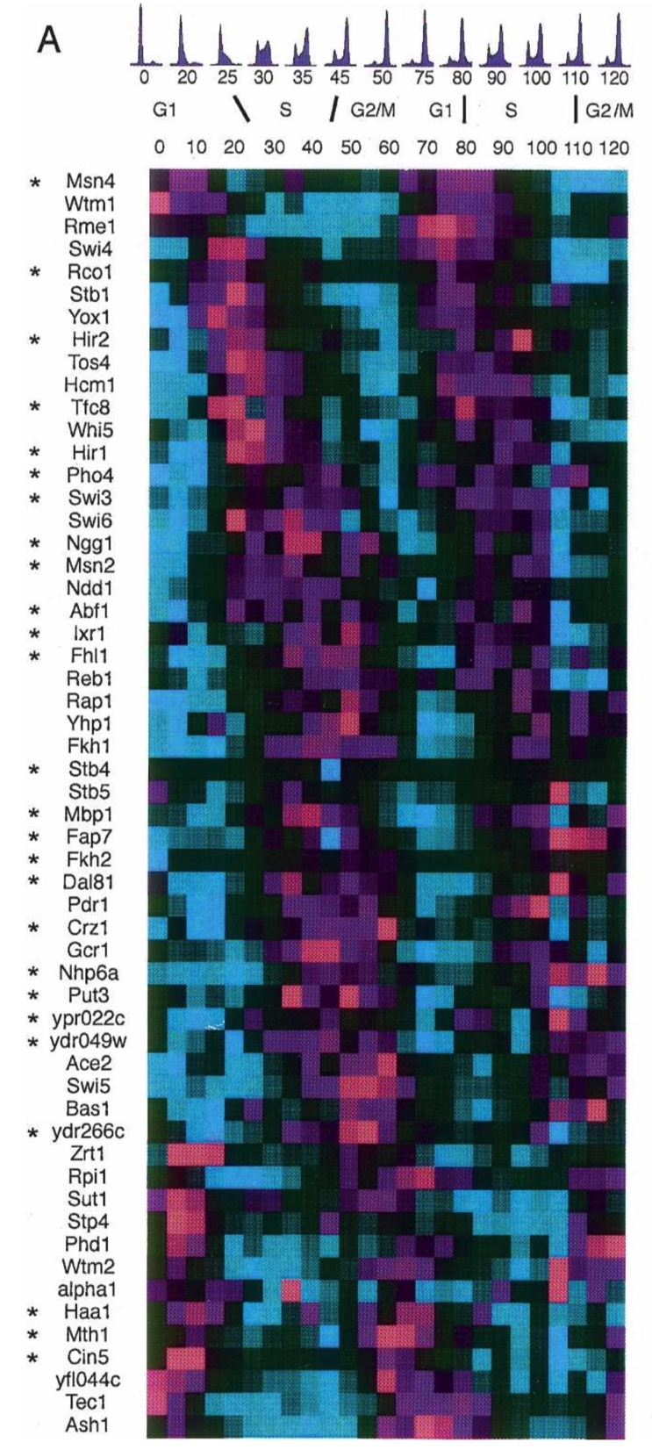
Yeast cell-cycle microarray data
The Forkhead transcription factor Hcm1 regulates chromosome segregation genes and fills the S-phase gap in the transcriptional circuitry of the cell cycle.
Tata Pramila, Wei Wu, Shawna Miles, William Stafford Noble, and Linda L. Breeden
Genes Dev (2006) 20:2266-2278
Hundreds of yeast genes show expression changes in their microarray transcription profiles that are correlated with the cell cycle.

Slide 7
crabs data
The crabs data frame has 200 rows and 8 columns, describing 5 morphological measurements on 50 crabs each of two colour forms and both sexes, of the species Leptograpsus variegatus collected at Fremantle, W. Australia.
library(MASS)
data(crabs)
head(crabs)
# Two species: blue and orange,
# Sex: female and male
# FL: frontal lobe size (mm)
# RW: rear width (mm)
# CL: carapace length (mm)
# CW: carapace width (mm)
# BD: body depth (mm)
fac <- as.factor(paste(crabs[, 1], crabs[, 2],sep="."))
head(fac)
c(fac[1], fac[51], fac[101], fac[151])
as.numeric(c(fac[1], fac[51], fac[101], fac[151]))
plot(crabs[, 4:8], pch=as.numeric(fac))
plot(crabs[, 4:5], pch=as.numeric(fac))

Slide 8
不知最親切
Attention! Master Jizo asked Hogen,
“Where have you come from?”
“I pilgrimage aimlessly,” replied Hogen.
“What is the matter of your pilgrimage?” asked Jizo.
“I don’t know,” replied Hogen.
“Not knowing is the most intimate,” remarked Jizo.
At that, Hogen experienced great enlightenment.
—Case 20 of the Book of Equanimity

Slide 9
boris.steipe@utoronto.ca

