Slide 1


Integrated Sensing, Computation, and Communication: System Framework and Performance Optimization
Yinghui He, Guanding Yu, Yunlong Cai, and Haiyan Luo

Slide 2
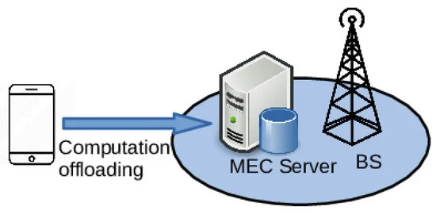
Background and Motivation
Integrated Sensing, Computation, and Communication (ISCC)
From ISAC to ISCC:
Intelligent sensing services (action recognition tasks) are based on AI-based algorithms (compute-intensive).
Mobile edge computing (MEC): deploy edge servers with sufficient computation capacity at base stations & reduce end-to-end latency.
Main issue of ISCC: how to jointly consider triple functions?
Focus on action recognition tasks.
ISAC
MEC
Sensing
Communication
Computation
ISCC

Slide 3






Background and Motivation
Challenges
Three challenges:
High computational overhead brought by the static state.
Sensing performance analysis.
Joint resource allocation.
Sleep
Static
What influences the sensing performance and how?
(sensing delay and accuracy)

Slide 4


Solution for Challenge
Challenge 1: High computational overhead
Difference:
Detect the variation over the time domain $→$ not easy $→$ frequency domain
Sensing signal
Almost unchanged
Static
Time
Sensing signal
Vary
Action
Time
Sensing signal
Amplitude
FFT
Time
Frequency

Slide 5
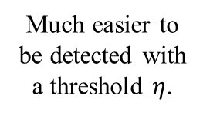
Solution for Challenge
Challenge 1: High computational overhead
Difference:
Detect the variation over the time domain $→$ not easy $→$ frequency domain
Sensing signal
Almost unchanged
Static
Time
Sensing signal
Vary
Action
Time
Much easier to be detected with a threshold $η$.
Sensing signal
Amplitude
FFT
Time
Frequency

Slide 6
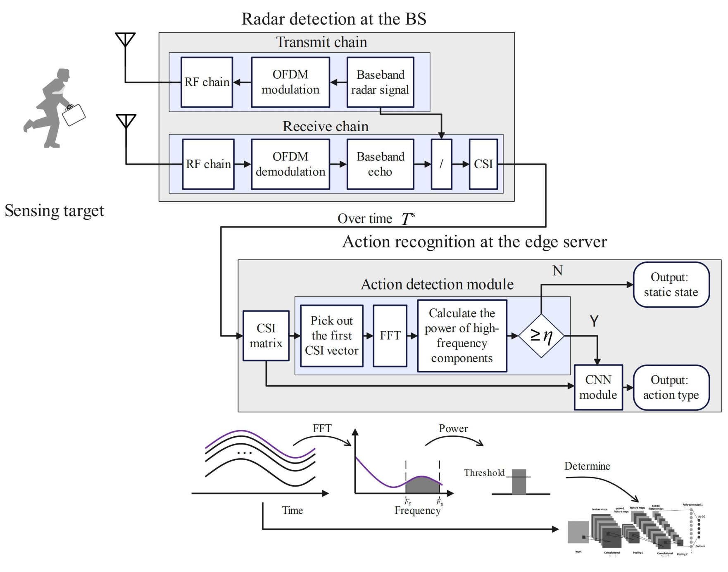


Solution for Challenge
Challenge 1: High computational overhead
A novel sensing framework (OFDM radar)
Key: an action detection module
Reduce the computational waste for the static state.
Sampling rate: $F^{s}$
CSI matrix
CSI vector for $k$-th subcarrier

Slide 7

Solution for Challenge
Challenge 2: Performance Analysis
Focus on the action recognition phase
Input: CSI matrix Size = the number of subcarriers $K$ $×$ (sampling rate $F^{s}⋅$ duration $T$)
Threshold $η$

Slide 8
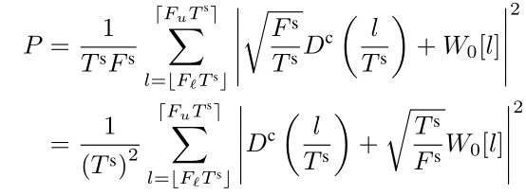


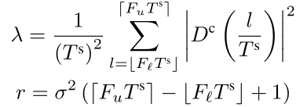

Solution for Challenge
Challenge 2: Performance Analysis
Action detection module:
The power of high-frequency components (using the sampling theorem):
Chi-squared distribution
Approximate
More samples $→$ less randomness $→$ more accurate
Degree of freedom is high enough
$P∼CN\left(μ_{P}, σ_{P}^{2}\right)$
Parameters are obtained by fitting.

Slide 9
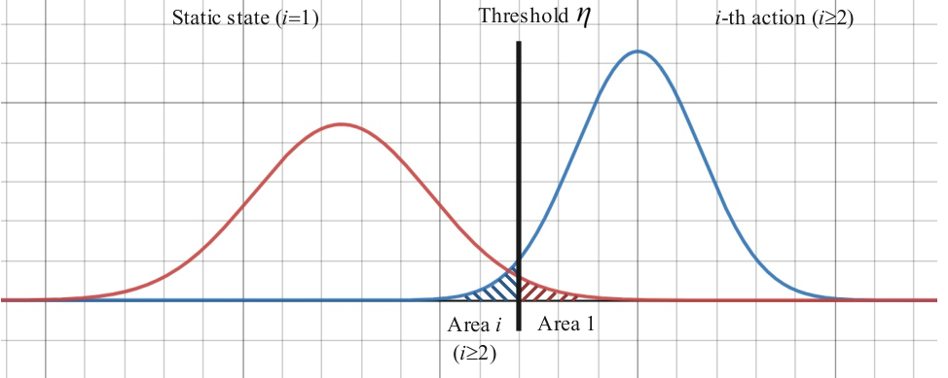
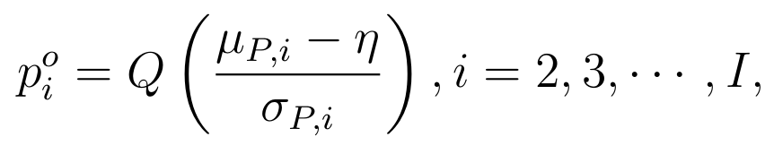
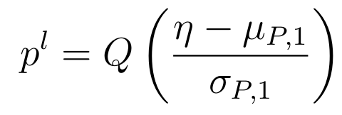
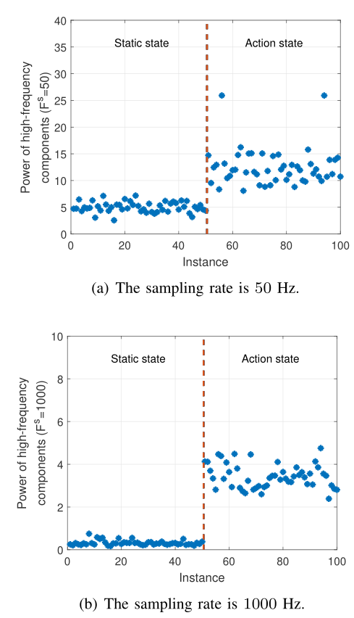
Solution for Challenge
Challenge 2: Performance Analysis
Action detection module:
Real-world test:
Miss rate for i-th action
False positive rate for the static state
A higher sampling rate
Higher gap
Lower variance

Slide 10
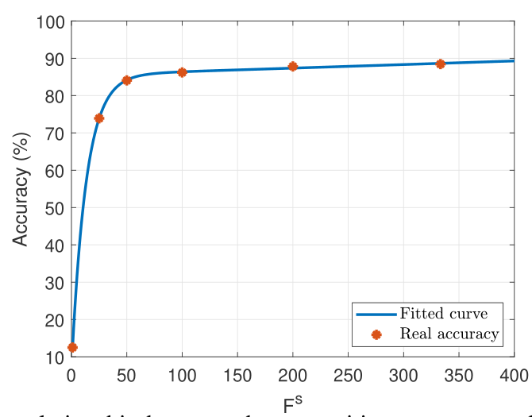
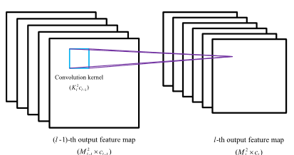


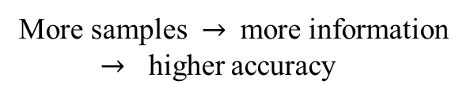
Solution for Challenge
Challenge 2: Performance Analysis
CNN module
Accuracy
Delay
Result based real-world dataset
More samples $→$ more information
$→$ higher accuracy
$α\left(F^{s}\right)$: a monotonically increasing function.
Computational complexity is proportional to the input matrix size.

Slide 11
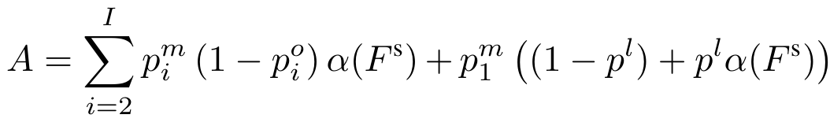
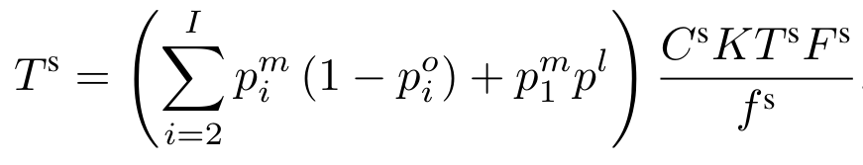
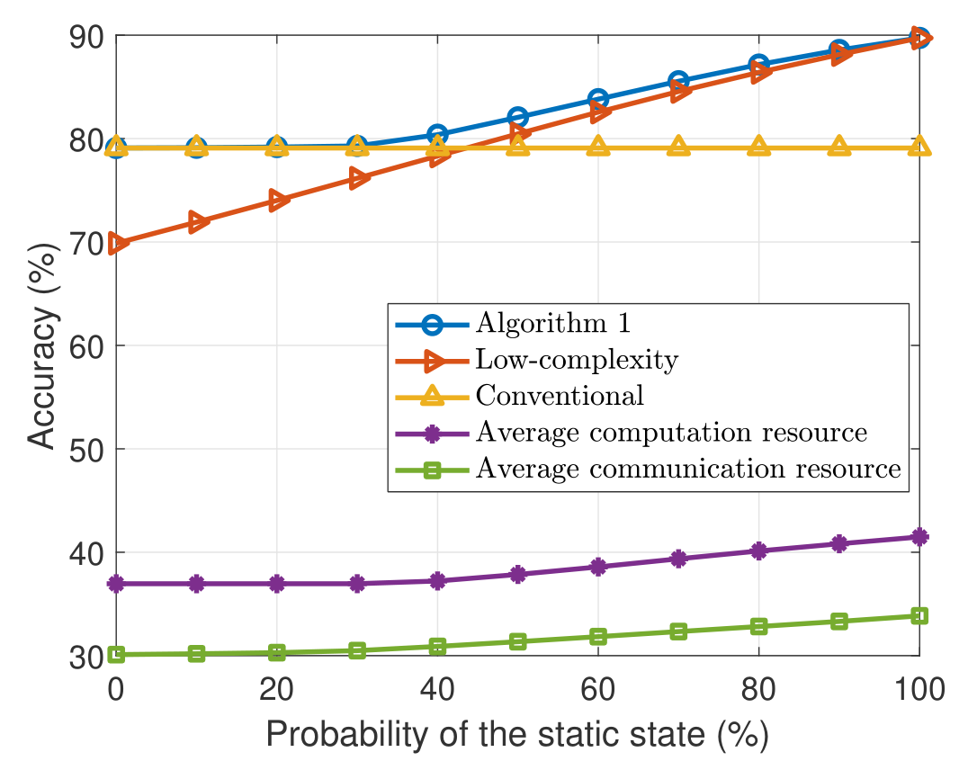


Solution for Challenge
Challenge 2: Performance Analysis
Sensing performance
Sensing accuracy:
Sensing delay:
Probability of an instance passing through the CNN module
Performance gain Benchmark: the conventional framework without action detection module.
Gain = $\frac{\text{saved} \text{computation} \text{resource} }{\text{required} \text{computation} \text{resource} \text{of} \text{benchmark}}$
Probability of the static state.

Slide 12
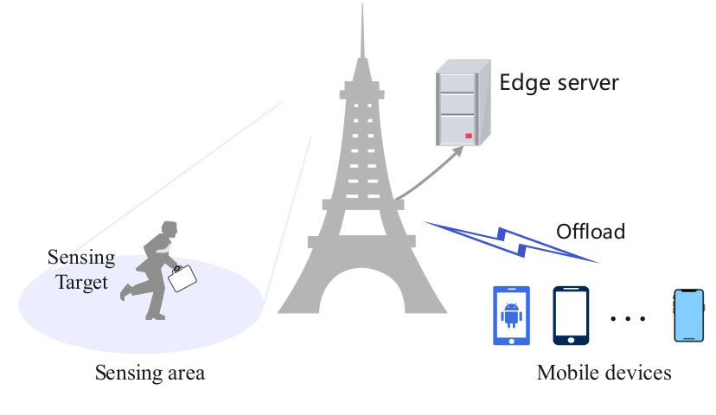
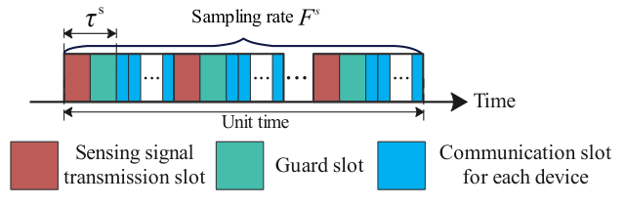
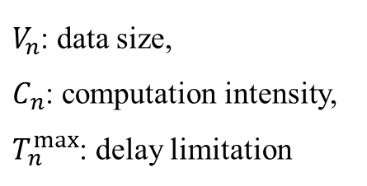
Solution for Challenge
Challenge 3: joint optimization
System model
A sensing task at the BS;
𝑁 devices.
TDMA method is adopted.
$V_{n}$: data size,
$C_{n}$: computation intensity,
$T_{n}^{max}$: delay limitation

Slide 13
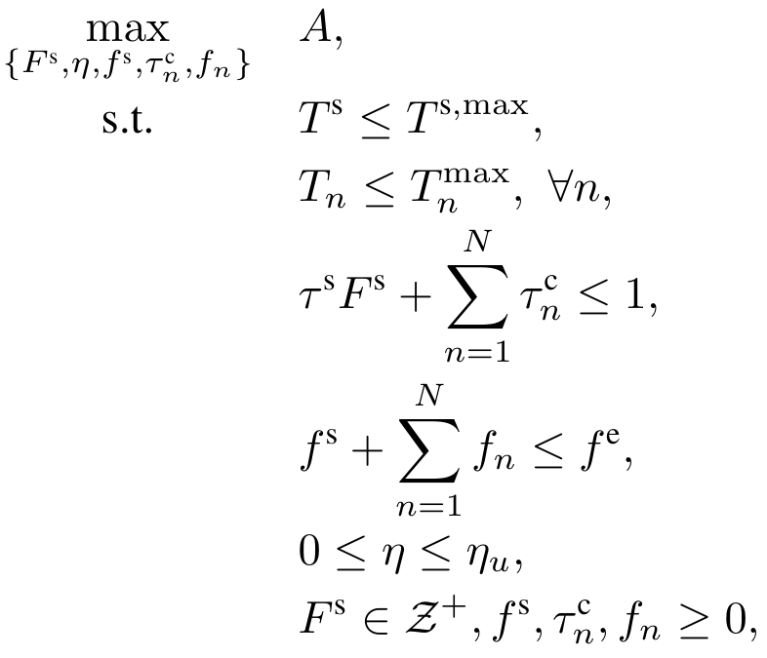


Solution for Challenge
Problem Formulation
Maximize sensing accuracy under resource limitations and delay requirement.
Under fixed sampling rate,
Minimize the required computation resource of $N$ devices by optimizing $f_{n}$ and $τ_{n}^{c}$;
Maximize the sensing accuracy by optimizing the threshold.
Delay constraint for sensing
Delay constraint for device $n$
Communication resource limitation
Computation resource limitation

Slide 14
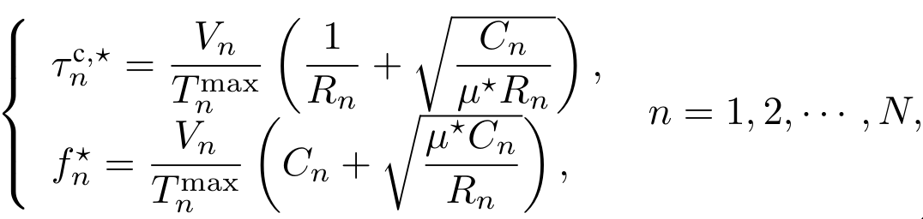

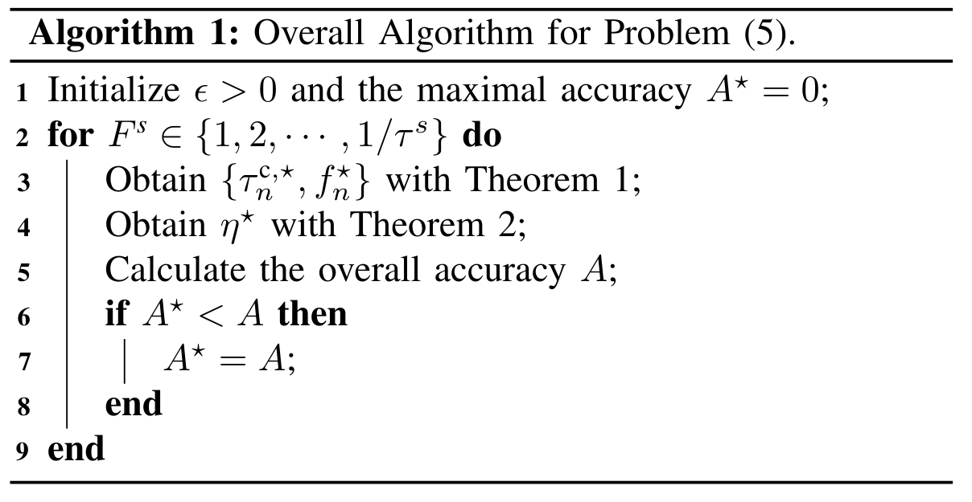
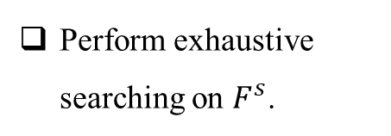
Solution for Challenge
Resource Allocation Strategy
Theorem 1:
Threshold Selection Policy
Theorem 2: , where $η^{T}$ is determined by delay requirement.
Overall Algorithm
Perform exhaustive searching on $F^{s}$.

Slide 15
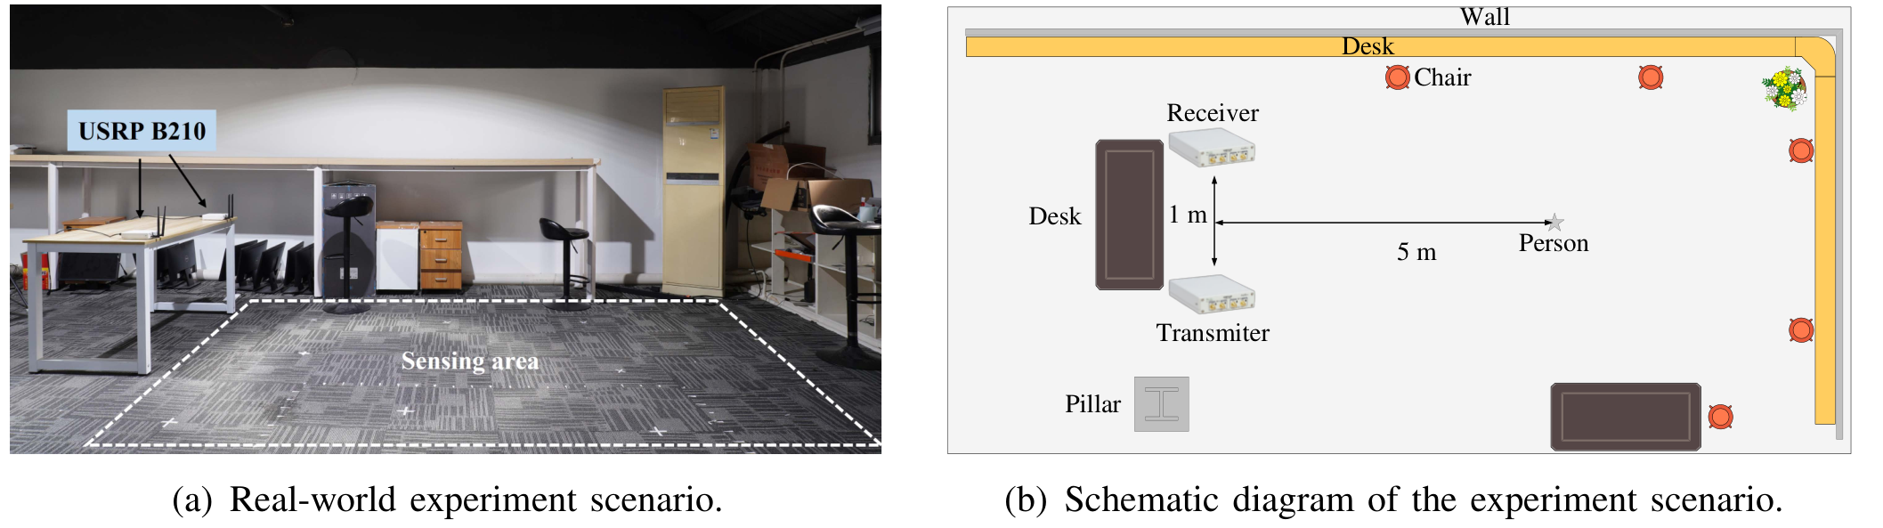
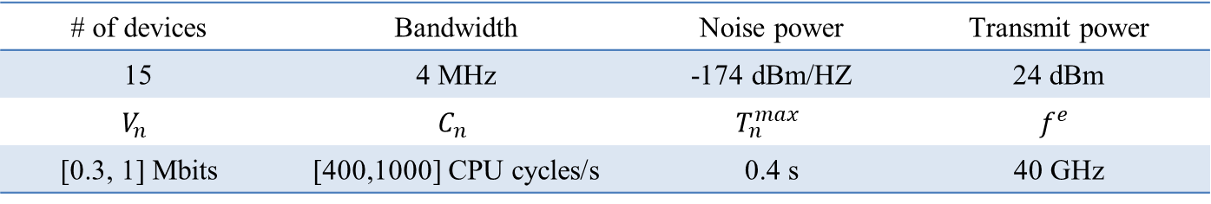
Test Results
Test Setup
For computation tasks:
For the sensing task:
Adopt OFDM radar;
Collect real-world dataset with two USRP B210;
CNN module: ResNet. It is tested on a Linux PC with Intel i7-8700K (refer to edge server).
# of devices | Bandwidth | Noise power | Transmit power
15 | 4 MHz | -174 dBm/HZ | 24 dBm
$$V_{n}$$ | $$C_{n}$$ | $$T_{n}^{max}$$ | $$f^{e}$$
[0.3, 1] Mbits | [400,1000] CPU cycles/s | 0.4 s | 40 GHz

Slide 16
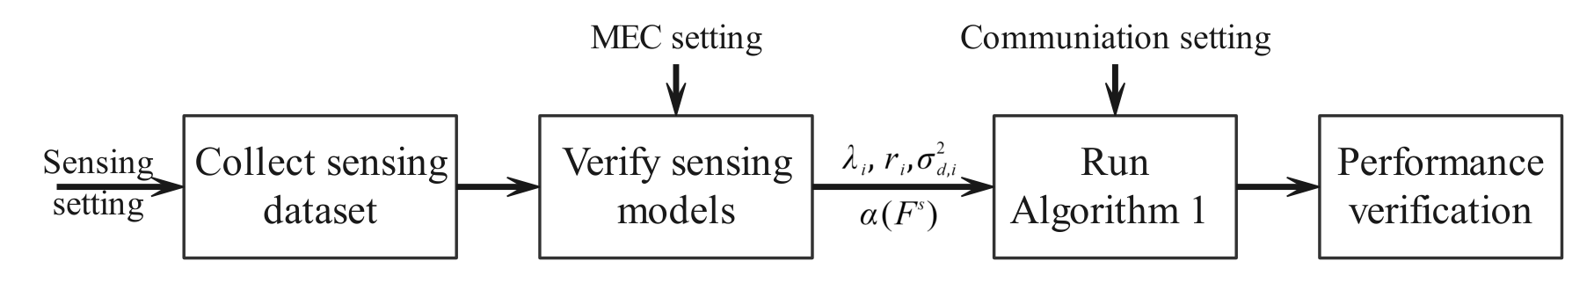
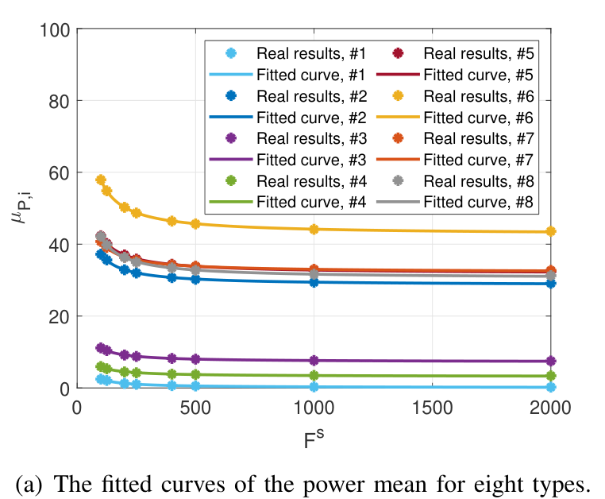
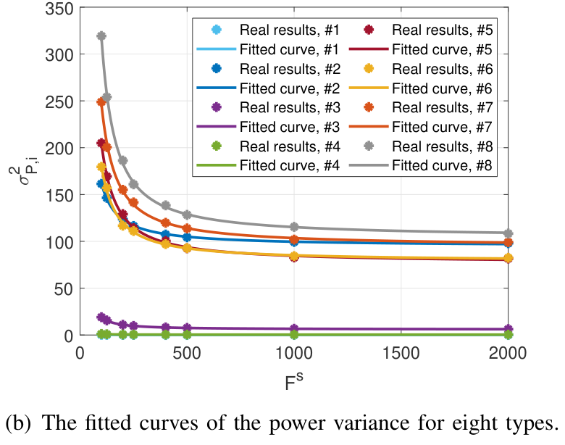
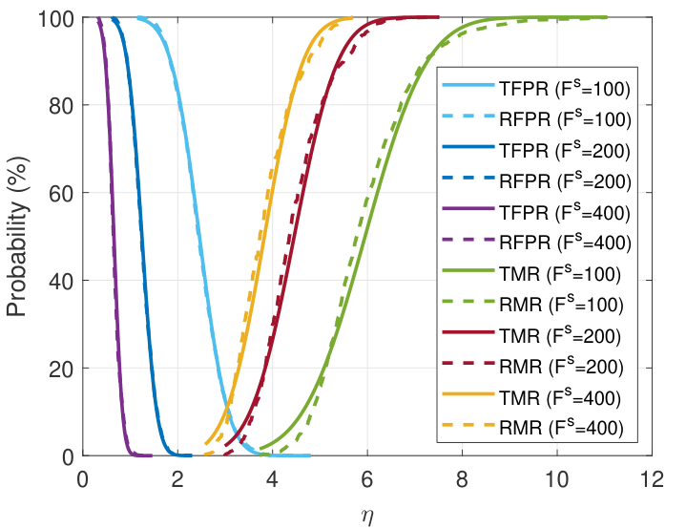
Test Results
Procedures of the test:
Model Verification
Power model and miss rate and false positive rate models
Prove the effectiveness of our proposed model for the action detection module.

Slide 17
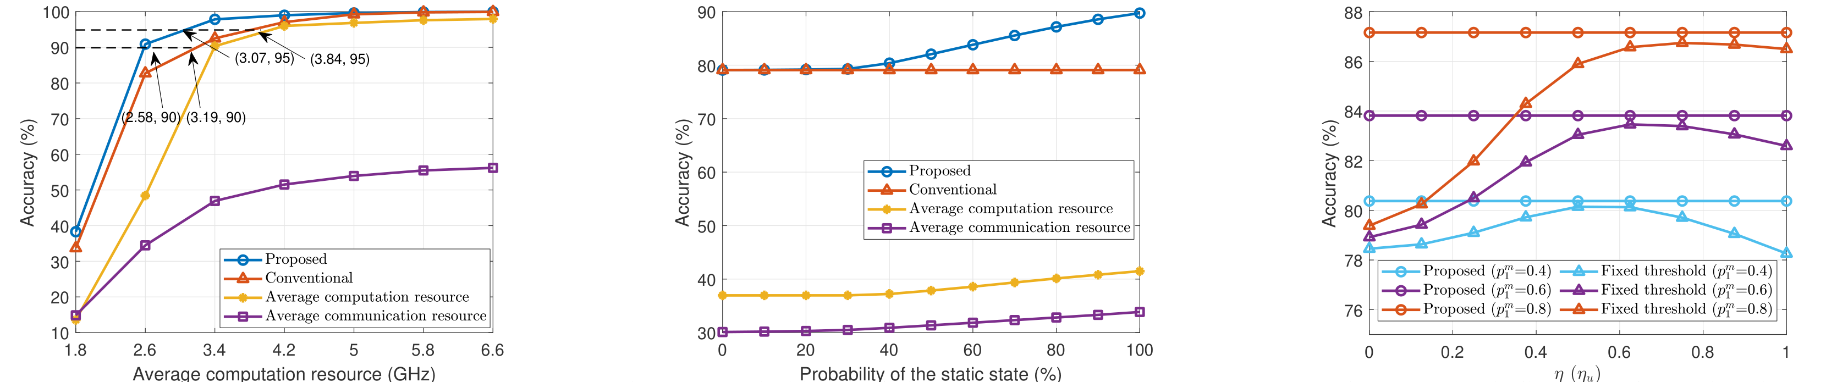
Test Results
Test Results
Benchmark algorithms:
Conventional scheme without proposed action detection module;
Average computation/communication resource scheme.
The proposal achieves the highest performance -> verify the effectiveness of resource allocation strategy & threshold selection policy;
The novel sensing framework is applicable for the scenario with a high probability of the static state.

Slide 18
Summary
Summary
A novel and effective sensing framework.
Analyze the overall sensing performance.
An optimal resource allocation strategy and a threshold selection policy.
A real-world test using the USRP B210.

Slide 19
THANKS

