Slide 1


Beamforming Design with Bilevel Optimization for RIS-Assisted SWIPT Systems
Yinghui He, Yunlong Cai, and Guanding Yu
Zhejiang University
2024-06-09

Slide 2






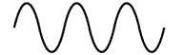
Background
Low battery anxiety outside
Base station (BS)
How to charge?
Data transmission
Simultaneous wireless information and power transfer (SWIPT)
Wireless charging

Slide 3




Motivation
Two functions:
Traditional methods:
One as objective function, the other as constraint;
Multi-objective optimization using weighted methods.
1. Data transmission
Disadvantage:
existing methods do not consider the priority of two functions!
2. Charging
BS
Maximize one objective function first, and then maximize the other one.
How to balance two functions?

Slide 4



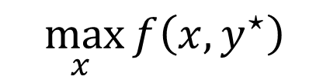
Motivation
Bilevel Optimization
$$y^{⋆}$$
Upper level:
Lower level:
$$\max_{x }{f\left(x,y^{⋆}\right)}$$
$$y^{⋆}∈{argmax}_{y} g\left(x,y^{⋆}\right)$$
$$x$$
Our objective:
Introduce bilevel optimization into dual-function SWIPT system for addressing priority issue!

Slide 5
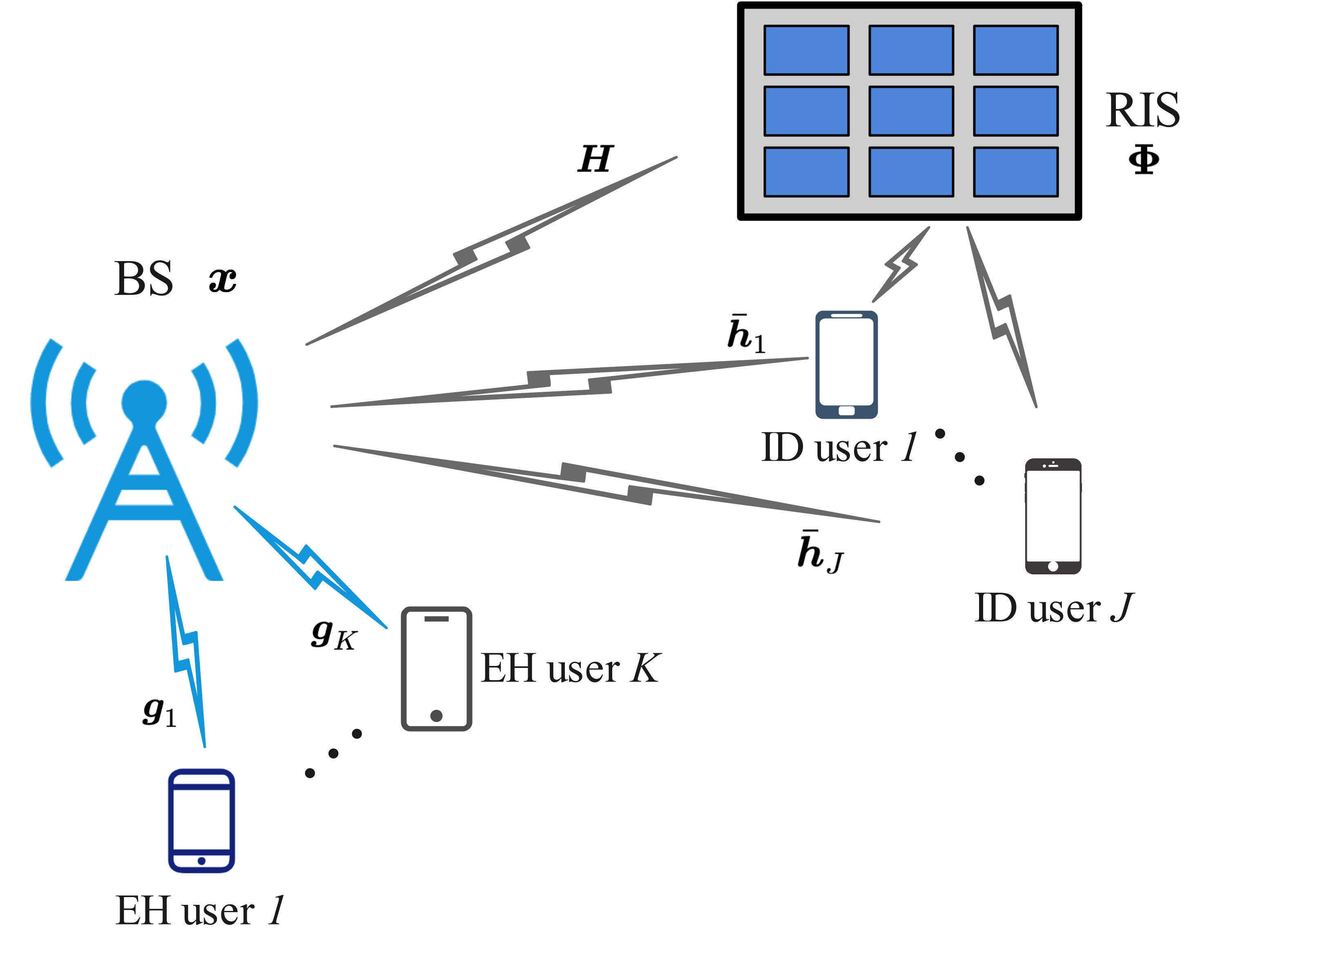
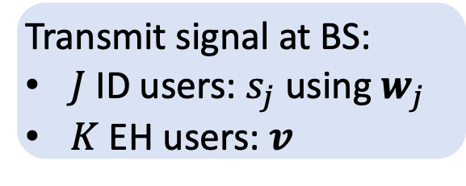
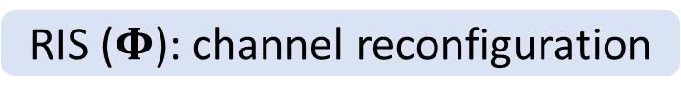
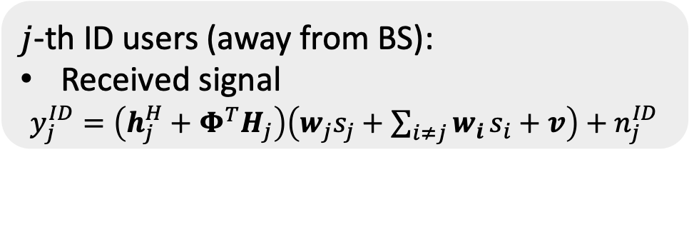
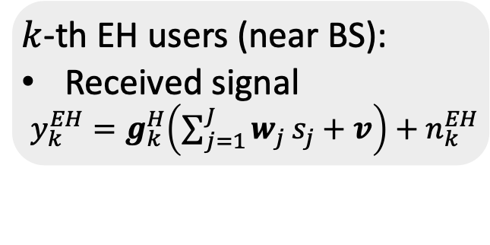
System Model
RIS ($Φ$): channel reconfiguration
Transmit signal at BS:
$J$ ID users: $s_{j}$ using $w_{j}$
$K$ EH users: $v$
$j$-th ID users (away from BS):
Received signal
$y_{j}^{ID}=\left(h_{j}^{H}+Φ^{T}H_{j}\right)\left(w_{j}s_{j}+\sum_{i≠j}{w_{i}}s_{i}+v\right)+n_{j}^{ID}$
$k$-th EH users (near BS):
Received signal
$y_{k}^{EH}=g_{k}^{H}\left(\sum_{j=1}^{J}{w_{j}}s_{j}+v\right)+n_{k}^{EH}$
Interference

Slide 6
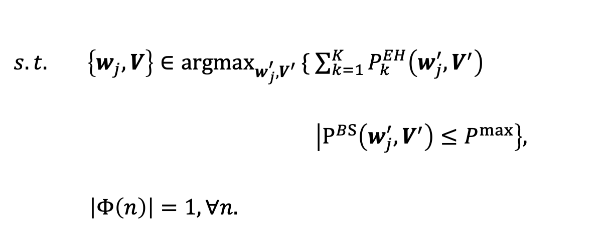
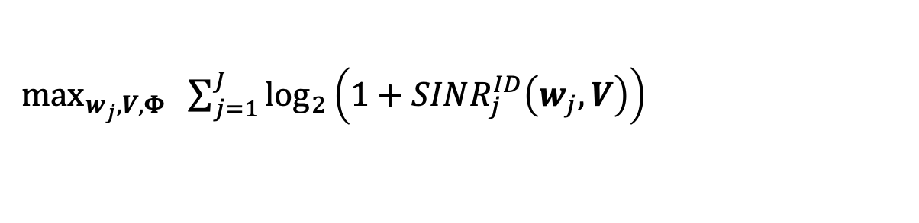
Problem Formulation
Constrained bilevel programming
$\max_{w_{j},V,Φ}{ \sum_{j=1}^{J}{\log_{2}\left(1+SINR_{j}^{ID}\left(w_{j},V\right)\right)}}$
Upper level (ID users) : maximize the sum rate
$s.t.{ \left\{w_{j},V\right\}∈{argmax}_{w_{j}^{′},V^{′}}}\{ \sum_{k=1}^{K}{P_{k}^{EH}\left(w_{j}^{′},V^{′}\right)}$ $\left|P^{BS}\left(w_{j}^{′},V^{′}\right)≤P^{max}\right\},$
$\left|Φ\left(n\right)\right|=1, ∀n.$
Lower level (EH users) : maximize total harvested power
under total transmit power limitation
Upper level: RIS constraint
Main idea:
Solve the lower level first and then optimize the upper level

Slide 7
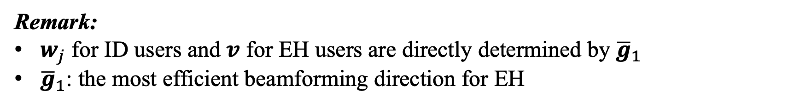
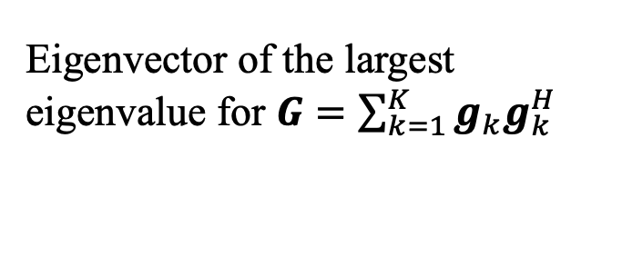

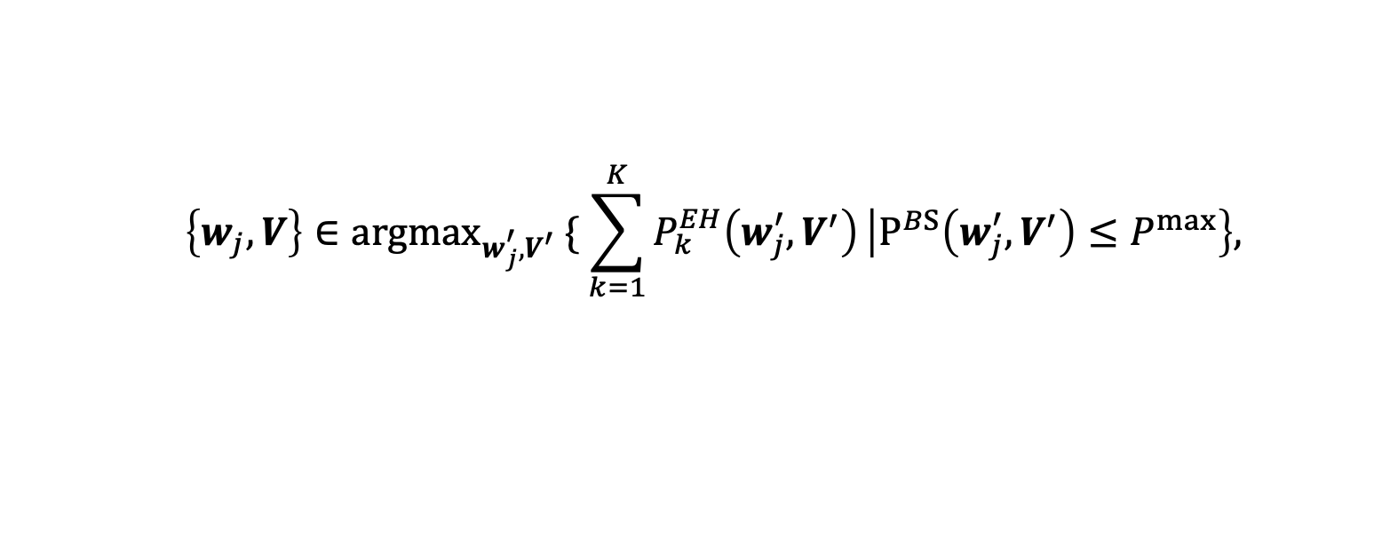
Beamforming Design
Optimal Set to Lower-Level Problem
$${ \left\{w_{j},V\right\}∈{argmax}_{w_{j}^{′},V^{′}}}\{ \sum_{k=1}^{K}{P_{k}^{EH}\left(w_{j}^{′},V^{′}\right)}\left|P^{BS}\left(w_{j}^{′},V^{′}\right)≤P^{max}\right\},$$
Lower-level problem:
Theorem 1: The necessary and sufﬁcient condition of the optimal solution:
$$w_{j}=α_{j}{\overline{g}}_{1}, V={\left|β\right|}^{2}{\overline{g}}_{1}{\overline{g}}_{1}^{H}$$
$\sum_{j=1}^{J}{{\left|α_{j}\right|}^{2}+}{\left|β\right|}^{2}=1$
Eigenvector of the largest eigenvalue for $G=\sum_{k=1}^{K}{g_{k}g_{k}^{H}}$
Remark:
$w_{j}$ for ID users and $v$ for EH users are directly determined by ${\overline{g}}_{1}$
${\overline{g}}_{1}$: the most efficient beamforming direction for EH

Slide 8
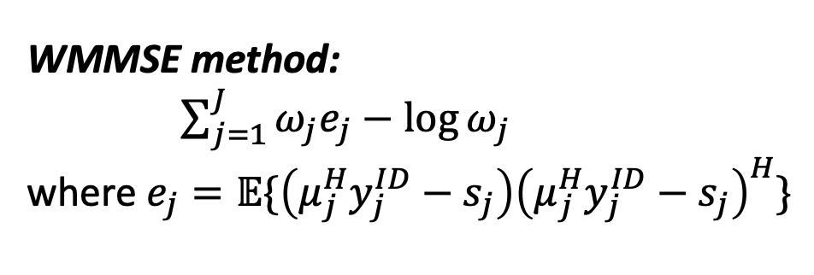

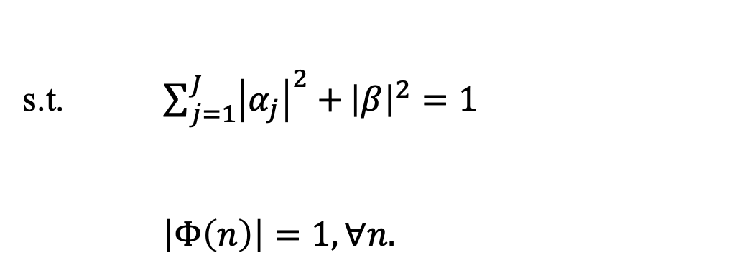
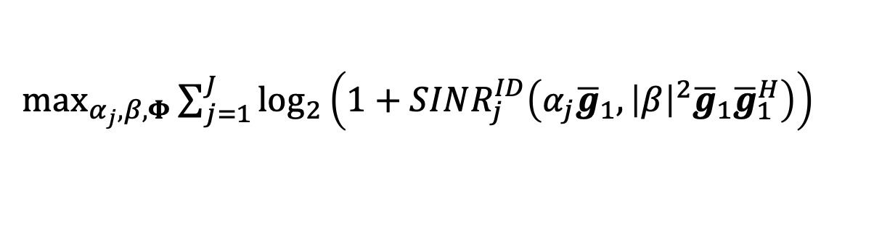
Beamforming Design
Bilevel problem
WMMSE method:
$\sum_{j=1}^{J}{ω_{j}e_{j}}−\log{ω_{j}}$
where $e_{j}=𝔼\{\left(μ_{j}^{H}y_{j}^{ID}−s_{j}\right){\left(μ_{j}^{H}y_{j}^{ID}−s_{j}\right)}^{H}\}$
Equivalent problem:
$\max_{α_{j},β,Φ}{\sum_{j=1}^{J}{\log_{2}\left(1+SINR_{j}^{ID}\left(α_{j}{\overline{g}}_{1},{\left|β\right|}^{2}{\overline{g}}_{1}{\overline{g}}_{1}^{H}\right)\right)}}$
s.t. $\sum_{j=1}^{J}{{\left|α_{j}\right|}^{2}+}{\left|β\right|}^{2}=1$
$\left|Φ\left(n\right)\right|=1, ∀n.$
Lemma 1: To maximize the sum rate of ID uses, $β$ should be zero.
Apply block coordinate descent (BCD) method to solve it.

Slide 9

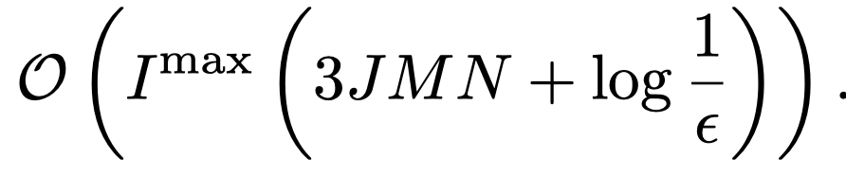
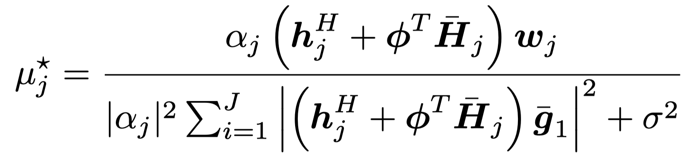
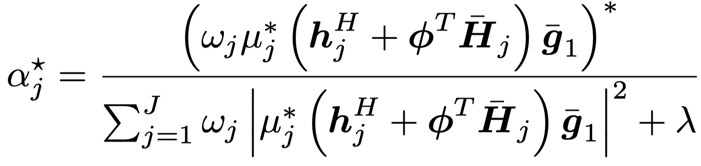
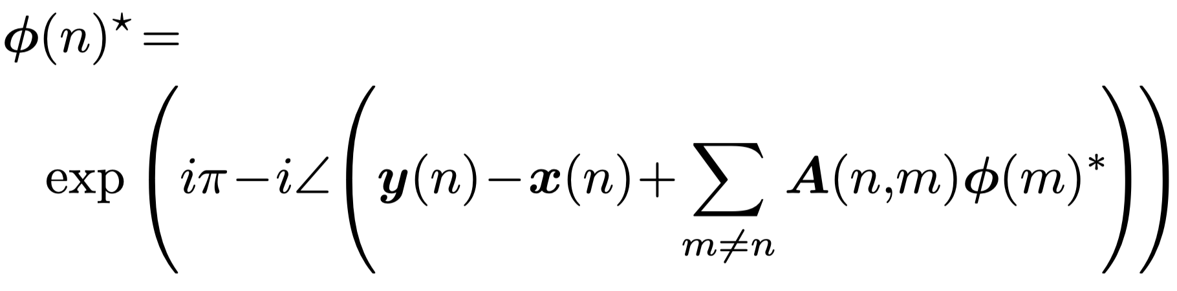
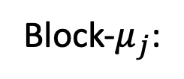
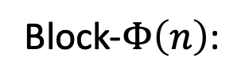
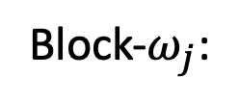
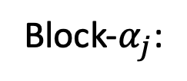
Beamforming Design
Block-wise bilevel-based beamforming design (B³D) algorithm
Block-$ω_{j}$:
Computational complexity:
Block-$μ_{j}$:
Two advantages (compared to existing bilevel algorithms):
Solve this bilevel problem with the lower problem being non-convex;
Have a low computational complexity.
Block-$α_{j}$:
Block-$Φ\left(n\right)$:

Slide 10
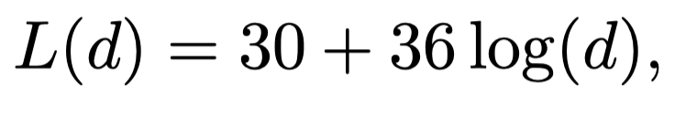
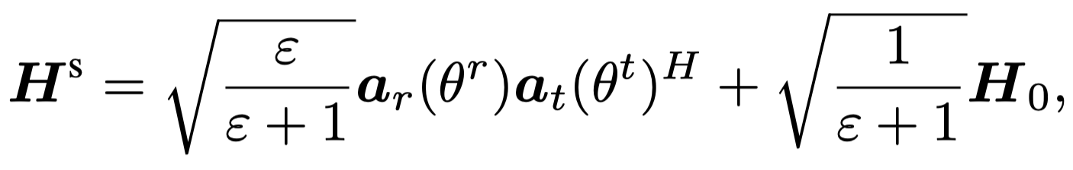
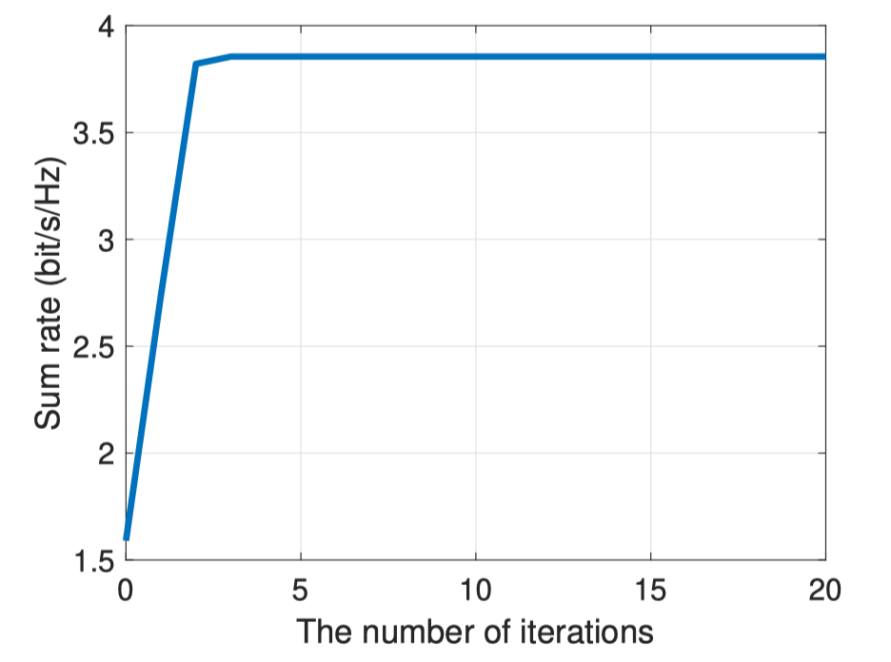
Simulation Results
Simulation setup
The number of
transmit antennas: 12
reflecting elements: 50
EH users (or ID users): 8
Large-scale fading:
Small-scale fading:
Convergence behavior:
The proposed algorithm demonstrates rapid convergence, achieving its result within a few iterations.

Slide 11
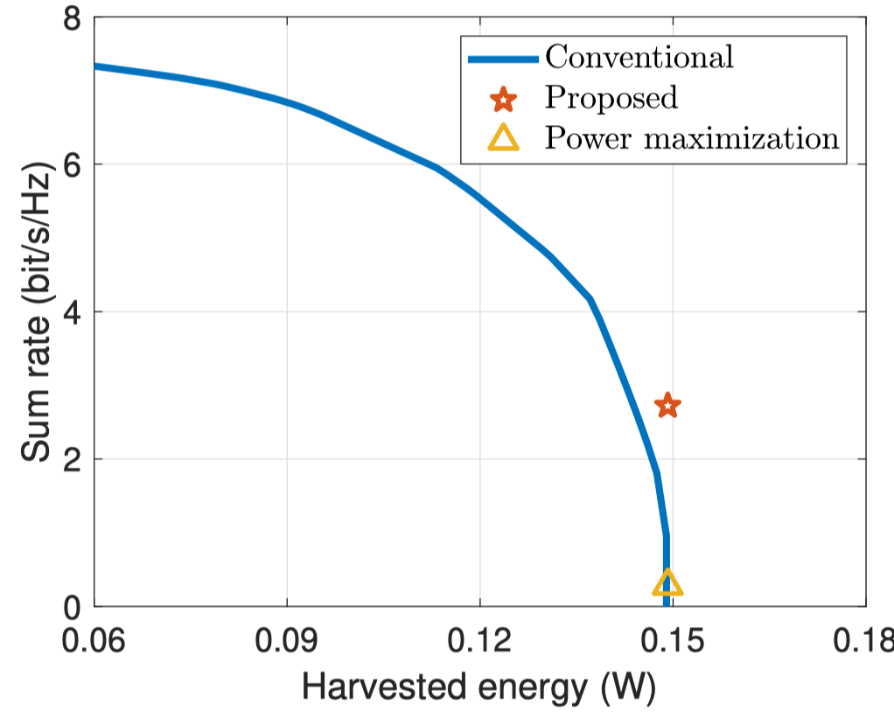
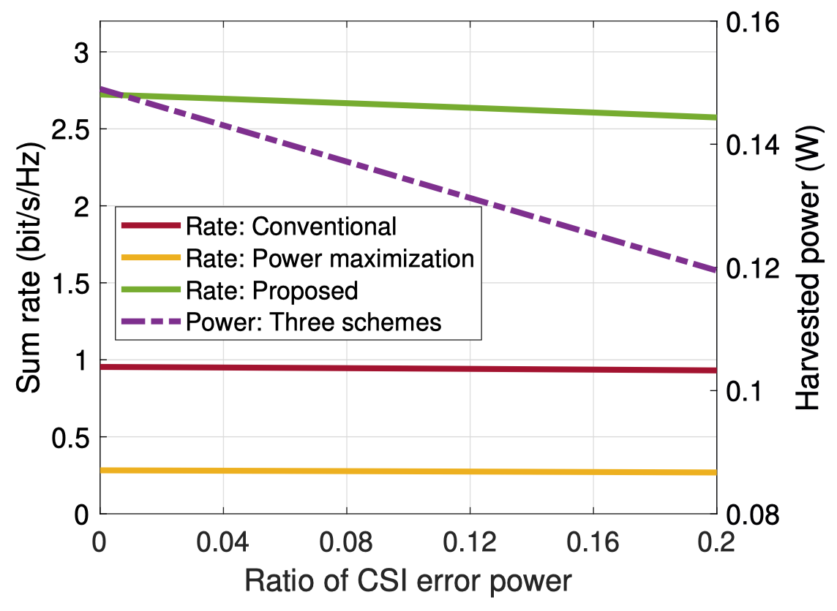
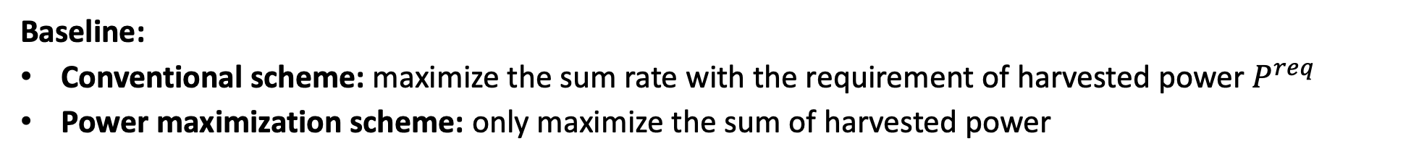
Simulation Results
Performance comparison
Baseline:
Conventional scheme: maximize the sum rate with the requirement of harvested power $P^{req}$
Power maximization scheme: only maximize the sum of harvested power
The obtained point of the proposed algorithm is located at the top right of the curve of the conventional scheme.
The proposed algorithm outperforms baseline algorithms with CSI estimation error.

Slide 12
Conclusion
Introduce bilevel optimization into RIS-assisted SWIPT systems for addressing priority issue;
Develop a B³D algorithm for the formulated bilevel problem:
The optimal set in closed-form for the non-convex lower-level problem;
Low-complexity BCD method for upper-level problem;
Numerical results show that the superiority of the proposed algorithm.

Slide 13

Thank you!

