Slide 1
Damped harmonic oscillator and its statistical distribution
HO, Ho Yi Alexis
Group 301b

Slide 2

Road Map
Goal: explore the behavior of the damped harmonic oscillator
Part I: Without noise ξ
Part II: introduce the noise ξ
Case 1: Without Spring
Case 2: With Spring

Slide 3


Part II: Assumptions of ξ
Set m = 0
mean reversion property: ⟨ξ⟩ = 0
specified autocorrelation function
builds a connection between the noise and the thermal energy

Slide 4


Part II: Extended Derivations of ξ
introduce a new notation
ξi is an independent random noise by our assumption
ζi is an integration of a large number of ξi
each ξi made a minuscule contribution to its integration
ζi follows a normal distribution by Central Limit Theorem

Slide 5

Part II.1 Without the Elastic Force
elastic force confines the range of the particle’s trajectory x(t)
Without the spring’s constraint, the particle will make a random motion instead
mean squared displacement (MSD): a standard measure of the random walk’s spatial extent
If the MSD grows with time, we can conclude the particle moves diffusively

Slide 6
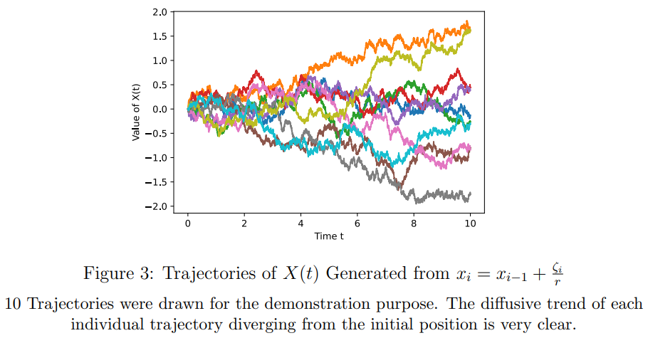

Slide 7
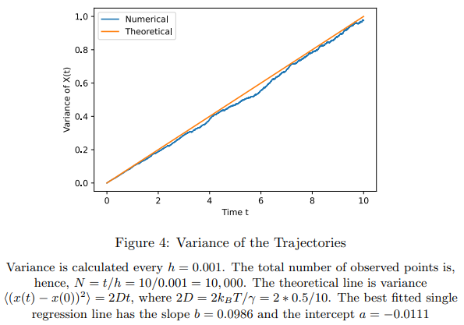

Slide 8


Part II. 2 With the Elastic Force
When there is no noise,
x(t) = 0 is an obvious solution of
It is an equilibrium state where the particle remains still
How about now after the noise is introduced?
Will x(t) = 0 still be an important position?

Slide 9
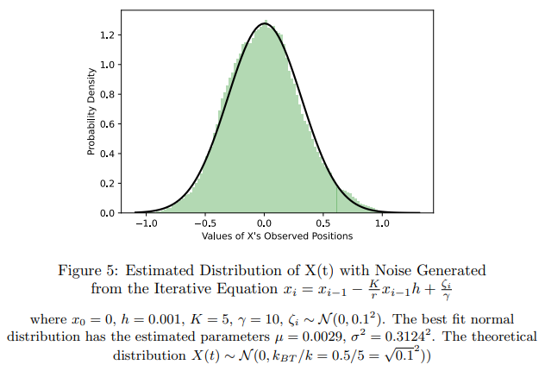

Slide 10
Q & A

Slide 11
Appendix
https://github.com/hyhoAlex/Math_Capstone_Project_Public/blob/main/Math_Capstone_Project_Alexis_11_23.pdf
https://github.com/hyhoAlex/Math_Capstone_Project_Public/blob/main/Math_Capstone_Project_Alexis_Appendix.pdf

