Slide 1

The interplay of internal noise and efficiency in peripheral letter recognition
Hörmet Yiltiz
Sept. 30, 2016

Slide 2
Introduction
Letter identification is harder at the periphery.
Contrast sensitivity and critical spacing.
Buoma law: critical spacing depends only on eccentricity, and not size. (Buoma, 1970)
Threshold variability with and without noise. (Rovamo, J., Franssila, R., & Näsänen, R., 1992)
Decomposing thresholds by adding noise. (Pelli, D. G. & Farell, B., 1999)
Notes:
Pelli, D. G. & Farell, B. (1999) Why use noise? Journal of the Optical Society of America A, 16, 647-653.

Slide 3
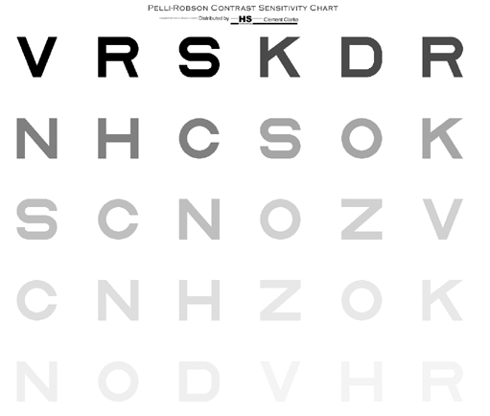

Slide 4
Introduction
Letter identification is harder at the periphery.
Contrast sensitivity and critical spacing.
Buoma law: critical spacing depends only on eccentricity, and not size. (Buoma, 1970)
Threshold variability with and without noise. (Rovamo, J., Franssila, R., & Näsänen, R., 1992)
Decomposing thresholds by adding noise. (Pelli, D. G. & Farell, B., 1999)

Slide 5
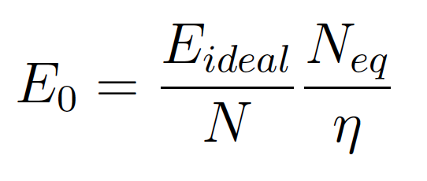
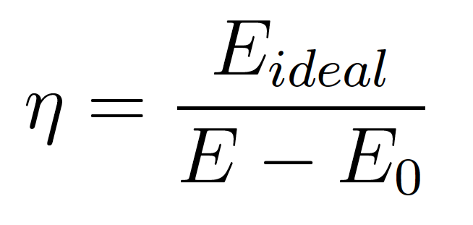
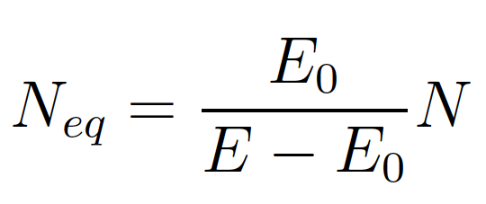
Introduction
Factoring threshold contrast into efficiency and equivalent input noise
Notes:
E Neq = Eo (N + Neq)

Slide 6
Introduction
Ideal observer model: Maximum likelihood estimator given target letter image and all possible letter images.
Notes:
E Neq = Eo (N + Neq)

Slide 7
Methods
Measure threshold contrast
Letter size: 0.5° to 32°
Eccentricity: 0° to 32°
Gaussian white noise
Noise radius: 0 to 32 (global) times letter size.
10-bit-per-channel displays

Slide 8
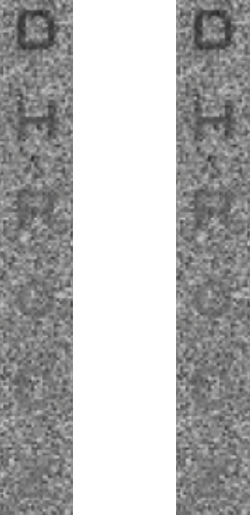
Demo

Slide 9
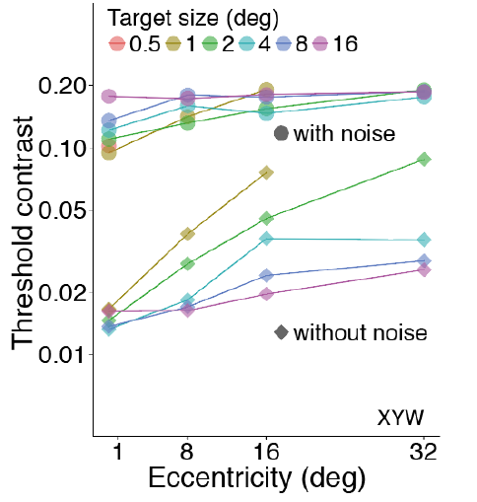
Results
Full-field noise

Slide 10
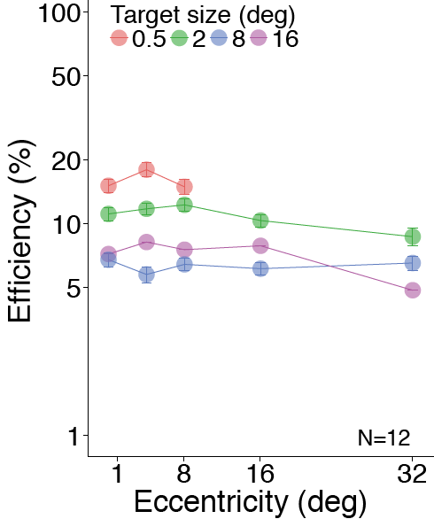
Results
Full-field noise

Slide 11
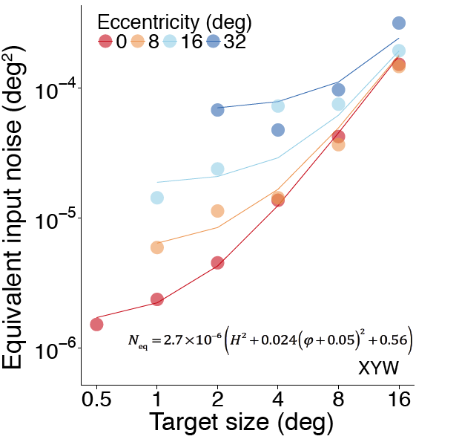
Results
Full-field noise

Slide 12
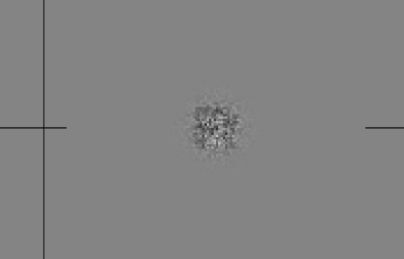
Local noise

Slide 13
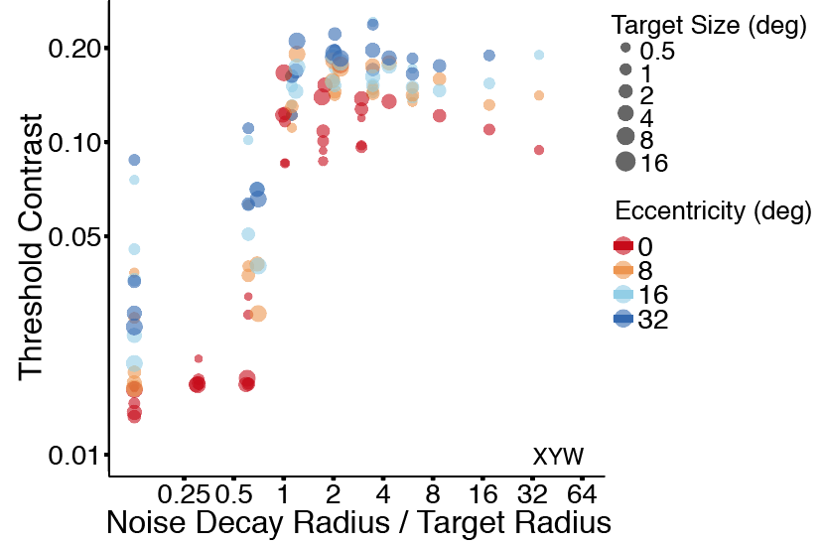
Results
Local noise

Slide 14
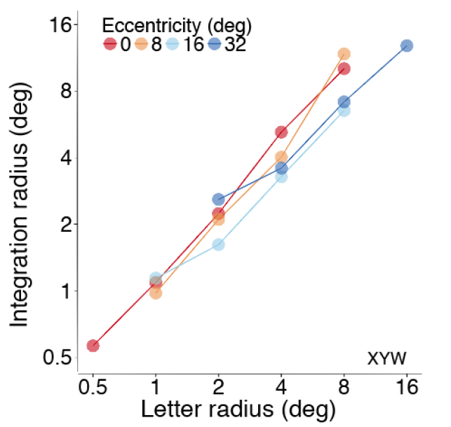
Results
Local noise

Slide 15
Conclusion
Efficiency is weakly dependent on letter size and eccentricity. Pelli, D. G., & Raghavan, M. (2016)
Equivalent input noise is a linear sum of two terms:
  Letter area (deg²): scale-invariant computation
  Eccentricity squared (deg²): some internal noise introduced by neurons
  The area occupied by a fixed number of this neurons increases as the square of eccentricity
Notes:
Scale-invariant computation is also suggested by the weak dependency of efficiency on letter size.
The area occupied by a fixed number of ganglion cells increases as the square of eccentricity.
There is about one ganglion cell for each cone in the fovea. As one moves away from the fovea, retinal ganglion cell spacing increases linearly with eccentricity.

Slide 16
References
Pelli, D. G. & Farell, B. (1999) Why use noise? Journal of the Optical Society of America A, 16, 647-653.
Pelli, D. G., & Raghavan, M. (2016) Photon and cortical noises limit what we see. CoSyNe 2016.
Rovamo, J., Franssila, R., & Näsänen, R. (1992). Contrast sensitivity as a function of spatial frequency, viewing distance and eccentricity with and without spatial noise. Vision research, 32(4), 631-637.
Bouma, H. (1970). Interaction effects in parafoveal letter recognition. Nature, 226(5241), 177–178.
Andrew W. Watson (2014). A formula for human retinal ganglion cell receptive field density as a function of visual field location. Journal of Vision, 14(7), 1–17.
Notes:
Scale-invariant computation is also suggested by the weak dependency of efficiency on letter size.
The area occupied by a fixed number of ganglion cells increases as the square of eccentricity.
There is about one ganglion cell for each cone in the fovea. As one moves away from the fovea, retinal ganglion cell spacing increases linearly with eccentricity.

Slide 17
Thank you!

Slide 18
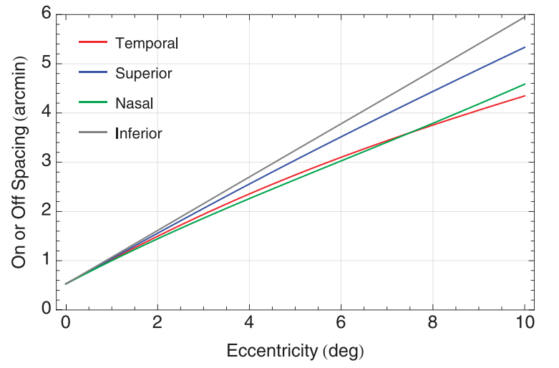
Discussion
Watson, 2014
Notes:
Andrew W. Watson (2014). A formula for human retinal ganglion cell receptive field density as a function of visual field location. Journal of Vision, 14(7), 1–17.

Slide 19
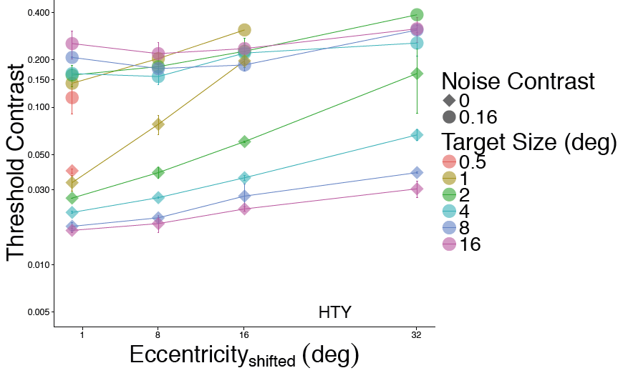
Results
Local noise

Slide 20
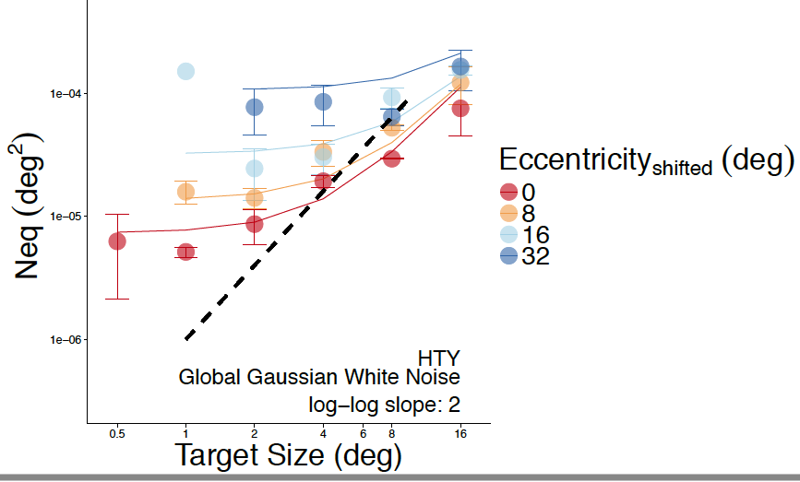
Results
Local noise

