Slide 1
<Contoso Bank>
<Yoojin Ha>
<hyj0522kl994@outlook.com>
Notes:
Please enter project details and your details here.

Slide 2
Computer science & Physcis
Looking UI & Source code
Playing badminton
YooJin Ha
UOA Student
Creative Developer
Practical assessment
Creative Developer
This section is NOT assessed. We just want to get to know you ☺.
Notes:
What your interests / hobbies are
What you are studying
Best part of MSA
What we could improve
Future Goals

Slide 3
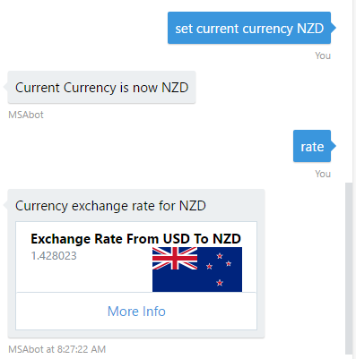
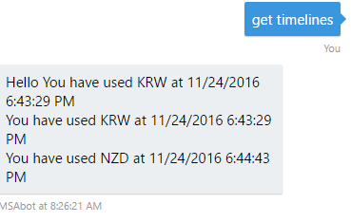
User Experience
Notes:
If you set the current currency , you don’t need to write the name again . Just write “rate”
We could see the current currency history. We could easily see where we go at specific time.

Slide 4
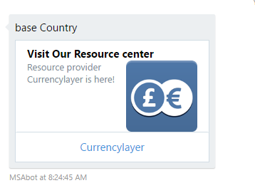
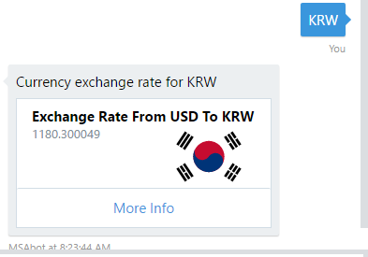
User Interface
Notes:
Easy to see what country ,
Could search more detail with large database program

Slide 5
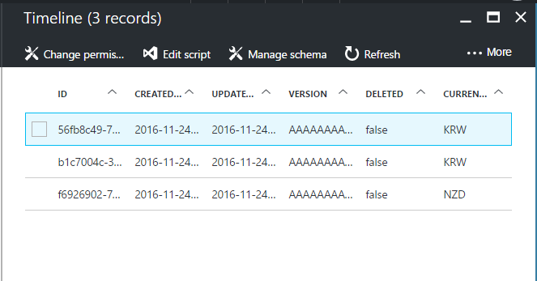
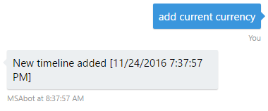
Databases
Notes:
Keep adding the data to Azure easy table, when we put add

Slide 6
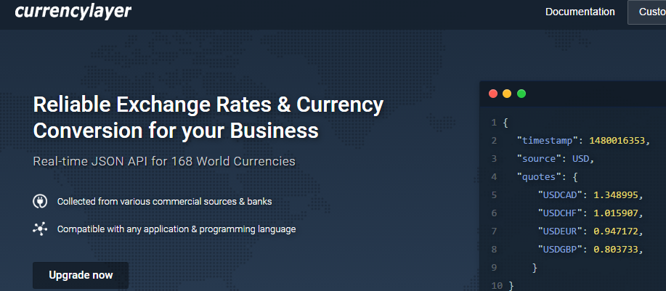
API
Notes:
Once you know exchage rates, and could record the rates, comparing, tracking,,,,
Important factor in Bank

Slide 7
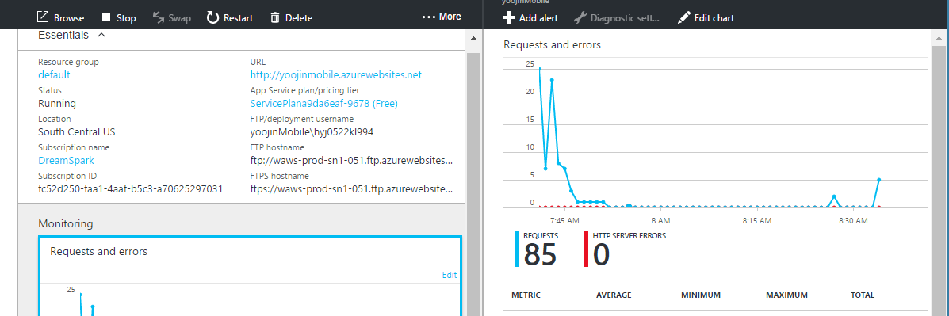
Azure Setup
Notes:
Explain your Azure features here

Slide 8
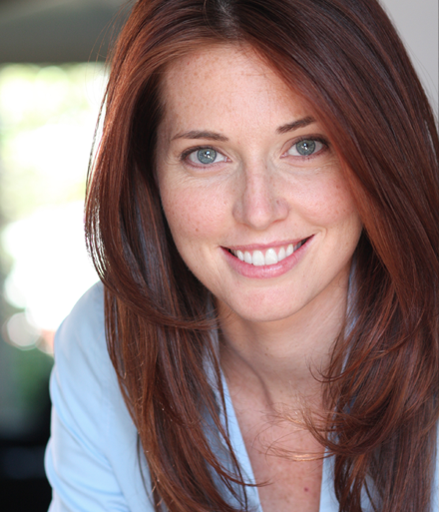
Personal & scenario for Demo
Christy Kim
Working in trading company
Frequent business travel
perfectionist
Living in USA
have to transfer money to children
Mobile user
She is checking exchange rate one of her consumer company in New zealand to go business trip. Also checking Korea where child study in.
And she will going to stay more than 2 month is New Zealand therefore she may want to set NZD for current currency that making easier to check next time.
http://howtochow.com/about/
Notes:
Any final things you want to tell us

Slide 9
