Slide 1
SATELLITE MANAGEMENT SYSTEM
DDD + Hexagonal Architecture + ArchUnit
Complete Architectural Blueprint, Codebase Mapping, & Presentation Deck

Slide 2
PART 1 — DOMAIN-DRIVEN DESIGN
Domain-Driven Design (DDD): What & Why
What is Domain-Driven Design (DDD)?
• A software design approach focused on modeling software to match a complex business domain.
• Formulated by Eric Evans, it connects business experts and developers using a Ubiquitous Language.
Why Do We Need DDD?
• Eliminates Anemic Domain Models: Data objects are no longer dumb getters/setters; rules live in the domain.
• Bridges Communication Gap: Developers and business stakeholders use identical terminology.
• Prevents Architectural Decay: Isolates business rules so infrastructure changes don't corrupt domain logic.

Slide 3
PART 1 — DOMAIN-DRIVEN DESIGN
DDD Components in Satellite System
• Aggregate Root (Satellite.java):
Core entity managing state machine (REGISTERED -> ACTIVE -> ANOMALY -> DECOMMISSIONED) & invariant enforcement.
• Value Objects (Orbit.java, Telemetry.java):
Immutable JDK records with self-validation rules (LEO/GEO altitude checks, anomaly battery/temp thresholds).
• Domain Events (SatelliteLaunchedEvent, AnomalyDetectedEvent):
Immutable records representing facts that occurred in the domain, recorded internally by the aggregate.
• Strongly-Typed Identity (SatelliteId.java):
Record wrapping UUID to prevent primitive obsession and guarantee type safety across layers.

Slide 4
PART 1 — DOMAIN-DRIVEN DESIGN
How to Implement DDD & Challenges
How to Implement DDD in Java 21:
1. Pure Java Domain Model: Zero imports from Spring, JPA, or Jackson in com.satellite.domain.
1. Java 21 Records: Use records for Value Objects and Domain Events to guarantee immutability.
1. State Machine Encapsulation: Keep status transition logic private inside Satellite.java.
Challenges & Mitigations:
• Initial Learning Curve -> Start with clear Bounded Contexts & Ubiquitous Language glossary.
• Over-engineering simple CRUD -> Use DDD for core business domains; keep simple lookup tables light.
• ORM Entity vs Domain Entity confusion -> Explicitly separate SatelliteJpaEntity from Satellite.java aggregate.

Slide 5
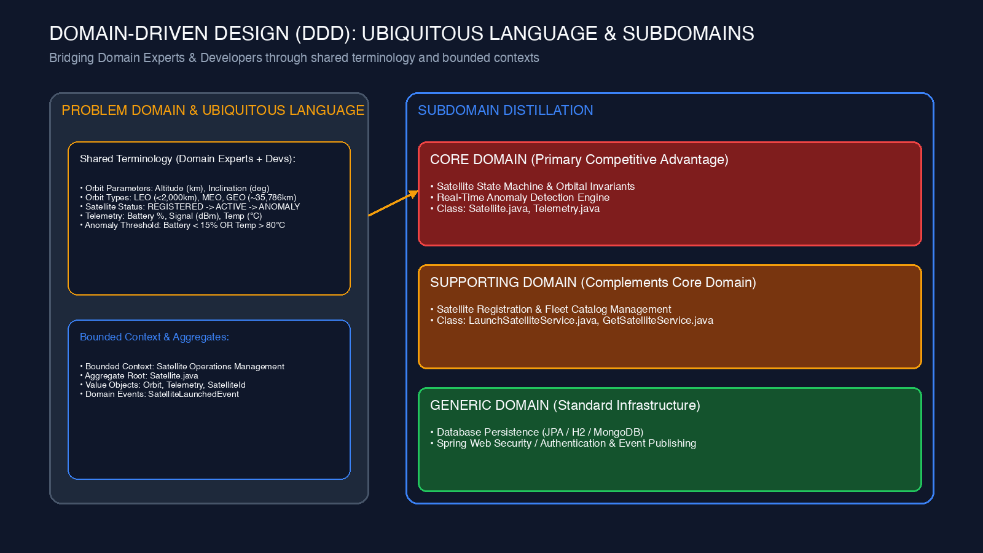
PART 1 — DOMAIN-DRIVEN DESIGN
DDD Ubiquitous Language & Subdomains Diagram

Slide 6
PART 2 — HEXAGONAL ARCHITECTURE
Hexagonal Architecture (Ports & Adapters): What & Why
What is Hexagonal Architecture?
• An architectural pattern created by Alistair Cockburn that isolates core application logic inside a Hexagon.
• Uses Ports (Interfaces) and Adapters (Implementations) so inputs and outputs can be plugged in seamlessly.
Why Do We Need Hexagonal Architecture?
• Decouples Business Logic from External Tools: Database, Web Frameworks, and MQ live outside the Hexagon.
• Enables Instant Testing: Domain logic is 100% testable in pure Java without booting Spring or DB (0.01s test execution).
• Prevents Technology Lock-in: Swap relational database (H2/Postgres) for MongoDB without changing domain code.

Slide 7
PART 2 — HEXAGONAL ARCHITECTURE
Hexagonal Components in Satellite System
• Driving Adapters (Inputs):
SatelliteController.java (REST API) & TelemetryConsumer.java (Kafka/CLI stream).
• Driving Ports (Inbound Contracts):
LaunchSatelliteUseCase.java & UpdateTelemetryUseCase.java (Interfaces defined in domain.port.in).
• Application Core:
LaunchSatelliteService.java — Orchestrates domain objects via ports in pure Java.
• Driven Ports (Outbound Contracts):
SatelliteRepository.java & SatelliteEventPublisher.java (Interfaces defined in domain.port.out).
• Driven Adapters (Outputs):
SatelliteJpaAdapter.java (SQL), SatelliteMongoAdapter.java (NoSQL), & SatelliteEventPublisherAdapter.java.

Slide 8
PART 2 — HEXAGONAL ARCHITECTURE
How to Implement Hexagonal Architecture & Challenges
How to Implement Hexagonal Architecture:
1. Package Structure: com.satellite.domain, com.satellite.application, com.satellite.infrastructure.
1. Inward Dependencies: Infrastructure depends on Application & Domain; Domain depends on NOTHING.
1. Bean Composition Root: Wire services and adapters in BeanConfig.java inside infrastructure package.
Challenges & Mitigations:
• Mapping Overhead (Domain <-> DTO <-> JPA Entity) -> Solved with dedicated mappers (SatellitePersistenceMapper).
• More interfaces & classes -> Solved by clear package isolation (ports/in, ports/out).
• Risk of developers bypassing ports -> Solved by ArchUnit automated architecture build gates!

Slide 9
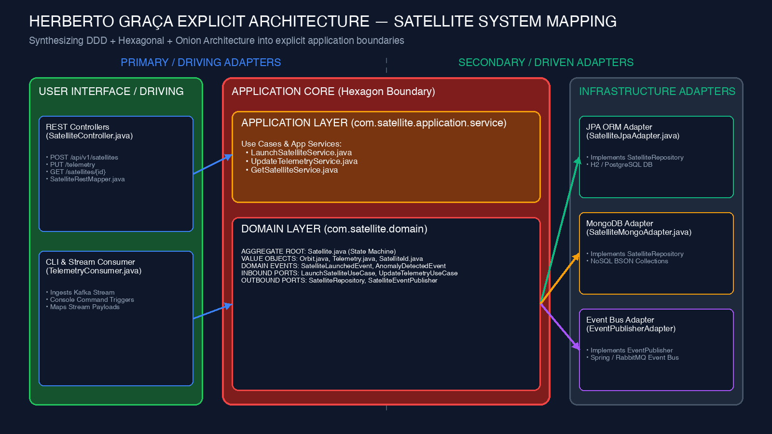
PART 2 — HEXAGONAL ARCHITECTURE
Herberto Graça Explicit Architecture Mapping

Slide 10
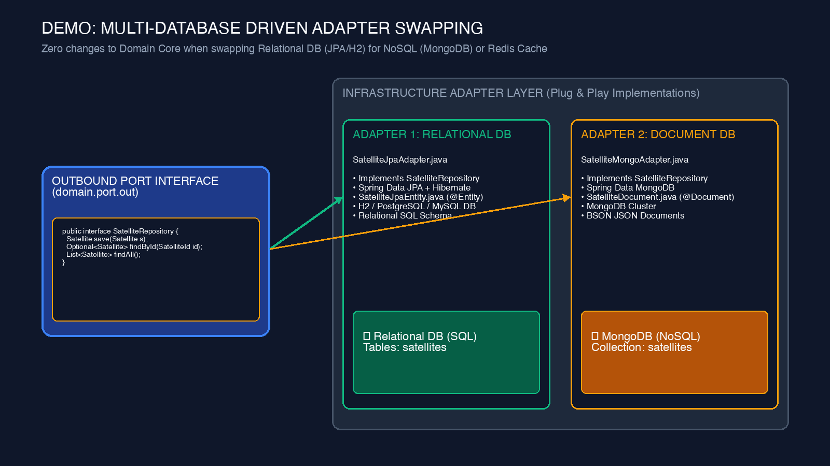
PART 2 — HEXAGONAL ARCHITECTURE
Multi-Database Adapter Swapping (SQL vs NoSQL)

Slide 11
PART 3 — ARCHUNIT ENFORCEMENT
ArchUnit Architecture Enforcement: What & Why
What is ArchUnit?
• A Java architecture testing library that checks Java bytecode (.class files) using fluent JUnit 5 tests.
• Analyzes package dependencies, class naming conventions, annotation rules, and layer isolation.
Why Do We Need ArchUnit?
• Automates Code Reviews: Architecture rules are checked on every commit in CI/CD pipelines.
• Prevents Architectural Erosion: Prevents quick shortcuts (e.g. Controller calling DB Repository directly).
• Runs as a Pre-Packaging Build Gate: Executes during mvn test — FAILS THE BUILD before packaging or deployment!

Slide 12
PART 3 — ARCHUNIT ENFORCEMENT
ArchUnit Rules & Build Gates in Satellite System
• Domain Purity Rule:
noClasses().that().resideInAPackage('..domain..').should().dependOnClassesThat().resideInAPackage('..infrastructure..')
• No Spring/JPA in Domain:
noClasses().that().resideInAPackage('..domain.model..').should().beAnnotatedWith('..Entity')
• Controller Port Constraint:
noClasses().that().resideInAPackage('..rest..').should().dependOnClassesThat().resideInAPackage('..application..')
• Layered Architecture Rule:
layeredArchitecture().layer('Domain').layer('Application').layer('Infrastructure')

Slide 13
PART 3 — ARCHUNIT ENFORCEMENT
How to Implement ArchUnit & Challenges
How to Implement ArchUnit:
1. Add Maven Dependency: archunit-junit5 (v1.3.0) in pom.xml.
1. Write Test Class: Annotate with @AnalyzeClasses(packages = 'com.satellite').
1. Define Rules: Write static @ArchTest rules using ArchRuleDefinition DSL.
1. Lifecycle Execution: Executes automatically post-compilation during mvn test before packaging!
Challenges & Mitigations:
• Retrofitting onto legacy codebases -> Solved with FreezingArchRule to freeze existing violations.
• Refactoring package structures -> Update package string variables in HexagonalArchitectureTest.java.

Slide 14
SUMMARY & LIVE DEMO
Execution & Live Demo Steps
1. Run Automated Test Suite & ArchUnit Build Gates:
$ mvn clean test # Executes 37 unit, integration & ArchUnit tests (0 failures)
2. Run Spring Boot Application & API Verification:
$ mvn spring-boot:run $ curl -X POST http://localhost:8080/api/v1/satellites -d '{...}'
3. Live Layer Conflict Demo (ArchUnit Build Failure):
• Inject LaunchSatelliteService into SatelliteController.java • Run mvn test -> ArchUnit FAILS THE BUILD with explicit violation error report!

