Slide 1
AI Drug Discovery for COVID-19
Kevin Liu, Ethan Liu, Byron Li, Fang Zhu, Max Fan

Slide 2
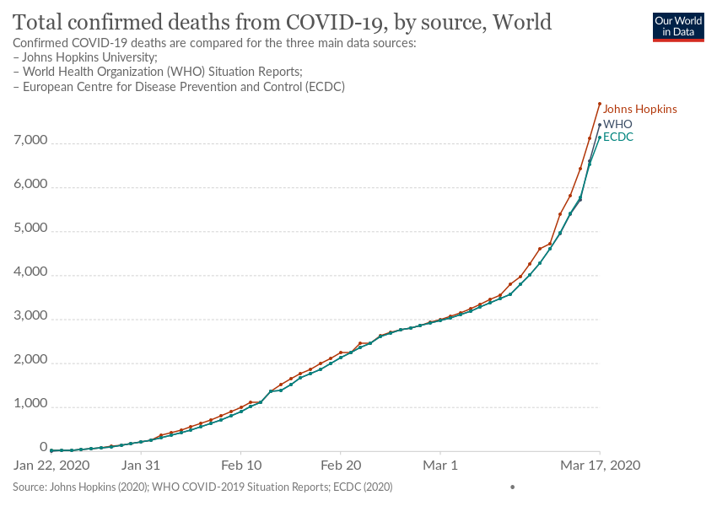
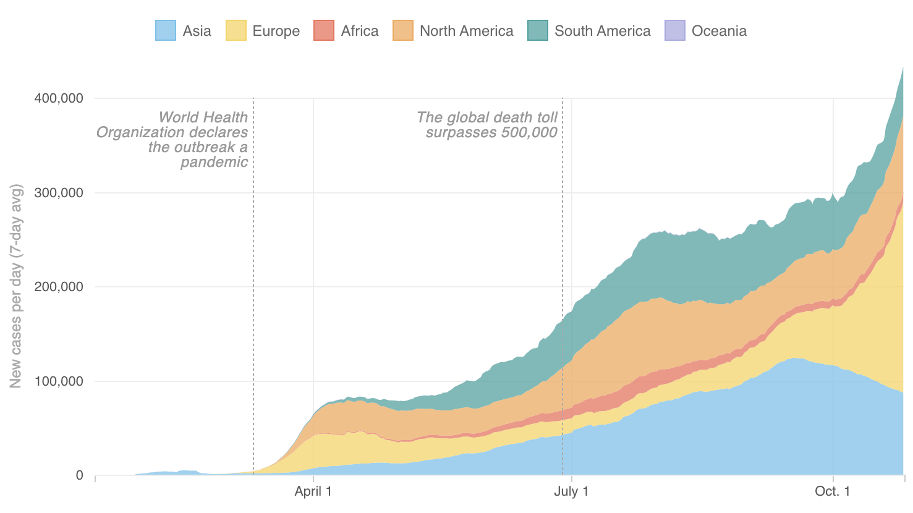
Problem / Background
The extremely quick outbreak of covid-19 led to a global shutdown, as well as millions of cases and deaths
There currently are no drugs for the treatment of covid-19

Slide 3
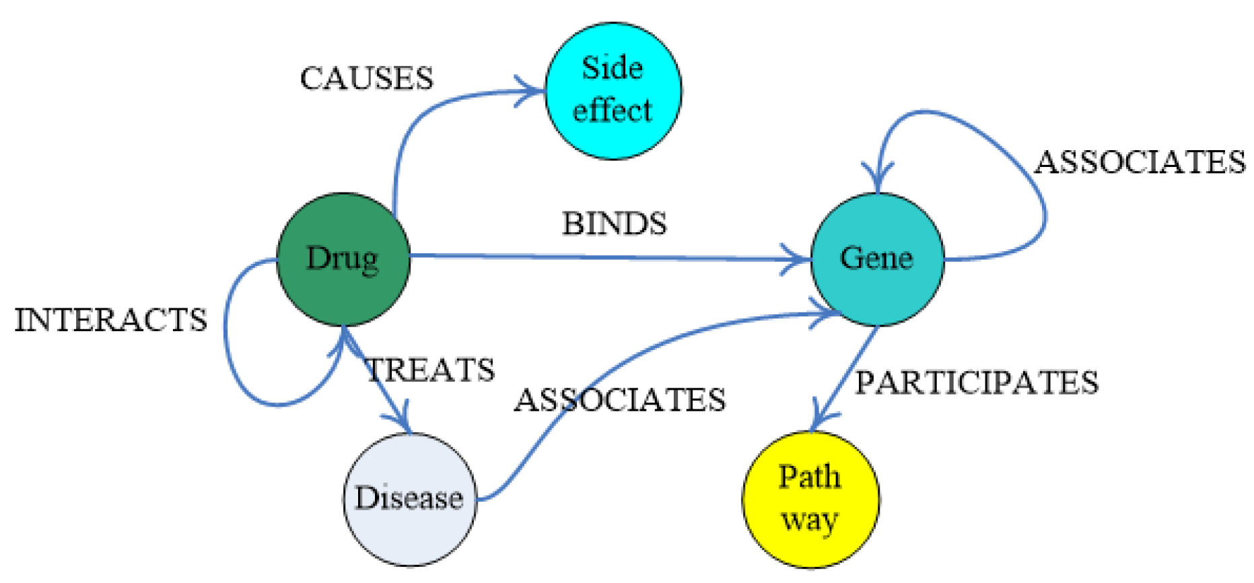
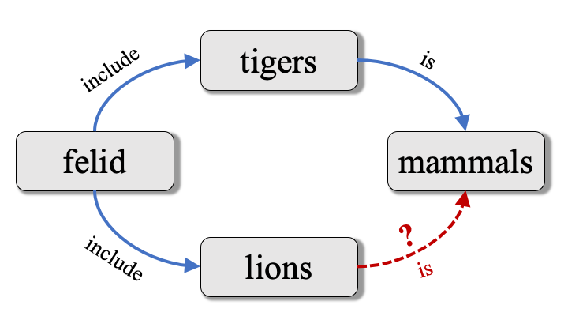
Solution
With a dataset of different drugs and their relationships with each other, we can train a neural network to identify various similarities. One application of this is to find drugs that can be repurposed to treat COVID-19
Notes:
We decided to use KGC to find repurposing candidates for covid 19. KGC is predicting new relations between concepts with information we already have. We’ll use this to predict whether some existing drugs have a relation with covid-19

Slide 4
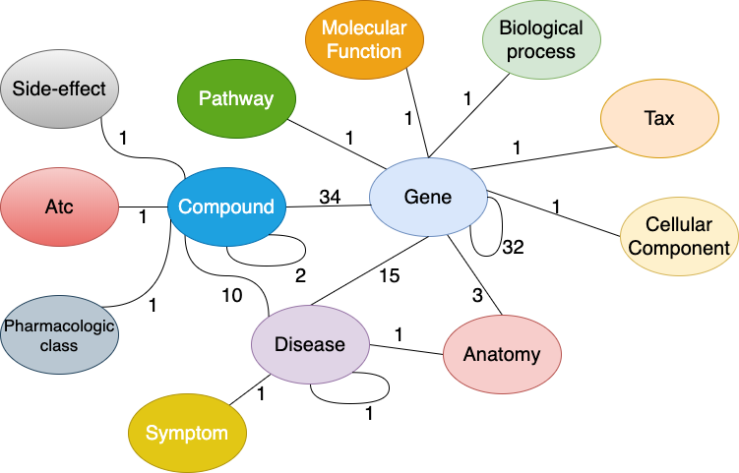
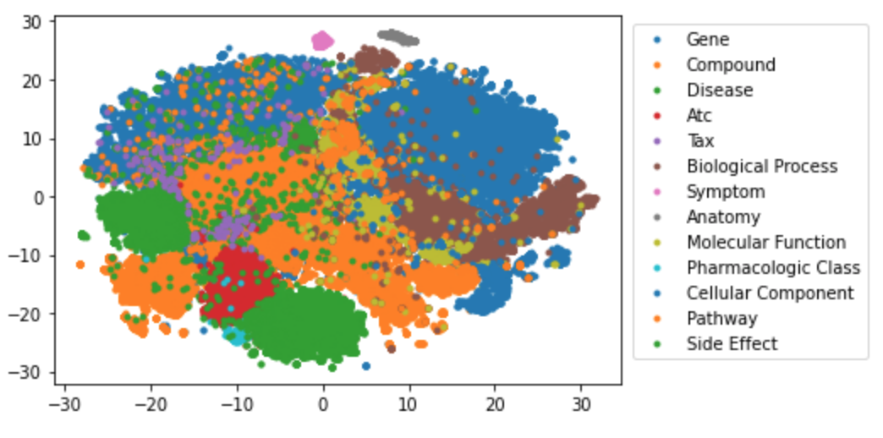
Dataset
Drug Repurposing Knowledge Graph (DRKG) is a large biological knowledge graph that combines info from various medical databases to relate genes, compounds, diseases, biological processes, side effects and symptoms.
DRKG contains a vast amount of nodes and edge types that identify relationships between drugs.
Notes:
The KG we used was made from data primarily from SemMedDB, but also recent publications. It’s an incredibly extensive graph that includes drugs, diseases, symptoms, side effects, and many many relations.

Slide 5
Algorithm
We tested the effectiveness of TransE, RotatE, DistMult, and ComplEx scoring functions in multiple link prediction models.
An open discovery pattern was used to find drugs that interacted with concepts related to covid-19
Through evaluation, we found transE to have the best results.
Notes:
We tested many different models and found that TransE worked the best. Meaning, it was the most efficient

Slide 6
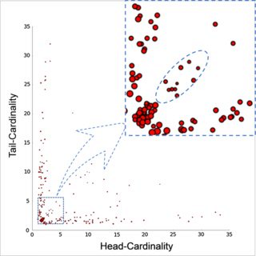
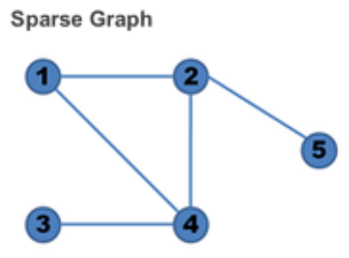
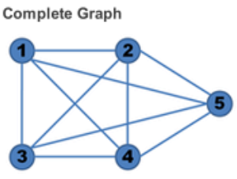
Embeddings
We generated an embedding for DRKG is trained using the TransE_l2 model with dimension size of 400. TransE uses relationship triplets (h, r, t) to convert a graph into a vector that can be analysed
Original Dataset
Generated Embedding
TransE 12 Model
Notes:
We generated an embedding for this big DRKG dataset with the TransE 12 model.
The Original DRKG is a sparse graph: drugs and diseases are only related if the drug has been tested to treat the disease.
The embedding we generate uses ML to generate weighted links between every drug and every disease so that we can find the probability a pre-existing drug can be repurposed to treat a new disease

Slide 7
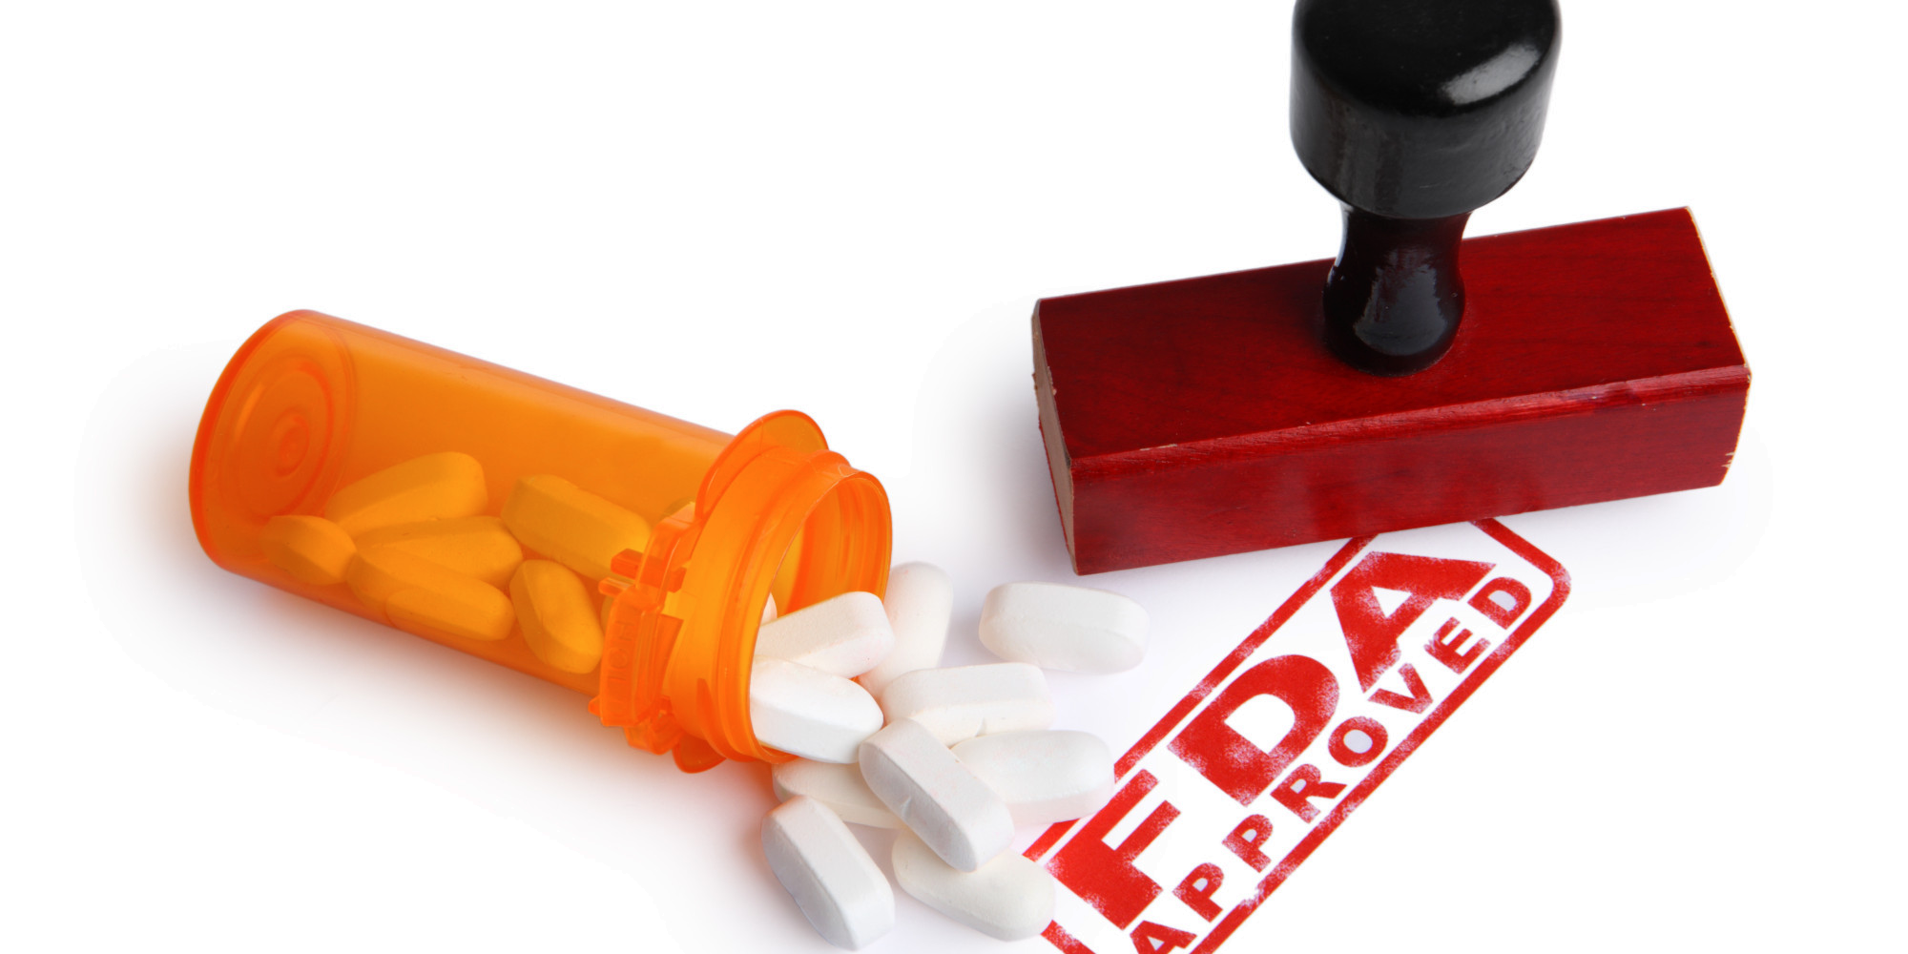
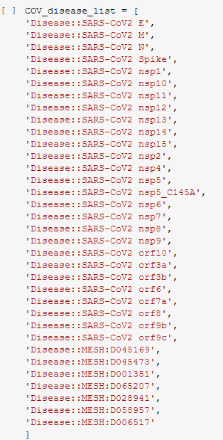
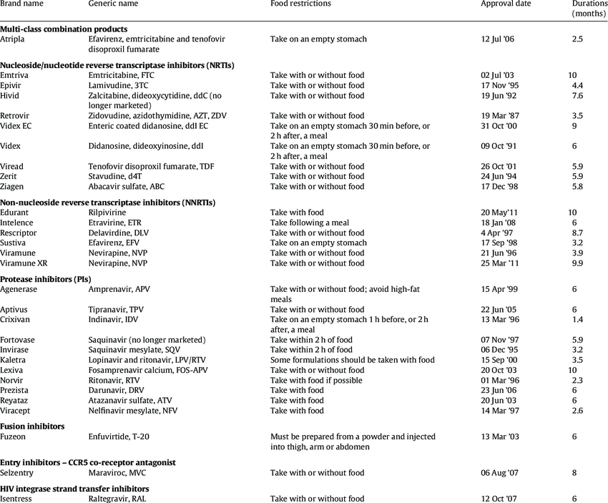

Repurposing
We used the generated embeddings to find drugs that could possible treat COVID 19
H
Drug
R
Strength of relationship
T
Disease
COVID
H
Drug
R
Strength of relationship
List of possible treatments
Drug → disease
Analyse strength of relationship
List of coronavirus-related diseases to target
FDA approved drugs

Slide 8
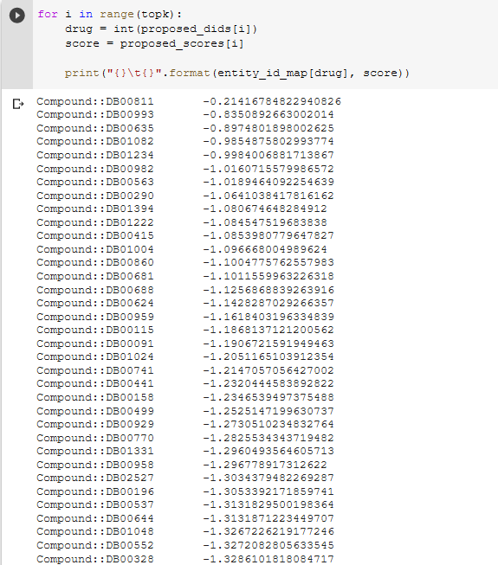
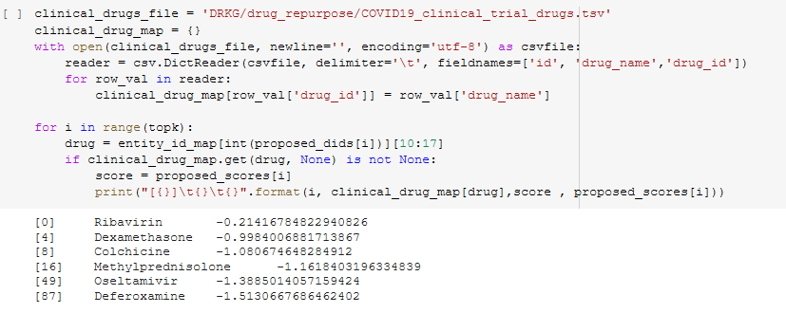
Results
Out of top 100 candidates, 6/100 are already in clinical trials for COVID-19. This is a much more effective way of finding new drugs then current techniques
Top 100 strongest links
Notes:
These are really impressive results because it proves the model’s effectiveness at finding new drugs to repurpose: 6 out the 100 drugs have been proven to be effective and many more out of this top 100 list could potential be of use. By repurposing drugs we can cut down on development and production time, getting drugs to people quicker and helping to save lives drug discovery

Slide 9
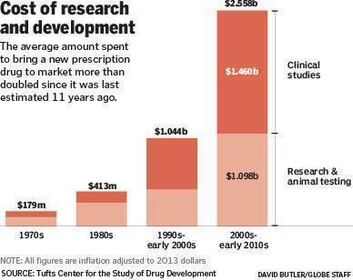
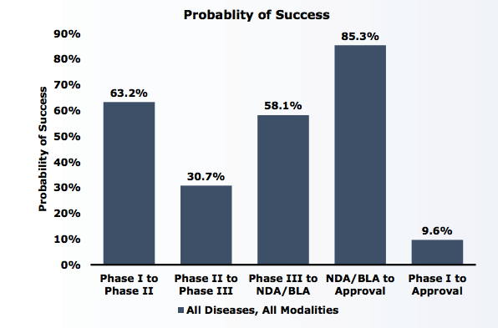
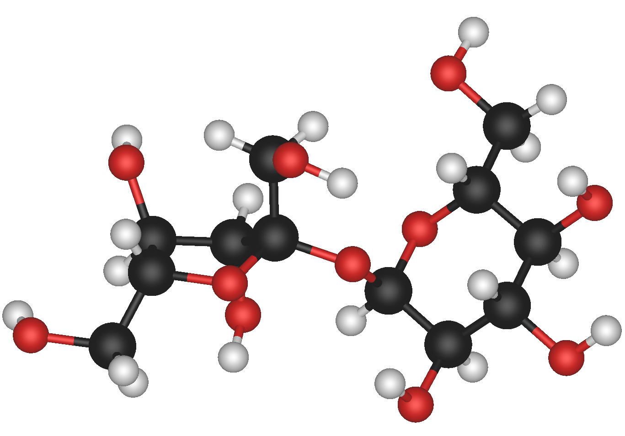
Impact
Repurposing of existing drugs
Increased Success Rates
New and Innovative Drugs

