Slide 1
Drug Repurposing for Covid-19
July 2021

Slide 2
Agenda
Background
Modeling Question

Slide 3
Background
Covid-19
Vaccine
Pfizer/BioNtech, 31 December 2020.
SII/Covishield and AstraZeneca/AZD1222 vaccines, 16 February 2021
Janssen/Ad26.COV 2.S, 12 March 2021
Moderna COVID-19 vaccine (mRNA 1273), 30 April 2021
Sinopharm COVID-19 vaccine, 7 May 2021
Sinovac-CoronaVac, 1 June 2021.
Therapy development and approval of an effective antiviral therapy remains a risky, costly, and time-consuming process. In the absence of effective therapies, there have been significant efforts in repurposing drugs approved for other diseases for COVID-19 treatment (dexamethasone, hydroxychloroquine, lopinavir/ritonavir, remdesivir(approved for patients hospitalized))

Slide 4
Background
Computational approaches to drug repurposing have also garnered much attention to accelerate discovery of therapies for COVID-19
drug signature matching
Molecular docking
genome-wide association studies
network analysis
These data-driven approaches involve systematic analysis of various types of biological and clinical data (e.g., gene expression, chemical structure, genome and protein sequences, and electronic health records) to generate hypotheses regarding repurposed use of approved or investigational drug
The potential of recent advances in AI and ML for COVID-19 has been highlighted and several studies using these techniques have reported promising results
Network medicine principles
Biological knowledge graphs
Literature-based discovery approach for COVID-19 drug repurposing casts drug repurposing as a task of knowledge graph completion (or link prediction).

Slide 5
Modeling Question
Computational approaches to drug repurposing have also garnered much attention to accelerate discovery of therapies for COVID-19
drug signature matching
Molecular docking
genome-wide association studies
network analysis
These data-driven approaches involve systematic analysis of various types of biological and clinical data (e.g., gene expression, chemical structure, genome and protein sequences, and electronic health records) to generate hypotheses regarding repurposed use of approved or investigational drug
The potential of recent advances in AI and ML for COVID-19 has been highlighted and several studies using these techniques have reported promising results
Network medicine principles
Biological knowledge graphs
Literature-based discovery approach for COVID-19 drug repurposing casts drug repurposing as a task of knowledge graph completion (or link prediction).

Slide 6
Modeling Question
Modeling Question: biomedical knowledge graph
Data:
SemMedDB/PubMed bibliographic database
Covid-19 research literature
Methodology:
Neural network-based algorithms for knowledge graph
Discovery patterns
Results: it can identify known drugs that have been used for COVID-19 and discover other novel drugs that can potentially be repurposed for COVID-19

Slide 7
Introduction_CCAR Scenarios
Objective: to discover candidate drugs to repurpose for COVID-19 using literature-derived knowledge and knowledge graph completion methods
Methods:We propose a novel, integrative, and neural network-based literature-based discovery (LBD) approach to identify drug candidates from PubMed and other COVID-19-focused research literature. Our approach relies on semantic triples extracted using SemRep (via SemMedDB). We identified an informative and accurate subset of semantic triples using filtering rules and an accuracy classifier developed on a BERT variant. We used this subset to construct a knowledge graph, and applied five state-of-the-art, neural knowledge graph completion algorithms (i.e., TransE, RotatE, DistMult, ComplEx, and STELP) to predict drug repurposing candidates. The models were trained and assessed using a time slicing approach and the predicted drugs were compared with a list of drugs reported in the literature and evaluated in clinical trials. These models were complemented by a discovery pattern-based approach.
In general, the baseline scenario will reflect the most recently available consensus views of the macroeconomic outlook expressed by professional forecasters, government agencies, and other public-sector organizations as of the beginning of the stress-test cycle. The severely adverse scenario will consist of a set of economic and financial conditions that reflect the conditions of post-war U.S. recessions.

Slide 8
Introduction_CCAR Scenarios
Results: Accuracy classifier based on PubMedBERT achieved the best performance (F₁ = 0.854) in identifying accurate semantic predications. Among five knowledge graph completion models, TransE outperformed others (MR = 0.923, Hits@1 = 0.417). Some known drugs linked to COVID-19 in the literature were identified, as well as others that have not yet been studied. Discovery patterns enabled identification of additional candidate drugs and generation of plausible hypotheses regarding the links between the candidate drugs and COVID-19. Among them, five highly ranked and novel drugs (i.e., paclitaxel, SB 203580, alpha 2-antiplasmin, metoclopramide, and oxymatrine) and the mechanistic explanations for their potential use are further discussed.
We showed that a LBD approach can be feasible not only for discovering drug candidates for COVID-19, but also for generating mechanistic explanations. Our approach can be generalized to other diseases as well as to other clinical questions.
In general, the baseline scenario will reflect the most recently available consensus views of the macroeconomic outlook expressed by professional forecasters, government agencies, and other public-sector organizations as of the beginning of the stress-test cycle. The severely adverse scenario will consist of a set of economic and financial conditions that reflect the conditions of post-war U.S. recessions.

Slide 9
Introduction_Recession
4.2.1 General Approach: The Recession Approach
The Board intends to use a recession approach to develop the severely adverse scenario. In the recession approach, the Board will specify the future paths of variables to reflect conditions that characterize post-war U.S. recessions, generating either a typical or specific recreation of a post-war U.S. recession. The Board chose this approach because it has observed that the conditions that typically occur in recessions - such as increasing unemployment, declining asset prices, and contracting loan demand - can put significant stress on companies' balance sheets. This stress can occur through a variety of channels, including higher loss provisions due to increased delinquencies and defaults; losses on trading positions through sharp moves in market prices; and lower bank income through reduced loan originations. For these reasons, the Board believes that the paths of economic and financial variables in the severely adverse scenario should, at a minimum, resemble the paths of those variables observed during a recession.
This approach requires consideration of the type of recession to feature. All post-war U.S. recessions have not been identical: Some recessions have been associated with very elevated interest rates, some have been associated with sizable asset price declines, and some have been relatively more global. The most common features of recessions, however, are increases in the unemployment rate and contractions in aggregate incomes and economic activity. For this and the following reasons, the Board intends to use the unemployment rate as the primary basis for specifying the severely adverse scenario. First, the unemployment rate is likely the most representative single summary indicator of adverse economic conditions. Second, in comparison to GDP, labor market data have traditionally featured more prominently than GDP in the set of indicators that the National Bureau of Economic Research reviews to inform its recession dates. 11 Third and finally, the growth rate of potential output can cause the size of the decline in GDP to vary between recessions. While changes in the unemployment rate can also vary over time due to demographic factors, this seems to have more limited implications over time relative to changes in potential output growth. The unemployment rate used in the severely adverse scenario will reflect an unemployment rate that has been observed in severe post-war U.S. recessions, measuring severity by the absolute level of and relative increase in the unemployment rate. 12

Slide 10
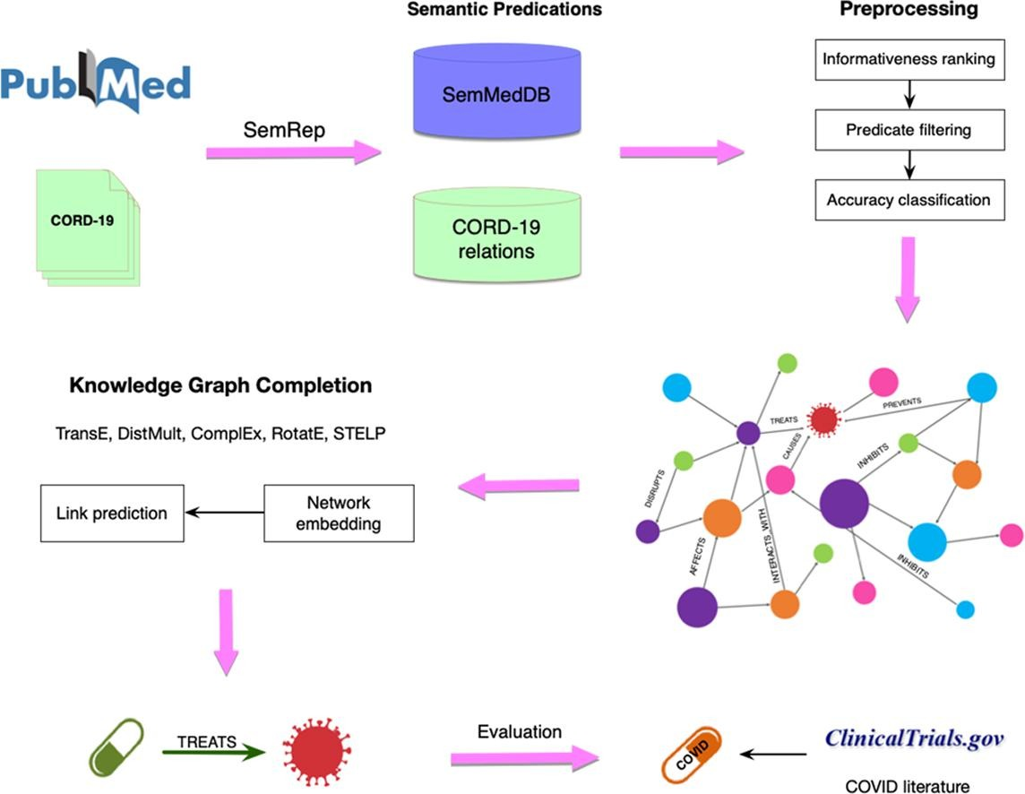
Introduction_Baseline

Slide 11
Literature-based discovery(LBD)
Literature-based discovery(LBD) is a method of automatic hypothesis generation based on the concept of “undiscovered public knowledge“. LBD seeks to uncover valuable hidden connections between disparate research literatures, and has been proposed as a potential solution for the problem of “research silos" (the view that scientfic research areas are largely isolated from one another).
Drug repurposing has been one of the prominent applications of LBD
In general, the baseline scenario will reflect the most recently available consensus views of the macroeconomic outlook expressed by professional forecasters, government agencies, and other public-sector organizations as of the beginning of the stress-test cycle. The severely adverse scenario will consist of a set of economic and financial conditions that reflect the conditions of post-war U.S. recessions.

Slide 12
Introduction_Recession
4.2.1 General Approach: The Recession Approach
The Board intends to use a recession approach to develop the severely adverse scenario. In the recession approach, the Board will specify the future paths of variables to reflect conditions that characterize post-war U.S. recessions, generating either a typical or specific recreation of a post-war U.S. recession. The Board chose this approach because it has observed that the conditions that typically occur in recessions - such as increasing unemployment, declining asset prices, and contracting loan demand - can put significant stress on companies' balance sheets. This stress can occur through a variety of channels, including higher loss provisions due to increased delinquencies and defaults; losses on trading positions through sharp moves in market prices; and lower bank income through reduced loan originations. For these reasons, the Board believes that the paths of economic and financial variables in the severely adverse scenario should, at a minimum, resemble the paths of those variables observed during a recession.
This approach requires consideration of the type of recession to feature. All post-war U.S. recessions have not been identical: Some recessions have been associated with very elevated interest rates, some have been associated with sizable asset price declines, and some have been relatively more global. The most common features of recessions, however, are increases in the unemployment rate and contractions in aggregate incomes and economic activity. For this and the following reasons, the Board intends to use the unemployment rate as the primary basis for specifying the severely adverse scenario. First, the unemployment rate is likely the most representative single summary indicator of adverse economic conditions. Second, in comparison to GDP, labor market data have traditionally featured more prominently than GDP in the set of indicators that the National Bureau of Economic Research reviews to inform its recession dates. 11 Third and finally, the growth rate of potential output can cause the size of the decline in GDP to vary between recessions. While changes in the unemployment rate can also vary over time due to demographic factors, this seems to have more limited implications over time relative to changes in potential output growth. The unemployment rate used in the severely adverse scenario will reflect an unemployment rate that has been observed in severe post-war U.S. recessions, measuring severity by the absolute level of and relative increase in the unemployment rate. 12

Slide 13
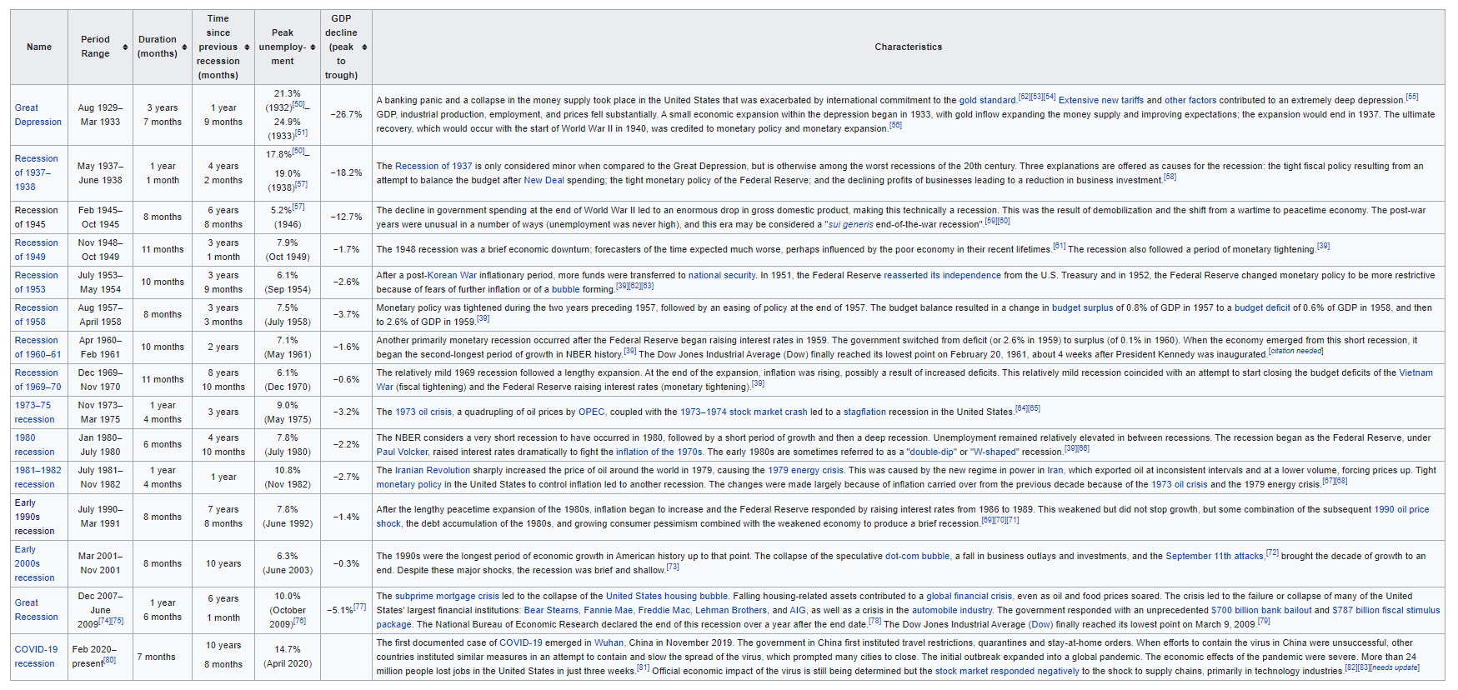
US Recessions (Great Depression -)

Slide 14
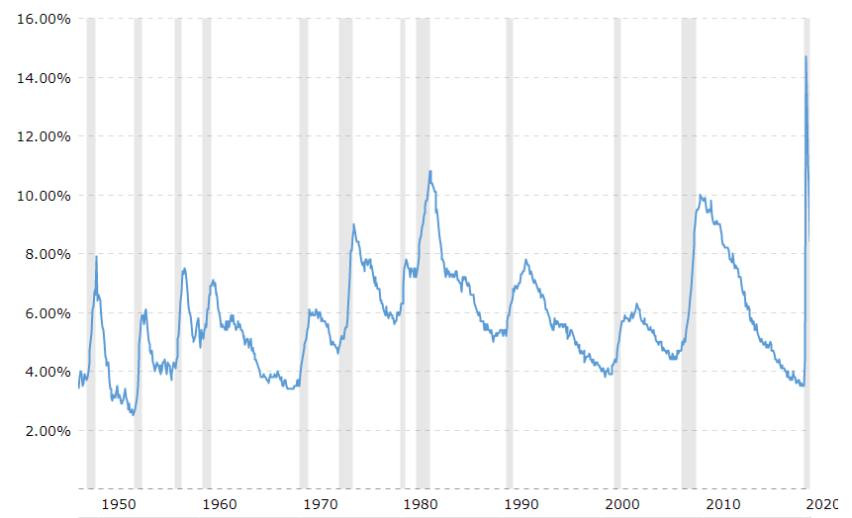
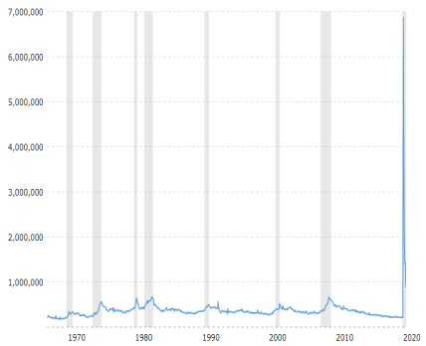
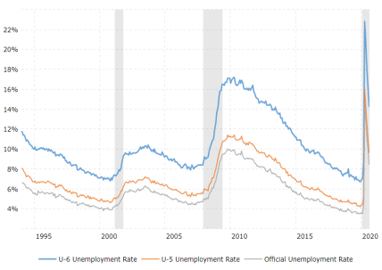
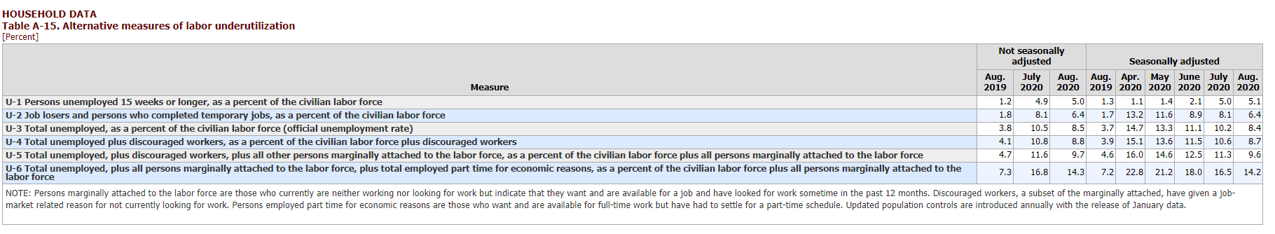
Unemployment Rate

Slide 15
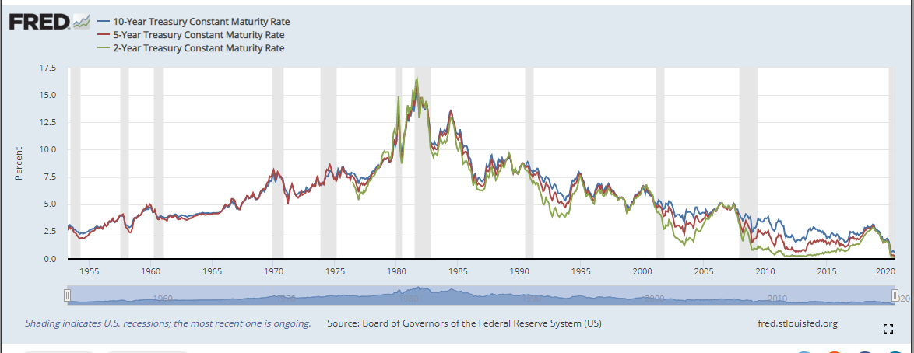
Interest Rate

Slide 16
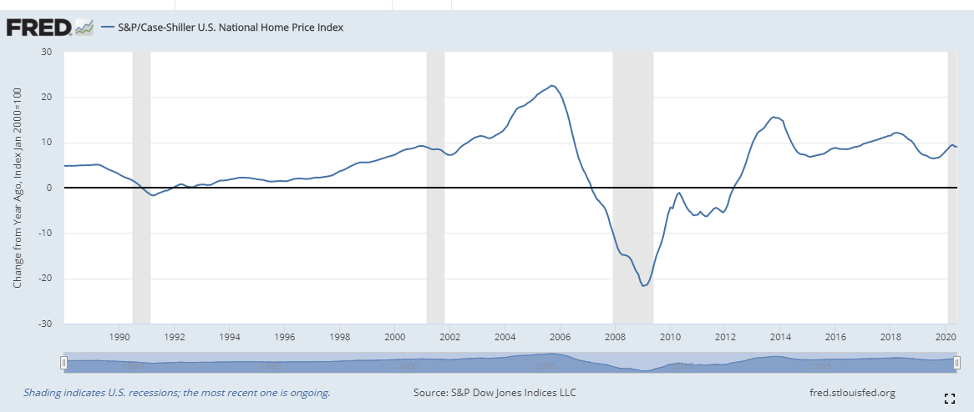
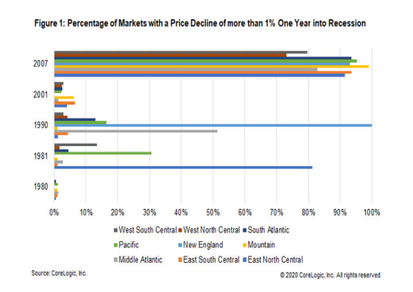
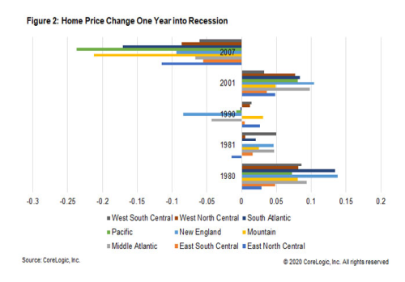
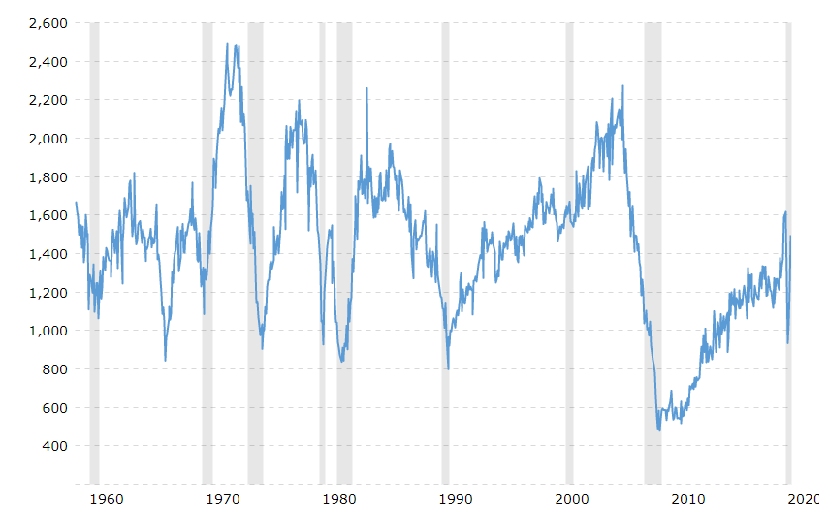
HPI
Housing Starts

Slide 17
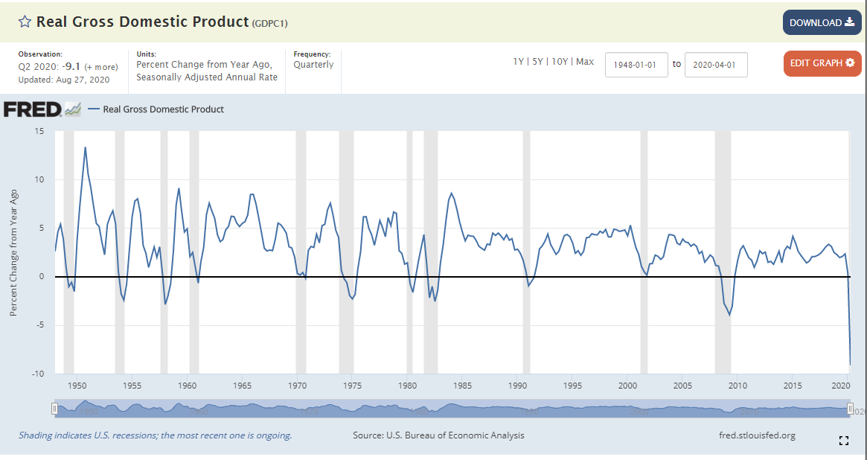
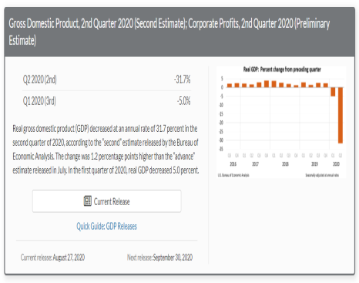
GDP

Slide 18
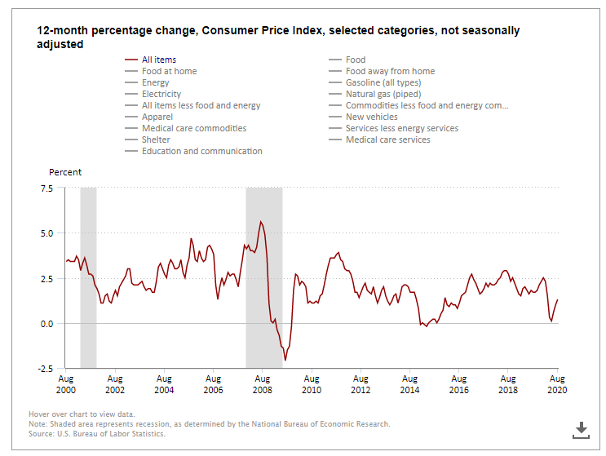
CPI

Slide 19
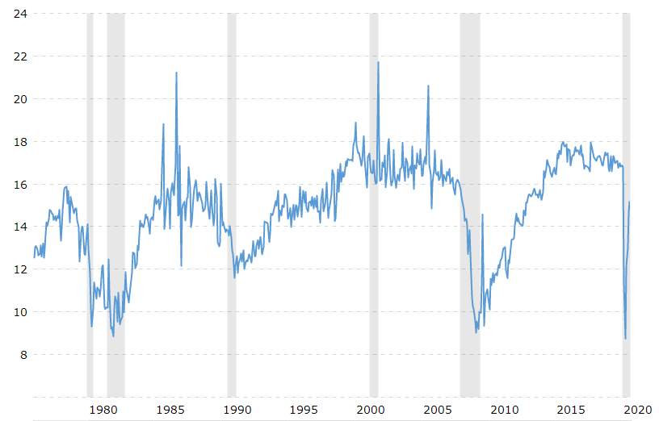
Auto and Light Truck Sale

Slide 20
Use in CCAR Model
Default/Prepay/LGD
Early transition vs late transition
Transformation
Cap & Floor

Slide 21
Questions and Comments?
Thank you!

Slide 22
Reference
Zhang, Hristovski, etc… Drug Repurposing for COVID-19 via Knowledge Graph Completion, Journal of Biomedical Informatics, Vol 115, March 2021,

