Slide 1
App Project 2024
Meet Your Team 👋

Slide 2
Agenda
Internship Homepage
Calendar / Working Hours
Intake Questionnaire
Team Building
What’s Left for Today

Slide 3
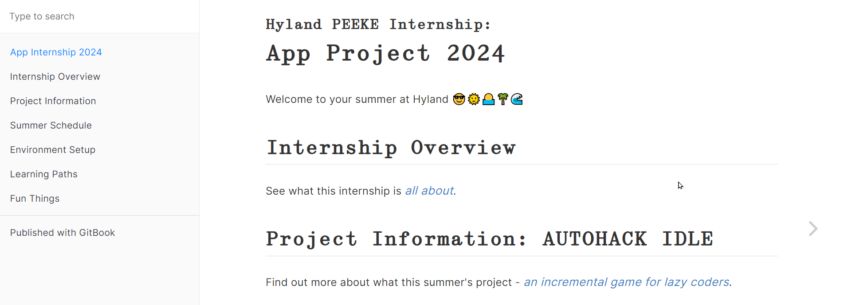
Internship Homepage
https://hylandtechoutreach.github.io/app-internship-2024

Slide 4
Internship Overview
Philosophy & Goals: it’s up to you
Project: AUTOHACK IDLE
Expectations: be professional
Dealing with downtime: fun things

Slide 5
Intake Questionnaire
find the link, answer the questions, share more about yourself

Slide 6
Team Building
let’s have some fun!

Slide 7
What’s Left for Today?
Time | Activity
12:00-12:30pm | Lunch
12:30-1:00pm | Internship Tips
1:00pm-1:30pm | Desk Time
1:30pm-3:00pm | Project Introduction
3:00pm-4:00pm | Desk Time

Slide 8
THANK YOU
lunch is next!

