Slide 1
More CSS Selectors
Introduction to web development

Slide 2
Selectors recap
Selectors determine which HTML elements to style for a ruleset
Q: What is an example of a selector?
Example Answer: The p selector will style all p elements
p {
color: red;
}
Notes:
Review selectors. Ask the students for an example of a selector, and then show them a ruleset using a paragraph selector.

Slide 3
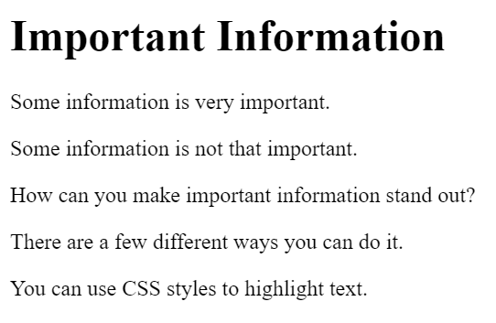
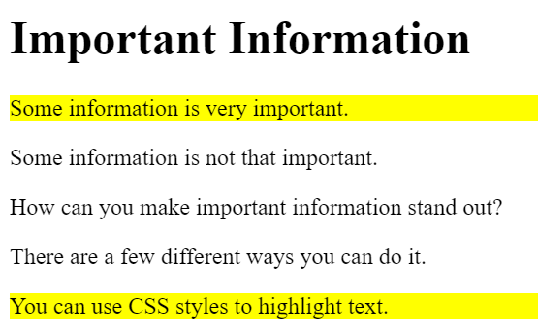
What if you want to select something else?
Example: you have five p elements, and you want to highlight some of them (but not all of them)
Notes:
Talk a little more about selectors. What if you didn’t want to select all paragraphs, just some of them? This is possible with Classes (on the next slide).

Slide 4
The class selector – example
CSS:
.important {
background: yellow;
}
HTML:
<p class="important">This is highlighted</p>
<h1 class="important">This header is highlighted too!</h1>
Notes:
Show the code for the class selector. Note the dot in front of the class name, and the class attribute value. Class names can be anything. Change “important” to anything else and it will still work the same.

Slide 5
The class Selector – More info
The class attribute can be added to any HTML element
It classifies the element, usually to determine which styles apply
This makes styles reusable across multiple elements
In CSS, HTML elements can be selected based on the value of the class attribute (using .class)
It is more specific than the element selector
An HTML element can have any number of classes
CLASS ⬄ DOT
Notes:
Go through this slide kind of quickly. It’s all useful information, but hard to retain. It’s generally easier to explain given an example. The important thing to remember – class goes with dot.

Slide 6
Class Selector example
https://replit.com/@HylandOutreach/CssClassExample
Notes:
For the Repl, show the relationship between the class attribute and the class ruleset. Change the value of a class attribute and add another ruleset or change the selector to show how it works.

Slide 7
id selector example
CSS:
#header1 {
color: orange;
}
HTML:
<h2 id="header1">This header is orange!<h2>
Notes:
Show the code for the id selector. Note the hashtag in front of the id name, and the id attribute value. Id names can be anything. Change “header1” to anything else and it will still work the same.

Slide 8
How is the id selector different?
The id attribute is UNIQUE to a given element
Use a hashtag to select the element in CSS (#id)
An element can only have ONE id
ID ⬄ HASHTAG

Slide 9
ID Selector example
https://replit.com/@HylandOutreach/IdExample
Notes:
For the Repl, show the relationship between the id attribute and the id ruleset. Change the value of an id attribute and add another ruleset or change the selector to show how it works.

Slide 10
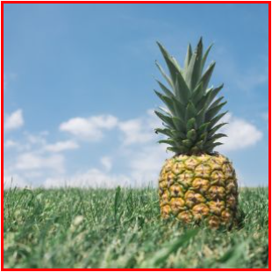
BONUS: Some New Properties
p {
font-style: italic;
}
img {
border: 2px solid red;
}
Looks like this
Notes:
Briefly introduce the font-style and border properties. These will be used in the code-along activity.

Slide 11
New Properties Example
https://replit.com/@HylandOutreach/PropEx
Notes:
Show examples of the two new properties. Change around the border values to see how they can be different.

Slide 12
Questions?

