Slide 1
CSS Grid
Introduction to Web Development

Slide 2
More hTML: The div Element
A generic container used for layouts and styling
One of the most basic HTML elements
Can be used to separate different parts of a page or section
A block-level element: stacks vertically
This means it adds a new line on the top and bottom

Slide 3
Div example
.box {
width: 200px;
height: 200px;
}
#b1 {
background: red;
}
#b2 {
color: red;
background: black;
}
<div class="box" id="b1">I'm on top</div>
<div class="box" id="b2">I'm on the bottom</div>
https://replit.com/@HylandOutreach/DivExample
Notes:
Ask the students to guess how this will appear. It will be two boxes, a red one on top of a black one.

Slide 4
CSS Properties for div elements
width: 200px;
Sets how big the box will be horizontally
height: 200px;
Sets how big the box will be vertically
text-align: center;
Puts text in the horizontal middle of the box
Notes:
Ask the students to guess what each of these properties do

Slide 5
More CSS Properties for div elements
border: 1px solid blue;
Adds a blue 1px border around the box
padding: 20px;
Adds space around the content within the box
background: red;
Sets the background color of the inside of the box
Notes:
Ask the students to guess what each of these properties do, then reveal the answers.

Slide 6
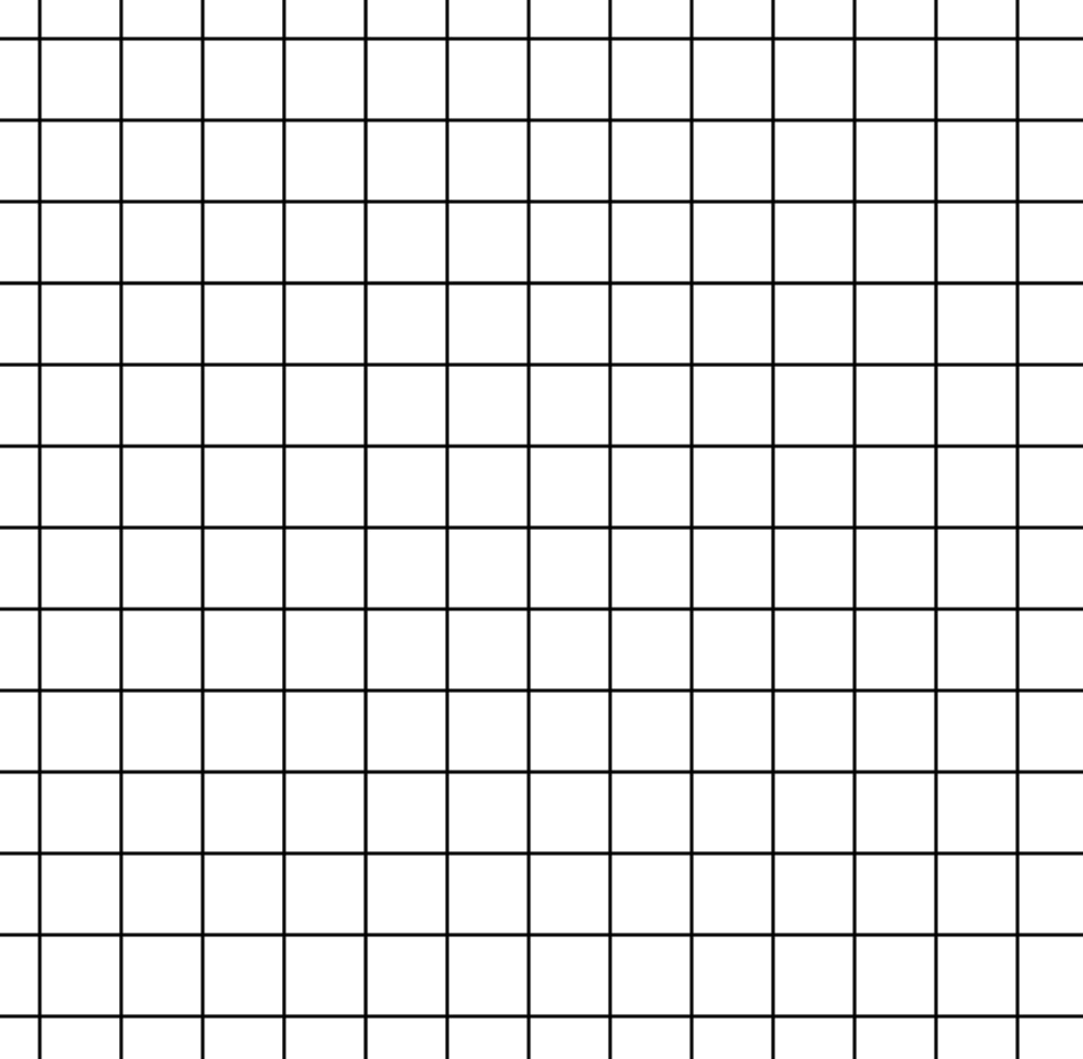
What is a grid?
Notes:
Ask the students if they can explain what a grid is. Basically – a way to divide space into rectangular areas, sometimes called cells.

Slide 7
Grids in HTML
<div id="main">
<div class="cell">1</div>
<div class="cell">2</div>
<div class="cell">3</div>
<div class="cell">4</div>
</div>
1
2
3
4
Parent div – container
Child divs – cells
Notes:
It is important to note here that there is a parent div and some child divs (how many? 4.) There is an ID and some classes as well, which will allow the CSS to style the divs.

Slide 8
Grids in CSS
#main {
display: grid;
grid-template-columns: 1fr 1fr;
}
#main – the main div element that contains the other div elements
display: grid – the div will be laid out as a grid
grid-template-columns: 1fr 1fr – each row will contain 2 equal columns

Slide 9
fractional units examples
grid-template-columns: 1fr 1fr;
grid-template-columns: 1fr 1fr 1fr;
1 | 2
1 | 2
1 | 2
1 | 2 | 3
1 | 2 | 3
1 | 2 | 3
grid-template-columns: 2fr 1fr;
grid-template-columns: 2fr 3fr;
1 | 2
1 | 2
1 | 2
1 | 2
1 | 2
1 | 2
Notes:
Go through some examples of grid template columns values. Ask the students:
How many columns will the grid have?
How big will the columns be?
Note that the grid-template-columns has nothing to do with the rows – it only affects the columns. Using the fr units, the size is based only on the relation with the whole container. So, for example, a 2fr will be 2 units of the total, so in 2fr 3fr, it would be 2 out of 5 or two fifths.

Slide 10
Grid Example
https://replit.com/@HylandOutreach/GridExample

Slide 11
Questions?

