Slide 2
What does a computer do?
Notes:
You can start by asking the students if they have ever used a computer (hopefully all of them should have). Allow the students to answer this question to the best of their ability.

Slide 3
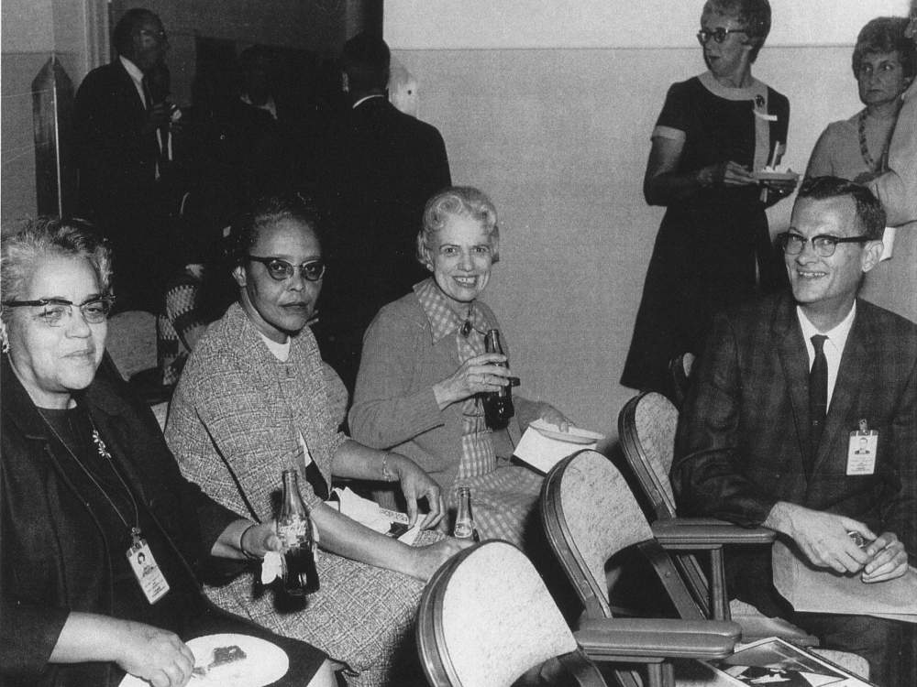
Hidden Figures:
Human Computers
They were people, primarily women, who reduced or analyzed data using mechanical calculators
Katherine Johnson’s calculations were used for manned and unmanned orbital missions by NASA
Notes:
Before electronic computers, “computers” were people! The 2016 film HIDDEN FIGURES is about some of these women, including Katherine Johnson.

Slide 4
Modern Computers
Computer – An electronic machine that executes programs
Computer Program – A sequence of instructions or steps that will be used by the computer to complete a task or solve a problem, written in a programming language
Algorithm – A complete, well-defined sequence of steps for completing a task or solving a problem
Notes:
The simplest definition for a computer is an electronic machine that executes programs.
What is a program? A program is simply a set of instructions that the computer can follow. You can ask the students to name any computer programs or apps they might use (e.g., Microsoft Word, Google Chrome, iTunes, Spotify, games)
You can ask students if they have ever used Alexa, and ask them for examples of things they would ask Alexa to do. Alexa is a computer that understands English commands, but other computers only understand special languages. You can ask the students what other languages they can name (e.g. Spanish, Japanese, etc).
Programs must be written in languages that computers can understand. You can ask the students if they have ever done coding before, and explain that coding uses these special languages.
The idea behind a program is called an algorithm. A program is the implementation of an algorithm, but an algorithm is conceptual, and does not require a computer.

Slide 5
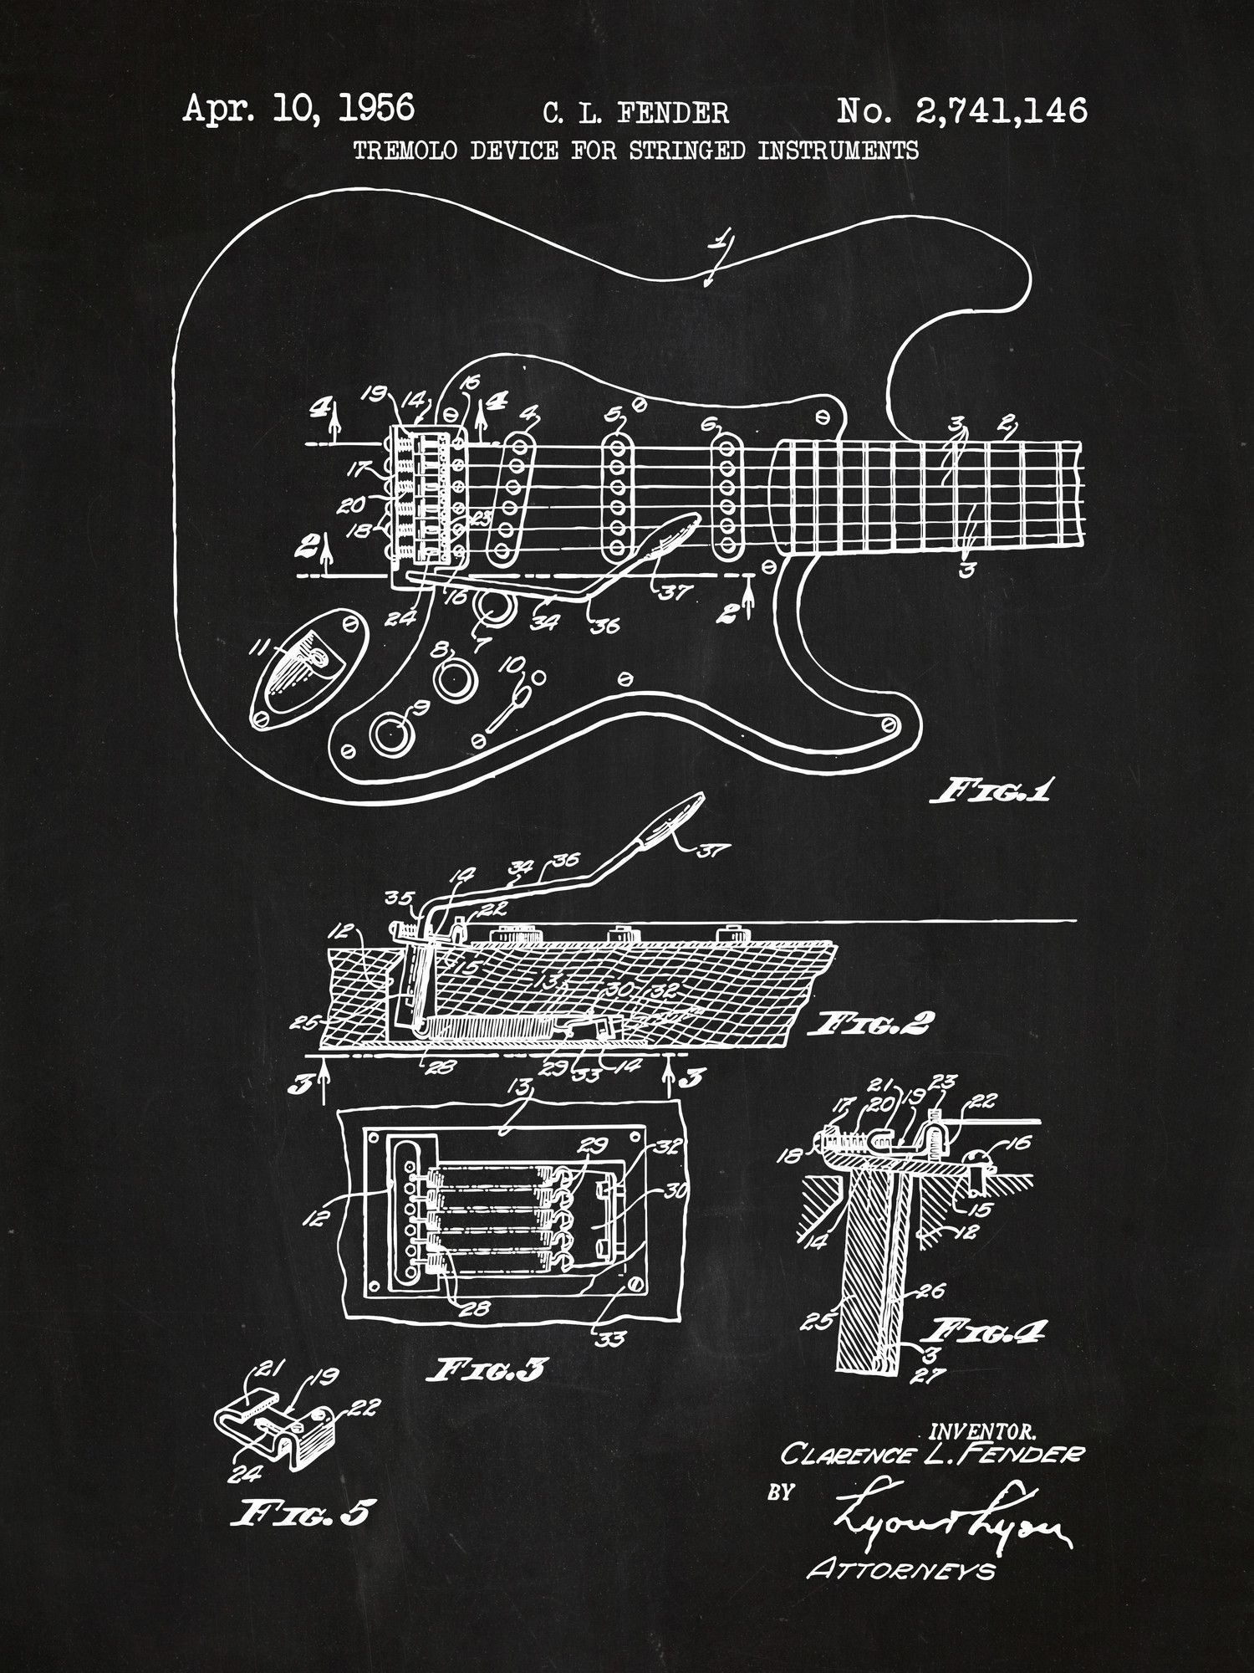
Procedures similar to Algorithms
Dance choreography
Construction plans
Culinary recipes
Notes:
Each of the similar procedures involves following a set of steps in order to achieve something. Any person, given the proper skillset, could follow the instructions and produce the same result. An example would be building a guitar – someone has to provide instructions (or a blueprint), and then someone (or something) else can build it!
You can ask the students if they like to dance, or build things, or cook. They would usually follow some form of instructions to do these things. You can ask students for examples of recipes or dance routines.

Slide 6
What is the biggest number in this list?
61
8, 19, 25, 7, 60, 29, 9, 9, 43, 8, 61, 49, 17
Your brain used an algorithm to find the answer!
Notes:
When a student provides the correct answer, ask them how they arrived at that answer. Explain that whether they knew it or not, they were using an algorithm! You can attempt to explain the algorithm they used; look at each number in the list, and keep track of the biggest one along the way.

Slide 7
Alphabetize the following list:
Banana
Your brain used an algorithm to sort the list!
Pear
Apple
Orange
Notes:
When a student provides the properly sorted list, ask them how they arrived at that result. Explain that whether they knew it or not, they were using an algorithm! You can try to explain how the brain sorts this list; finding the first item by looking through the whole list, then removing it, then finding the second item, etc.

Slide 8
Translating Ideas into Instructions
The job of a computer scientist is to translate ideas into programs a computer can execute
Modern computers are stupid; they need someone to tell them exactly what to do
Even if a person knows how to do something, it can be a challenge to explain it to a computer
Notes:
Some things, like sorting a list, might be easy for a human to do, but hard to explain. How would you tell a computer how to sort a list, or find the biggest number in a list?

Slide 9
Marshmallow Fluff & Jelly Sandwich
On a piece of paper, write precise instructions explaining how to make a MF&J sandwich
The instructions must be complete and detailed enough for a “computer” to understand
Once complete, an instructor will execute your instructions just like a computer program!
Notes:
Keep this slide displayed as the students work on their instructions. After a 5-10 minutes, instructors can begin to execute the instructions, and most should fail.
Explain that the instructions should be as specific as possible… a computer is very dumb, and may make the wrong assumptions if the instructions are not specific!

Slide 10
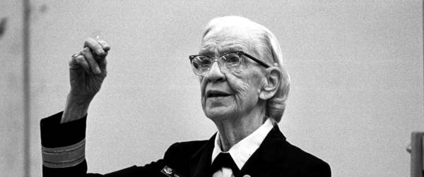
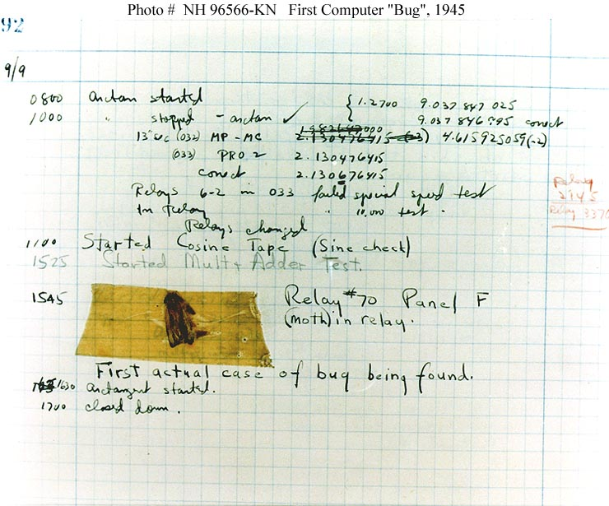
Bugs
A bug is a problem with a computer program
The first “bug” was discovered in 1945 by Admiral Grace Hopper, a prominent computer scientist
It was an actual physical moth!
Removing bugs from programs is called debugging
Notes:
Display this slide after instructors have executed some instructions, and failed.
You can ask the students if they have ever had a computer crash, or an app do something different than it was supposed to do.

Slide 11
Debugging the Sandwich
Rewrite any instructions that led to “bugs” in the algorithm
Notes:
Give the students an opportunity to revise their algorithms based on the outcomes of the execution.

Slide 12

One last algorithm
First photograph of a black hole
10 telescopes around the world linked together by computers to work like one massive telescope
The algorithm to make it work was developed by Dr. Katie Bouman
Notes:
This slide is a quick tag for the end that ties the past to the present. Women are still at the forefront of innovation, doing incredible things with technology!

