Slide 1
Build a Heart-Healthy Website with HTML & CSS

Slide 2
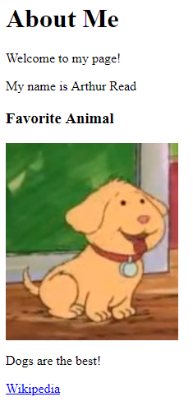
What is HTML?
HTML a markup language
It is the most basic building block of the web
Web browsers take HTML text and turn it into a website!
<html>
<body>
<h1>About Me</h1>
<p>Welcome to my page!</p>
<p>My name is Arthur Read</p> <h3>Favorite Animal</h3>
<img src="https://i.imgur.com/GfT5Z9R.png" />
<p>Dogs are the best!</p>
<a href="https://en.wikipedia.org/wiki/Dog">Wikipedia</a>
</body>
</html>
Notes:
Browser reads the text, interprets it, and shows it to the user. HTML is behind every user interface on the web.
It can be helpful to view a popular Wikipedia page in the web, and then view the source to see how the web browser renders it into a viewable page.

Slide 3
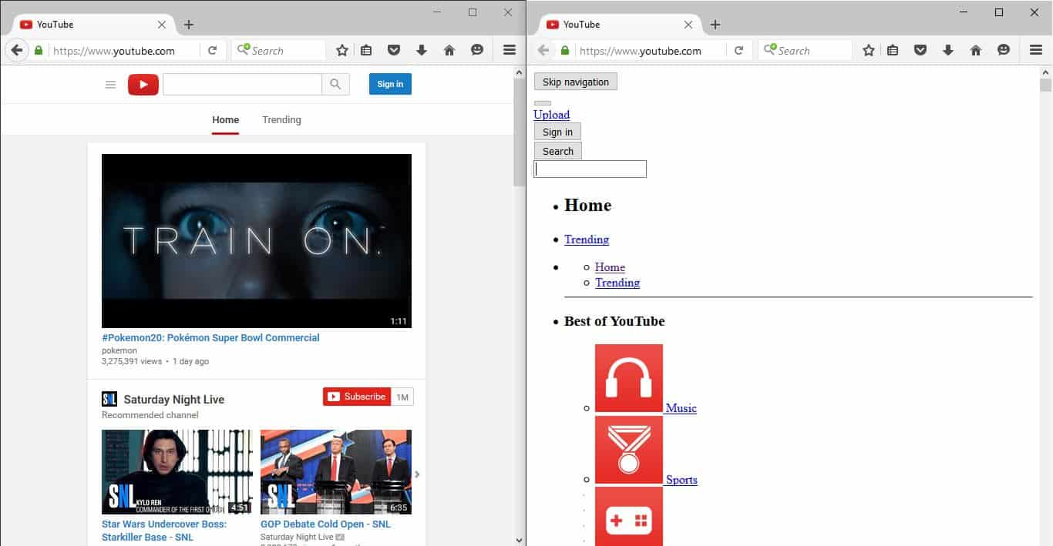
What is CSS?
CSS is a styling language for websites
It can update fonts, colors, and more!
With CSS
Without CSS

Slide 4
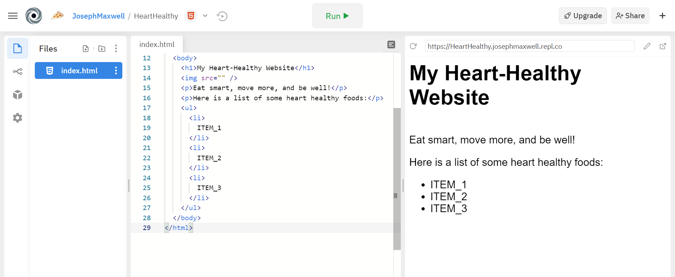
What is repl.it?
repl.it is a tool that lets developers create websites!

Slide 5
Let’s get started!
Go to bit.ly/heartwebsite

